Slide 1


Introduction to
TB Vaccines
TB Vax 101 Webinar
HANC Community Partners
February 22, 2024
Mike Frick
TB Project Co-director

Slide 2

Agenda
1 opening framework
2 guiding questions
3 vaccine development strategies
4 views of the pipeline
3 clinical trial and candidate close-ups
2 hurdles to jump
https://www.treatmentactiongroup.org/resources/pipeline-report/2023-pipeline-report/

Slide 3
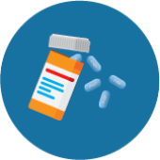

New TB vaccines will sit alongside many ways to prevent TB.
Preventive Treatment
ART for PLHIV
Infection Control
Vaccination
Adequate Nutrition
social protection / human development / universal health coverage / poverty elimination / human rights
These are not discrete choices (A or B) but instead interventions that work better when used together (A+B). No silver bullets, but lots of powerful tools.

Slide 4
Why do we need new TB vaccines when we have BCG?
Because BCG is >100 years old and it hasn’t stopped the epidemic!

Slide 5
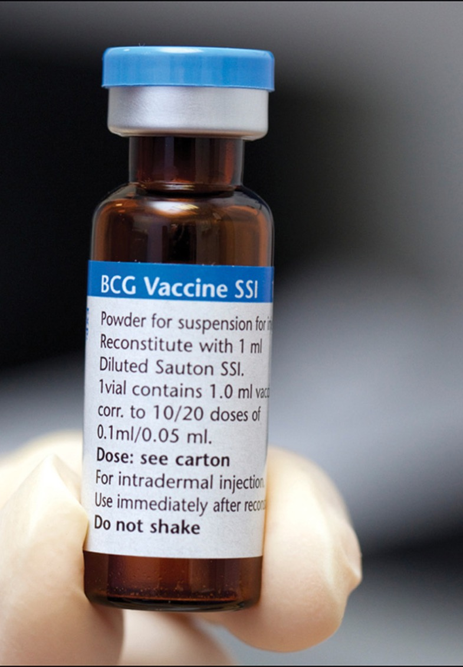
BCG: the only existing vaccine against TB
Bacillus Calmette–Guérin (BCG): developed by Albert Calmette and Camille Guérin in France in early 1900s (interrupted by WWI).
First introduced into human use in 1921.
BCG is a live attenuated form of Mycobacterium bovis, the organism that causes TB in cattle.
Part of the EPI package and given to infants soon after birth. Believed to be the mostly widely administered vaccine in human history.
Protects children against severe forms of TB (e.g., TB meningitis, miliary TB, disseminated TB), but offers highly variable protection against pulmonary TB in adolescents and adults, who account for most TB transmission.

Slide 6
BCG: the old friend we’re still getting to know
Offers some protection against leprosy and buruli ulcer.
Being studied against bladder cancer, as adjunctive therapy for diabetes, and was also studied against COVID-19.
BCG has demonstrated “non-specific effects.” Observational studies and RCTs have shown that BCG reduces the occurrence and severity of infectious diseases other than TB, in particular the acute lower respiratory infections that are a leading cause of death in children under five years of age in developing countries.
  Heterologous immunity? Immunity to one pathogen provides protection against others.
  Trained immunity? BCG alters the expression of genes involved in pathogen recognition and immune response.
And BCG is still being studied against TB! Several studies are looking at whether revaccination with BCG prevents TB infection among adolescents and household contacts.

Slide 7
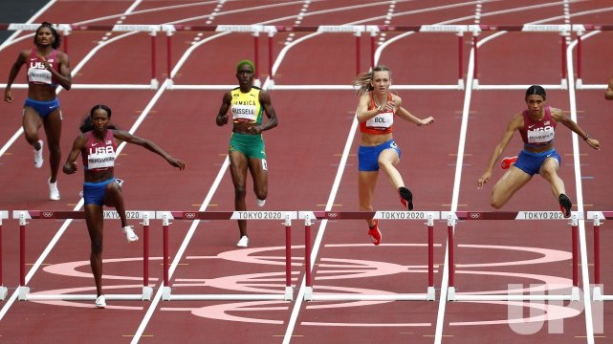
Why is it taking so long to develop new vaccines against TB?
Because we’re running the hurdles, not a straightaway sprint. There are multiple obstacles – scientific, political, financial – that we have to jump over, knock down, or clear away.

Slide 8
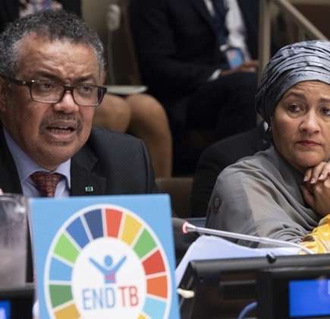
“We now have new and powerful tools that we didn’t have five years ago. Rapid diagnostics to test for TB in less than two hours. And effective treatment regimens, including for drug-resistant TB. But there is one important tool that we still need, and that is a new vaccine.”
— Tedros Adhanom Ghebreyesus, WHO Director-General
“Research and development must be supported and encouraged, fostering an environment where new tools and treatments can be deployed to reach even the remotest of communities. All of this requires financing on a massive scale.”
— Amina Mohammed, UN Deputy Secretary-General

Slide 9
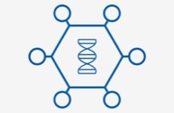
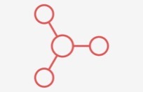


General vaccine types
Viral vector vaccines use a harmless virus to deliver instructions to your body’s cells to make antigens from a target pathogen, triggering protective immunity against it.
Protein subunit vaccines use fragments of protein from the pathogen to trigger protective immunity against it. Often paired with adjuvants: something that boosts the body’s immune response to the protein.
Whole cell vaccines use a weakened or deactivated version of the disease-causing pathogen to trigger protective immunity against it.
Nucleic acid vaccines use genetic material – could be RNA or DNA – from a disease-causing pathogen to trigger protective immunity against it.
antigen = a molecule or other foreign substance (for example, a small piece of the pathogen) which causes the body to generate an immune response
Source: GAVI https://www.gavi.org/vaccineswork

Slide 10





Types of TB vaccines under development
Viral vectored
Protein/adjuvant (subunit)
RNA
Contain whole bacteria which have been killed. Inactivated, replication-deficient whole-cell or fragmented mycobacteria closely related to MTB (e.g., M. vaccae, M. obuense, MTB fragments).
Mycobacterial – killed whole cell or extract
Mycobacterial – live recombinant or live attenuated
Contain whole bacteria which have been weakened so that they create an immune response without causing disease. e.g., live MTB weakened through gene deletions. Also, recombinant BCG vaccines (i.e., BCG with intentional genetic modifications).
Notes:
Antigen = substance that is recognized by the immune system and provokes an immune response

Slide 11


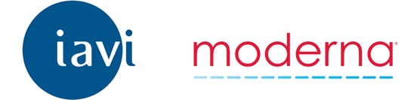
And now also: mRNA vaccines!
“mRNA platforms deliver a piece of genetic material that instructs the body to make a protein fragment of a target pathogen (such as HIV or TB), which the immune system will hopefully recognize and mount a defense against.”^{[1]}
Has registered two phase I clinical trials of two investigational vaccines under the name BNT164 (BNT164a1 and BNT164b1).
NCT05537038 (Germany)
NCT05547464 (South Africa)
Each will evaluate safety, reactogenicity, and immunogenicity of three dose levels of the vaccines given in a three-dose schedule.
April 7, 2022: “[Moderna and IAVI] today announced a new collaboration to employ mRNA technology to meet the challenge of a range of global health threats: HIV/AIDS, tuberculosis, antimicrobial-resistant enteric infections, and COVID-19.”
“Currently, IAVI/Moderna mRNA TB vaccine constructs are undergoing preclinical evaluation.”
Has started discovery and preclinical work on a TB vaccine candidate(s).
Discussed mRNA and TB vaccines in April 2022 during the Hub’s meeting in Cape Town.
[1] AVAC. https://avac.org/resource/phase-1-mrna-hiv-vaccine-trials/

Slide 12
TB vaccine strategies
Currently, there are three overarching strategies guiding TB vaccine development efforts. Each is known by the primary endpoint of interest.
POI = prevention of infection
POD = prevention of disease
POR = prevention of recurrence (relapse or reinfection)
Notes:
POI and POR trials are intended to help developers select which vaccine candidates to advance to late-stage POD trials by yielding glimpses of vaccine efficacy at earlier points on the clinical development pathway

Slide 13
Re-exposure
Exposure
Diagnosis
Progression
5-10%
Re-infection TB
M.tb
infection
Active
TB
TB
treatment
Relapse/
Recurrence
Different endpoints in TB vaccine trials:
Prevention of infection (POI)
Cure
Prevention of disease (POD)
Prevention of recurrence (POR)
Adapted from Thomas Scriba (UCT) and Sara Suliman (UCSF)

Slide 14
POD = prevention of disease
Most relevant endpoint for licensure and scale-up.
Requires measuring the incidence of microbiologically confirmed pulmonary TB in the vaccine and placebo/control arms.
Long trials, with large sample sizes, and therefore expensive. Why?
  Most POD vaccine trials are “event driven.” That means investigators must follow participants until they observe a certain number of people develop TB in order to know whether the vaccine is effective.
  It takes time for TB disease to develop.
    Estimated incidence of TB disease in most high-incidence countries is not above 400/100,000 per year, so very large sample sizes are needed in order to measure protective efficacy with sufficient precision.
  These limitations can be (partially) addressed by enrolling participants with TB infection (IGRA+ or TST+) as opposed to people without TB infection.

Slide 15
The fourth strategy: therapeutic vaccination (Rx Vax)
Some developers are studying TB vaccines as an “add on” to TB treatment.
The goal here is to see whether giving a vaccine together with treatment improves treatment outcomes.
This improvement could be measured as:
  time to treatment completion
  better treatment outcomes (cure, mortality, relapse)
  fewer side effects
  better “post TB treatment” lung health (e.g., clearer chest radiography, better lung function, improved long term health post-TB).

Slide 16

The Pipeline the bird’s eye view
16
The pipeline contains ~16 vaccine candidates including 6 in or preparing for phase III trials.
5
5 candidates are in or preparing to begin phase III efficacy trials.
>80,000
The field is mounting multiple phase III trials that will together enroll over 80,000 people. (The most since the middle of the 20th century!)
28
28 countries on five continents have a registered TB vaccine trial (any phase).
100,000s
Investigators will collect hundreds of thousands of participant samples that will guide next-generation vaccine development and immunology and other basic science research on TB.
Ongoing and planned phase II and III trials will enroll diverse populations of people at risk of TB, including PLHIV, children, household contacts of people with TB, people treated for TB disease, and people with MTB infection and those without.

Slide 17
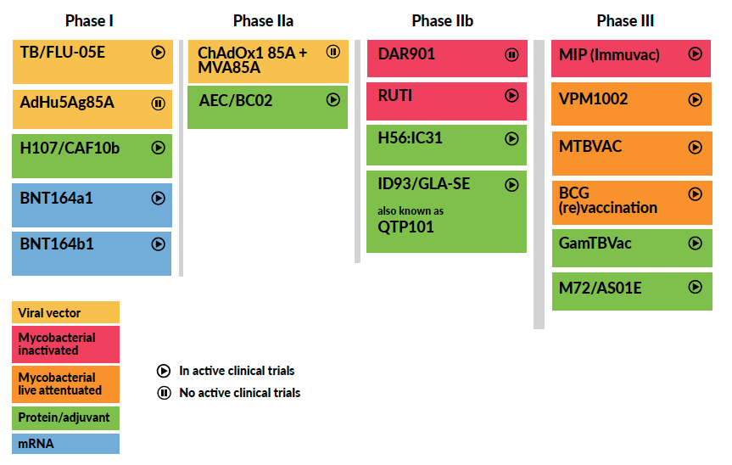

The Pipeline by type
No longer being developed

Slide 18
The Pipeline by recent news
Results expected this year
New!
Secured funding for efficacy trial
Negative results shared Dec. 2023
Results expected soon
First mRNA TB vaccine candidates
Phase III trial
starting soon!
No longer being developed

Slide 19

The Pipeline work by NIAID
No longer being developed

Slide 20
NIAID TB Vaccine Clinical Trials
IMPAACT 2035 / HVTN 604
Phase I/II safety and immunogenicity study of BCG revaccination and VPM1002 – each compared to placebo – in 480 HIV-positive and HIV-negative preadolescents ages 8–14 in South Africa. NCT05539989.
ACTG 5397 /
HVTN 603
Phase IIa/IIb efficacy, safety, and immunogenicity study of ID93/GLA-SE given as a therapeutic vaccine to 1,500 participants with drug-sensitive TB at different timepoints in TB treatment. The main idea is to see whether vaccination with ID93/GLA-SE improves TB treatment outcomes.
ACTG 5421 /
HVTN 605
Phase IIa study that will test the safety and immunogenicity of MTBVAC and BCG revaccination in 276 HIV-negative and HIV-positive adolescents and adults living with HIV in South Africa.

Slide 21
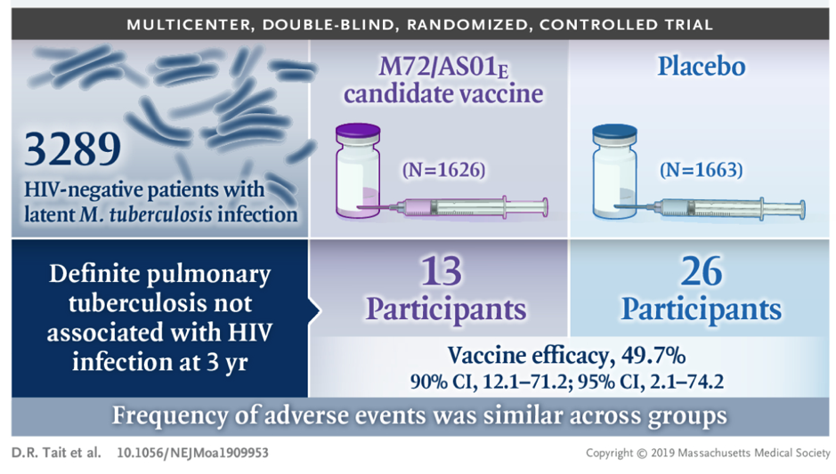
M72/AS01E
Subunit protein/adjuvant vaccine.
Initially developed by GSK and now being taken forward by the Gates Medical Research Institute.
Positive efficacy signal in phase IIb trial in Kenya, South Africa, and Zambia.
M72/AS01E
M72
Antigen
(Gates MRI)
AS01E
Adjuvant
(GSK)
  49.7% (90% CI: 12.1–71.2) protection against developing bacteriologically confirmed pulmonary TB disease among HIV-negative, MTB-infected adults.

Slide 22
M72/AS01E
Phase III study (next slide).
MESA-TB: Safety/immunogenicity study of M72/AS01E in ~400 PLHIV (16–35 years) in South Africa on ART and who have previously taken TB preventive treatment.
  Participants must have HIV RNA <200 copies/mL at screening and CD4+ cell counts ≥200 cells/μL and have previously completed TB preventive treatment.
Epidemiology study to prepare for the phase III trial. The study will assess IGRA positivity and TB incidence near potential trial sites.
  Will enroll 8,000 participants in Bangladesh, Brazil, DRC, Gambia, India, Indonesia Kenya, Mozambique, Peru, Philippines, South Africa, Uganda, Vietnam, Zambia.
  Data will be a “global good” available to other vaccine developers and researchers.
Starting soon!
NCT06062238
Results presented at 2023 Union Conference.
✓ Safety
✓ Immunogenicity
Will allow PLHIV to enroll in the phase III trial. NCT04556981
Epi study to prepare for ph. III trial. NCT05190146

Slide 23

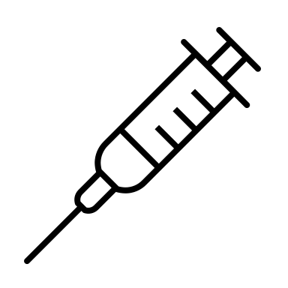
Phase III Trial of M72/AS01E
To begin soon
26,000
1
M72/AS01E
Primary objective: Evaluate vaccine efficacy in preventing of bacteriologically-confirmed pulmonary TB (POD) among participants who are IGRA+ (indicating MTB infection) and HIV-negative.
Gates MRI hopes to open enrollment in spring 2024 and to have results 4–5 years after enrollment begins. ~2028
Participating countries: Indonesia, Kenya, Malawi, Mozambique, South Africa, Vietnam, Zambia.
participants to be randomized
2
placebo
Cohort | N
IGRA+, HIV- | 20,000
IGRA-, HIV- | 4,000
HIV+ | 2,000
Total | 26,000
1 month
* Information as reported by Gates MRI in 2023 TAG Pipeline Report

Slide 24
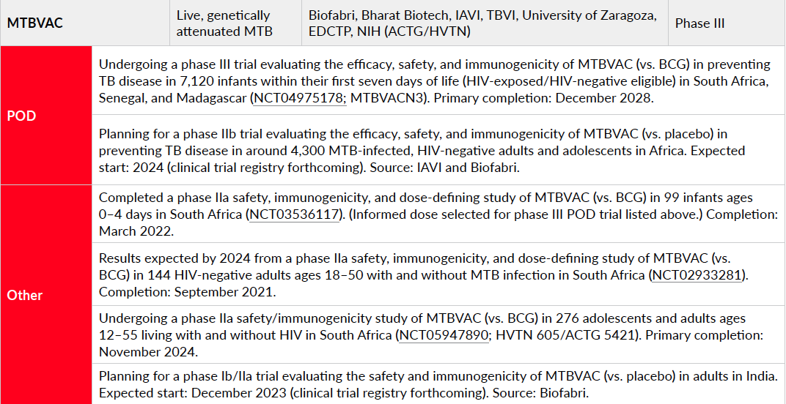
MTBVAC
MTBVAC = live attenuated MTB (i.e., a weakened version of the TB pathogen itself!) In this case, the attenuation is the deletion of two genes responsible for virulence (phoP and fadD26).

Slide 25



Phase III trial of MTBVAC
NCT04975178
~7,000
1
MTBVAC
Primary outcome: Prevention of TB disease (POD) in healthy HIV-uninfected (HU) and HIV-exposed uninfected (HEU) newborns.
Infants will be followed for a minimum of 24 months to see how many develop TB disease.
Status: recruiting.
infant participants
2
BCG
HIV unexposed newborns
HIV exposed, uninfected newborns
single dose

Slide 26

2
Hurdles
Money problems
Scientific challenges

Slide 27

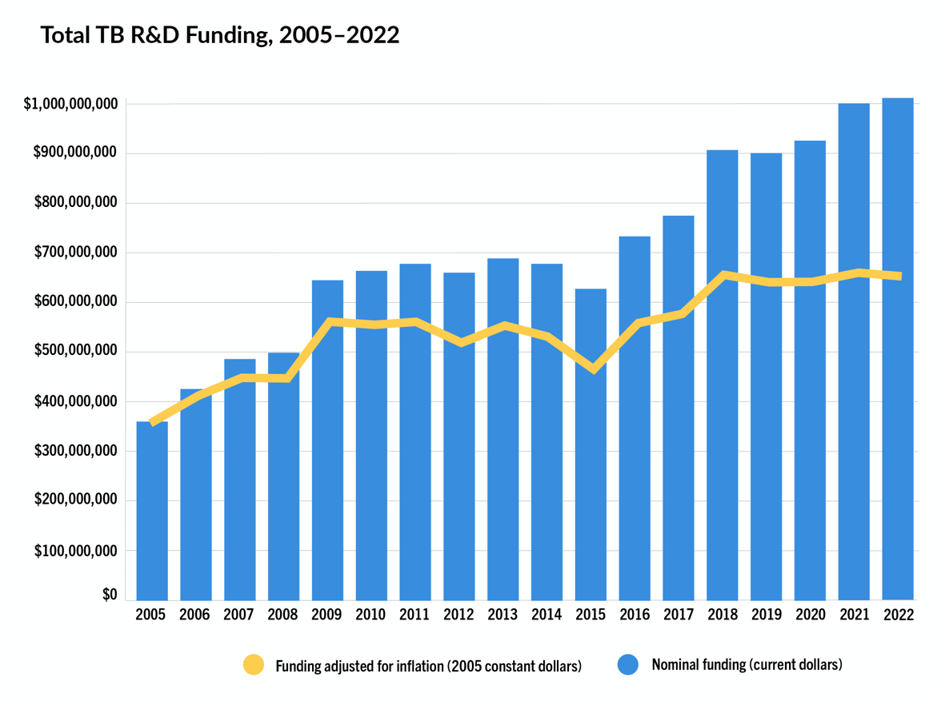
Money problems
TAG and Stop TB
TB Research Funding Trends, 2005–2022
FY2022:
$1.034 billion
(nominal dollars)
$649 million
(inflation adjusted 2005 constant dollars)
Spending on TB research over 2018–2022 = $4.7 billion.
This is less than half of the $10 billion that would have been mobilized if governments had met their UN HLM commitments to mobilize $2 billion/year.

Slide 28
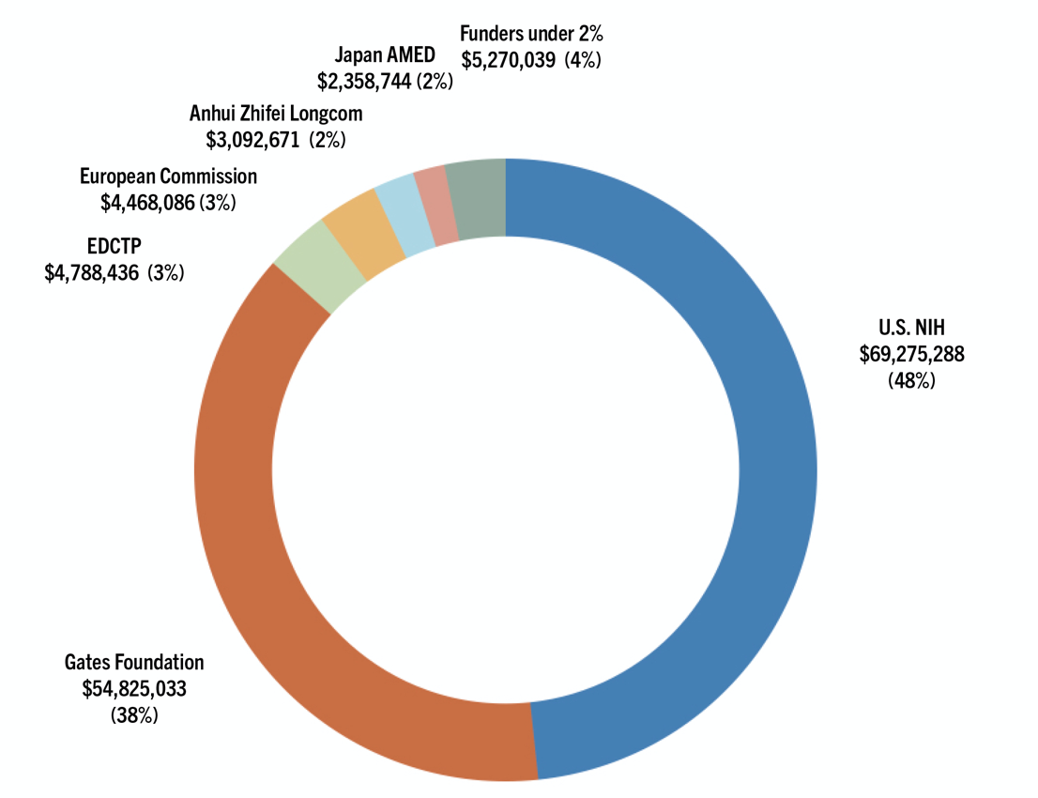
Not enough money for TB vaccine R&D!
FY2022 funding for TB vaccine R&D = $144 million.
  86% of spending came from two donors: U.S. NIH and Gates Foundation.
2018–2022: $610 million spent on TB vaccine R&D.
  This is ~50% of the annual 2023–30 Global Plan target of $1.25 billion/year.
Note: the FY22 figures do not reflect pledged funding of $550 million by Gates Foundation and Wellcome for the M72/AS01E ph. III trial or funding recently awarded to IAVI for an efficacy trial of MTBVAC.

Slide 29
Big Funding Pledges, but Mostly from Philanthropies
MTBVAC
M72/AS01E
Wellcome and Gates Foundation to Fund Late-Stage Development of a TB vaccine Candidate that Could be First in 100 Years if Proven Effective
“To support the M72 Phase III clinical trial, which will cost an estimated US$550 million, Wellcome is providing up to US$150 million and the Gates Foundation will fund the remainder, about US$400 million.”
IAVI and Zendal Announce Funding for Efficacy Trial of Promising TB Vaccine Candiate in Africa
“The Gates Foundation has awarded IAVI US$55 million to conduct a Phase IIb trial assessing the safety and efficacy of the TB vaccine candidate MTBVAC … This funding has been made possible in part through a grant provided by Open Philanthropy. This trial is also supported by additional funding provided by the German Federal Ministry of Education and Research through KfW Development Bank.”

Slide 30






Scientific challenges
Lack of biomarkers or correlates of protection that could act as surrogate markers → faster, shorter, less expensive trials.
  This is a chicken/egg problem. Until we have a vaccine that shows efficacy, we can’t identify protective biomarkers. But without protective biomarkers, we are stuck conducting longer clinical trials.
Need to develop better animal models to inform human trials.
Need to select the right target: which antigens should we include in the vaccine to generate protective immunity?
Inclusion of priority populations – PLHIV, children, pregnant and lactating people – in the TB vaccine R&D agenda.
Incorporation of TB preventive treatment into TB vaccine trial design.

Slide 31
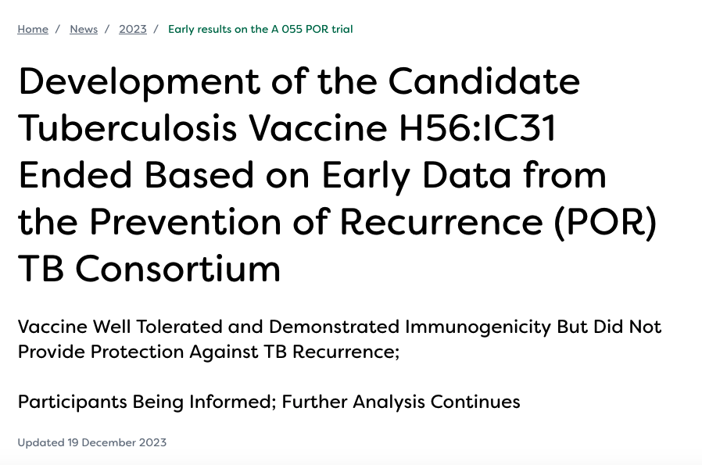
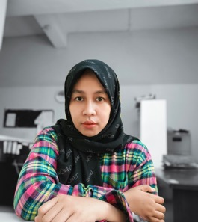

Promising science is no guarantee of success
“While the results are disheartening, it underscores the need for TB vaccine research and generating data to help move science forward. Ultimately there are no ‘bad’ results, because investigators collected data that we learn from. Knowing what doesn’t work may help us to discover what does.”
– Ani Herna Sari, co-chair of the Global TB Community Advisory Board (Global TB CAB).

Slide 32
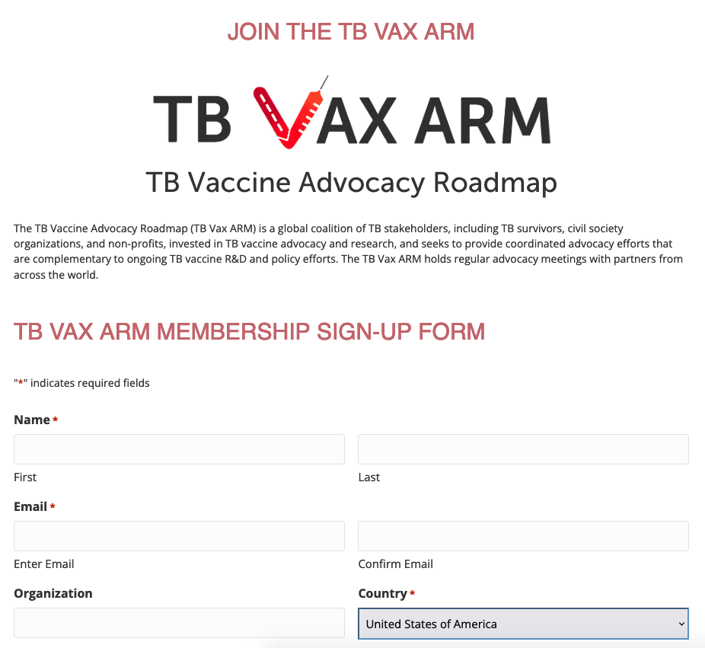
Want to join a community of advocates for TB vaccines?
Join the TB Vax ARM coalition!
https://newtbvaccines.org/join-tbvaxarm/
Why ARM?
ARM = Advocacy RoadMap. We intend to work together over the coming years on multiple actions that add up to a comprehensive and ongoing campaign for new TB vaccines.
Arms are the site of many (though not all) immunizations.
The arm image signals our intention to get down to work. “We’re building the ship as we sail it.”
When different arms come together, a heavy lift is made lighter.

Slide 33
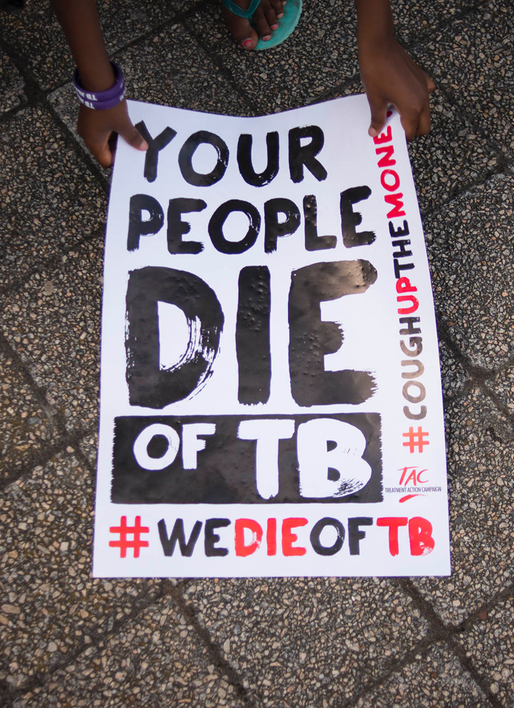


Thank you!
mike.frick@treatmentactiongroup.org
https://www.treatmentactiongroup.org/resources/tbrd-report/tbrd-report-2023/
Treatment Action Campaign
https://www.treatmentactiongroup.org/resources/pipeline-report/2023-pipeline-report/

