Slide 1



01
Cross-Network CAB Onboarding
Package

Slide 2




NIH-funded HIV/AIDS Research Networks
02
The Division of AIDS, which is part of the National Institute of Allergy and Infectious Disease at the US National Institutes of Health, is committed to supporting community engagement in all aspects of the research it supports.
Community Advisory Boards (CABs) are the cornerstone of community engagement at the NIH-funded HIV/AIDS Clinical Trials Networks.
Advancing Clinical Therapeutics Globally (ACTG)
HIV Prevention Trials Network (HPTN)
International Maternal Pediatrics Adolescents AIDS Clinical Trials Network (IMPAACT)
HIV Vaccine Trials Network (HVTN)

Slide 3
  What is Community Engagement?
  What is a CAB?
  Roles and Responsibilities of CABs
  CAB Operations
  Site Support for CABs
  Benefits and Impact of CABs
  US Government Overview of Selected Health Agencies
  Network Overview
  Additional DAIDS-funded HIV Research Programs
  Additional Collaborative Community-focused Organizations
  Resources
03
Thank you for joining your local CAB!

Slide 4
04
General definition:
Working cooperatively with groups of people (communities) who are related by shared interests, geographic proximity, or comparable circumstances.
(McMacmillan & Chavis, 1986)
What is Community Engagement?
In Health Research & Development:
A process of building relationships that allow stakeholders to collaborate on health-related issues and wellbeing to achieve positive health impacts and outcomes.
(WHO, 2020)

Slide 5
Principles of Community Engagement
05
• Respect
• Mutual understanding
• Integrity
• Transparency
• Accountability
• Community Stakeholder
Autonomy
Source: Good Participatory Practice Guidelines (GPP)

Slide 6




Why is Community Engagement Needed?
06
Humanity
Communities and their context
Human rights and dignity
Advancing
Health and Wellbeing
Recognizes what and who matters in research and development
Acknowledges people are experts in their challenges and solutions
Centers their views and input to inform, guide, and benefit from what is about them
Guarantees relevance for the program

Slide 7
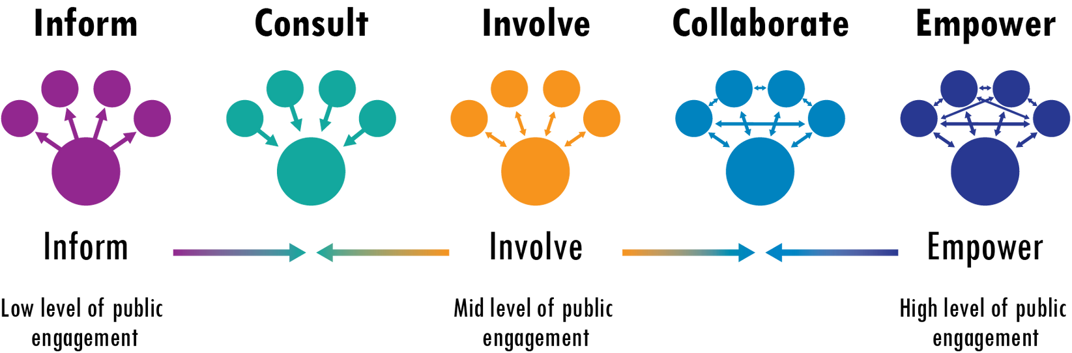
The Impact of Community Engagement
07
• Empowers communities in decision making
• Builds relationships between communities and researchers
• Supports exchange of information and knowledge between research staff and community
Source: Good Participatory Practice Guidelines (GPP)

Slide 8
08
Impact of Community Engagement
… build mutually beneficial, sustained relationships between trial funders, sponsors, and implementers and other stakeholders that are transparent and respectful, that address the interests of community stakeholders, and
that support the conduct of scientifically rigorous and ethical biomedical (HIV prevention or TB) clinical trials.

Slide 9





Benefits of Community Engagement
09
Facilitates community-researcher collaboration in finding public health solutions
Balances power relationship between researchers and communities
  Requires bi-directional accountability,
  Strengthens research integrity,
  Reinforces ethical conduct in research and development
Strengthens community buy-in and uptake of research and outcomes
Empowers communities through participation
Builds research literacy in the community

Slide 10
Benefits of Community Engagement
10
Community Engagement Requires:
Engaging communities as early as concept development and planning, through study conduct and conclusion.
Planning, budgeting, and overall resourcing of a community engagement program
Developing multiple mechanisms for ongoing participation of community stakeholder representatives (UNAIDS, 2011)
  Advisory mechanisms
  Outreach and education plans
  Consultations and feedback loops with involved communities
Partnerships with and involvement in other related community programs
Empowerment initiatives of community partners

Slide 11
A formal advisory group that is coordinated by the research site.
Made up of diverse community members affected by and interested in the research.
Members can vary in age, race, gender, education, religion, and sexual orientation to represent all segments of the community.
Meets regularly to provide feedback to the site on their research plans and provide input on specific studies and their relevance to the local community.
Provides 2-way communication between the research staff and the broader community.
  Ensures that the research is:
  culturally sensitive,
  relevant to the community's needs, and conducted in a way that respects their values and concerns
11
What is a Community Advisory Board?

Slide 12
12
CABs Connect Community to Networks
Local Communities
Local
CABS
Network
Involvement

Slide 13
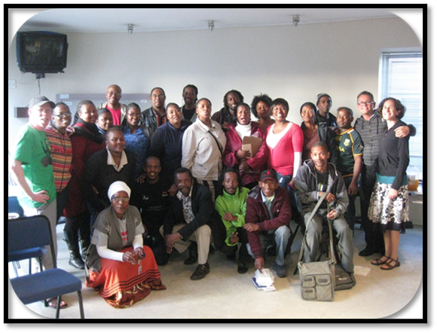
Who Makes Up a CAB?
13
Study participants, or individuals with similar characteristics
Prominent community members & key opinion leaders
Family members of study participants
Representatives of local community-based organizations and/or AIDS service organizations
Religious leaders
Individuals affected by or living with HIV

Slide 14
Roles and Responsibilities of CABs
14
Provide a conduit for bi-directional communication between research staff and community.
Participate in CAB meetings and activities, including skill building and training opportunities.
Help dispel myths about HIV and TB research and provide accurate information to peers.
Help educate the community about the site’s research activities.
Help recruit, train, and retain new CAB members.
Provide insight into the “real lives” of the populations prioritized for trial participation.

Slide 15
Roles and Responsibilities of CABs
Help to identify emerging research needs and identify gaps
15
Help ensure community concerns are adequately addressed in informed consent documents & the overall consent process, including language & cultural sensitivity
Advise on strategies for dissemination of research results to the community.
Advise on the site’s community education programs
Represent the diversity of individuals that are living with HIV/affected and the concerns of those communities.
Ask questions!
(and respond to questions asked of you)
Advise on site recruitment and retention activities

Slide 16

Creating Context
16
Disseminating
Findings
Defining community, creating consensus, and developing identity.
Sharing findings and outcomes with the community
Collaboration
Community
Advisory
Board
Responsibilities
Building mutual trust, enhancing communication, striving for collective impact.
Setting Priorities
Informing
Interventions
Deciding the challenges and opportunities
worth
addressing
Tailoring intervention design and delivery to unique community needs.

Slide 17
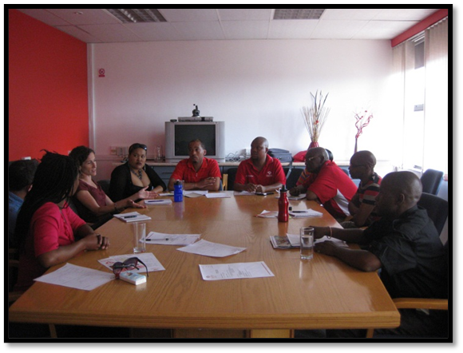
When are CAB Members Involved?
ALL stages of the research process:
17
1
Planning
2
Development
3
Implementation
4
Dissemination of results
Providing input on:
Local relevance and acceptance
Ethical and scientific quality of research
Anticipated concerns by study volunteers

Slide 18
CAB Operations
18
CABs would benefit from:
Meeting regularly (monthly or bi-monthly) with a defined agenda and/or educational component
Having an elected or appointed Chair and
Co-Chair to help set the agenda and facilitate the meeting; terms could vary but would typically be 1-2 years
Developing mission statement
Establishing operating guidelines to include policies, procedures, and role descriptions to ensure that expectations are clear and help the group operate efficiently, effectively and fairly.
Having an initial CAB orientation for new CAB members and ongoing training
Identifying CAB priorities and regularly
re-evaluating them

Slide 19
Site Support for CABs
19
CAB support should include:
A designated site staff member to work with the CAB chair and co-chair and with the CAB on an ongoing basis. This role would include scheduling and attending meetings, preparing materials, identifying speakers as needed, and providing any other services to facilitate the CAB meeting.
A budget for CAB support to cover the costs of CAB member transportation to and from CAB meetings, food (if appropriate for CAB meetings), other CAB support as needed e.g., data packages, laptops, etc., as well as education and training for CAB members; this budget would be separate community engagement outreach.

Slide 20





20
Benefits and Impact of CABs
CABs can change the way a protocol is designed/conducted
They can make sure protocol language, not limited to informed consent is understandable to non-scientists and culturally appropriate
CAB members can propose research ideas and bring research needs or concerns to the attention of the site
Being on a CAB is a big commitment and requires additional work outside of the monthly meetings
CAB members can learn a great deal about science, the clinical research process,
HIV, TB, and
related research specifically, and about research advances

Slide 21




US Government Overview of Selected Health Agencies
21
The mission of the U.S. Department of Health and Human Services (HHS) is to enhance the health and well-being of all Americans, by providing for effective health and human services and by fostering sound, sustained advances in the sciences underlying medicine, public health, and social services.
The US Centers of Disease Control and Prevention (CDC) is the nation's leading science-based, data-driven, service organization that protects the public's health. The CDC conducts critical science and providing health information that protects our nation against expensive and dangerous health threats and responds when these arise.
The US Food and Drug Administration (FDA) works all 50 states in the US and internationally to ensure the safety and effectiveness of human and veterinary medicines, biologics, and medical devices; the FDA also regulates the safety of food, cosmetics, devices that emit radiation, and tobacco products.
The National Institutes of Health (NIH), a part of the U.S. Department of Health and Human Services, is the nation’s medical research agency — making important discoveries that improve health and save lives. NIH organizational chart

Slide 22
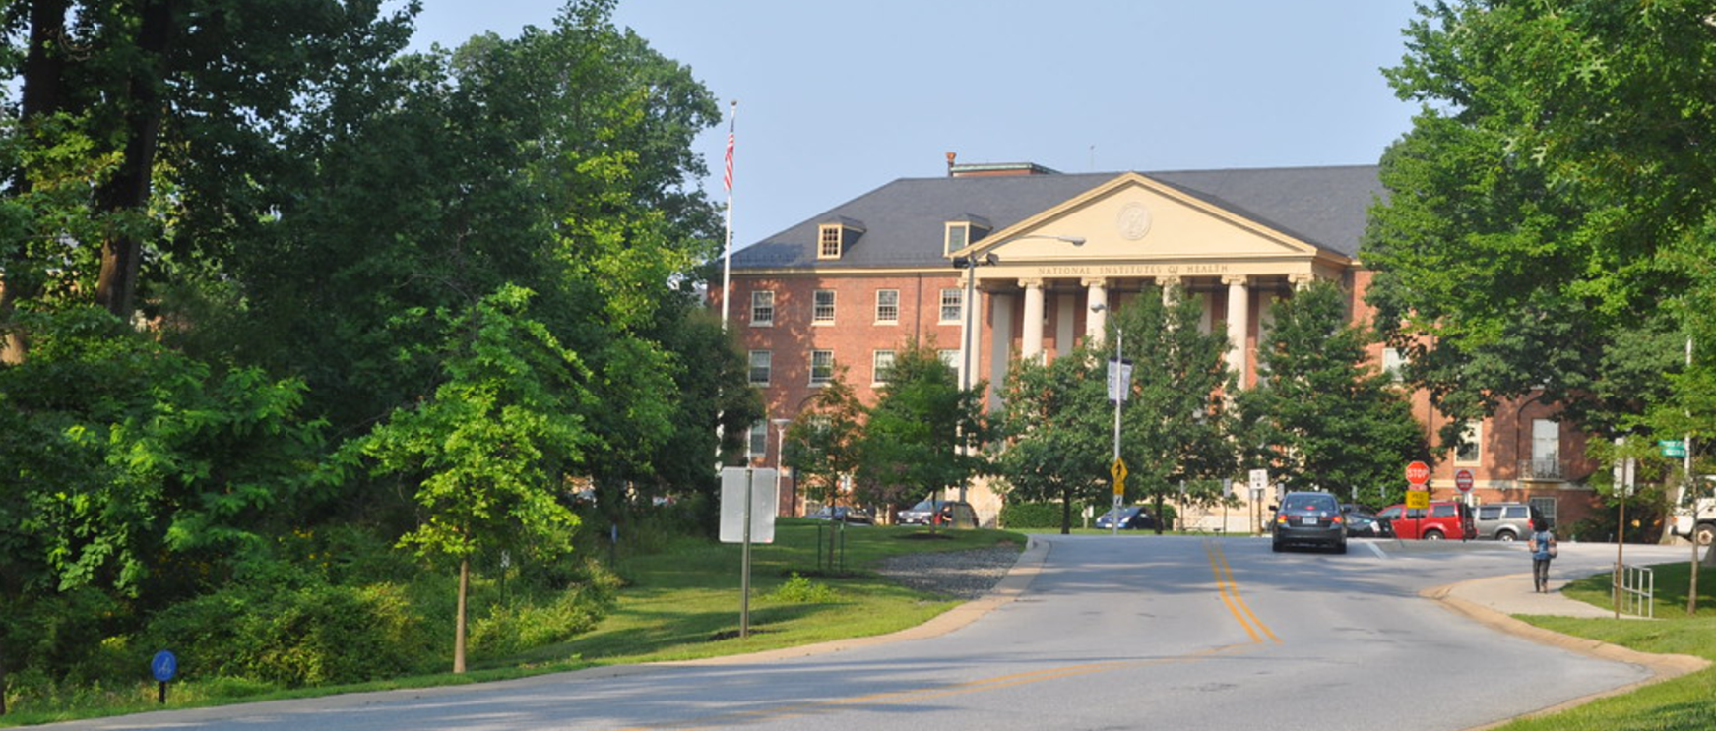
National Institutes of Health (NIH)
22
The NIH is comprised of 27 components known as Institutes and Centers (IC),
of which NIAID is one. Each IC has its own research agenda, typically focusing on particular diseases or
body systems.
This is a photo of the James H. Shannon Building (Building One), which houses the NIH Office of the Director. The Office of the Director sets policy for the NIH and plans, manages, and coordinates the programs and activities of the ICs.

Slide 23

National Institute of Allergy & Infectious Diseases (NIAID)
23
NIAID conducts and supports basic and applied research to better understand, treat, and ultimately prevent infectious, immunologic, and allergic diseases.
For more than 60 years, NIAID research has led to new therapies, vaccines, diagnostic tests, and other technologies that have improved the health of millions of people in the US and around the world.
NIAID consists of several Divisions,
including the:
  Division of AIDS
  Division of Allergy, Immunology, and Transplantation
  Division of Microbiology and Infectious Diseases
  Division of Extramural Activities
  Division of Clinical Research
  Division of Intramural Research
  Vaccine Research Center

Slide 24
24
Division of AIDS (DAIDS)
DAIDS was formed in 1986 to develop and implement the national research agenda to address the HIV/AIDS epidemic. Toward that end, the division supports a global research portfolio to advance biological knowledge of HIV/AIDS, its related co-infections, and co-morbidities.
With the goal of creating an “AIDS-Free Generation,” the division develops and supports the infrastructure and biomedical research needed to:
  Halt the spread of HIV through the development of an effective vaccine and biomedical prevention strategies that are safe and desirable
2. Develop novel approaches for the
treatment and cure of HIV infection
3. Treat and/or prevent HIV
co-infections and co-
morbidities of greatest
significance
4. Partner with scientific and
community stakeholders
to efficiently implement
effective interventions.

Slide 25
Network Overview
25
There are four NIH-funded HIV/AIDS Clinical Trials Networks.
The networks are an affiliated group of national and international medical research institutions and investigators that conduct clinical HIV/AIDS research to develop safe and effective drugs, prevention strategies, and vaccines.
Advancing Clinical Therapeutics Globally (ACTG)
HIV Prevention Trials Network (HPTN)
International Maternal Pediatrics Adolescents AIDS Clinical Trials Network (IMPAACT)
HIV Vaccine Trials Network (HVTN)

Slide 26
Advancing Clinical Therapeutics Globally
26
ACTG is a global clinical trials network that conducts research to improve the management of HIV and its comorbidities; develop a cure for HIV; and innovate treatments for tuberculosis, hepatitis B, and emerging infectious diseases.

Slide 27
HIV Prevention
Trials Network
27
The HPTN develops and evaluates cutting-edge biomedical, behavioral, and structural interventions to reduce the transmission of HIV.

Slide 28
HIV Vaccine
Trials Network
28
The HVTN’s mission is to fully characterize the safety, immunogenicity, and efficacy of HIV vaccine candidates with the goal of developing a safe, effective vaccine as rapidly as possible for prevention of HIV globally.

Slide 29
International Maternal Pediatric Adolescent
AIDS Clinical Trials Network
29
IMPAACT’s mission is to improve health outcomes in infancy, childhood, adolescence, pregnancy, and postpartum among those who are impacted by or living with HIV by evaluating novel treatments and interventions for HIV, tuberculosis, and other related complications.

Slide 30

30
The Office of HIV/AIDS Coordination & Community Partners
The Office of HIV/AIDS Network Coordination (HANC) works with the HIV/AIDS Clinical Trials Networks of the U.S. National Institutes of Health (NIH) with the intent of creating a more integrated, collaborative and flexible research structure.
Community Partners (CP) is a cross-network body charged by the Network and DAIDS Leadership to promote effective representation of the many communities within which the four HIV/AIDS Clinical Trials Networks conduct research.
CP is made up of community representatives and staff liaisons from the ACTG, HPTN, HVTN, and IMPAACT. HANC staff and DAIDS representatives serve as non-voting members.

Slide 31
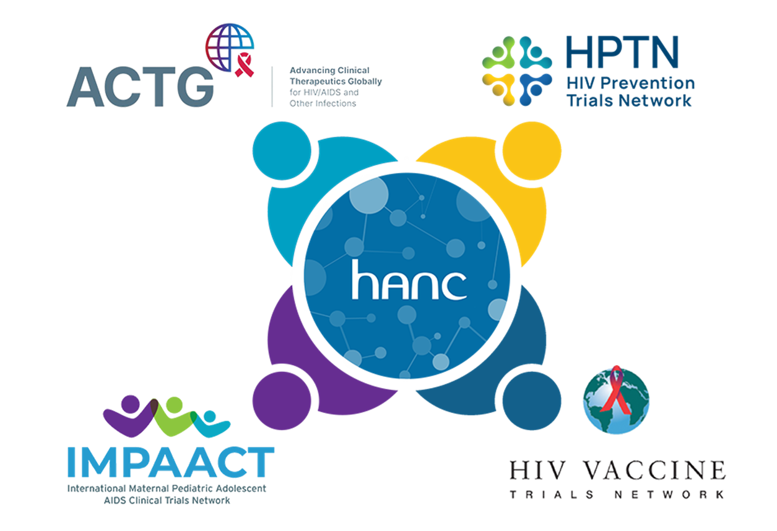
HANC and the Networks
31

Slide 32
Flagship NIH program on HIV cure research.
Fosters dynamic, multidisciplinary collaborations between basic, applied, and clinical researchers studying HIV persistence and developing potential curative strategies.
Establishes partnerships across academia, industry, government, and community, with a goal of leveraging common resources to accelerate the pace of HIV cure research and engage the next generation of HIV cure researchers.
Launched in July 2011 with the funding of three Collaboratories: CARE, DARE, and defeatHIV. Expanded in July 2016 to include three additional Collaboratories (BELIEVE, BEAT-HIV, and I4C). Further expanded in 2021 to include a total of 10 Collaboratories (CARE, DARE, BEAT-HIV, I4C, REACH, ERASE-HIV, CRISPR for Cure, PAVE, RID-HIV, and HOPE), with one (PAVE) focused specifically on HIV cure research in infants and children. Combined the network supports approximately 300 Collaboratory members.
32
Additional DAIDS-funded HIV Research Programs
Martin Delaney Collaboratories (MDC) for HIV Cure Research

Slide 33
33
Additional DAIDS-funded HIV Research Programs
Provides administrative and shared research support to synergistically enhance and coordinate high quality HIV research projects.
CFARs funds core facilities that provide expertise, resources, and services not otherwise readily obtained through more traditional funding mechanisms.
Centers for AIDS Research (CFAR)
Centers for AIDS Research
(CFAR)

Slide 34
Tuberculosis Trials Consortium Community
Research Advisors Group (TBTC)
34
Additional Collaborative Community-focused Organizations
Conducts CDC-led clinical trials to improve TB treatment. The TBTC Community Research Advisors Group (CRAG) is coordinated by TAG (Treatment Action Group).
AVAC
An international non-profit organization that leverages its independent voice and global partnerships to accelerate ethical development and equitable delivery of effective HIV prevention options, as part of a comprehensive and integrated pathway to global health equity.
International AIDS Vaccine Initiative (IAVI)
A nonprofit scientific research organization that develops vaccines and antibodies for HIV, tuberculosis, and emerging infectious diseases.

Slide 35
What Happens to Lab Samples?
35
How to read a protocol
Resources
Community Recommendations document
HANC community resources: Featured on this page are a list of resources covering various aspects of community engagement in clinical research.
DAIDS Learning Portal:
Three community training modules:
UNAIDS/AVAC: GPP guidelines for Guidelines for Biomedical HIV Prevention Trials
Community Advisory Boards (CAB)
AERAS: Good Participatory Practice Guidelines for TB Vaccine Research (GPP-TB VACC)
Research Ethics and Informed Consent in Research
SAAVI: Guidelines for Community Advisory Groups
Understanding Clinical Research
Acronyms/Glossary of HIV-related terms

Slide 36
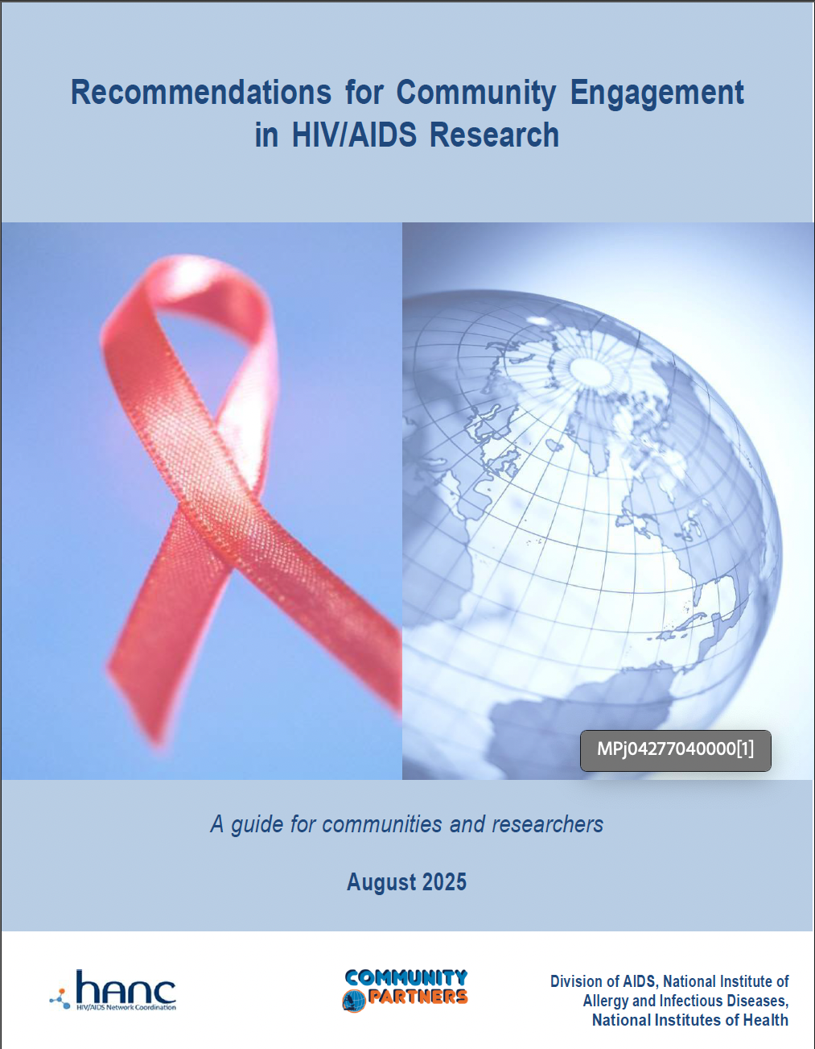
Recommendations for Community Engagement in HIV/AIDS Research
36
This document outlines the process for engaging community in the research process through CABs.
These recommendations help research staff and community representatives expand and deepen existing partnerships, and forge new ones, with the goal of facilitating effective community engagement in all aspects of clinical trials research.
Notes:
The Recommendations for Community Engagement that was developed by CP and DAIDS. The Recommendations document would not exist without that tireless efforts of my amazing colleague, Rona Siskind
This document focuses primarily on CAB development since that’s what our networks and sites rely on but it doesn't exclude other forms of community engagement – in fact encourages them.. And before I continue, please understand that I’m using CAB a bit generically knowing that in some cases they are Community Advisory Group or a Community Working Group. In reality they all function similarly so for ease I’m just using the term CAB
The goals of this document are to:
Improve the role of community in NIAID funded research
Assist staff and community in implementing effective CE
Foster stronger partnerships between staff and community
Harmonize community engagement practices across groups (NIAID networks)

Slide 37
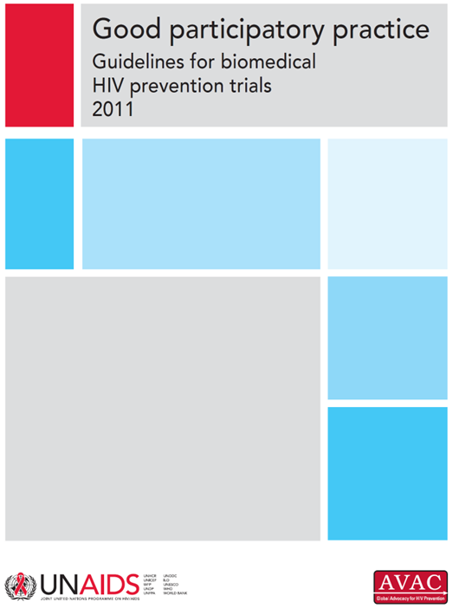
Good Participatory Practice Guidelines (GPP)
37
GPP guidelines were created to provide a consistent global standard for stakeholder engagement throughout the life-cycle of the research enterprise, from trial design to trial conduct to the dissemination of research results to, finally, access to proven intervention.
GPP guidelines are available in 10 languages. Training tools and materials to support implementation of GPP are available at https://avac.org/project/good-participatory-practice/

Slide 38
38
Thank You
Community engagement and CABs play a critical role ensuring research is acceptable and effective. We are grateful for your interest, time, and commitment to this critical work.

Slide 39
39
Acknowledgements
The HANC-facilitated Cross-network CAB Onboarding Package Workgroup would like to thank the Network community engagement teams for their work that contributed to this onboarding presentation.

