Slide 1
Red Ribbon Registry
Clinical Research Site User Training
Greg Davis, Office of HIV/AIDS Network Coordination (HANC)
Milan Vu, HANC
Kylie McCloskey, HVTN and CoVPN

Slide 2
Agenda
Red Ribbon Registry Overview
User Onboarding Requirements
Data Use Agreement
Registry Site Portal
  Account Activation
  Checkout Registrants
  Registrant Management
  Outcome Codes
Resources

Slide 3
Overview
Red Ribbon Registry

Slide 4
Red Ribbon Registry
The Red Ribbon Registry (R3) is based on a pre-screening questionnaire accessible from: http://redribbonregistry.org/
Current focus is adults 18+, will expand to children in late 2022.
Each survey response creates a record in the registry.
Volunteer data includes contact information, location, demographics, health conditions and information on HIV status and PrEP usage.
  R3 Team will centrally solicit updates from all volunteers on a yearly basis.
  Volunteers can update contact information any time via a secure online portal.

Slide 5
Red Ribbon Registry
Sites set a catchment area radius in miles to see all available volunteers that provide a zip code within the radius.
  Catchment area radius is one number in miles.
  Maintenance of a zip code list is not required.
Volunteers are routed to sites and protocols they may be eligible for based on zip code entered in survey.
Each site has a 4-digit recruitment code that can be given to volunteers to provide when completing their survey.

Slide 6
Red Ribbon Registry
Site Administrators are responsible for site user management, including onboarding and ensuring training requirements are met.
Two-factor authentication is required to access the registry for security.
Important Reminders:
  PI approval and completion of training are required for all users to access the registry.
  The intent is to only grant access to staff participating in recruitment efforts or oversight.
  Registry data is sensitive and must be handled according to applicable laws and regulations.
  Use of registry does not replace screening for protocol-specific eligibility.

Slide 7
User Onboarding Requirements

Slide 8
User Onboarding
Each user must complete the following in order to access the registry:
  Completion of training, defined as either reviewing:
    Live or recorded CRS User training, OR
    Posted training slides and data use agreement
  PI approval:
    User can copy site PI on access request to Site Admin, OR
    Site Admin can ask PI for approval/list of staff that should access the registry

Slide 9
User Onboarding
Notify Site Admin when onboarding requirements have been met
Acceptance of Data Use Agreement is also required to access the registry
  Done via an electronic pop-up at first login to Site Portal

Slide 10
Data Use Agreement
Use of Data Set
You will use the Data Set only for purposes of identifying potential volunteers to participate in HIV Clinical Trials conducted in collaboration with the NIAID HIV Clinical Trials Networks (the “Purpose”) and for no other use.
Permitted Users
The Data Set will be used solely by you. You will restrict access to the Data Set and prevent unauthorized users from using or accessing it.
No Transfer
You will not distribute or transfer the Data Set to any unauthorized person or any third party for any reason.
No Unapproved or Commercial Use
You will not use the Data Set for any purpose other than the Purpose. You will not use the Data Set in any research that is subject to consulting or licensing obligations to any for-profit organizations.

Slide 11
Data Use Agreement
Use Under Suitable Containment
You agree to store, transfer, and use the Data Set under suitable containment conditions pursuant to the HIPAA Security Rule described in 45 CFR Part 160 and Subparts A and C of 45 CFR Part 164. Under no circumstances may the Data Set be emailed or transferred via mobile storage devices.
Confidentiality of the Data Set
You agree to maintain the confidentiality of the Data Set. You agree not to disclose any of the Data Set in any form other than to authorized users. You will not use the Data Set for publication.
No Warranties
The Data Set is provided “as is” without any express or implied warranties of any kind.
Unique Identifiers
You agree to retain unique identifiers provided for each volunteer and to transmit any status updates solely using these identifiers.

Slide 12
Data Use Agreement
Breach Notification
You agree to notify Fred Hutch immediately upon becoming aware of any data security breach. Notices should be directed to generalcounsel@fredhutch.org with a copy to jkublin@fredhutch.org.
Compliance
You agree to utilize the Data Set in accordance with all applicable laws, including but not limited to the Health Insurance Portability and Accountability Act of 1996, as amended, and all applicable organizational guidelines and policies.
Deletion of Data Set
You agree to delete the Data Set from your device and servers upon the first of the following to occur: (a) completion of enrollment by your organization for the particular clinical trial for which the Data Set was downloaded; or (b) completion or termination of the Purpose.
By accessing the Data Set, you represent that you have all applicable approvals in place that are necessary to use and access the Data Set for the Purpose, including but not limited to approval by an Institutional Review Board.

Slide 13
Site Onboarding Process
Site Admins are responsible for onboarding site and providing site catchment area radius
Contact Site Admin if your user information should be changed and to discuss updates to catchment area radius

Slide 14
IRB Approval
In order to begin using the data for study-specific recruitment, IRB approval must be obtained.
Your Network Regulatory Specialist has received approval for sites to use the registry for A5386 and A5391 with the protocol-level submission.
  Approval notices are available on your Advarra CIRBI Platform workspace under the "IRB-Approved Documentation" tab.

Slide 15
Site Portal
Red Ribbon Registry

Slide 16
Account Activation
User information provided to Site Admins is used to generate accounts.
Once account has been added, registry sends an email with an activation link to set up secure password.
  Email will come from no-reply@oracle.com.
Clicking link will take you to site portal to set a password.
  Link may only be used once and is active for 24 hours.
After password setup is complete, return to your activation email and click on Site Portal URL to login.
  Recommend bookmarking Site Portal URL.

Slide 17
Account Activation
After password is entered, user will be prompted to set up two-factor authentication (TFA) during first login and select TFA method.
  Email, OR
  Oracle Authenticator app.
Reminders:
  Use the same email address to login each time.
  Activation email cannot be forwarded – both parties will be locked out.
    Ask Site Admin if new users need to be added.

Slide 18
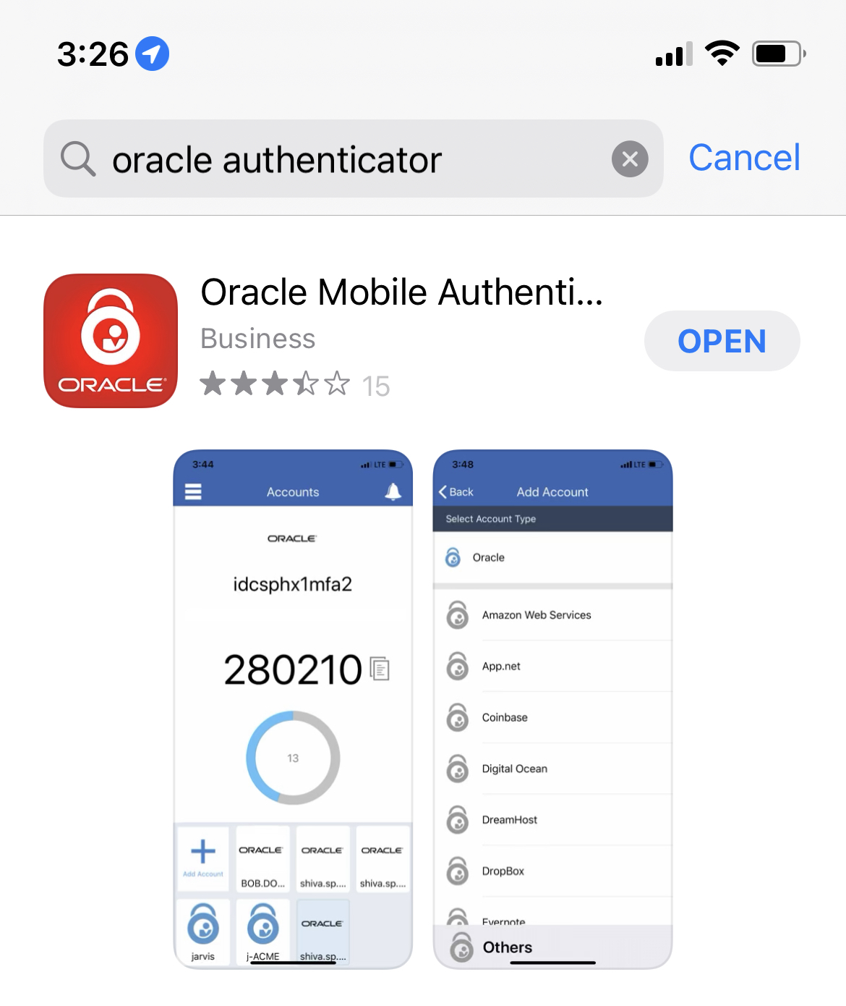
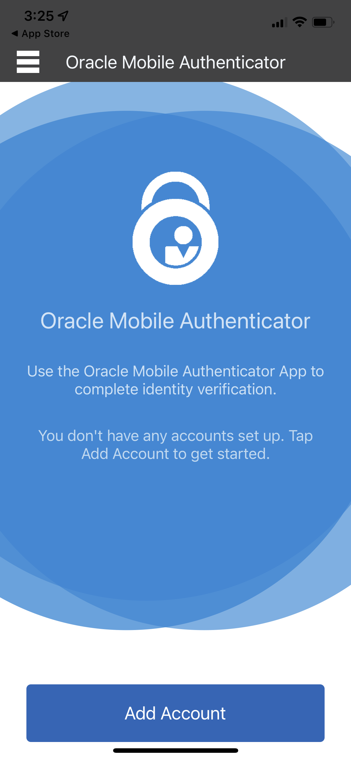
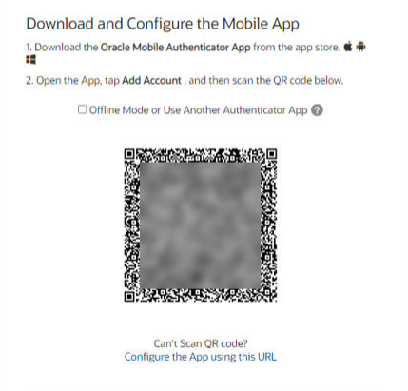
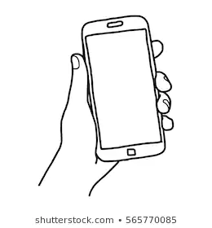
Two Factor Authentication Set Up – Oracle Authenticator
STEP
STEP
1
STEP
3
STEP
2
4
Download Oracle Authenticator on iPhone or Android smartphone
Choose “Add Account”
Follow instructions and use phone camera to scan the QR code in the R3 Site Portal
Enter 6-digit code from Oracle Authenticator each time you log into R3 Site Portal

Slide 19
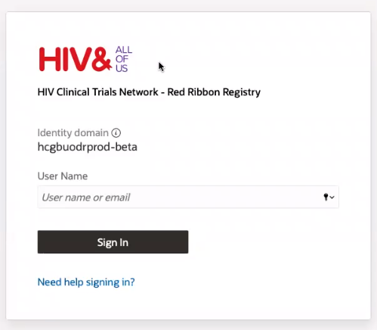
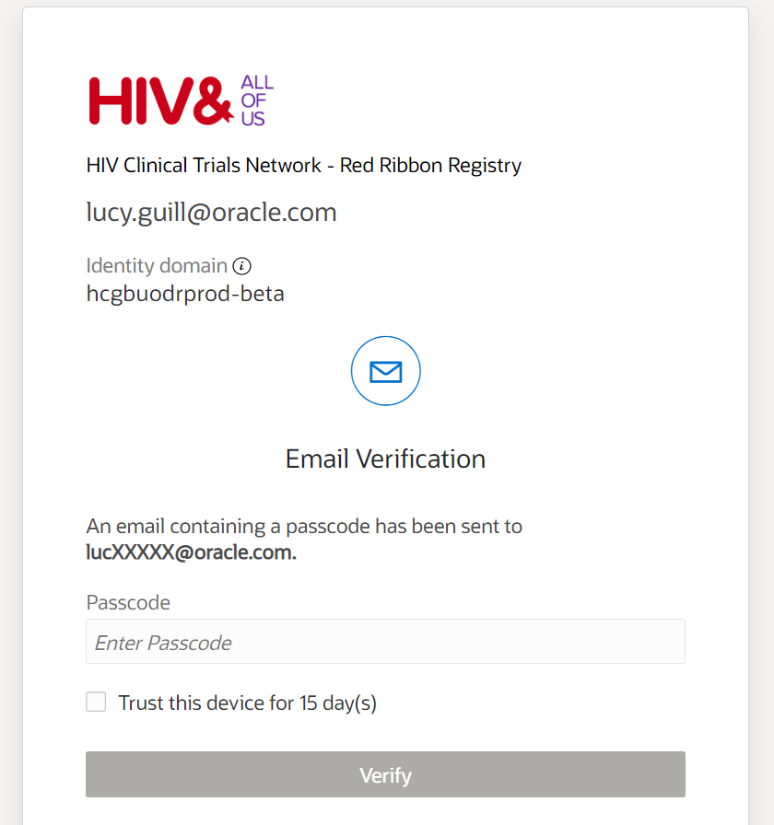
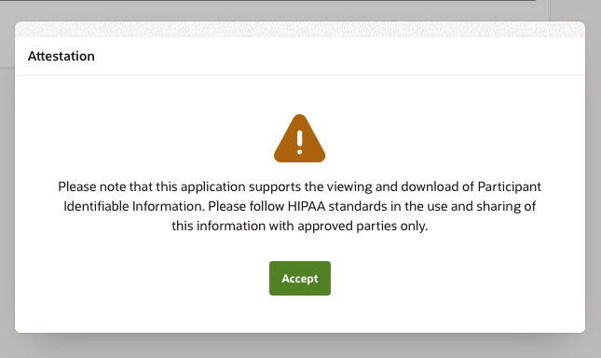
Future Logins
STEP
STEP
2
STEP
1
3
Sign in via the Site Portal URL (found in activation email OR bookmark)
Enter the 6-digit authentication code (from email or Oracle Authenticator)
Acknowledge data use agreement reminder

Slide 20
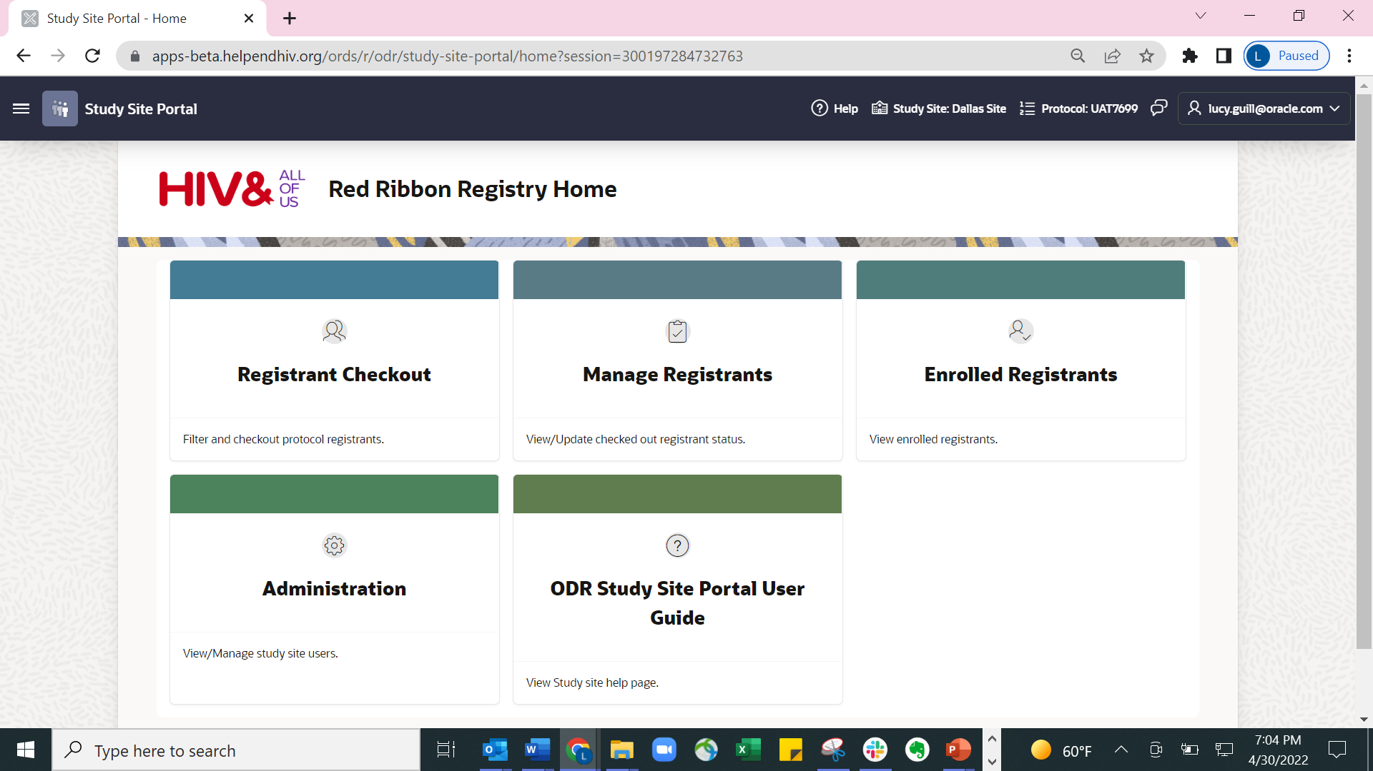
Site Portal Homepage
The Dashboard can be used to navigate to all pages in the Site portal.
Administration will only be seen by Site Admins.

Slide 21
Site Portal Homepage
From the Homepage:
- Toggle between study site and protocol,
- Submit feedback on your experience with the registry
- Access user guides

Slide 22
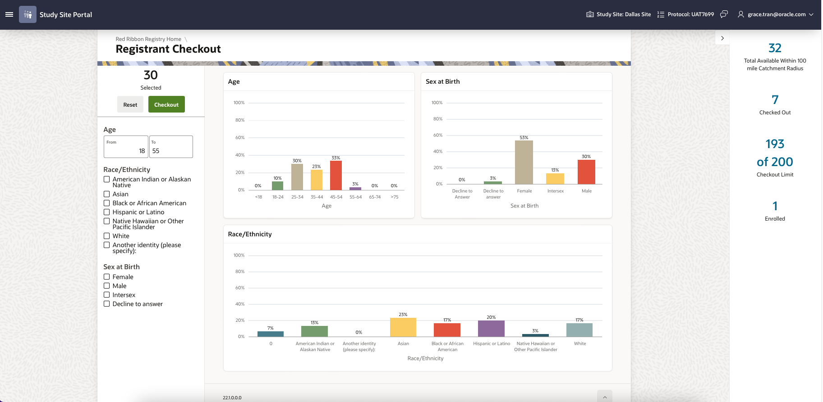
Checkout Registrants

Slide 23
Checkout Registrants
Users can filter available registrants on:
Age
Race/Ethnicity
Sex at Birth
View details for:
Total registrants available
# Checked out
Checkout limit
# Enrolled
Some filters coded into protocol based on I/E criteria and hidden on backend:
Exclude HIV positive, pregnant
Limit age to 18-55

Slide 24
Checkout Registrants
View the total number of registrants that meet criteria of interest
Choose Checkout to access selected registrants

Slide 25
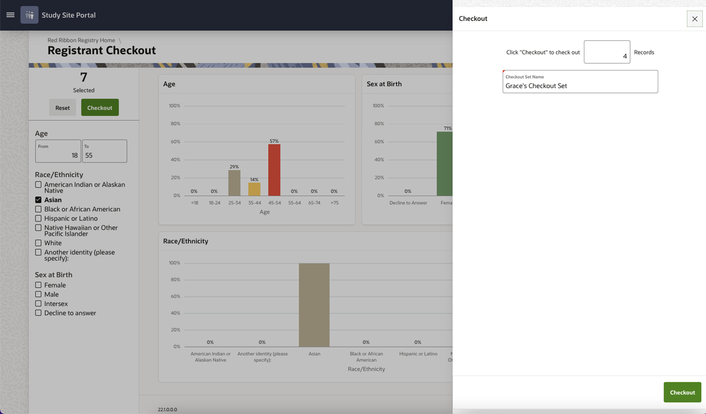
Checkout Registrants
Adjust desired number of registrants, name checkout sets, and press “Checkout” to initiate checkout

Slide 26
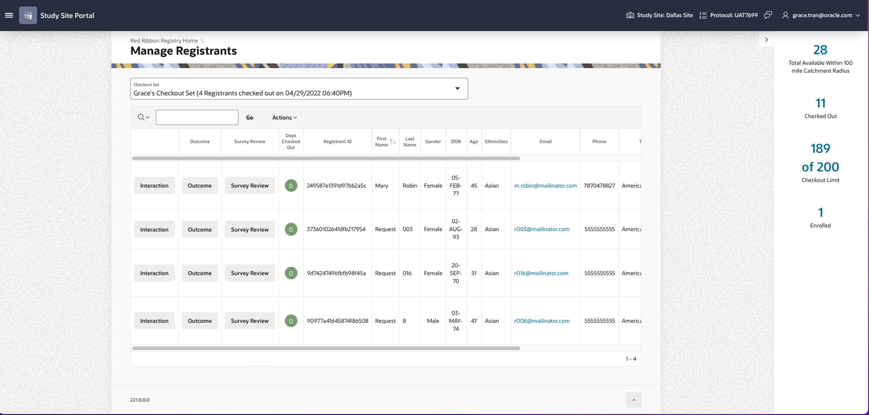
Manage Registrants

Slide 27
Manage Registrants
Toggle between checkout sets or click on column to filter by criterion
3 different activities to update status of registrants:
Interactions
Outcomes
Survey Review

Slide 28
Registrant Interactions
Once a registrant is checked out, interactions can be logged to track activities throughout the screening process. This does not return registrants to the pool.
This includes:
  Contact attempts and method of contact (phone, email, etc.)
  User that contacted the volunteer
  Notes on result of interaction or next steps (i.e., bringing registrant in for screening appointment)
Interaction history is available to view all previous interactions made by any user.
Once a registrant is returned to the registry with an outcome code, other sites will be able to view the interactions.
  No notes or user information will be provided to other sites.

Slide 29
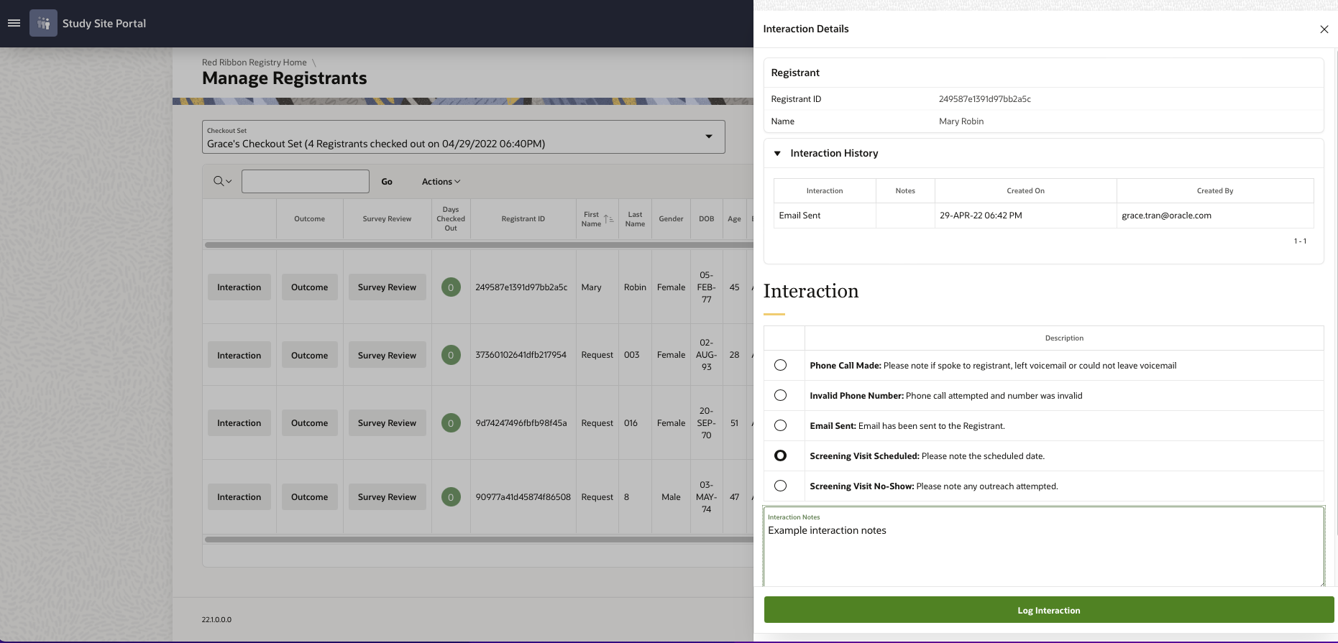
Registrant Interactions
View history of previous interactions
Interaction notes can be entered to provide more detail about the result of the interaction and any next steps for the registrant.

Slide 30
Interaction Codes
Summary of available interactions and example notes users may want to include.
Interaction | Description | Example Notes
Phone Call Made | Please note if spoke to registrant, left voicemail or could not leave voicemail. | Call made on 12-May and discussed study with registrant.
Invalid Phone Number | Phone call attempted and number was invalid. | Will email registrant to have them update phone number.
Email Sent | Email has been sent to Registrant. | Sent email with study summary on 12-May
Screening Visit Scheduled | Please note the scheduled date. | Scheduled registrant for visit on 12-May at 11 am.
Screening Visit No-Show | Please note any outreach attempted. | Registrant did not show for visit on 12-May. Attempting to reschedule.

Slide 31
Survey Review
To aid in pre-screening, a user can review survey answers over the phone to confirm or update information if it has changed.
Once a survey review has started, as user must go through all pages of the survey to complete the review.
This is an optional activity and only needs to be completed if helpful during screening.
  Screening must still be completed per protocol to determine protocol-specific eligibility.

Slide 32
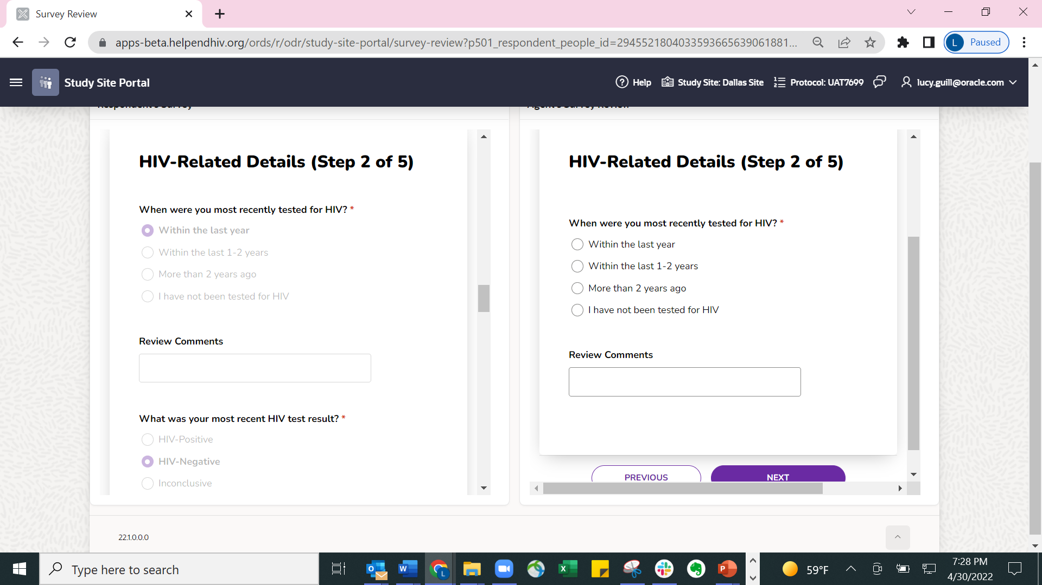
Survey Review

Slide 33
Registrant Outcomes
To monitor site recruitment and maintain active registrant pool, outcome codes must be returned for all volunteers regardless of screening outcome.
  Enrolled, ineligible, lost to follow-up, etc.
Helps prevent sites from contacting registrants repeatedly for the same study, while retaining registrants in the registry for future studies.
If there are any issues with a registrant, please provide their unique registrant ID. DO NOT provide any identifiable information.

Slide 34
Outcome Code Update Schedule
Each site will progress through registrant screening at its own pace. However, recommendation is to update outcome codes monthly at minimum.
Maximum limit on the number of volunteers that can be checked out at a time. Limit decreases each time registrants are checked out.
  Example: If a site has a limit of 500 records and checks out 300 registrants from a query, the remaining limit is 200. If outcome codes are provided for 140 of the checked-out registrants, the limit increases to 340.
Outcome codes can be updated as often as needed but should only be done when there is a final outcome to report.
Notes can be provided to provide more detail on outcome (especially for registrants that did not enroll).

Slide 35
Outcome Codes
Outcome codes are only provided once screening is complete, or the volunteer is enrolled. Until this is complete, the record should remain checked out.
Code | Meaning | Result
Cancelled Checkout | For accidental checkout or registrant that will not be contacted. | Removed from Checked Out Registrants Returned to pool Still available for protocol
Not Enrolled – Ineligible | Registrant was contacted but was ineligible for protocol. | Removed from Checked Out Registrants Returned to pool Only available for other protocols
Not Enrolled – Not Interested | Registrant was contacted but was not interested in protocol. | Removed from Checked Out Registrants Returned to pool Only available for other protocols
Not Enrolled – Other Reason | Registrant was contacted, was interested, but was not enrolled in the protocol for various reasons. | Removed from Checked Out Registrants Returned to pool Only available for other protocols
Remove from Registry | Registrant requested to be removed from Registry. | Removed from Checked Out Registrants REMOVED from pool Not available for any protocols
Enrolled | Registrant enrolled in this protocol. | Moved from Checked out to Enrolled Registrants Retained in pool May be available for other select protocols

Slide 36
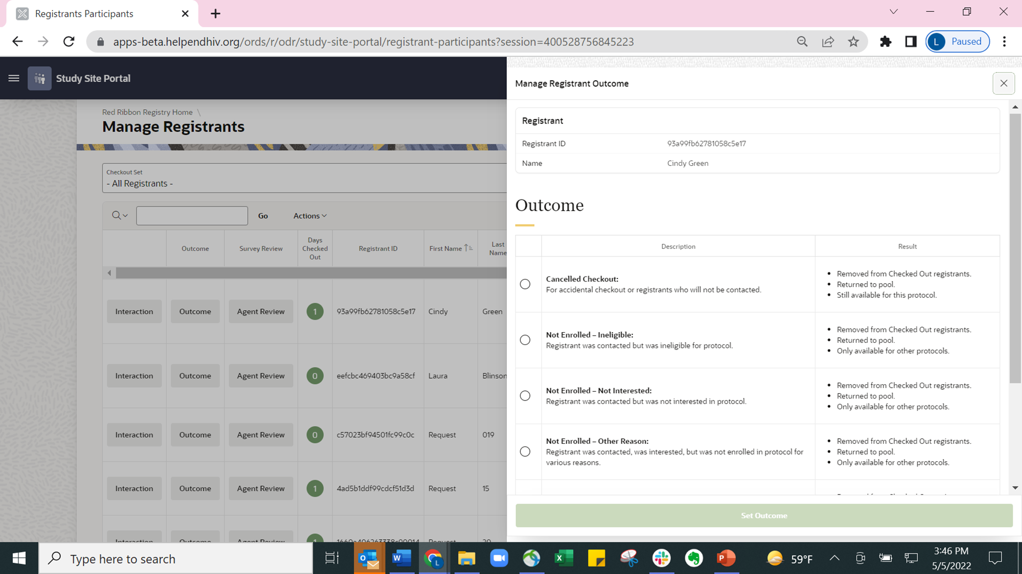
Registrant Outcomes
Example outcome notes:
Ineligible due to heart condition
Not enrolled because they did not have time to participate in study
Not enrolled because they were not interested in Phase 1 trials

Slide 37
Enrolled Registrants
Enrollment is defined per-protocol and outcome code should only be used once a volunteer has been officially enrolled in protocol.
  Example, for HVTN studies enrollment is typically concurrent with first study product administration.
Once registrants are enrolled, users will be able to refer to these registrants at any time via the Enrolled Registrants page.

Slide 38
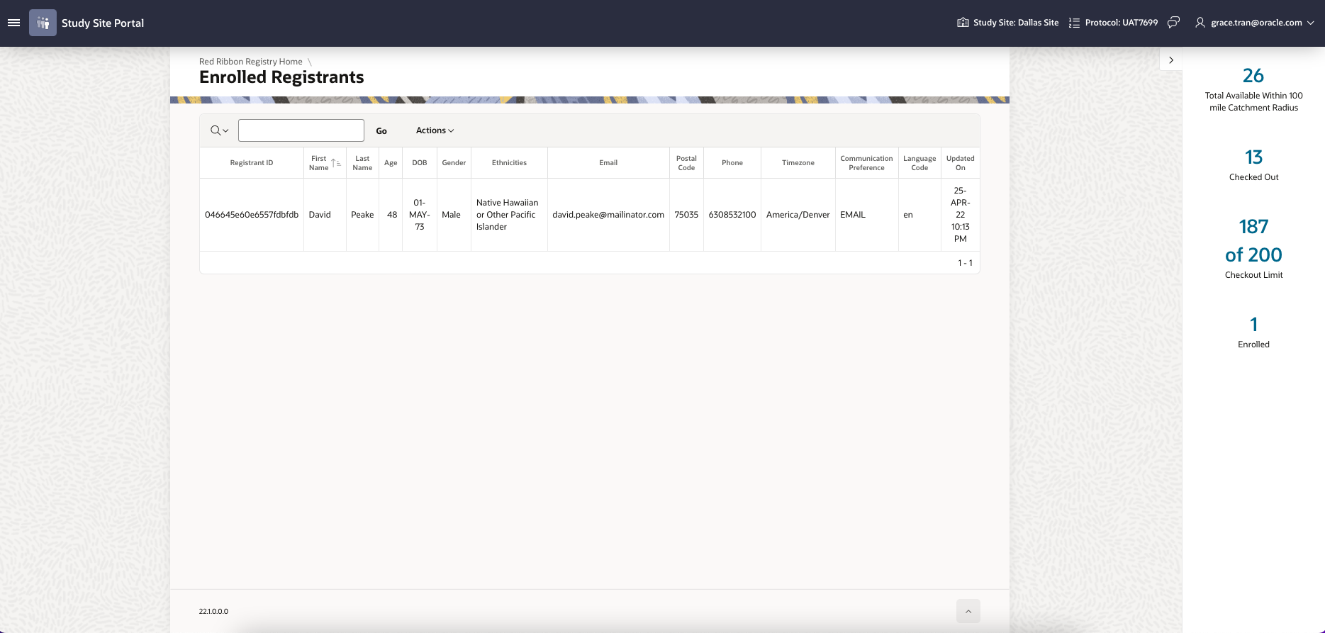
Enrolled Registrants
Can filter enrolled registrants by:
Demographics
Zip code

Slide 39
Resources

Slide 40
Important Reminders
The activation link will only be functional for 24 hours.
The same email address used in activation must be used to log in to the Site Portal.
The activation link cannot be shared with others – both users will be temporarily locked out of the Site Portal.
Each new user must be authorized by the site PI.

Slide 41
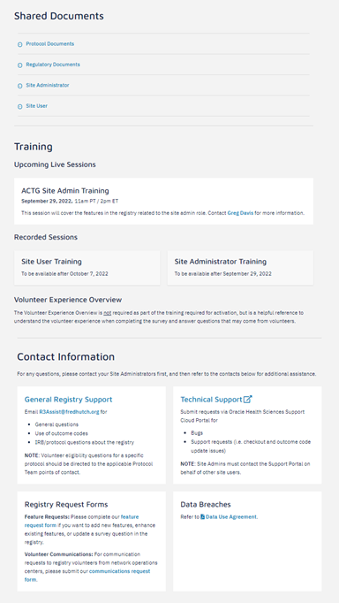
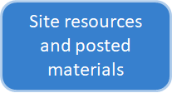
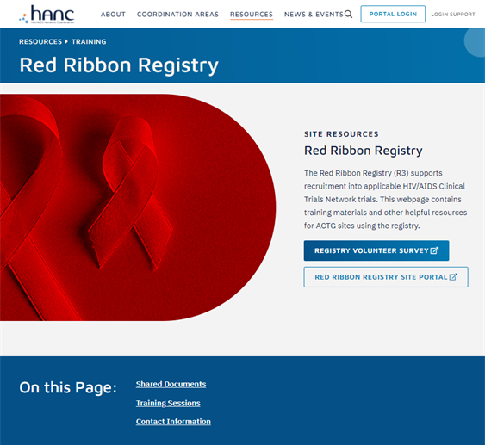


R3 Resources Webpage
https://www.hanc.info/resources/training/red-ribbon-registry.html
Links to survey, site and support portal

Slide 42
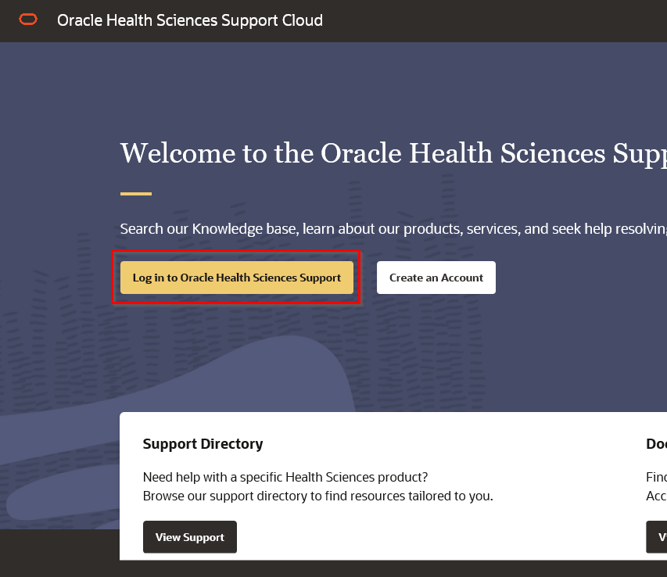
Oracle Health Sciences Support Cloud Portal
https://hsgbu.custhelp.com/
Technical support and help desk for:
  Support requests
  Checkout and outcome code update issues
  Bugs
Site Admins must contact portal on behalf of other users

Slide 43
Contacts
Contact R3Assist@fredhutch.org for:
  General questions about the registry
    Including when to use outcome codes
  IRB/protocol questions related to the registry
  All other questions
Goal: Site Admins will be first point of contact for questions
Refer to the Data Use Agreement for contacts related to data breaches.
Contact Protocol Team for eligibility questions related to a specific protocol.

Slide 44
Questions?
Email R3Assist@fredhutch.org for any additional questions or requests for assistance.
Notes:
This is the end of the general session. As a reminder, we will be holding registry training sessions starting next week. These are a great opportunity to learn more about the registry and ask any questions you may have. Thank you for joining and we hope the registry will help aide in your important recruitment efforts!
There will now be a training for CER staff on ordering the print materials mentioned earlier in the presentation. You are welcome to leave if this training does not apply to you.
For those attending in-person, if you have questions about the registry, we can answer questions in the back right corner of the room. Our communications and marketing team can answer any questions about the campaign in the back left corner of the room.

Slide 45
Thank You!
Notes:
This is the end of the general session. As a reminder, we will be holding registry training sessions starting next week. These are a great opportunity to learn more about the registry and ask any questions you may have. Thank you for joining and we hope the registry will help aide in your important recruitment efforts!
There will now be a training for CER staff on ordering the print materials mentioned earlier in the presentation. You are welcome to leave if this training does not apply to you.
For those attending in-person, if you have questions about the registry, we can answer questions in the back right corner of the room. Our communications and marketing team can answer any questions about the campaign in the back left corner of the room.

