Slide 1
Red Ribbon Registry
Clinical Research Site Administrator Training
Milan Vu, Office of HIV/AIDS Network Coordination (HANC)
Greg Davis, HANC
Kylie McCloskey, HVTN & CoVPN

Slide 2
Important Note
This training is intended to supplement the CRS User Training and focuses on the roles and responsibilities of Site Administrators.
Complete the CRS User Training to learn how to use the registry to support recruitment efforts.
  Required to complete training and gain access to the registry.

Slide 3
Agenda
Red Ribbon Registry Overview
Site Admin Roles and Responsibilities
User Onboarding Requirements
Registry Site Portal Administration
  Activating New Users
  Revoking User Access
  User Account Troubleshooting
  Updating Catchment Area Radius
Resources

Slide 4
Red Ribbon Registry
Overview

Slide 5
Red Ribbon Registry
The Red Ribbon Registry (R3) is based on a pre-screening questionnaire accessible from: http://redribbonregistry.org/
Current focus is adults 18+, will expand to children in late 2022.
Data includes contact information, location, demographics, health conditions, HIV status, and PrEP usage.
Use of registry does not replace screening for protocol-specific eligibility.

Slide 6
Red Ribbon Registry
Site Administrators are responsible for site user management, including onboarding and ensuring training requirements are met.
Users gain access to the site portal using two-factor authentication for security.
Important Reminders:
  PI approval and completion of training are required for all users to access the registry.
  The intent is to only grant access to staff participating in recruitment efforts or oversight.
  Registry data is sensitive and must be handled according to applicable laws and regulations.

Slide 7
IRB Approval
In order to begin using the data for study-specific recruitment, IRB approval must be obtained.
Your Network Regulatory Specialist has received approval for sites to use the registry for A5386 and A5391 with the protocol-level submission.
  Approval notices are available on your Advarra CIRBI Platform workspace under the "IRB-Approved Documentation" tab

Slide 8
Roles and Responsibilities
Site Administrator

Slide 9
Site Administrator
~2 staff at each site that manage site users and will (eventually) become local experts for their site
  Think “super users” of the site!
Responsible for:
  Tracking onboarding requirements for site staff
  Activating new users
  Revoking user access
  Updating site catchment area radius
  Answering site questions (when possible)

Slide 10
Changes to Site Administrators
To change staff designated as Site Administrators:
  Access should be revoked for the outgoing Site Admin
    Done by site or via email request to R3Assist@fredhutch.org
  New Site Admin is identified they complete necessary training
    Site Admin supplement training
    CRS User Training (if new to the registry)
  New Site Admin emails R3Assist@fredhutch.org to notify R3 Team that training requirements have been met
    Copy site PI to provide approval (if not provided previously)
  R3 Team will grant new Site Admin necessary permissions in Site Portal
    Will activate account if the user is new to the registry

Slide 11
User Onboarding Requirements

Slide 12
Site Onboarding Process
Minimum information needed to onboard a site:
  Site Administrator contacts
  Catchment area radius
Provided by site to HANC via survey or email to R3Assist@fredhutch.org
  Email or re-submit survey to make changes to this information

Slide 13
User Onboarding
Each user must complete the following in order to access the registry:
  Completion of training, defined as either reviewing:
    Recorded or live Site User training, OR
    Posted training slides and data use agreement
  PI approval:
    User can copy site PI on access request to Site Admin, OR
    Site Admin can ask PI for approval/list of staff that should access the registry
Users should notify Site Admins when onboarding requirements have been met so Site Admins can activate account
Acceptance of Data Use Agreement is also required to access the registry
  Done via an electronic pop-up at first login

Slide 14
Tracking Onboarding Requirements
Site Admins must ensure that all users complete onboarding requirements before accessing the registry and track completion of requirements:
  Completion of user training
    Documentation of training via form, email or other site process
  Receive PI approval
    Individual approval per user is not required, approval can be provided in bulk
Can use existing documentation of training process or resources provided on Red Ribbon Registry page on HANC website
  Example documentation of training form
  Registry user tracker

Slide 15
Registry Site Portal Administration

Slide 16
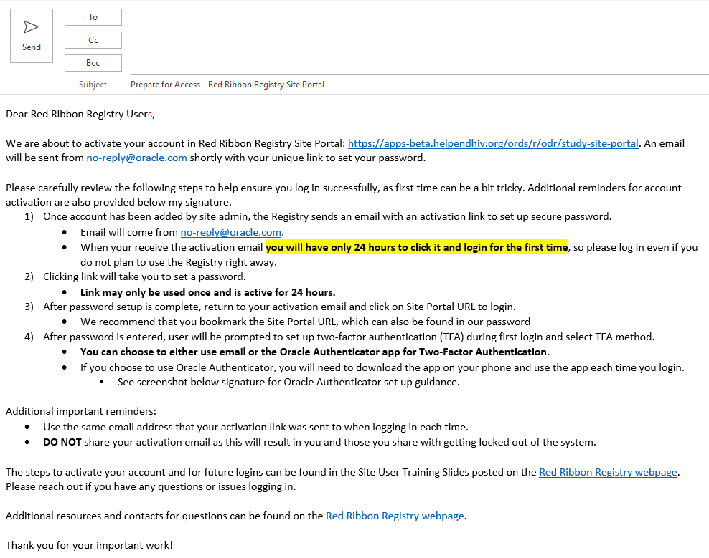
Prepare for Activation
STEP
1
Send “Prepare for Access” email to users
Contains important reminders about account activation
Template posted on Registry page on HANC website
Important: DO NOT activate new users on Friday!
Password set link is only active for 24 hours.

Slide 17
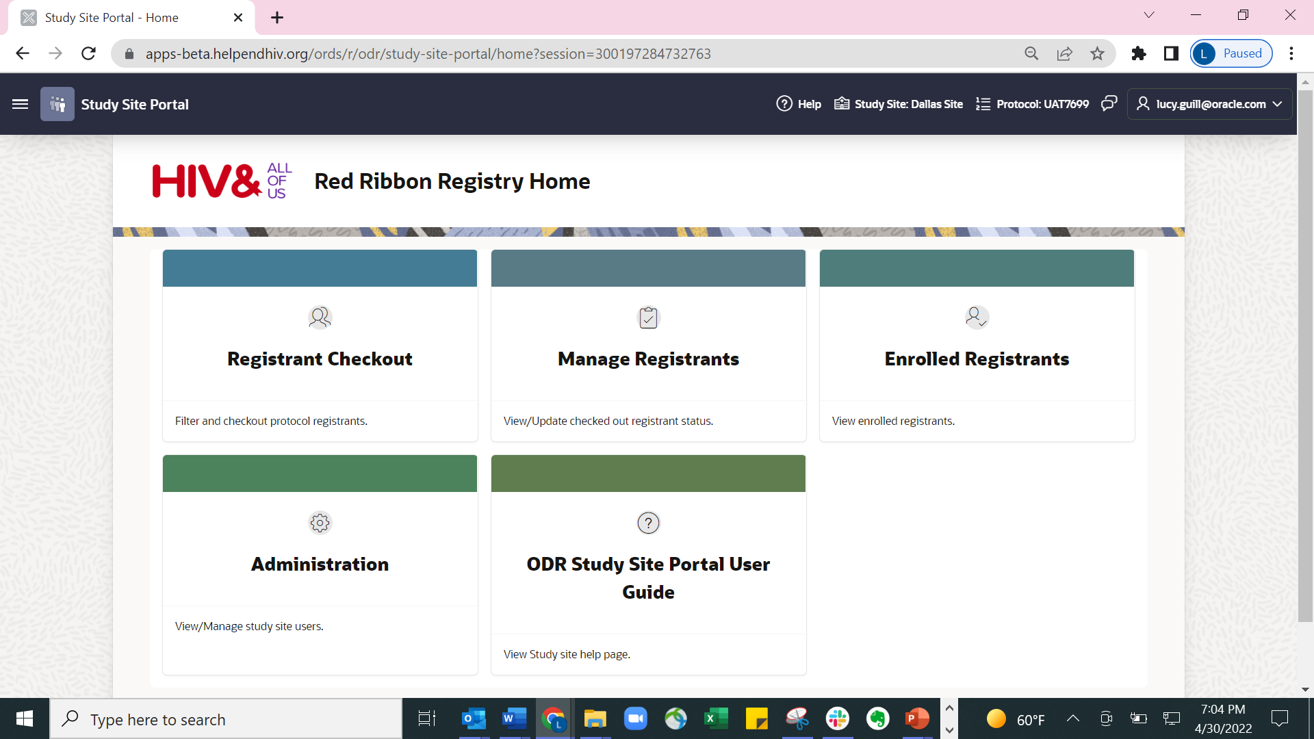
Administration Page in Site Portal

Slide 18
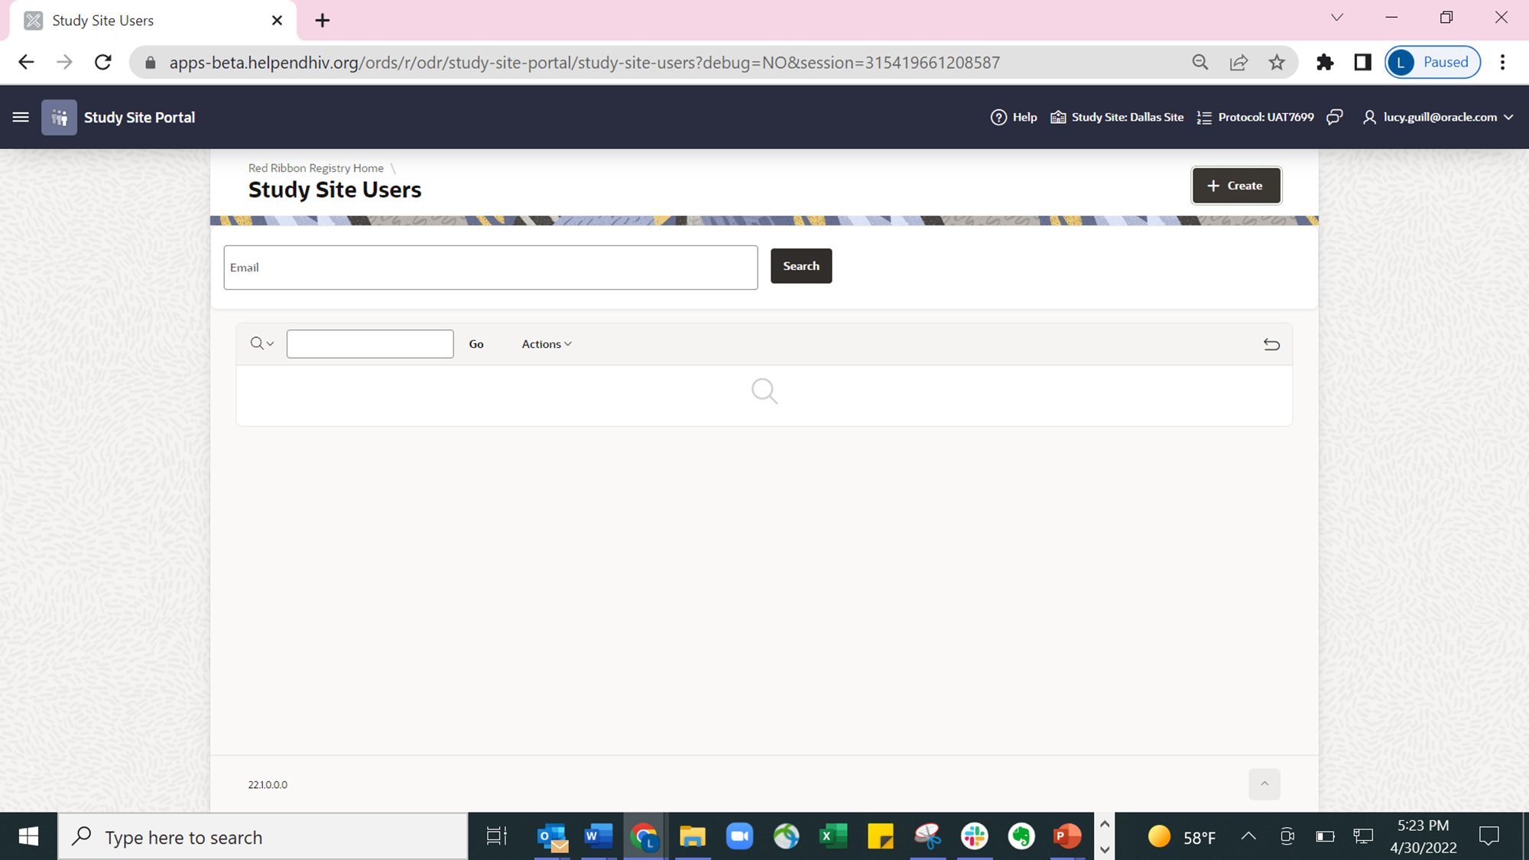
Activating New Users
STEP
2
Select “+ Create User”

Slide 19
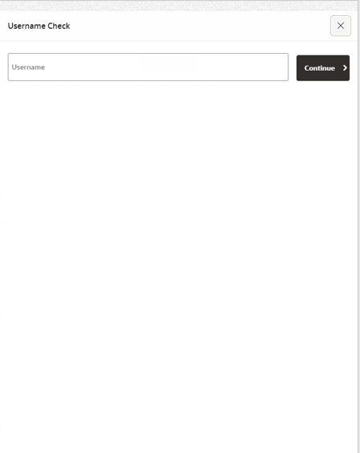

Activating New Users
STEP
3
Complete the username check to confirm user does not already exist

Slide 20

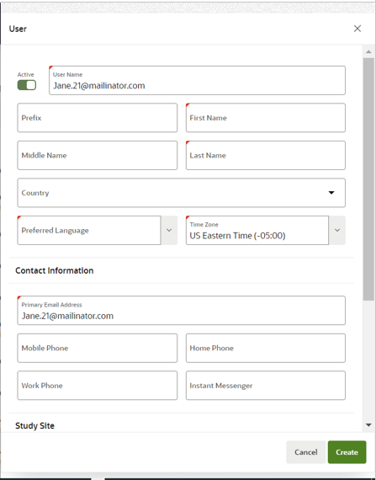
Activating New Users
STEP
4
Enter all user information in required fields, denoted with a red corner.

Slide 21
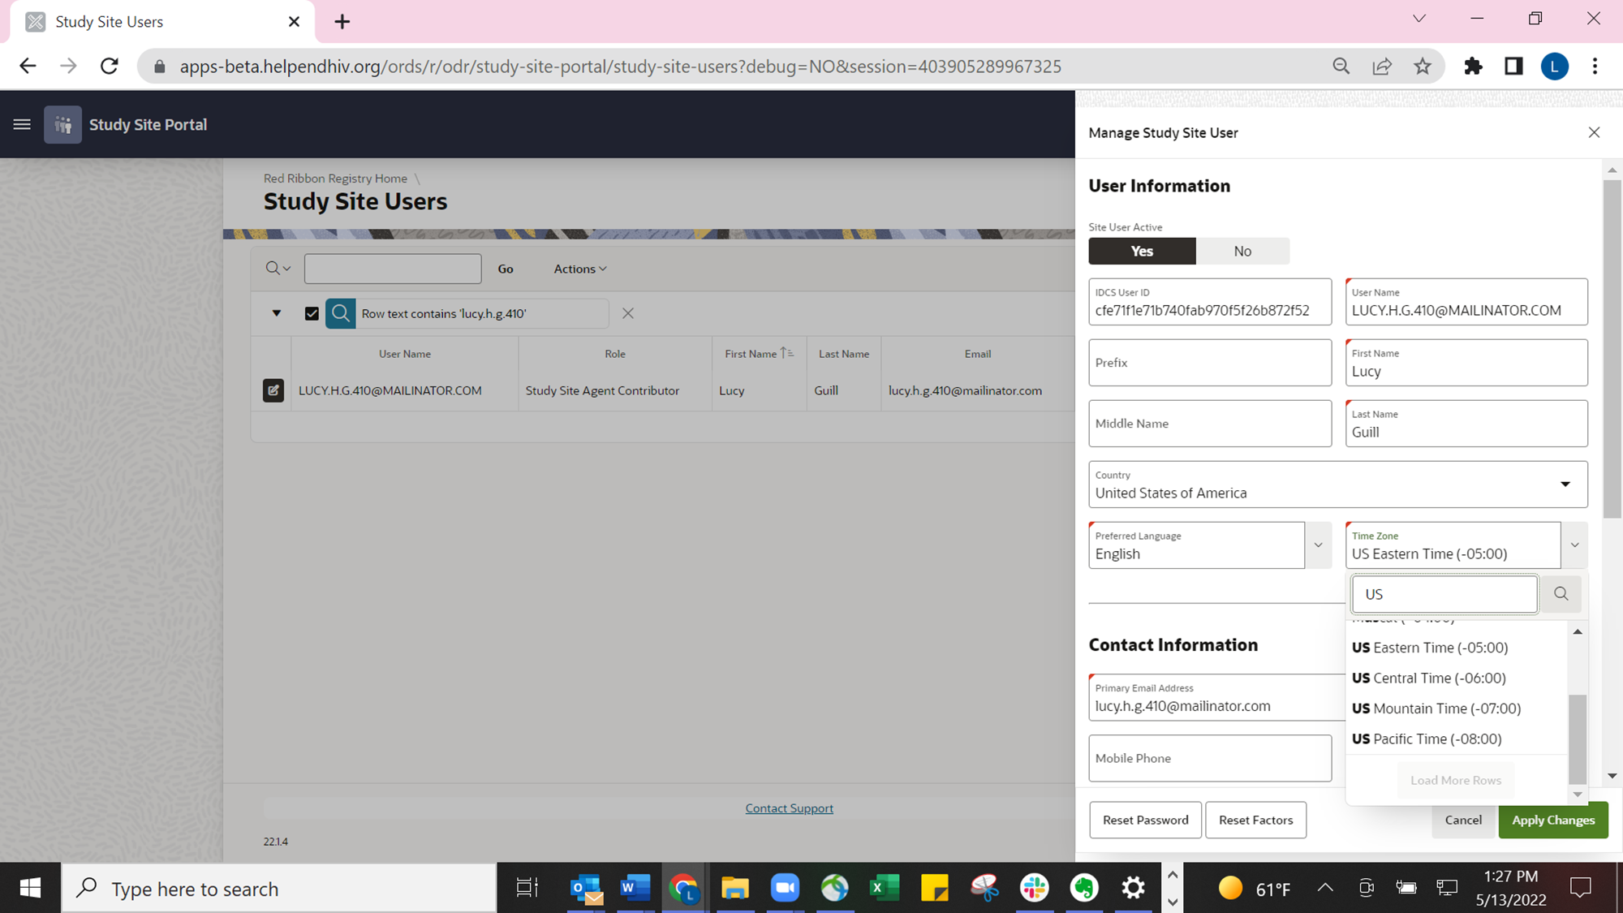
Activating New Users
STEP
4
To select the correct time zone for the user:
Click into the box labeled Time Zone. A search box and list of time zones will appear.
In the search box, type “US” then click Enter or the magnifying glass to search.
Scroll down and at the bottom of the search results, you can select from:
  US Eastern Time (-05:00)
  US Central Time (-06:00)
  US Mountain Time (-07:00)
  US Pacific Time (-08:00)

Slide 22

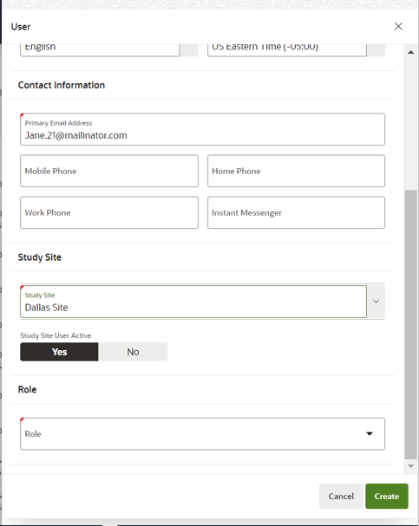
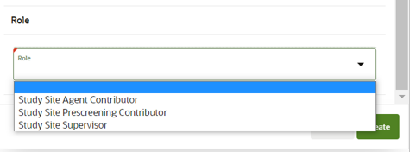
Activating New Users
STEP
4
For Role, select “Study Site Agent Contributor” for Site Users.
“Study Site Supervisor” is only for Site Admins.

Slide 23
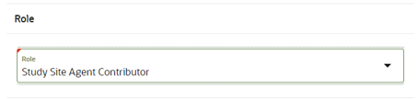
Activating New Users
STEP
5
Click “Create” to complete user activation and trigger activation email.

Slide 24
Revoking User Access
If staff leave the site or no longer require access to the registry, then their access must be revoked.
Best practice is to update in registry and note in user tracking system.

Slide 25
Revoking User Access
STEP
1
Go the Administration page and search for the user with their email.

Slide 26
Revoking User Access
STEP
2
Click on the pencil and paper icon to pull up the user’s profile.

Slide 27
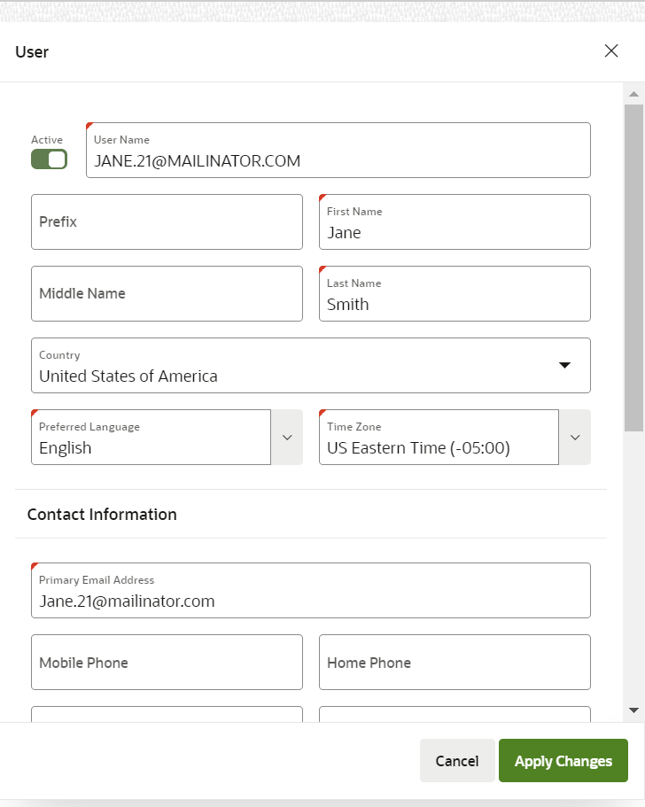
Revoking User Access
STEP
3
Toggle the “Active” status to “Inactive” and click “Apply Changes.”

Slide 28
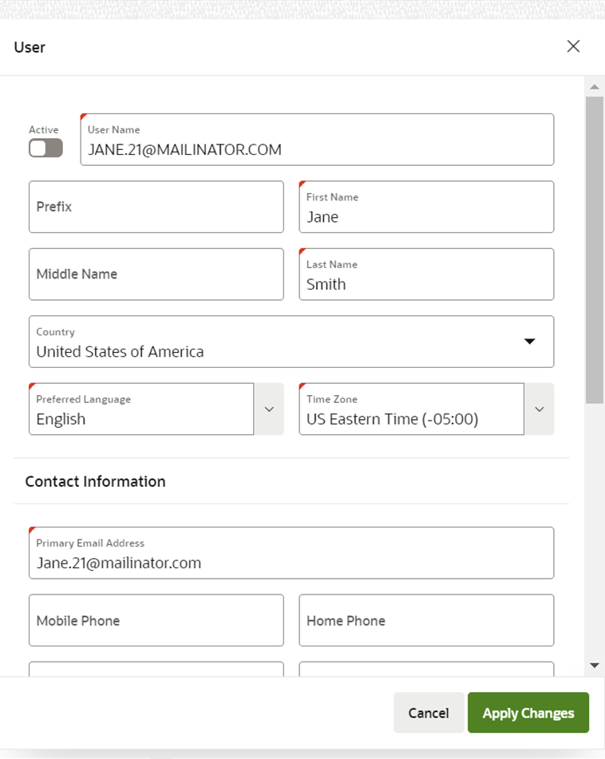
Revoking User Access
STEP
3
Toggle the “Active” status to “Inactive” and click “Apply Changes.”

Slide 29
Resending Activation Link
Account Troubleshooting
If a user fails to access the activation link within 24 hours, a new email and link will need to be sent.
Please email R3Assist@fredhutch.org with the user’s email address to resend their link.
We are determining how this process will work long-term.

Slide 30
Resetting Two-Factor Authentication (TFA)
Account Troubleshooting
TFA will need to be reset if a user uses Oracle Authenticator and gets a new phone or resets their current phone, or if an issue occurs with their email.
Please email R3Assist@fredhutch.org with the user’s email address to have their TFA reset.
Once reset, the user will be prompted to set up TFA again the next time they login.
  If using Oracle Authenticator app, new QR code will appear to scan in app.
We are determining how this process will work long-term.

Slide 31
Updating Catchment Area Radius
Email R3Assist@fredhutch.org with the desired radius for site’s catchment area.
R3 Team will notify Site Admins when the catchment area radius has been updated.

Slide 32
Resources

Slide 33
Training and Office Hours
Live trainings September 29 and October 3
  Site Admin and Site User trainings
  Recordings to be posted on the HANC website
Office hours every other Tuesday at 10am PT / 1pm ET
  Allow sites to ask questions with R3 Team
  Review training materials before attending
  Next Session: October 11, 2022

Slide 34
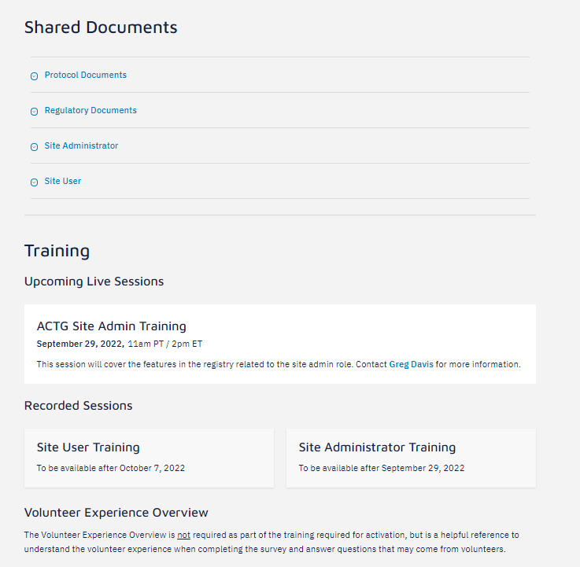
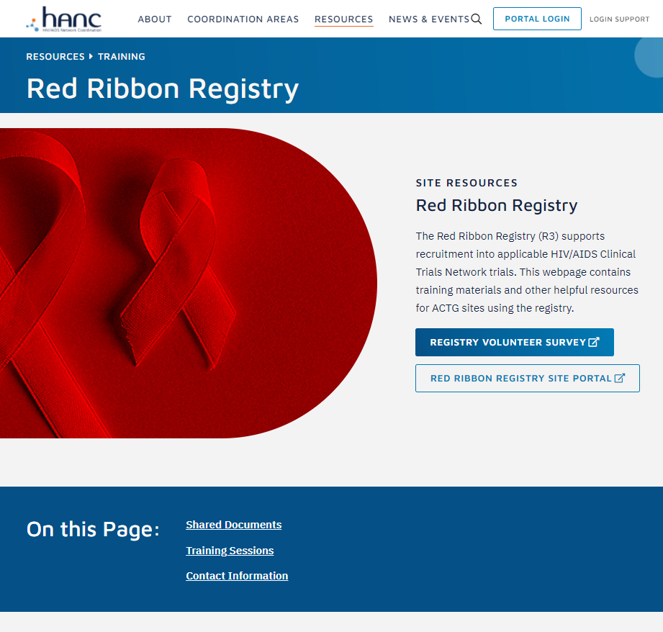
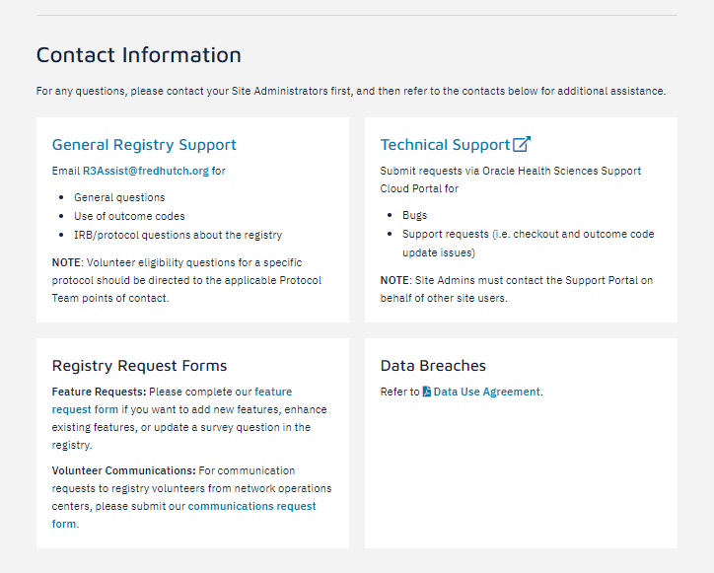
R3 Resources Webpage
Site resources and posted materials
https://www.hanc.info/resources/training/red-ribbon-registry.html
Coming soon: Links to recorded trainings
Contact information
Links to survey and site portal

Slide 35
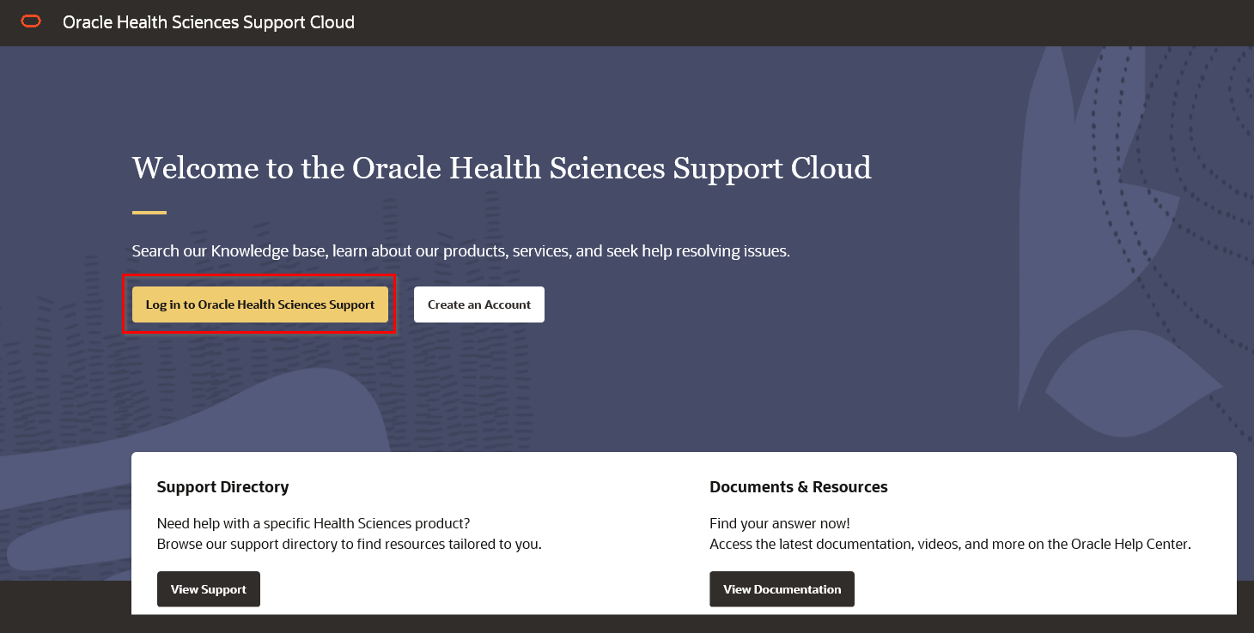
Oracle Health Sciences Support Cloud Portal
https://hsgbu.custhelp.com/
Technical support and help desk for:
  Support requests
  Checkout and outcome code update issues
  Bugs
Site Admins must contact portal on behalf of other users

Slide 36
Oracle Health Sciences Support
Support Overview

Slide 37
Oracle Health Sciences Support – Introduction
Contacting Us:
Submit a service request via the Oracle Health Sciences Support Cloud portal. This portal is available 24x7.
Support Hours: 8am to 8pm US/ET Mon – Fri
Supported Language: English only
Severity Expectations*:
Severity 1: complete loss of service – worked 24/7 until resolution
Severity 2: Severe loss of service; usable in restricted fashion
Severity 3: Minor loss of service; inconvenience
Severity 4: No loss of service; request information, enhancement, clarification, etc.
Best Practices:
Provide screenshots where possible if reporting unexpected behavior (please do not include PII)
Provide full syntax of any error messages and exact time frame of error received
Provide any troubleshooting steps already taken, and/or steps to reproduce
Use Chat for immediate assistance
First Response SLOs:
Severity 1 = 15 mins
Severity 2 = 2 hours (business hours)
Severity 3 = 3 hours (business hours)
Severity 4 = 8 hours (business hours)

Slide 38
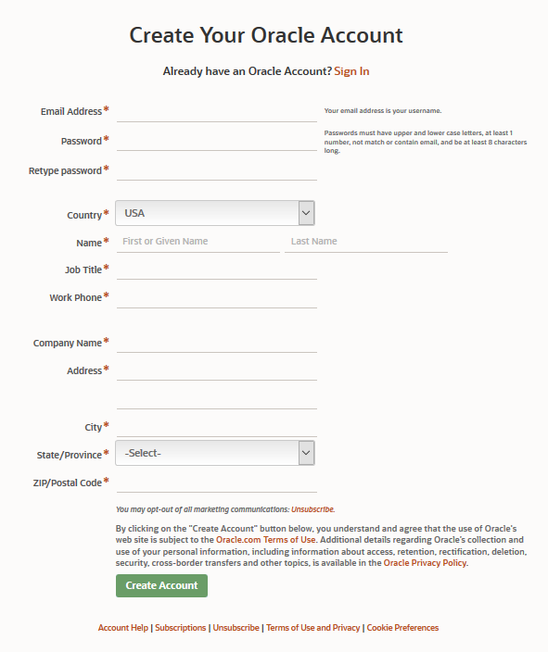
Oracle Health Sciences Support – Getting Started
Before you can access Oracle Health Sciences Support portal, you will need to have an Oracle Account.
Most users have already been setup in the Support portal. All pre-setup users will receive a Welcome email with a link to create an Oracle Account, which is a one-time registration process.
Email will come from hsgbu_outreach@rnmk.com
Complete all required fields marked with a red *
Create your Oracle Account using the same email address that you received the Welcome email.
Following successful account creation, an email will be sent to verify your email address.
Click on the “Verify Email Address” button in the email to complete the verification procedure.

Slide 39
Oracle Health Sciences Support – How to Contact Support?
Submit a Service Request for a technical issue or a non-technical question via Oracle Health Sciences Support Cloud portal: https://hsgbu.custhelp.com

Slide 40
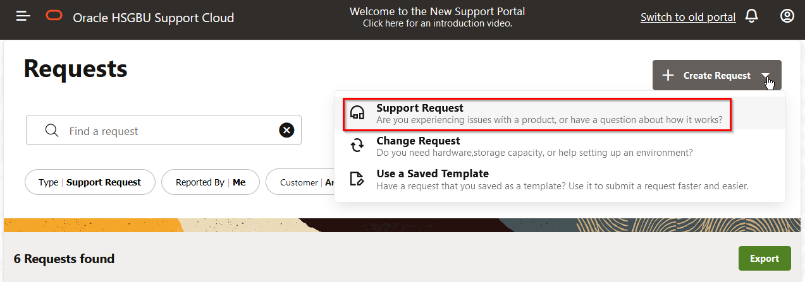
Oracle Health Sciences Support - Creating a Support Request
Go to Oracle Health Sciences Support Cloud home page: https://hsgbu.custhelp.com
On the Welcome page, click on the Log in to Oracle Health Sciences Support button.
On the Requests page, click on the ‘Create Request’ button to open a new ticket.
From the drop-down, select Support Request to report issues with a product or questions about how it works.

Slide 41
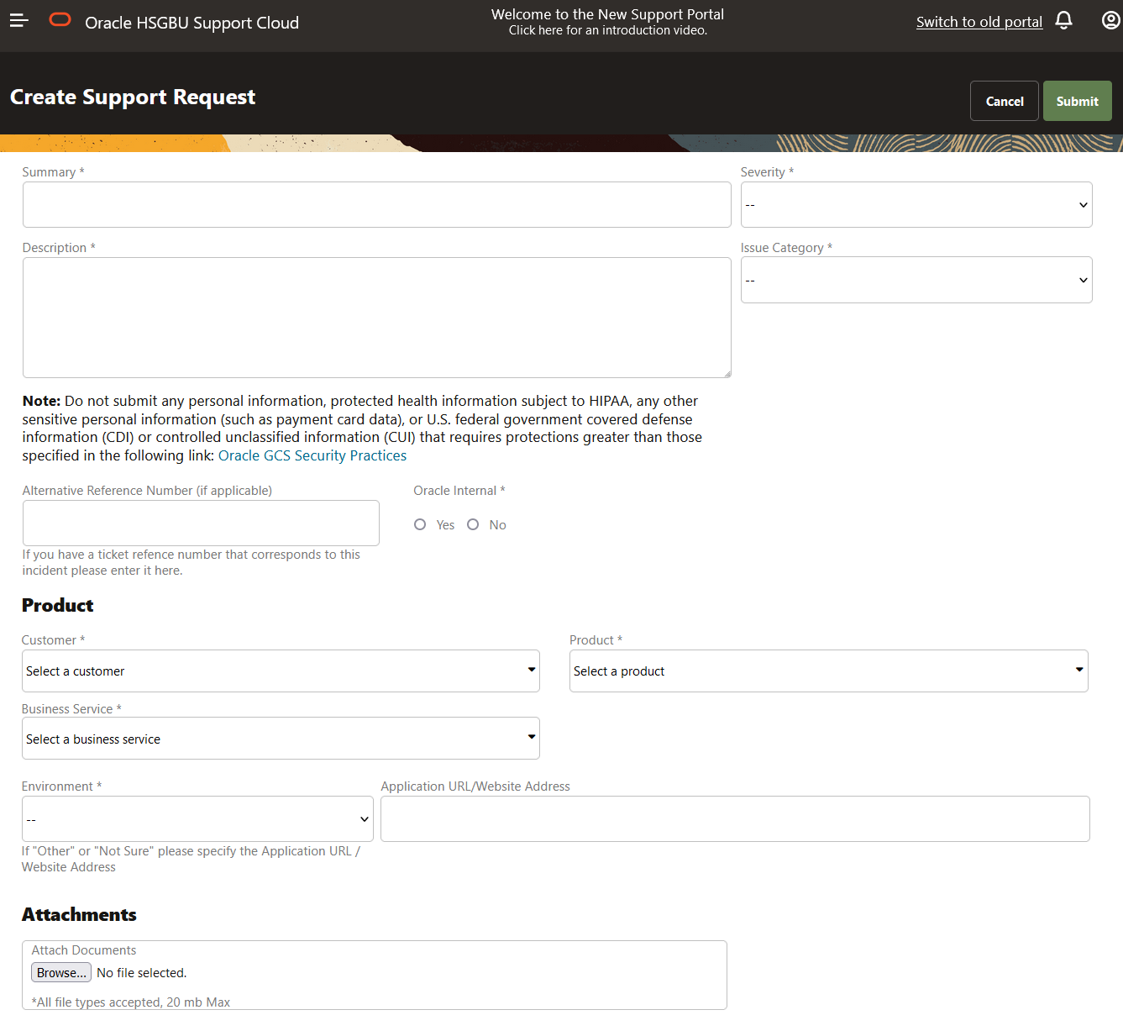
Oracle Health Sciences Support - Creating a Support Request
Complete all required fields marked with an asterisk (*)
Categorize the issue to the best of your knowledge
Describe the issue in detail to minimize back and forth
Provide file attachments where necessary
Click on Submit
You will receive an email that your Support Request has been received.
Severity Definitions:
  1 – Mission Critical Business Impact
  2 – Serious Business Impact
  3 – Minor Business Impact
  4 – No Business Impact

Slide 42
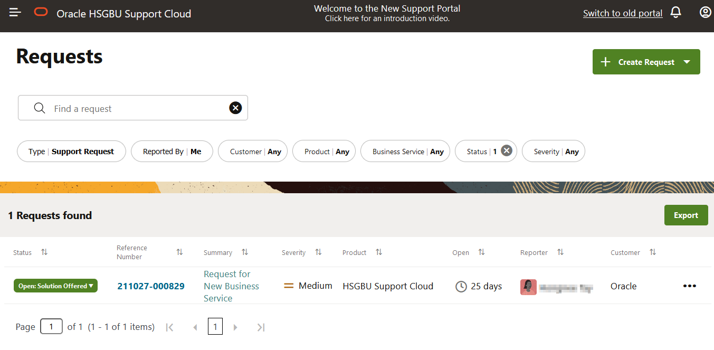
Oracle Health Sciences Support - Updating a Support Request
After logging into Health Sciences Support portal, on the Requests page, you will see all your Service Requests listed as shown below:
Click on the hyperlink under ‘Reference Number’ column to view or update your Service Request.

Slide 43
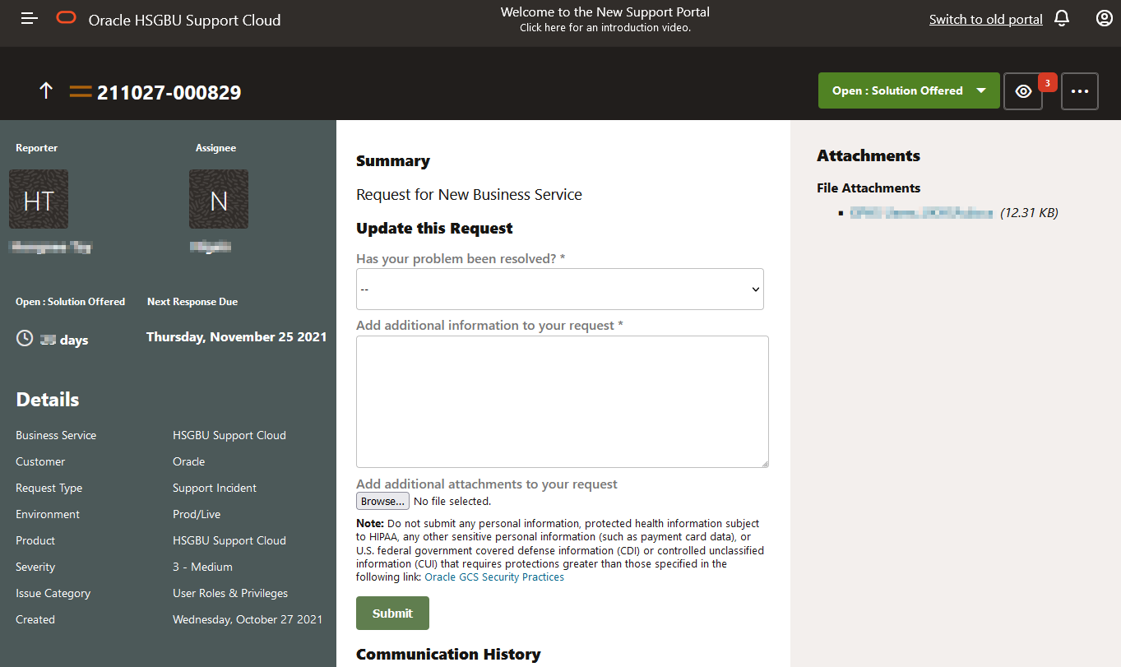
Oracle Health Sciences Support - Updating a Support Request
Answer the question ‘Has your problem been resolved?’ by selecting ‘No, I require further assistance’ and add additional information to your request.
Click ‘Submit’ to post your update to the Service Request.
Requesting SR closure is also done exactly the same way except that the answer to the question ‘Has your problem been resolved?’ should be ‘Yes, please close this ticket’.
Attachments can be added from this page at any time during the course of the SR.
All communication history between Oracle Support and customers will be visible on this page.

Slide 44
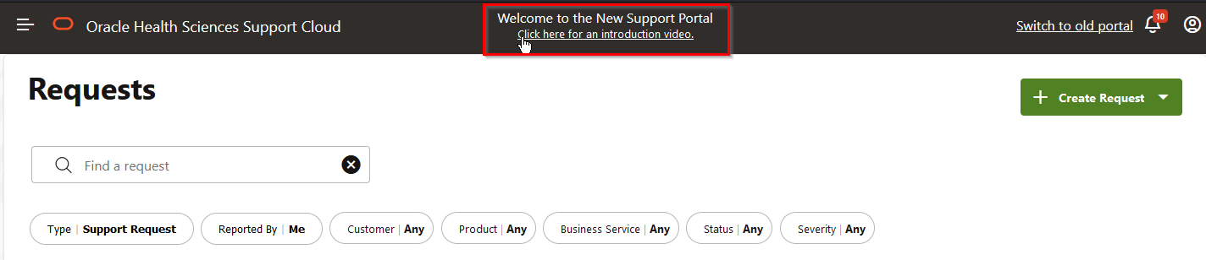
Oracle Health Sciences Support - Resources
After logging into the Health Sciences Support portal via https://hsgbu.custhelp.com
Under the heading of Welcome to the New Support Portal, there is an introduction video on how to use the Oracle Health Sciences Support portal
Refer to the Oracle Health Sciences Support Cloud Quick Reference Guide for additional information.

Slide 45
Contacts
Contact Oracle Support Cloud Portal for:
  Site Portal technical issues:
    Software bugs
    Querying and checkout issues
    Outcome code updates
Contact R3Assist@fredhutch.org for:
  General questions about the registry
    Including when to use outcome codes
  IRB/protocol questions related to the registry
  All other questions
Refer to the Data Use Agreement for contacts related to data breaches.
Contact Protocol Team for eligibility questions related to a specific protocol.

Slide 46
Questions?
Email R3Assist@fredhutch.org for any additional questions or requests for assistance.

Slide 47
Thank You!

