Slide 1





HIV Prevention Research Tools
Presenters:
Subtitle will go here
Notes:
No Participant Guide page.
Welcome participants to the course. Tell participants to sit down anywhere they will be comfortable.
Thank participants for coming to the workshop. Remind participants that the course will be more interesting and fun if they ask questions and share their experiences.
Distribute a copy of the Participant Guide to each attendee. Tell participants they can write their names on their copy, that the Participant Guide is a reference for the workshop and includes space for them to take notes during the workshop.
Explain that the Participant Guide contains a lot of information. Ask participants to look at the Table of Contents and review with them the topics covered in the course. Then show participants the Glossary at the back of the Participant Guide.

Slide 2

HIV Prevention Tools and How They ARE Used in HIV Prevention Research
This project was supported through Federal funds from the Division of AIDS (DAIDS), National Institute of Allergy and Infectious Diseases, National Institutes of Health, Department of Health and Human Services Grant # UM01 AI068614: “Leadership Group for a Global HIV Vaccine Clinical Trials (Office of HIV/AIDS Network Coordination) and the NorthEast Two-Spirit Society.”
Notes:
Participant Guide page 15.
Review the content on the slide.

Slide 3
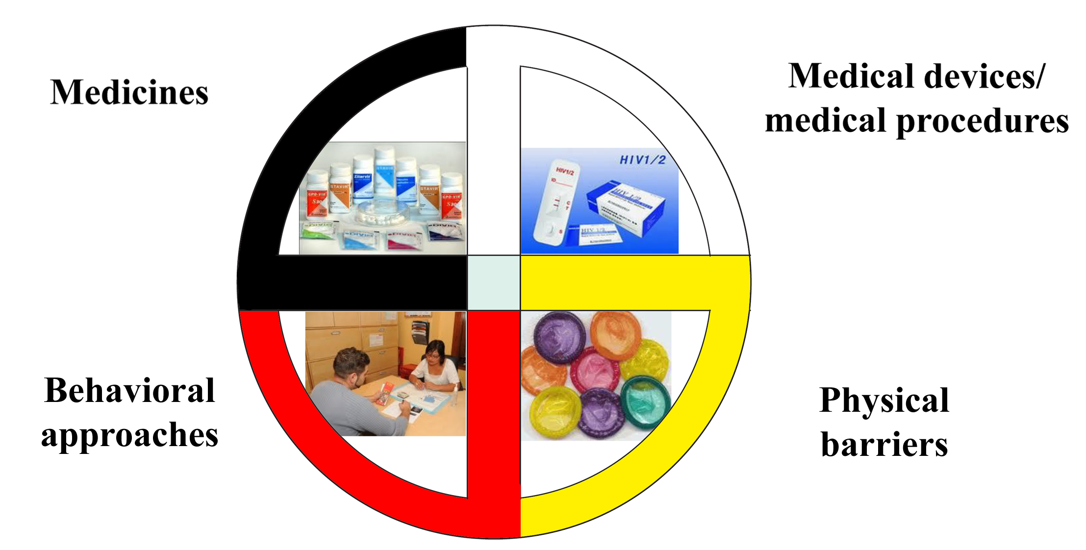
Introduction
HIV prevention includes: medicines, medical devices, medical procedures, physical barriers, and behavioral approaches.
Notes:
Participant Guide page 4.
Review the content on the slide.

Slide 4
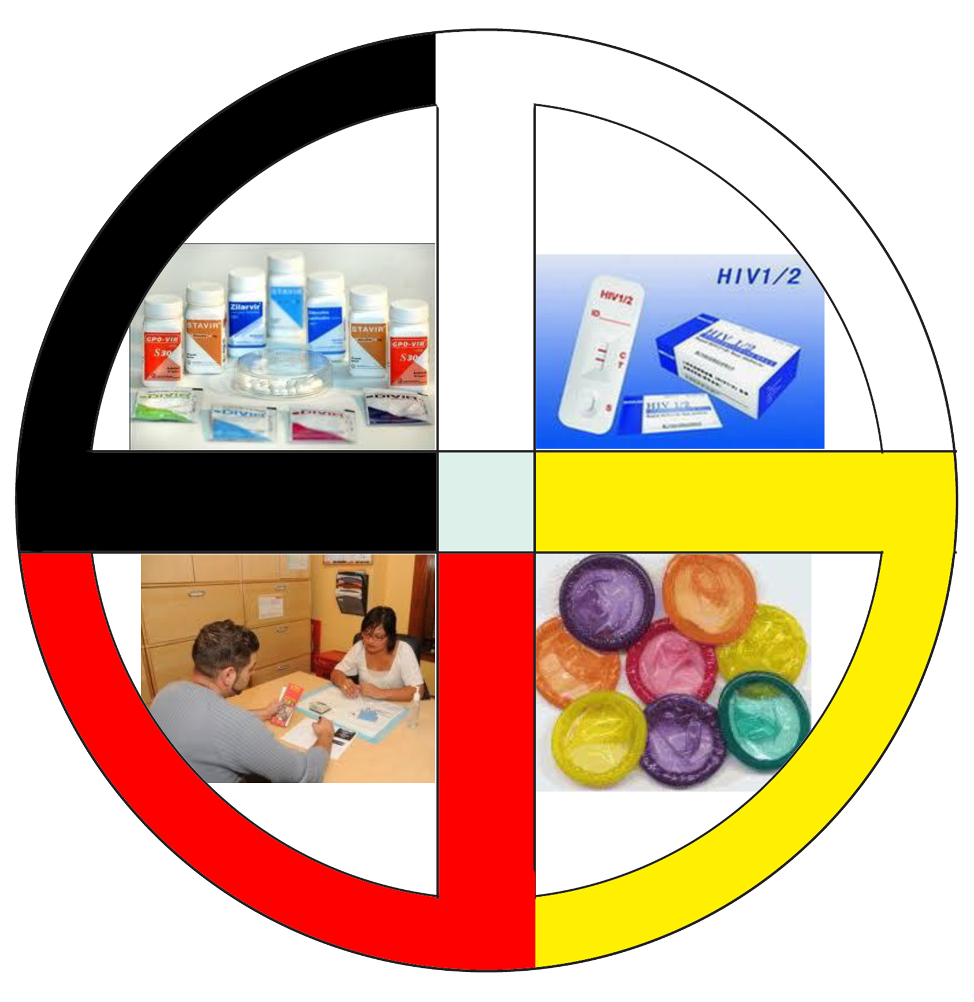
Introduction, continued
Comprehensive HIV prevention includes multiple approaches instead of just one or two approaches.
Notes:
Participant Guide page 4.
Tell participants after reviewing the slide content: Combination prevention incorporates biomedical, behavioral, and other interventions all designed to reduce HIV acquisition. This kind of comprehensive and combination HIV prevention is referred to as “high-impact HIV prevention.”
Review the content on the slide.

Slide 5


Introduction, continued
No one HIV prevention approach will be acceptable to all people.
Research is critical to develop and test new prevention options that offer people more choices.
The best option for one person may not be the best for others.
Notes:
Participant Guide page 4.
Read the content on the slide as the animated sections are revealed. Add the following information for each of the sections:
Treatment options: HIV vulnerability varies for each person and over time. Therefore, it is important that people have options for HIV prevention so they can choose the approach that is the best fit for them.
Question mark: Choosing the right HIV prevention option may depend on cost, availability, ease of use, or needing the consent of a partner.
Research: Finding clinical research participants who are willing and able to meet the rigorous clinical trial requirements is also important, and they must be able to stay in the clinical trial for the full duration.
Tell participants after reviewing the slide content: HIV prevention methods also need to be supported by the community at the local, tribal, and national levels.

Slide 6
The HIV Combination Prevention Toolbox
The toolbox is organized into two sections:
Tools and approaches that are “medical” in nature
Tools and approaches that are “behavioral” in nature
Notes:
Participant Guide page 6.
Note: If applicable (this section may be delivered as a stand-alone section), remind participants that we talked a little bit about medical and behavioral research earlier (in the What Is Clinical Research? Section). Now we’ll talk about specific tools in the toolbox.
Tell participants before reviewing the slide content: We have divided the combinations of interventions that can be used to prevent HIV infection into medical (meaning ones that generally would require a prescription or use of a biological product) and behavioral/physical barriers (meaning ones that are within the direct control of the person and hopefully readily available). It should be emphasized that all of these interventions are generally used in combination and all involve some behavioral activity on the part of the user. Most of the HIV prevention research being conducted by the NIH HIV/AIDS Clinical Trials Networks involves some type of medical intervention in combination with behavioral components. The HIV combination prevention toolbox shows this kind of combination of approaches. The toolbox is organized into two sections…
Add the following to “Tools and approaches that are “medical” in nature”: including medicines, medical devices, and medical procedures.
Add the following to “Tools and approaches that are “behavioral” in nature”: including risk reduction counseling and effective behavioral interventions.

Slide 7

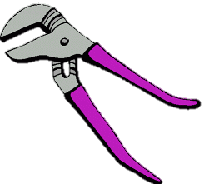
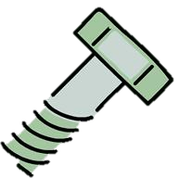








The HIV Combination Prevention Toolbox
Vaccines
Post-Exposure Prophylaxis (PEP)
Treatment as Prevention (TasP)
HIV Prevention Toolbox
Pre-Exposure Prophylaxis (PrEP)
Microbicides
Diagnosis and treatment of sexually transmitted infections (STIs)
Prevention of perinatal transmission (PMTCT)
Medical
Harm reduction
Education
Voluntary Medical Penile Circumcision (VMMC)
Needle exchange programs
Condoms and other barrier methods
Treatment/
prevention of drug/
alcohol abuse
Behavioral/Physical Barriers
Notes:
Participant Guide page 6.
Review the toolbox graphic on the slide.
Medical HIV prevention tools include:
Post-exposure prophylaxis (PEP): Taking anti-HIV drugs as soon as possible after exposure to HIV.
Pre-exposure prophylaxis (PrEP): a biomedical prevention approach for people who do not have HIV; they take medication before exposure to HIV to reduce their likelihood of acquiring HIV.
Prevention of perinatal transmission (PMTCT): Interventions to reduce infant exposure to HIV during pregnancy, labor, and breastfeeding. Note that this is sometimes known as “prevention of mother-to-child transmission,” but many find this term stigmatizing and prefer terms like “perinatal” or “vertical,” which remove the implication of blame. We have left the acronym PMTCT because many are still familiar with it.
Vaccines: A substance that teaches the body’s immune system to recognize and protect against a disease caused by an infectious agent or virus, often by stimulating the body to produce antibodies to that infection.
Treatment as Prevention: a medical prevention approach that uses antiretroviral treatment for people with HIV to decrease their chance of transmitting HIV, ideally to zero chance under conditions of viral suppression (undetectable)
Microbicides: Products being developed and tested for use in the vagina or rectum to reduce the likelihood of HIV transmission during vaginal and anal sex
Sexually Transmitted Infections (STIs) Diagnosis and Treatment: having an STI can increase one’s likelihood of contracting HIV, so treatment of STIs is important for HIV prevention.
Tell participants after reviewing the graphic: Some of these prevention tools are approved for use and some are still being tested. Research is under way.
Information related to the optional quiz (treatment as prevention): Q15: True.
Q: Many people living with HIV around the world are virally suppressed, meaning their medications have succeeded in reducing the amount of HIV in the body to levels such that a regular HIV test can no longer detect the virus. People with viral suppression cannot transmit HIV to their sex partners, even if they don't use a condom.
A: When people living with HIV take anti-retroviral medications, they can become virally suppressed. Viral suppression means that the medications are working to reduce the amount of HIV in the body to undetectable levels. Estimates indicate that more than 40% of the world's people living with HIV are virally suppressed. Studies have shown that people with viral suppression cannot transmit HIV to their sex partners—not even through acts of condomless sex. Because anti-retroviral treatment for people living with HIV can prevent HIV transmission in this way, we call it “Treatment as Prevention” (TasP). Many scientists around the world, including those at the National Institutes of Health and the Centers for Disease Control and Prevention, agree that there is zero chance of HIV transmission through sex under conditions of viral suppression.

Slide 8
Introduction
Vaccines
Post-Exposure Prophylaxis (PEP)
Treatment as Prevention (TasP)
HIV Prevention Toolbox
Pre-Exposure Prophylaxis (PrEP)
Microbicides
Diagnosis and treatment of sexually transmitted infections (STIs)
Prevention of perinatal transmission (PMTCT)
Medical
Harm reduction
Education
Voluntary Medical Penile Circumcision (VMMC)
Needle exchange
Condoms and other barrier methods
Treatment/
prevention of drug/
alcohol abuse
Behavioral/Physical Barriers
Notes:
Participant Guide page 16.
Tell participants before reviewing the slide content: We call these medical prevention tools “modalities.”
Remind participants that:
They just saw this graphic introduced to all of the prevention techniques.
Just because we’re only talking about PrEP & TasP, vaccines, and microbicides here doesn’t mean they should forget about the other prevention methods.
We said earlier that education and a combination of prevention approaches improves effectiveness.
Tell participants after reviewing the slide content: Participation in research can lead to intervention and prevention.

Slide 9
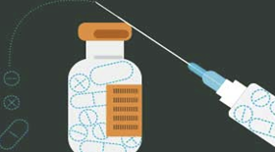
Pre-Exposure Prophylaxis
(PrEP)
www.bethegeneration.org
Notes:
Participant Guide page 19.
Review the content on the slide.

Slide 10
Introduction
Vaccines
Post-Exposure Prophylaxis (PEP)
Treatment as Prevention (TasP)
HIV Prevention Toolbox
Pre-Exposure Prophylaxis (PrEP)
Microbicides
Diagnosis and treatment of sexually transmitted Infections (STIs)
Prevention of perinatal Transmission (PMTCT)
Medical
Harm Reduction
Education
Voluntary Medical Penile Circumcision (VMMC)
Needle exchange programs
Condoms and other barrier methods
Treatment/
prevention of drug/
alcohol abuse
Behavioral/Physical Barriers
Notes:
Participant Guide page 19.
Tell participants before reviewing the slide content: We said earlier that education and a combination of prevention approaches improves prevention effectiveness. The HIV combination prevention toolbox shows the importance of both medical and behavioral/physical tools. Combining multiple tools may provide the best method for HIV prevention. It is recommended that people who are prescribed PrEP also receive counseling as part of a comprehensive HIV prevention package and consistently use condoms.

Slide 11
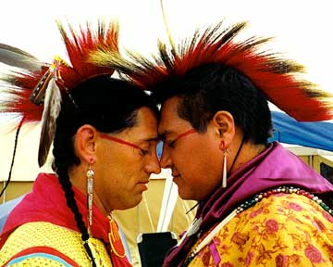
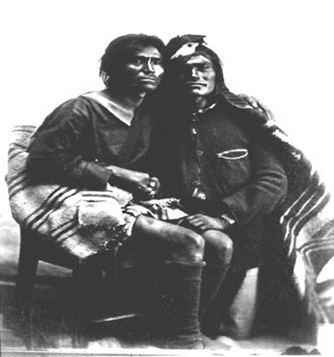
Introduction
The PrEP prevention approach is focused on people who do not have HIV, but may acquire HIV through sexual contact and/or injection drug use (IDU).
With PrEP, people who do not have HIV take a medication.
The medication lowers their likelihood of contracting HIV through sexual contact as well as IDU. .
Notes:
Participant Guide page 19.
Each of the following modalities stand alone in terms of content and can be pulled out, as needed. If presenting a modality outside of the main context of the training, discuss the toolbox graphic as an introduction. There is repetition of the graphic and some text to ensure that each modality stands alone. Repetition of the graphic is designed to remind participants which modality is being discussed and serve as a reminder of the toolbox.
Tell participants after reviewing the last bullet:
This approach is only effective if the medication is taken exactly as prescribed on a consistent, daily basis.
The idea of PrEP is not new. It is the same idea behind taking birth control pills to prevent pregnancy or taking anti-malarial drugs before traveling to areas where malaria is an issue. People can be healthy but still taking a daily medication to avoid a specific health problem, such as HIV.
PrEP is only available by prescription.
Information related to the optional quiz (referring to injection drug use (IDU)): Q10: False.
Q: PrEP is an HIV prevention method intended for use by people living with HIV.
A: PrEP is an HIV prevention strategy in which HIV‐negative people are prescribed antiretroviral medication to reduce their chances of contracting HIV. However, PrEP is meaningful for people living with HIV too; it has been shown to be an effective HIV prevention method for mixed-status partners to help HIV-negative partners stay negative. Truvada® was the first pill approved by the U.S. Food and Drug Administration as daily oral PrEP in 2012, and Descovy® was the second in 2019. Other medications are being researched as PrEP.
Information related to the optional quiz included in the Participant Guide (referring to the importance of taking medication exactly as prescribed on a consistent, daily basis): Q8: False.
Q: PrEP is a way to prevent HIV by taking HIV treatment medication after exposure to the virus.
A: Among the many ways to prevent HIV, two strategies sound very similar but are quite different: PrEP versus PEP.
PrEP stands for Pre‐Exposure Prophylaxis. It involves prescribing anti-HIV medications to people who are HIV-negative before they are exposed to HIV. People who are vulnerable to contracting HIV who take PrEP every day as prescribed greatly lower their likelihood of contracting HIV.
PEP stands for Post-exposure prophylaxis. This involves taking antiretroviral medicine after being potentially exposed to HIV to prevent the virus from establishing itself in the body. PEP must be started within 72 hours after a possible exposure to HIV.
PrEP and IDU: a study in Thailand showed a reduction in HIV contraction among PWID. Research in this area has not been extensive, but CDC recommends PrEP for people vulnerable to contracting HIV through IDU.

Slide 12
PEP vs. PrEP
HIV Exposure
PrEP: treatment before exposure
PEP: treatment after exposure
Notes:
Participant Guide page 20.
Among the many ways to prevent HIV, two strategies sound very similar but are quite different: PrEP versus PEP.
PrEP stands for Pre‐Exposure Prophylaxis. It involves prescribing anti-HIV medications to people who are HIV-negative before they are exposed to HIV. People who are vulnerable to contracting HIV who take PrEP every day as prescribed greatly lower their likelihood of contracting HIV.
PEP stands for Post-exposure prophylaxis. This involves taking antiretroviral medicine after being potentially exposed to HIV to prevent the virus from establishing itself in the body. PEP must be started within 72 hours after a possible exposure to HIV.
For more info and helpful videos explaining the differences between PrEP and PEP, see: http://www.fredhutch.org/en/research/divisions/vaccine-infectious-disease-division/research/immunology-and-vaccine-development/be-the-generation/prep-tasp.html

Slide 13
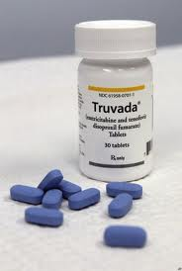
PrEP Progress
One major milestone in HIV prevention was the first approval of daily oral PrEP in the United States. This happened for the first time in 2012, marketed under the brand name Truvada®. Truvada® is a combination of two antiretroviral drugs:
Tenofovir disoproxil fumarate (also called TDF)
Emtricitabine (also called FTC)
Notes:
Participant Guide page 20.
Tell participants before reviewing the slide content: PrEP research focuses on using medications combined with other HIV prevention methods, including consistent use of condoms.
Review the content on the slide.
In October 2019, the US FDA approved another option for PrEP called Descovy, which contains a slightly different formulation of drugs than Truvada. Both are equally effective at preventing HIV. We will focus on Truvada instead of Descovy because Truvada is approved for anyone vulnerable to HIV acquisition, while Descovy has limited approval (i.e. it is not approved for people vulnerable to HIV acquisition through receptive vaginal sex, and it is not approved for preventing transmission through any routes except sexually). There are sure to be more options for PrEP approved in years to come.

Slide 14
HIV Prevention Using Oral PrEP
Truvada® (also known as TDF/FTC) is FDA-approved for daily use for HIV prevention.
Truvada® should be taken as prescribed to be effective as PrEP.
It is recommended that people who are prescribed PrEP continue to use condoms to prevent other STIs.
Notes:
Participant Guide page 21.
Review the content on the slide.
Add the following information for the bullets:
Truvada® (also known as TDF/FTC) is FDA-approved for daily use for HIV prevention: For HIV treatment, Truvada® is approved only in combination with other ARVs.
It is recommended that people who are prescribed PrEP continue to use condoms. Like any prevention modality (including condoms), PrEP is not 100% effective in preventing HIV, and it does not prevent the transmission of other sexual transmitted infections such as syphilis or gonorrhea.

Slide 15
HIV Prevention Using Oral PrEP
How Truvada® as PrEP works
Truvada® is an oral pill consisting of two antiretroviral medications (ARVs) that protects people who do not have HIV if they are exposed to the virus
ARVs block HIV replication in multiple places in the reproductive cycle of the virus
Notes:
Participant Guide page 21.
Tell participants before reviewing the slide content: While the availability of Truvada® as a prescription for use as PrEP is a major breakthrough, there are still limitations, and there are very specific guidelines for use.
Continue reviewing the guidelines for using Truvada®.

Slide 16
HIV Prevention Using Oral PrEP
Who should use Truvada® for HIV prevention?
Anyone who could acquire HIV, including…
Male-assigned Two-Spirit or Native men who have sex with men
Transgender women who have sex with cisgender men
Couples where one partner has HIV and the other does not
People who use injection drugs
Notes:
Participant Guide page 21.
Continue reviewing the guidelines for using Truvada®.
Presenters should be prepared to check for updated information and data on the UNAIDS, CDC, NAID, and NIAID websites and provide updates, as needed.

Slide 17
HIV Prevention Using Truvada®
Requirements for use
Be HIV-negative
Test for HIV at least every three months while taking Truvada®
Take Truvada® as prescribed to achieve the maximum HIV prevention benefit
Notes:
Participant Guide page 21.
Continue reviewing the guidelines for using Truvada®.
Add the following information: To get Truvada®, one must initiate a conversation with their doctor.

Slide 18
PrEP Continuing Research
Research in more countries and populations
Different drugs, delivery methods, and dosing schedules
Implementation research to understand PrEP in “real world” settings
Some of the goals of ongoing PrEP research include:
Notes:
Participant Guide page 22.
Tell participants before reviewing the slide content: Although PrEP has now been approved in the U.S., ongoing PrEP research is still needed. There is currently research of different oral dosing strategies, long-acting injectables, implants, and other drugs that could be used as PrEP.
Tell participants after the last section of the Implementation research part of the graphic is revealed: This research will not only continue to examine the effectiveness of PrEP, but will also examine the factors that may impact access to PrEP and decisions to use this HIV prevention tool within various groups of people, such as young men who have sex with men (YMSM).

Slide 19
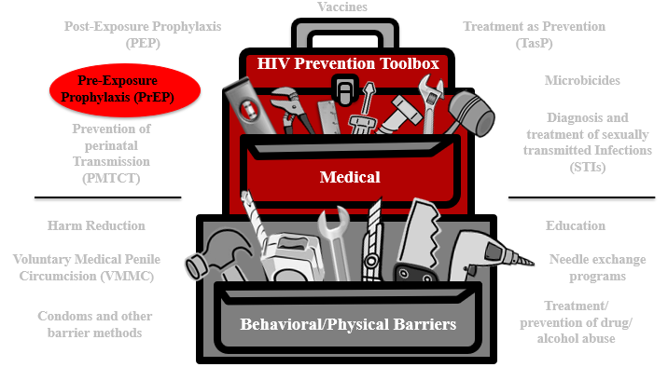
PrEP Summary
PrEP is a medical HIV prevention approach for people who don’t have HIV but are vulnerable to HIV.
Oral Truvada® was the first drug approved for PrEP and involves taking medication on a daily basis to reduce the likelihood of contracting HIV through sex or injection drug use.
Researchers are studying new PrEP approaches like injectables and implants that would last much longer than daily-dose pills.
Notes:
Participant Guide page 24.
Review the content on the slide.
Tell participants after reviewing the slide content: The HIV combination prevention toolbox reinforces the role of PrEP combined with other behavioral/physical tools. Combining multiple tools may provide the best method for HIV prevention.

Slide 20
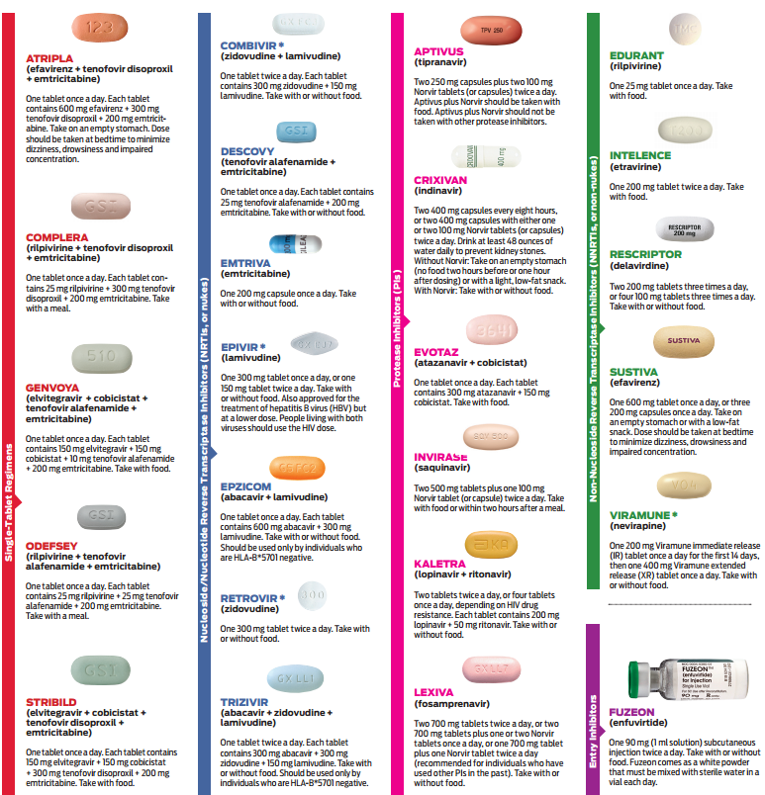
Treatment as Prevention
(TasP)
Notes:
Participant Guide P. 25

Slide 21
Introduction
Vaccines
Post-Exposure Prophylaxis (PEP)
Treatment as Prevention (TasP)
HIV Prevention Toolbox
Pre-Exposure Prophylaxis (PrEP)
Microbicides
Diagnosis and treatment of sexually transmitted Infections (STIs)
Prevention of perinatal Transmission (PMTCT)
Medical
Harm Reduction
Education
Voluntary Medical Penile Circumcision (VMMC)
Needle exchange programs
Condoms and other barrier methods
Treatment/
prevention of drug/
alcohol abuse
Behavioral/Physical Barriers
Notes:
Participant Guide page 25.
Tell participants before reviewing the slide content: We just talked about PrEP. Now let’s talk about another highly effective HIV prevention method: Treatment as Prevention, or “TasP.”
Tell participants after reviewing the slide content: While PrEP is only to be used by people who do not have HIV, TasP is an approach for people living with HIV to reduce the likelihood of passing HIV to others.

Slide 22
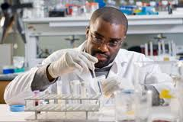
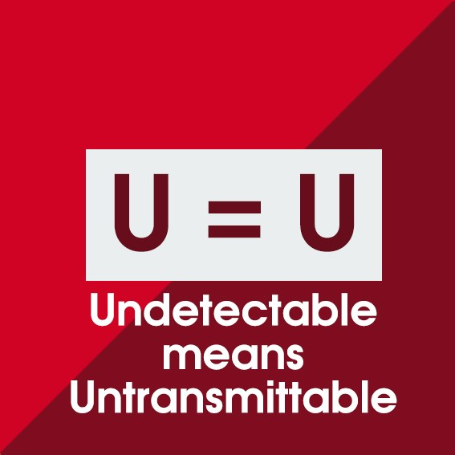

Introduction
The TasP prevention approach is focused on people living with HIV.
With TasP, people with HIV take medication.
The medication controls the HIV in their bodies and keeps them healthy.
The medication also lowers their likelihood of transmitting HIV to others.
Notes:
Participant Guide page 25.
Both PrEP and TasP involve people taking anti-HIV medications. The difference is that people who are HIV-negative take medications in the PrEP approach to lower their likelihood of getting HIV, while people who are living with HIV take medications to treat their condition, which also results in a reduction in the likelihood of HIV transmission to others. This is why we call it “Treatment as Prevention,” or “TasP.”
As discussed previously in the history of HIV, we have had effective combination anti-retroviral therapies for treating HIV since 1996. Today, many people with HIV take only one pill a day to successfully treat HIV and live healthy lives with life expectancy nearly equal to that of people who do not have HIV. There are now many different options for drug regimens prescribed to treat HIV, and the main purpose of anti-retroviral therapy is to control the amount of HIV in the body to keep the immune systems of people with HIV healthy, protecting against opportunistic infections and the development of AIDS. Additionally, we have learned through clinical research that ART is also highly effective in preventing the transmission of HIV to others. By successfully treating HIV in people living with the virus, we are also preventing new transmissions. This is why we call it Treatment as Prevention (TasP).

Slide 23
The Treatment Cascade in the U.S.
1.1 million people with HIV
935,000 (85%) know their status
682,000 (62%) have started HIV medical care
528,000 (48%) have stayed in HIV medical care
539,000
(49%)
-CDC, 2017
(https://www.cdc.gov/nchhstp/newsroom/2017/HIV-Continuum-of-Care.html)
…have a suppressed viral load (<200 copies/ml)
Notes:
Participant Guide page 27.
The research findings about TasP have helped us to better understand the importance of the treatment cascade. About half of the people living with HIV in the US have a suppressed viral load, which means they cannot transmit HIV to others as long as their viral load stays suppressed. The better we can help more people know their status, link them to HIV care, start ART, and achieve viral suppression, not only will we help people with HIV stay healthy, but we will also drastically reduce rates of new HIV transmissions.
Adding PrEP into the landscape for people who do not have HIV but are vulnerable to getting it has the potential to turn around the trajectory of the epidemic. Remember that there is an entire combination HIV prevention toolbox including biomedical and behavioral interventions; using multiple strategies in combination has the best chance of ending the epidemic.
This approach is most effective if the medication is taken exactly as prescribed.
The gold standard for effective ART is called “viral suppression,” also referred to as “undetectable.” This means that the ART is working such that the amount of virus in the body is reduced so low that an average HIV test can no longer detect the virus. Under this condition of viral suppression, HIV cannot be transmitted!

Slide 24
Continuing Research: Treatment as Prevention
Develop products that:
Are/are not ARV-based
Conduct more research on:
Drug resistance
Understand issues around:
Address adherence issues
Reach the most vulnerable populations
Alternate dosing
Delivery methods (for example, injections and implants)
ART access and availability
Cost
Barriers to linkage and retention in HIV medical care
Stigma
Notes:
Participant guide page 28.
Research into treatment for people with HIV continues, including research looking specifically at treatment as prevention. We know that only about half of people with HIV in the US have reached viral suppression, so additional strategies are needed to improve treatment. If every person with HIV in the US could reach viral suppression, we could effectively end the sexual transmission of HIV. But that is not the world we currently live in; we need a multitude of products, dosing, delivery methods, and so forth because no single product will be right for everyone.

Slide 25
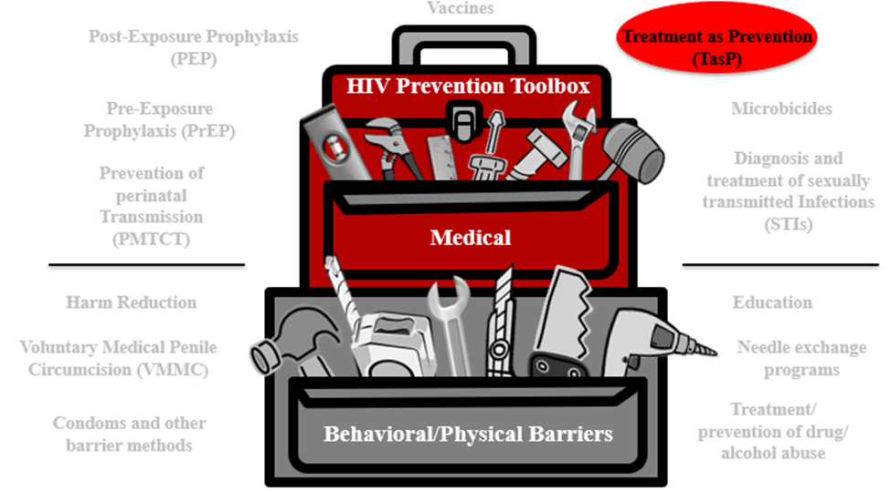
TasP Summary
TasP is a medical HIV prevention approach for people with HIV to reduce the likelihood of transmission to others.
Many treatment options are available for TasP, but gaps persist in the HIV treatment cascade.
Researchers are studying new treatment approaches to address these gaps like injectable ART and ART implants.
Notes:
Participant Guide page 29.
Review the content on the slide.
Tell participants after reviewing the slide content: The HIV combination prevention toolbox reinforces the role of TasP combined with other behavioral/physical tools. Combining multiple tools may provide the best method for HIV prevention.

Slide 26

Continuing Research: PrEP & Integrated Strategies
A number of public and private organizations, in partnership and individually, are working together to find solutions that can help prevent HIV.
The HIV Prevention Trials Network (HPTN), funded by the National Institute of Allergy and Infectious Diseases (NIAID), National Institute of Mental Health (NIMH), and the National Institute of Drug Abuse (NIDA) is dedicated to discover and develop new and innovative research strategies to reduce the acquisition and transmission of HIV.
Notes:
Participant Guide page 29.
Review the content on the slide.
Together, PrEP and TasP have the potential to end the HIV epidemic as we know it. However, the PrEP and TasP approaches we currently have are not reaching those who need them most. Research continues to strive to find improved PrEP and TasP methods to end the epidemic.

Slide 27
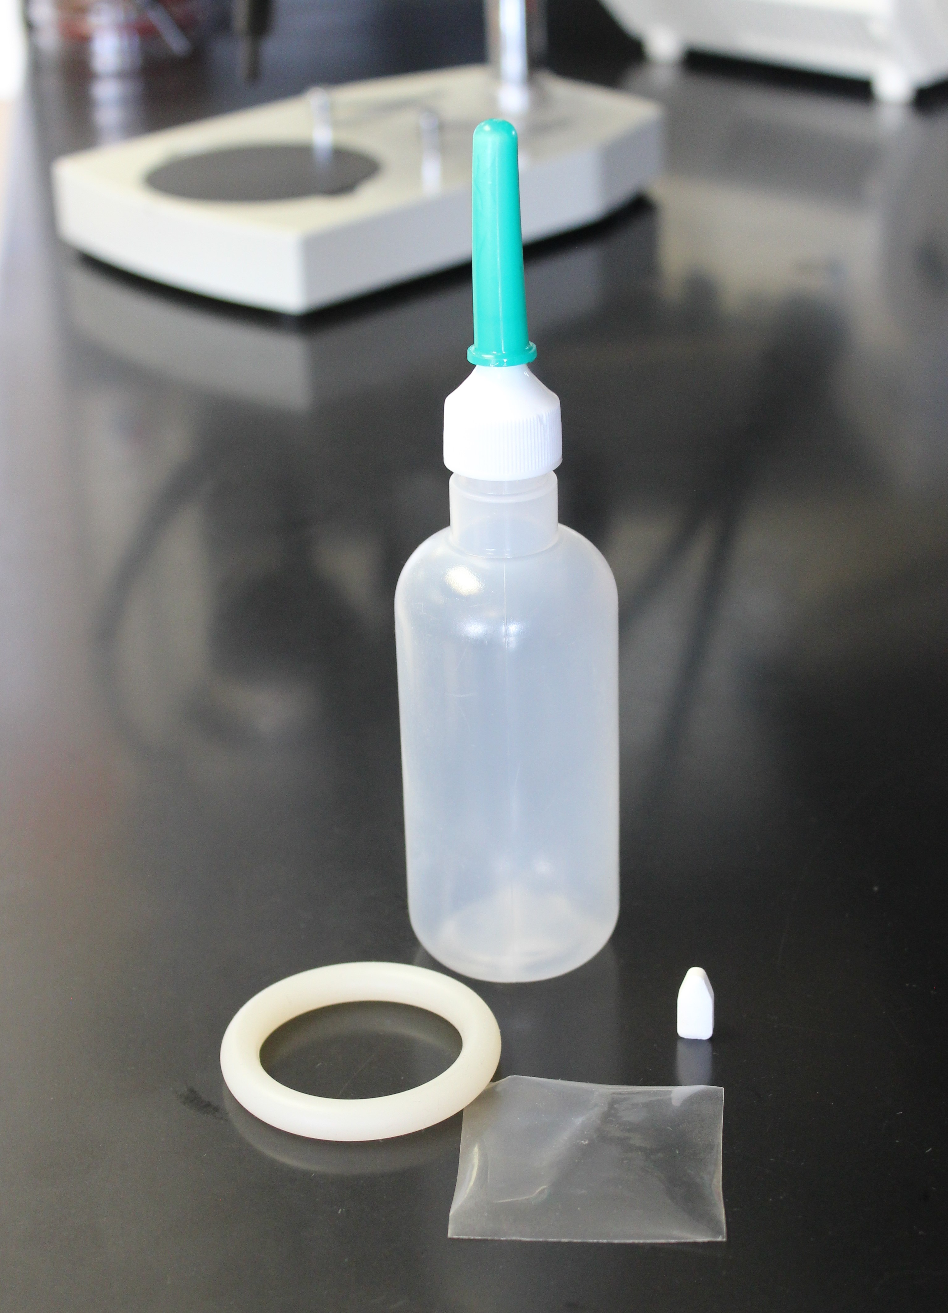
Microbicides
www.bethegeneration.org
Notes:
Participant Guide page 31.
Introduce the next modality: Microbicides.

Slide 28
Introduction
Vaccines
Post-Exposure Prophylaxis (PEP)
Treatment as Prevention (TasP)
HIV Prevention Toolbox
Pre-Exposure Prophylaxis (PrEP)
Microbicides
Diagnosis and treatment of sexually Transmitted Infections (STIs)
Prevention of perinatal transmission (PMTCT)
Medical
Harm reduction
Education
Voluntary Medical Penile Circumcision (VMMC)
Needle exchange programs
Condoms and other barrier methods
Treatment/
prevention of drug/
alcohol abuse
Behavioral/Physical Barriers
Notes:
Participant Guide page 31.
Tell participants after reviewing the slide content: Just because we’re only talking about biomedical HIV prevention doesn’t mean you should forget about the other prevention methods.
We said earlier that education and a combination of prevention approaches improves effectiveness, which includes combination prevention.
Participation in research can lead to intervention and prevention.
Tell participants after reviewing the slide content: The HIV combination prevention toolbox shows the importance of both medical and behavioral/physical tools. Combining multiple tools may provide the best method for HIV prevention.

Slide 29
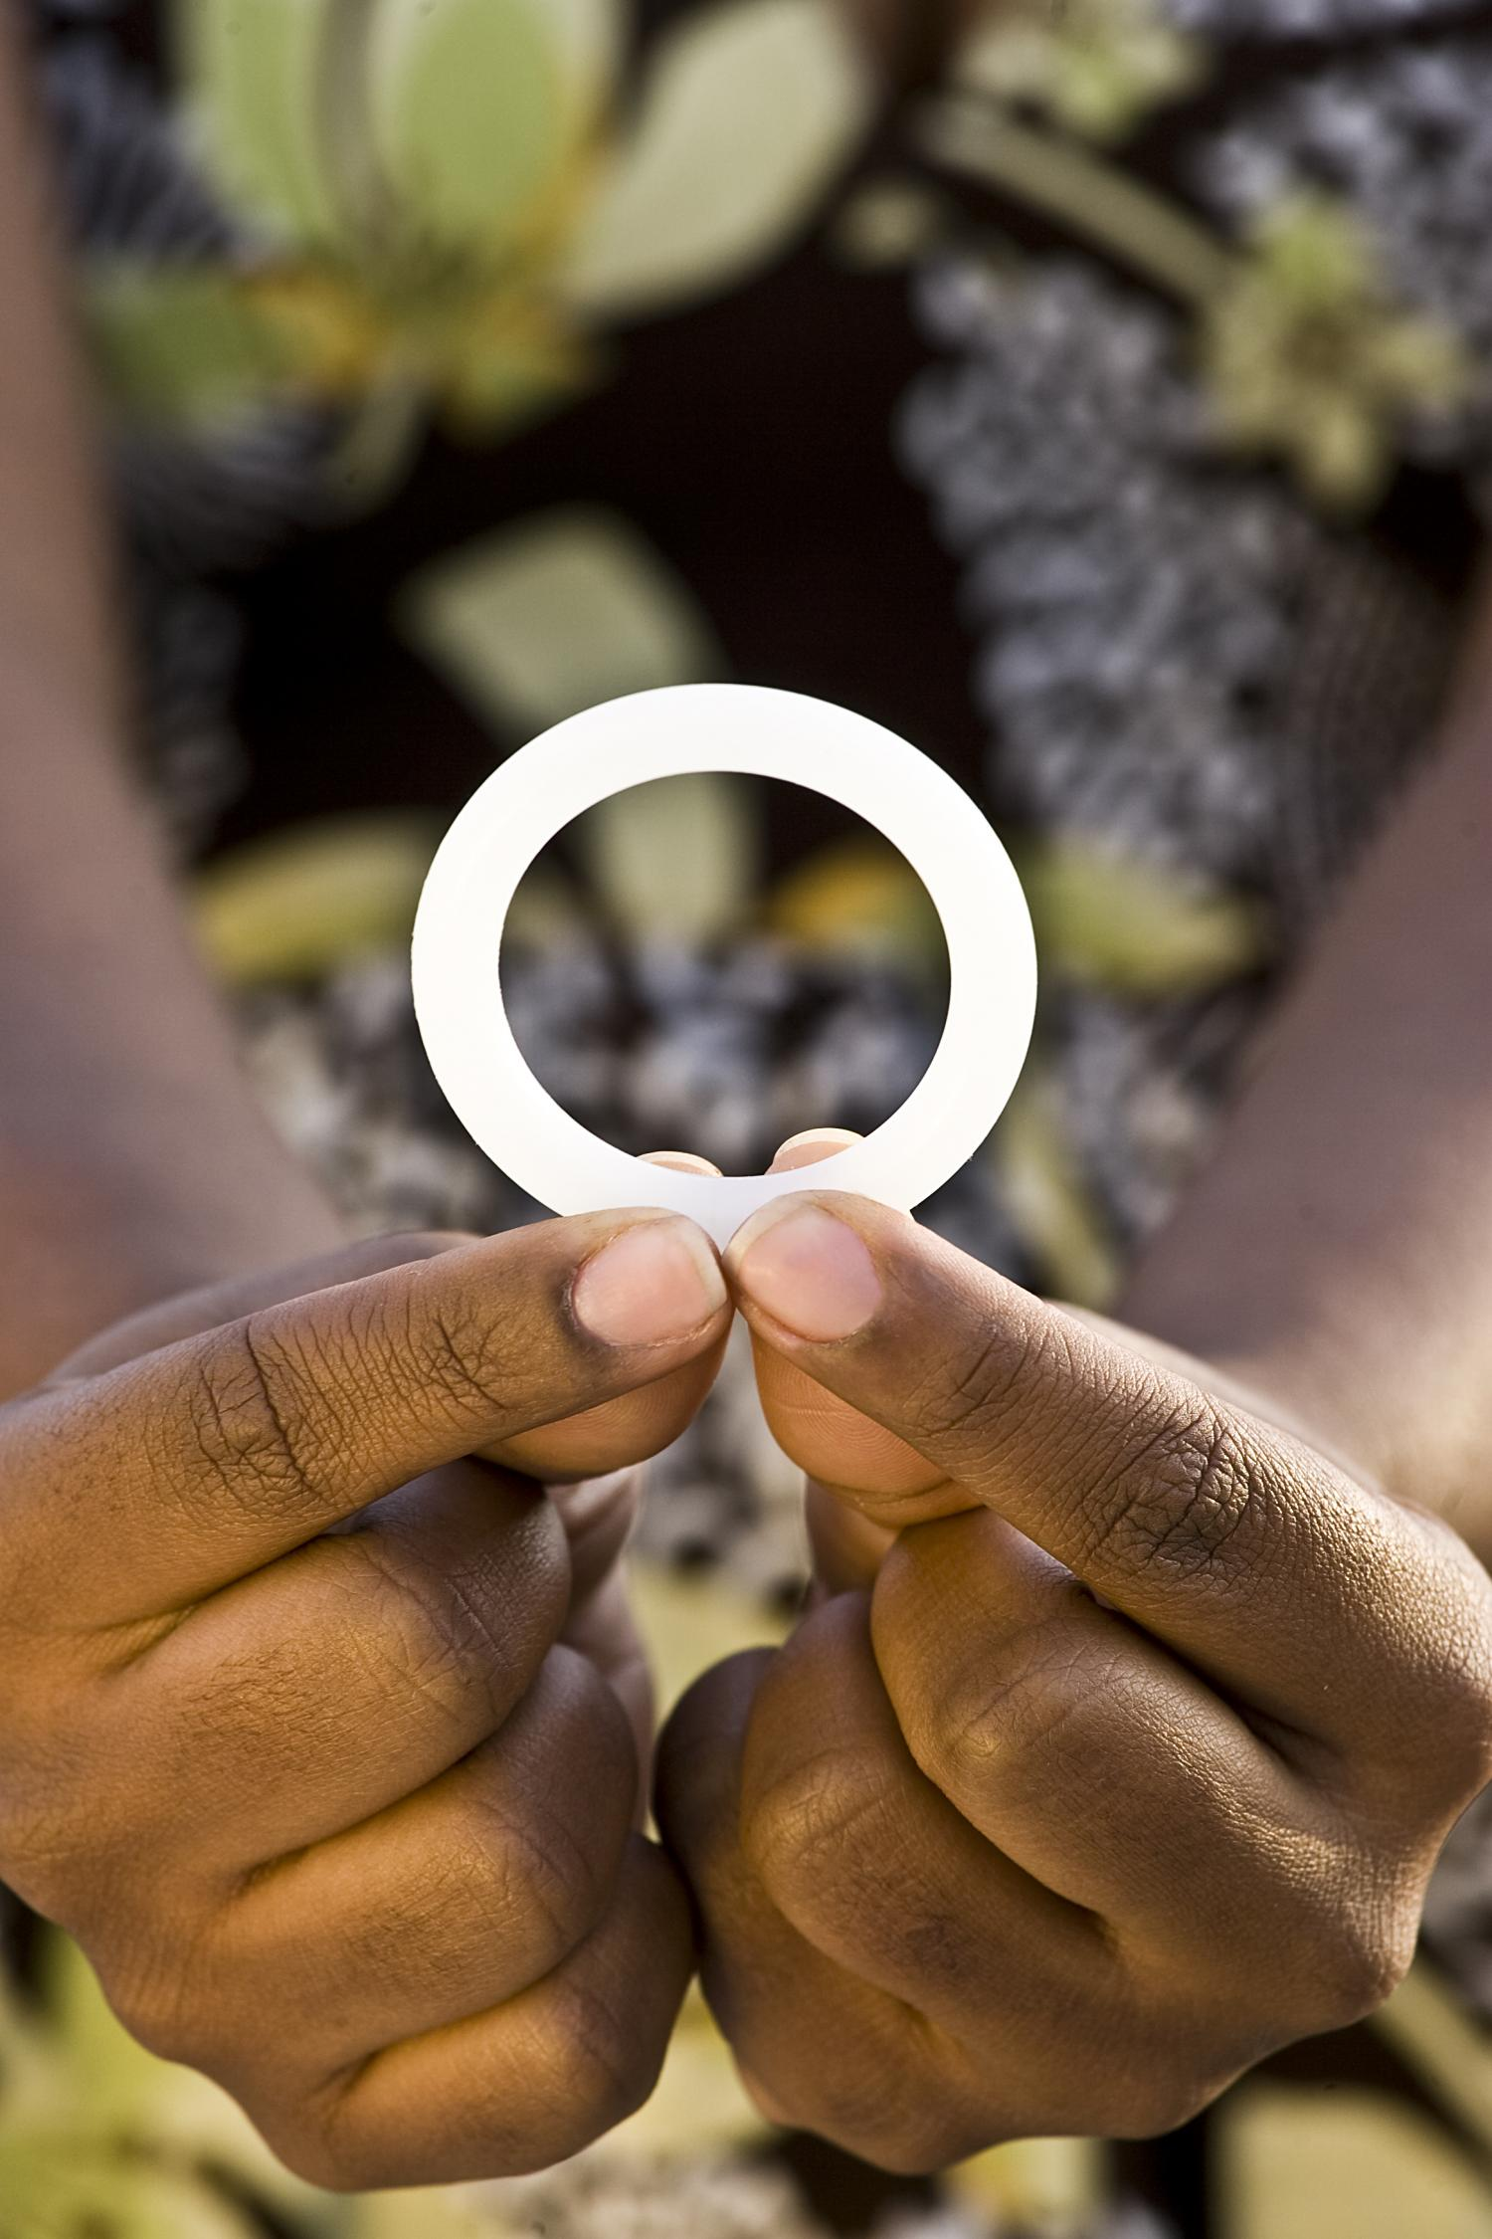
Introduction
Microbicides are products applied inside the vagina or rectum to reduce the likelihood of HIV transmission during vaginal and anal sex. Microbicides can include:
Films, gels, douches, fast-dissolving inserts, and suppositories
Vaginal rings, which are furthest along in development and may be licensed soon
Notes:
Participant Guide page 31.
Review the content on the slide.
Microbicides are products applied inside the vagina or rectum to protect against HIV through sex. They are different from other PrEP products because they only deliver anti-HIV drugs to the sites of potential HIV transmission with very little drug absorbed into the body, whereas pills, injectables, and implants deliver drugs systemically (throughout the entire body). Microbicides could fulfill the need for a non-systemic and/or short-acting method for HIV prevention that could be used around the time of sex.
The image featured here is of the dapivirine vaginal ring, the study product from the three vaginal ring studies we discussed earlier: ASPIRE, The Ring Study, and HOPE. It’s a flexible silicone monthly ring that slowly releases the drug dapivirine inside the vagina. Regulatory approval is currently being sought for the ring based on multiple studies with more than 6,600 cisgender women, finding that the ring has as strong safety profile and reduces HIV transmission—especially when used consistently.

Slide 30

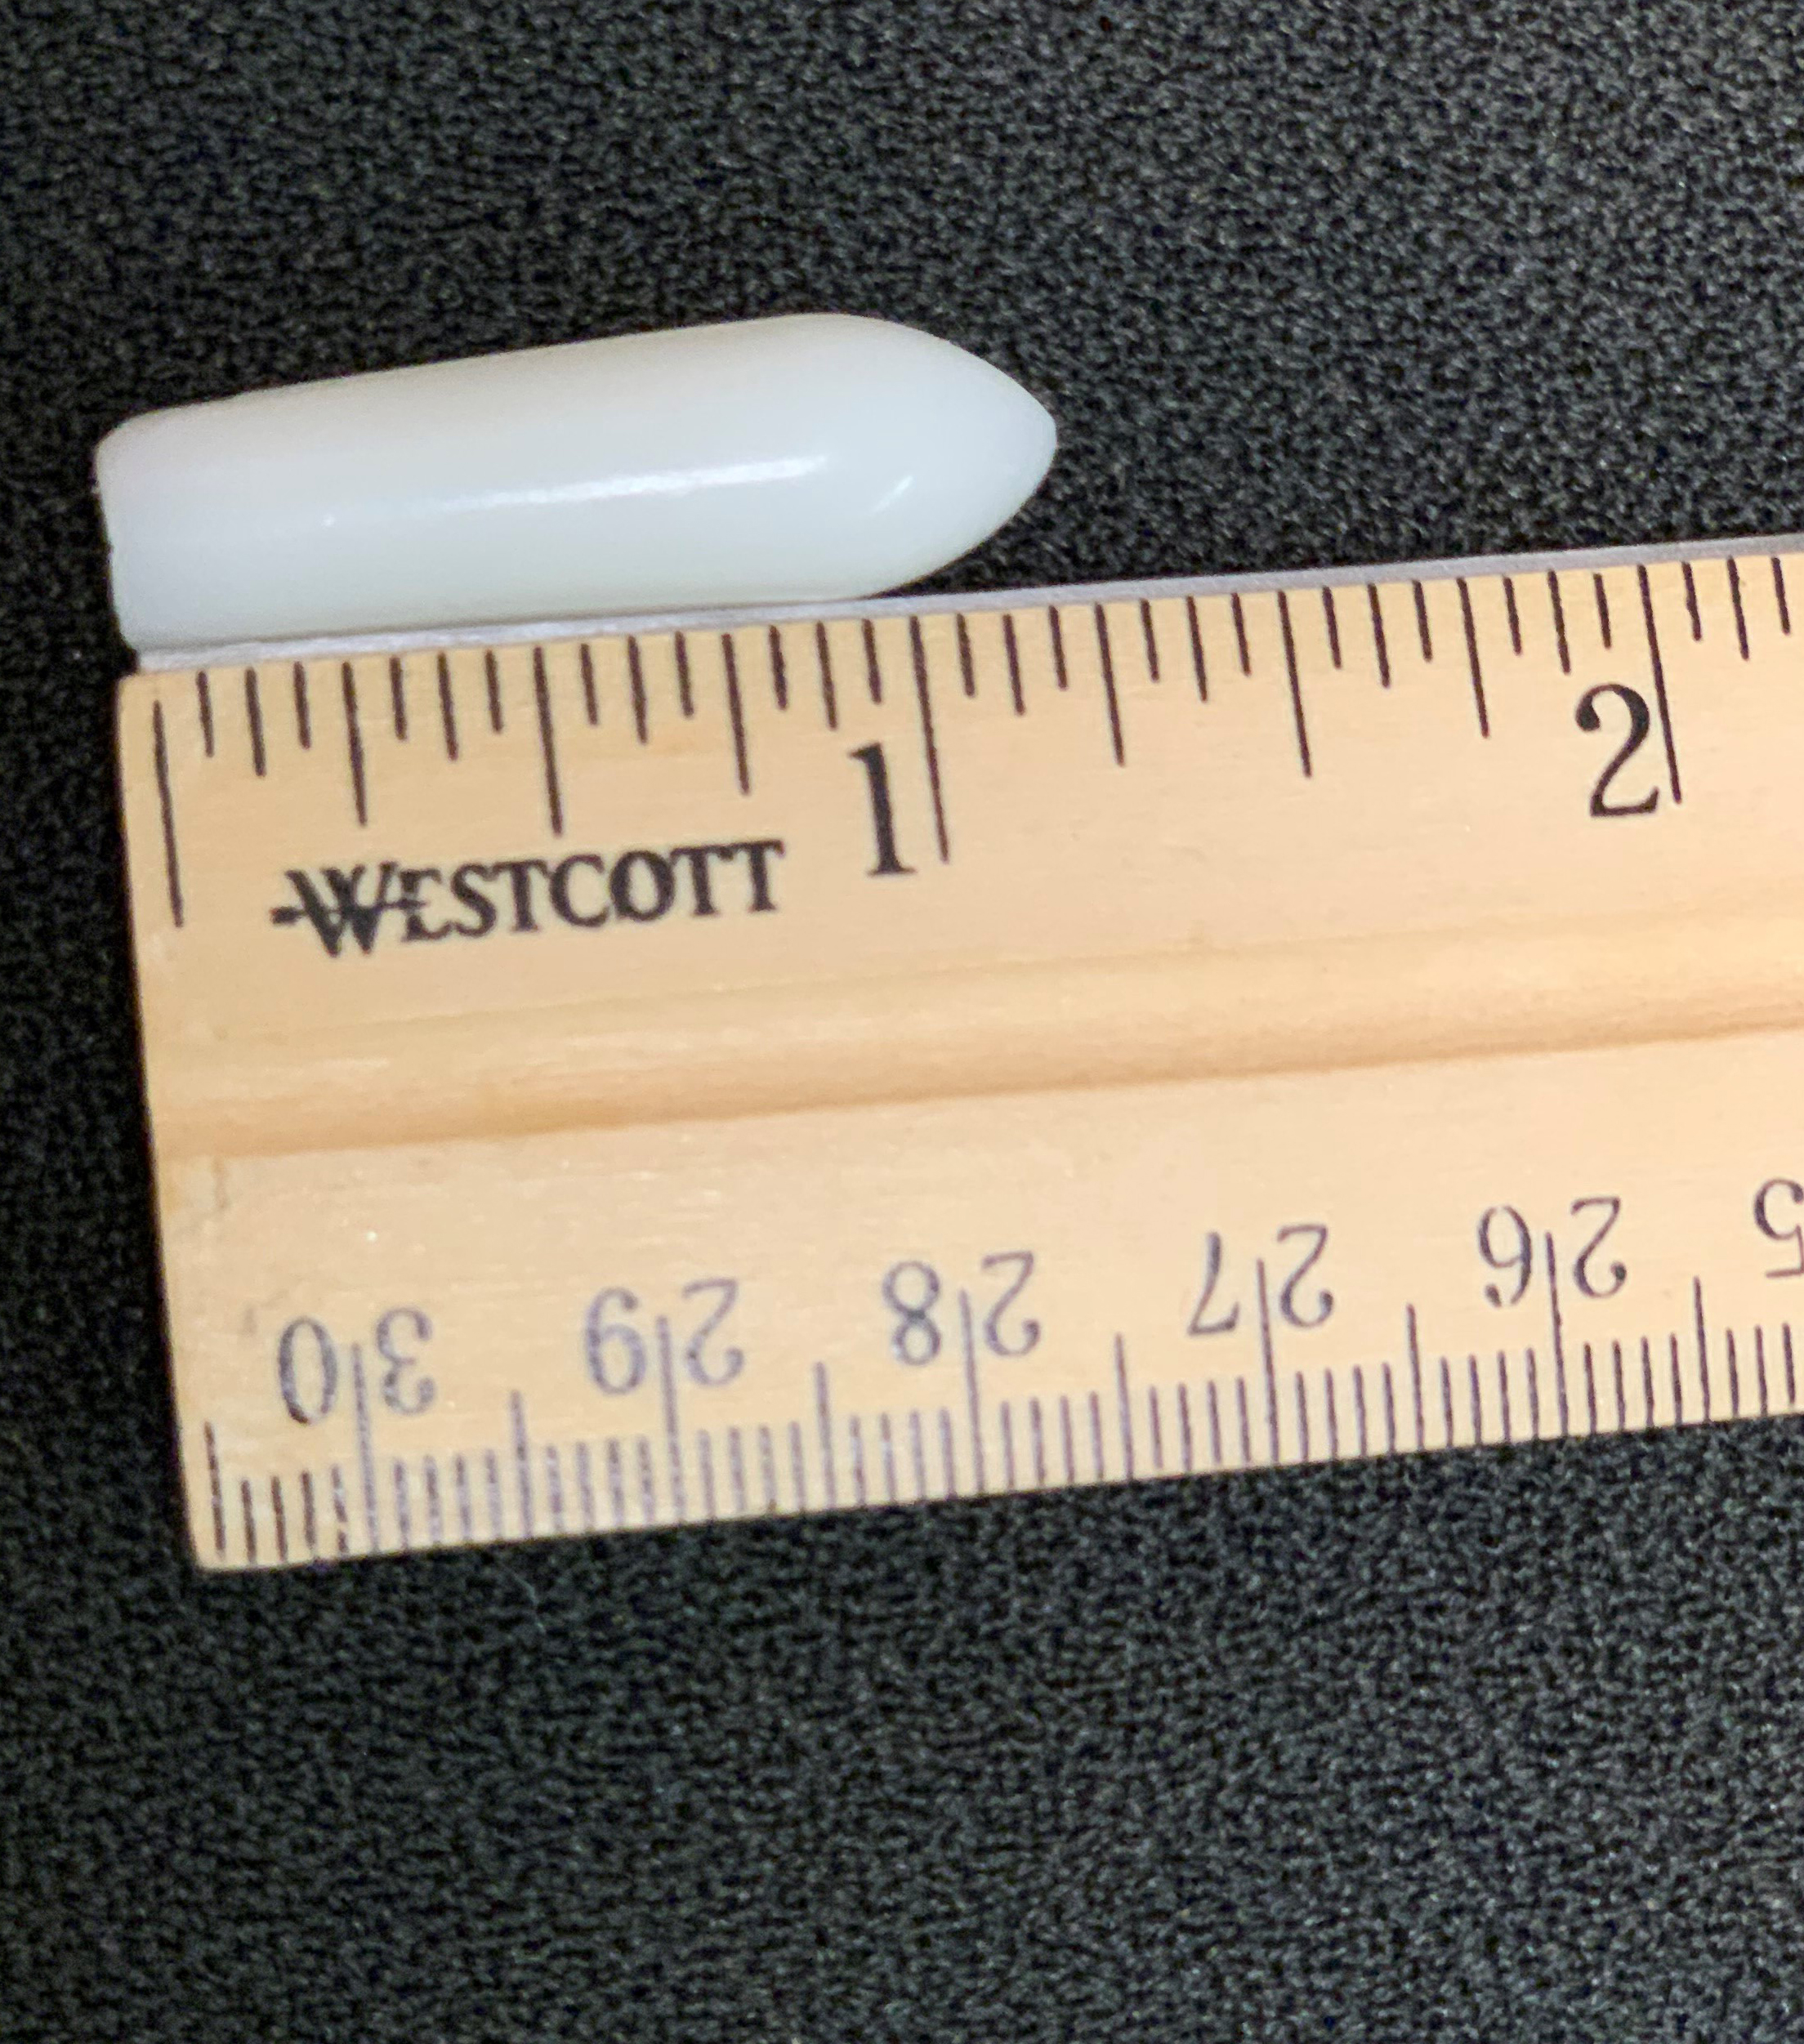
Introduction
Most microbicides being tested today contain antiretroviral (ARV) drugs.
ARVs block HIV replication in multiple places in the reproductive cycle of the virus.
These drugs have been shown to protect people who do not have HIV if they are exposed to the virus by disrupting HIV’s life cycle, thus preventing HIV from taking hold in the body.
Notes:
Participant Guide page 31.
Review the content on the slide.
Tell participants after reviewing the second bullet: Tell participants after reviewing the slide content: For example, ARVs are used in Pre-Exposure Prophylaxis, or PrEP.
Information related to the optional quiz (see the first bullet): Q13: True.
Q: Most microbicides tested today contain HIV antiretroviral drugs which are also used to treat people living with HIV/AIDS.
A: Different types of microbicides are being tested in clinical trials, but those that incorporate antiretroviral (ARV) drugs are furthest along in development and testing. The idea behind ARV-based microbicides is that some of the same drugs used to treat HIV may also help prevent people without HIV from contracting it.

Slide 31
Why Are Microbicides Important?
Vaginal microbicides
Designed to prevent HIV acquisition through the vagina
Rectal microbicides
Designed to prevent HIV acquisition through the rectum
Notes:
Participant Guide page 32.
Tell participants before reviewing the slide content: Microbicides are not yet available for use outside clinical trials. The microbicides under study are used vaginally and/or rectally to protect the user from HIV transmission during sex.
Tell participants after reviewing the “Vaginal microbicides” content:
Cisgender women represent about 20 percent of new HIV cases in the U.S.
Cis women are more likely than cis men to contract HIV through heterosexual sex.
Tell participants after reviewing the “Rectal microbicides” content:
Rectal microbicides are designed to prevent HIV among people of all genders during anal sex. The rectum is the part of the body located inside the bum; it is about the first five inches going up inside the bum.
An estimated 5-10% of the world’s population engages in anal sex.
Because the lining of the wall of the rectum is different from the lining of the vagina, rectal-specific microbicides and formulations are being tested in clinical trials in addition to products for vaginal use.
The likelihood of contracting HIV during anal sex (without condoms or anti-HIV drugs) is 10 to 20 times greater than vaginal sex (without condoms or anti-HIV drugs). Because the rectal lining is only one-cell thick, the virus can more easily reach cells.
Information related to the optional quiz Q11: False.
Q: Microbicides refer to pills taken orally to prevent people from contracting HIV.
A: Microbicides are being developed to reduce a person’s likelihood of contracting HIV or other sexually transmitted infections when applied topically inside the vagina or rectum. Vaginal microbicides are primarily being tested as rings, while rectal microbicides are being tested as gels, douches, and suppositories. Unlike microbicides, oral pre‐exposure prophylaxis (PrEP) is an HIV prevention approach that involves the use of an antiretroviral pill by people who are HIV-negative.
Information related to the optional quiz (rectal microbicides): Q12: False.
Q: Microbicides are only being tested among women.
A: Microbicides are being tested among women and men--transgender and cisgender alike--and gender non-binary people. Within these populations, microbicides research is being conducted on products for use during vaginal sex as well as anal sex. According to estimates, 5 to 10 percent of the world’s population engages in anal sex, including cisgender and transgender women and men and gender non-binary people.

Slide 32
Why Are Microbicides Important? continued
“If proven effective…microbicides could protect against HIV in people who are unable or reluctant to use condoms. Unlike condoms, they could provide an alternative way to reduce risk that is not controlled by one’s sexual partner and possibly enhance sexual pleasure, helping to motivate consistent use.”
-MTN Rectal Microbicide Fact Sheet
Notes:
Participant Guide page 32.
Review the content on the slide.

Slide 33
Why Are Microbicides Important? continued
Microbicides and women
For trans and cis women around the world, some prevention tools are not practical.
Because of gender-based violence and other factors, it can be difficult for women to:
Insist that partners use condoms
Limit their or their partner’s HIV exposure
Test or treat themselves or their partners for sexually transmitted infections (STIs)
Notes:
Participant Guide page 32.
Review the content on the slide.
Tell participants there are many complex societal, economic, and cultural reasons why women specifically need multiple forms of HIV prevention tools.

Slide 34
Why Are Microbicides Important?
Microbicides and men
Men who have sex with men:
Make up about 70% of all new cases of HIV in the US
Represent more than 50% of the people currently living with HIV in the US
Globally, are 19 times more likely to contract HIV than the general population
Consistent condom use is a problem for many men. Microbicides may offer an alternative and could be formulated like a lubricants and douches, which many men already use for anal sex
Notes:
Participant Guide page 32.
Review the content on the slide.
Note that there is not adequate data to report on transgender men.

Slide 35
Challenges with Microbicides
Dependence on human behavior requiring regular application
Cultural and regional preferences
Rectal microbicides research is in the early phase of clinical development due in part to scientific challenges related to the biology of the rectum and cultural reluctance to address anal sex.
Notes:
Participant Guide page 33.
Tell participants before reviewing the slide content: HIV prevention in general has challenges, and microbicides are no exception.
Review the content on the slide.
Research is under way to explore issues related to STIs and contraception.

Slide 36
Continuing Research: Microbicides
Develop products that:
Are/are not ARV-based
Conduct more research on:
Drug resistance
Understand issues around:
Are contraceptive, non-contraceptive, and broad-spectrum against several sexually transmitted diseases
Designed for vaginal and/or rectal use
Alternate dosing
Delivery methods (for example, rectal douches)
Access and availability
Cost
Regular HIV testing requirements
Need for prescriptions for ARV-based microbicides
Effects on pregnancy and breastfeeding
Notes:
Participant Guide page 34.
Tell participants before reviewing the slide content: Next steps in vaginal and rectal microbicides research are to…
Review the content on the slide.

Slide 37
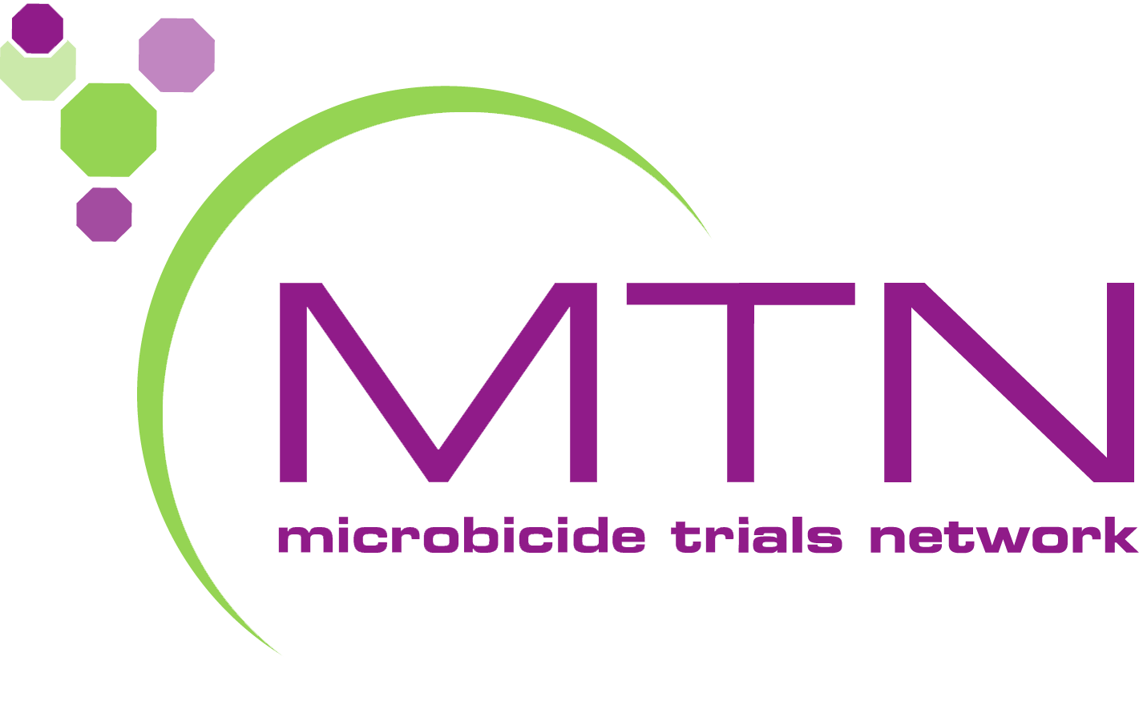
Continuing Research: Microbicides
A number of public and private organizations, in partnership and individually, are working together to find microbicides that can help prevent HIV.
The Microbicide Trials Network (MTN), funded by the National Institute of Allergy and Infectious Diseases (NIAID), brings together international investigators, community stakeholders, and industry partners who focus on developing and evaluating microbicides. The MTN is focused on evaluating non-systemic and multi-purpose products with studies designed to support potential regulatory approval of products.
Notes:
Participant Guide page 34.
Review the content on the slide.
Presenters should be prepared to check for updated information and data on the UNAIDS, CDC, NAID, and NIAID websites and provide updates, as needed.
Information related to the optional quiz Q14: True.
Q: There are possible health risks associated with participating in biomedical HIV prevention studies.
A: There are risks involved in participating in any clinical trial. Researchers in the HIV prevention field strive to minimize these risks by incorporating a multi‐tiered safety review process into clinical studies, engaging in the informed consent process to ensure that participants understand the risks associated with the study, and by conducting them under the watchful eye of regulatory and research authorities.

Slide 38
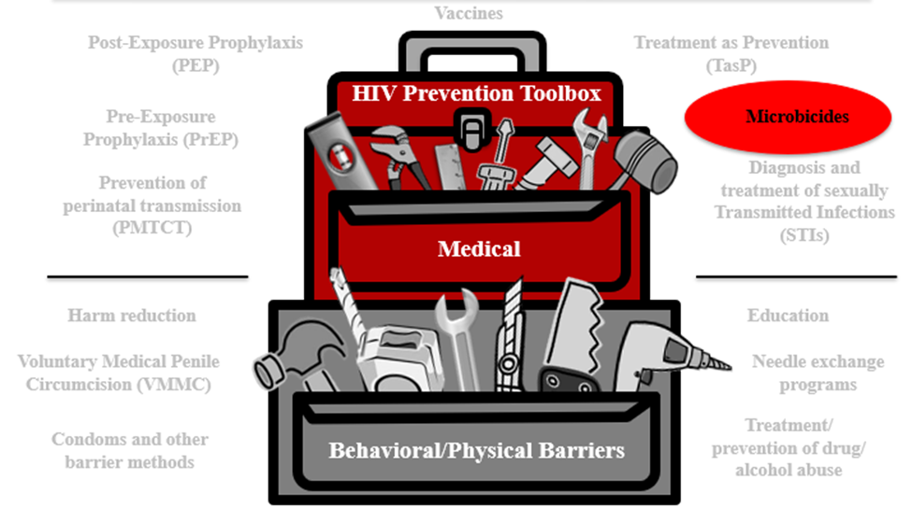
Microbicides Summary
Microbicides are products being developed and tested for use in the vagina and rectum to reduce the likelihood of HIV transmission during vaginal and anal sex.
Notes:
Participant Guide page 36.
Review the content on the slide.
Tell participants after reviewing the slide content: The HIV combination prevention toolbox reinforces the role of microbicides combined with other behavioral/physical tools. Combining multiple tools may provide the best method for HIV prevention.

Slide 39
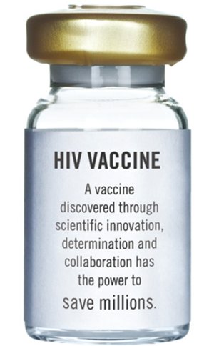
Vaccines
www.bethegeneration.org
Notes:
Participant Guide page 37.
Introduce the next modality: Vaccines.

Slide 40
Introduction
Vaccines
Post-Exposure Prophylaxis (PEP)
Treatment as Prevention (TasP)
HIV Prevention Toolbox
Pre-Exposure Prophylaxis (PrEP)
Microbicides
Diagnosis and treatment of sexually transmitted infections (STIs)
Prevention of perinatal transmission (PMTCT)
Medical
Harm reduction
Education
Voluntary Medical Penile Circumcision (VMMC)
Needle exchange programs
Condoms and other barrier methods
Treatment/
prevention of drug/
alcohol abuse
Behavioral/Physical Barriers
Notes:
Participant Guide page 37.
Tell participants after reviewing the slide content: Just because we’re only talking about biomedical HIV prevention doesn’t mean you should forget about the other prevention methods.
We said earlier that education and a combination of prevention approaches improves effectiveness, which includes combination prevention.
Participation in research can lead to intervention and prevention.
Tell participants after reviewing the slide content: The HIV combination prevention toolbox shows the importance of both medical and behavioral/physical tools. Combining multiple tools may provide the best method for HIV prevention.

Slide 41
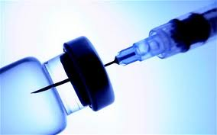
Introduction
A vaccine is a substance that teaches the body’s immune system to recognize and protect against a disease caused by an infectious agent or virus, often by stimulating the body to produce antibodies and T-cells against that infection.
A safe and effective preventive vaccine is believed to be the best way to control the HIV/AIDS epidemic in the long term. There is a lot of important research going on to find a safe and effective HIV vaccine.
However, there is currently no licensed vaccine against HIV.
Notes:
Participant Guide page 37.
Review the content on the slide.
Information related to the optional quiz (However, there is currently no…): Q4: False.
Q: Scientists have already developed a vaccine that prevents HIV.
A: Currently, there is not a vaccine to prevent HIV. Some HIV vaccine studies have been conducted that did not produce results needed to effectively prevent HIV. Ongoing research is being conducted to find a safe and effective preventive HIV vaccine. In order to find one, researchers will need thousands of volunteers to participate in clinical trials.

Slide 42
How Would a Vaccine Work?
Teach the body to recognize HIV
Tell the body to sound an alarm
Send fighter cells to go into action
Result: HIV is controlled or killed
Notes:
Participant Guide page 38.
Tell participants before reviewing the slide content: HIV vaccines would work to…
Review the content on the slide as it is revealed.
Information related to the optional quiz: Q6: True.
Q: HIV vaccines under study would train the body to recognize the HIV virus if a person is exposed to the virus.
A: Vaccines would teach the body to recognize the virus, sounding an internal “alarm” which would call fighter cells into action and ultimately help prevent or control an HIV infection.
Information related to the optional quiz: Q7: True.
Q: HIV vaccines do not contain live human immunodeficiency virus (HIV).
A: HIV vaccines do not contain either live or killed forms of the virus. The vaccines are synthetic (lab‐made) compounds designed to look like pieces from real HIV, triggering the body’s immune responses that would help your body recognize and fight the virus should it enter your system. There is no whole virus, real virus, or infected material in the vaccine, so there is no way that it could give a study participant HIV.

Slide 43
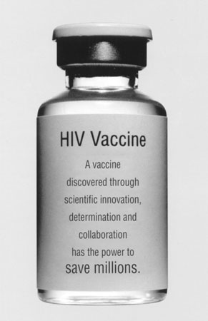
HIV Vaccines—the Future
Vaccines are important to control the spread of HIV.
Preventive vaccines are tested with people who do not have HIV.
HIV vaccines may one day be able to prevent or delay AIDS in people with HIV too.
Notes:
Participant Guide page 39.
Review the content on the slide.
Information related to the optional quiz Q5: False.
Q: Volunteers for preventive HIV vaccine clinical trials cannot get HIV from the vaccines being tested.
A: The HIV vaccines used in clinical trials cannot cause people to contact HIV or AIDS, and volunteers are not exposed to HIV through the study. Just like anyone else, however, volunteers in clinical trials can contract HIV from other people through behaviors like condomless/PrEP-less sex or injection drug use.

Slide 44
HIV Vaccines—the Future
How an HIV vaccine might work
Prevent HIV in most people
Possible benefits
Even if a vaccine only protects some people, it would have a major impact on controlling the HIV/AIDS epidemic
Prevent HIV disease progression after people contract HIV
A partially effective vaccine could decrease the number of people who contract HIV
There would be fewer people with HIV to pass the virus on to others
One example showed that if a 50% effective vaccine was given to 30% of the population in developing countries between 2015-2030, it could prevent 25% of the new HIV cases that would otherwise occur.
Notes:
Participant Guide page 39.
Review the content on the slide.

Slide 45
Challenges in Developing an HIV Vaccine
HIV can “hide” from the immune system that protects the body.
HIV attacks the same immune cells that the body uses to defend itself against infections.
There are many different varieties of HIV.
HIV changes rapidly, even in a single person.
There is no perfect model for testing HIV vaccines in animals, because HIV impacts people in ways that are different from the animal versions.
The human immune system is not designed to clear HIV, so we are not sure what the immune response is that would be needed for protection; we have to do better than “mother nature.”
Notes:
Participant Guide page 40.
Tell participants before reviewing the slide content: Remember, there is currently no licensed vaccine against HIV or AIDS. Most vaccines we use today (polio, rubella, mumps) took more than 25 years to develop. Some challenges in developing HIV vaccines are…
Review the content on the slide.

Slide 46
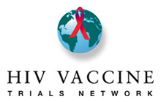
Continuing Research: Vaccines
A number of public and private organizations, in partnership and individually, are working together to find a vaccine that could end the epidemic.
The HIV Vaccine Trials Network (HVTN), funded by the National Institute of Allergy and Infectious Diseases (NIAID), is an international collaboration that conducts all phases of clinical trials to test HIV vaccines.
Notes:
Participant Guide page 41.
Review the content on the slide.
Tell participants after reviewing the slide content: HVTN clinical research sites are located at leading research institutions throughout the world. The HVTN’s mission is to fully characterize the safety, immunogenicity, and efficacy of HIV vaccine candidates as rapidly as possible for prevention of HIV globally.
Presenters should be prepared to check for updated information and data on the UNAIDS, CDC, NAID, and NIAID websites and provide updates, as needed.

Slide 47
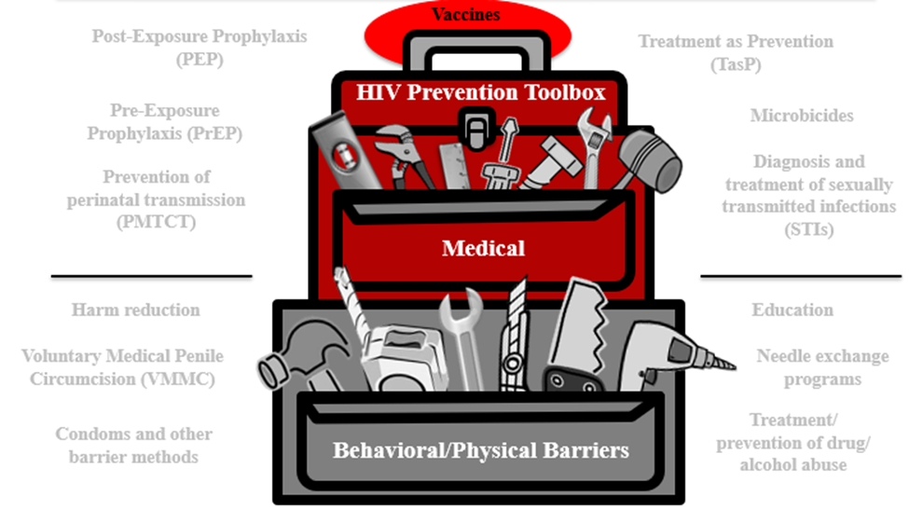
Vaccines Summary
A vaccine teaches the body’s immune system to recognize and protect against a disease caused by an infectious agent or virus, often by stimulating the body to produce antibodies and T-cells against that infection.
Notes:
Participant Guide page 44.
Review the content on the slide.
Tell participants after reviewing the slide content: The HIV combination prevention toolbox reinforces the role of vaccines combined with other behavioral/physical tools. Combining multiple tools may provide the best method for HIV prevention.

Slide 48
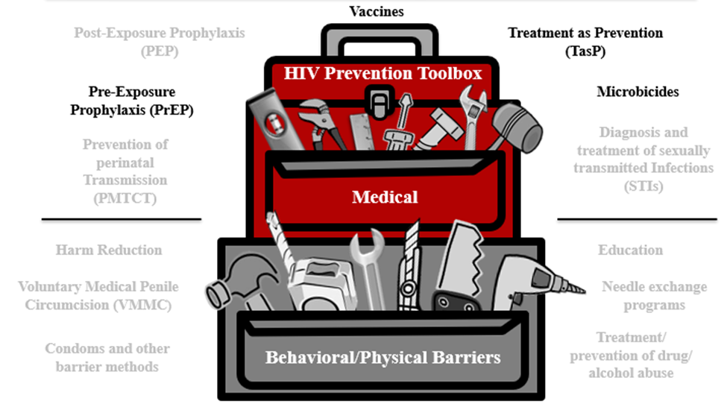
Summary
HIV prevention research is important to find safe and effective approaches to prevent the spread of HIV. These approaches can include:
Promoting awareness, understanding, and dialogue
Supporting research
Developing new prevention technologies
Notes:
Participant Guide page 47.
Review the content on the slide.
Review the objectives for this section. Tell participants: In this session, you learned about:
Prevention research and HIV prevention research successes
The role of pre-exposure prophylaxis (PrEP) in HIV prevention research
The role of treatment as prevention (TasP) in HIV prevention research
The role of microbicides in HIV prevention research
The role of vaccines in HIV prevention research
Tell participants where to find the glossary of terms and abbreviations used in this session in case they have questions about them.
Review the Frequently Asked Questions (FAQs) and additional resources for more information.
Ask participants if they have any additional resources they would like to share.
Save and add any additional resources for future use.

Slide 49
Conclusion
This project was supported through Federal funds from the Division of AIDS (DAIDS), National Institute of Allergy and Infectious Diseases, National Institutes of Health, Department of Health and Human Services Grant # UM01 AI068614: “Leadership Group for a Global HIV Vaccine Clinical Trials (Office of HIV/AIDS Network Coordination) and the NorthEast Two-Spirit Society.”
Notes:
Review the content on the slide.

Slide 50
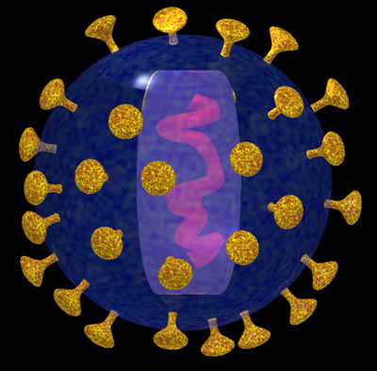
Conclusion
You have now completed the workshop about HIV Prevention Research.
This vital research is designed to find safe and effective methods to prevent HIV and AIDS.
Preventing HIV is our best hope for ending the HIV/AIDS epidemic.
Notes:
Participant Guide page 53.
Review the slides for the conclusion. Review the content on the slide.

Slide 51
What Is HIV Prevention and the HIV Combination Prevention Toolbox?
Different HIV prevention approaches need to be tested to find out what works best. Identifying and offering more options will allow people to determine which options fit their lives, their needs, and the needs of their family and friends. Ongoing HIV prevention research supports:
More HIV prevention options
More combination HIV prevention options
More diverse research participants to enlarge the understanding of what works
Notes:
Participant Guide page 55.
Tell participants before reviewing the slide content: Comprehensive HIV prevention includes treatment, information, skills, personal responsibility, and access to tools, products, and approaches.
Review the content on the slide.

Slide 52


What Are HIV Prevention Tools and How Are They Used in HIV Prevention Research?
HIV prevention research is important to find safe and effective approaches to prevent the spread of HIV. These approaches can include:
Promoting awareness, understanding, and dialogue
Supporting research
Developing new prevention technologies
Notes:
Participant Guide page 55.
Check slide heading format for this slide before presenting. The heading takes up two lines, so the background has been revised to accommodate two lines.
Review the content on the slide.

Slide 53

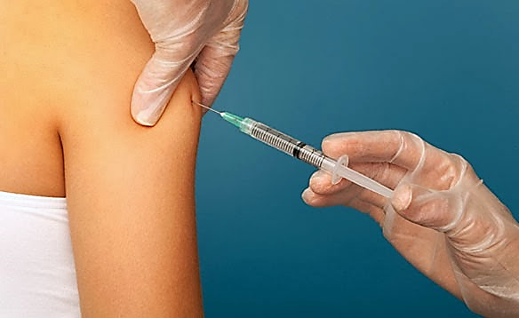
What Are HIV Prevention Tools and How Are They Used in HIV Prevention Research?
Three Important Areas of Biomedical Prevention
PrEP & Integrated Strategies
Microbicides
Vaccines
New formulations and delivery methods to reduce the likelihood of transmission.
Products applied vaginally and rectally that may prevent HIV transmission.
Harnessing the immune system to help prevent a person from contracting HIV.
Notes:
Participant Guide page 55.
Check slide heading format for this slide before presenting. The heading takes up two lines, so the background has been revised to accommodate two lines.
Review the content on the slide.
Tell participants while reviewing the graphic:
The PrEP prevention approach is focused on people who do not have HIV, but may be vulnerable to exposure to HIV through sexual contact and injection drug use (IDU). With PrEP, people who do not have HIV receive a prescription to take a medication. The medication may lower their likelihood of contracting HIV.
Treatment as Prevention (TasP) is an approach for people living with HIV to reduce the likelihood of passing HIV to others. With TasP, people with HIV take medication. The medication controls the HIV in their bodies and keeps them healthy. The medication also lowers their likelihood of transmitting HIV to others through sex.
Microbicides are designed to reduce HIV transmission during vaginal and anal sex. Most microbicides being tested today contain antiretroviral (ARV) drugs. These drugs have been shown to help prevent HIV acquisition if someone is exposed to the virus.
A safe and effective preventive vaccine is believed to be the best way to control the HIV/AIDS epidemic in the long term. A vaccine uses a substance that teaches the body’s immune system to recognize and protect against a disease caused by an infectious agent or virus, often by stimulating the body to produce antibodies and T-cells against that infection. There is a lot of important research going on to find a safe and effective HIV vaccine.

Slide 54
For More Information
For more information on HIV prevention research, visit:
AVAC http://www.avac.org/
Be The Generation http://www.bethegeneration.org/
HANC/Legacy https://www.hanc.info
HIV Prevention Trials Network http://www.hptn.org/
HIV Vaccines Trials Network http://www.hvtn.org/
Microbicides Trials Network http://www.mtnstopshiv.org/
NorthEast Two-Spirit Society http://ne2ss.org
Notes:
Participant Guide page 56.
Review the content on the slide.

Slide 55

Questions?...and
Thank You!
Notes:
No Participant Guide page.
Distribute the workshop evaluation (if applicable).
Ask participants if they have any questions. Answer all questions, if possible. If not, make a note of these questions to prepare for the next training session.

