Slide 1

HIV Prevention Research Tools
Presenter:
Subtitle will go here
Notes:
No Participant Guide page.
Welcome participants to the course: Welcome to this workshop about HIV (Human Immunodeficiency Virus) prevention research.
Tell participants to make themselves comfortable.
Thank participants for coming to the workshop. Remind participants that the course will be more interesting and fun if they ask questions and share their experiences.
Distribute a copy of the Participant Guide to each attendee. Tell participants they can write their names on their copy, that the Participant Guide is a reference for the workshop and includes space for them to take notes during the workshop.
Explain that the Participant Guide contains a lot of information. Ask participants to look at the Table of Contents and review with them the topics covered in the course. Then show participants the Glossary at the back of the Participant Guide.

Slide 2
INTRODUCTION
This project was initially created under the National Institute of Allergy and Infectious Diseases (NIAID) HIV Vaccine Research Education Initiative (NHVREI) and later managed by the Be the Generation Bridge project. The project is now managed by the Legacy Project at the Office of HIV/AIDS Network Coordination (HANC), which works with the NIH-funded HIV/AIDS Clinical Trials Networks to create a more integrated, collaborative, and flexible research structure. Learn more at
www.bethegeneration.org
Notes:
Participant Guide page 3.
Review the content on the slide.

Slide 3
What Will We Do in This Workshop?
Define and describe HIV prevention tools and the latest in biomedical HIV prevention research.
Notes:
Participant Guide page 3.
Tell participants before reviewing the slide content: In this workshop, we will provide basic information about HIV prevention research tools in simple terms. We will present important information and you will be able to ask questions. We will also do activities together to help you remember what you hear…
Review the objective on the slide.
Tell participants: This workshop is designed to give you an opportunity to:
Apply the information you learn in activities and discussions.
Ask questions about information you do not understand.
Practice what you learn.
This Participant Guide includes information, facts, and space to write your own notes, and a glossary. The glossary includes many words, abbreviations, and definitions that may not be familiar to you.
Presenter notes: The optional quiz can be used here (see quiz handout) or when participants arrive. The quiz can be given at the beginning of the presentation and at the end of the presentation. There are 16 questions. Allow approximately 15 mins for participants to complete the quiz. The quiz answers will be reviewed at the end of the presentation.
Notes have been inserted in the PPT that provide the content needed to answer each of the questions in the quiz. These notes are titled: “Information related to the optional quiz.” Presenters should add the answers to the presentation if the optional quiz is included.

Slide 4
Agenda
Introduction
What Is HIV
Prevention and the HIV Combination Prevention Toolbox?
What Are HIV Prevention Tools and How Are They Used in HIV Prevention Research?
What Are HIV Prevention Tools and How Are They Used in HIV Prevention Research? (continued)
Conclusion
Lunch
Notes:
There is no Participant Guide page for this slide.
Review the high-level agenda for the workshop. Be prepared to change this slide if the workshop is given with a different time structure.
Review the logistics of breaks and lunch, depending on the location.

Slide 5
Housekeeping
Nearest Exits
Restrooms
Parking Lot
Breaks and Lunch
Remember to:
Ask questions
Share what you know
Participate in all activities
Notes:
No Participant Guide page.
Review the content on the slide.
Provide information depending on the location.
Parking Lot: this is for questions that come up during the training that you may not have time to answer during a particular section but can return to later. Typically this is done by putting up a flip chart paper and having people write their questions on the paper or a post-it.

Slide 6
Icebreaker
What is your name?
Your Pronouns?
Tell us something special about yourself.
What do you do?
Notes:
There is no Participant Guide page.
After everyone is settled, set up a whole group activity to introduce participants to each other (take approximately 5 mins). Go around the room and ask each person to stand up and state his/her name, what they do, and something special about him/herself. Begin with yourself to provide an example. Or, feel free to use a different introductions activity or “ice breaker,” if desired.

Slide 7
What Is HIV Prevention and the HIV Combination Prevention Toolbox?
www.bethegeneration.org
Notes:
Participant Guide page 4.
Review the content on the slide.

Slide 8
Objectives
The qualities of high-impact HIV prevention
The HIV combination prevention toolbox and what it contains
Notes:
Participant Guide page 4.
Tell participants before reviewing the slide content: In this session (What Is HIV Prevention and the HIV Combination Prevention Toolbox?), you will learn about…
Review the objectives on the slide.

Slide 9
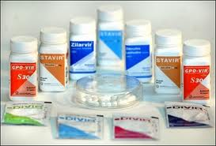
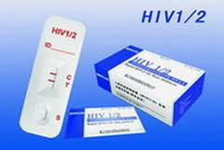
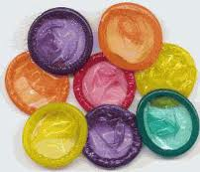
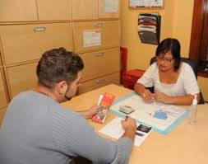
Introduction
HIV prevention includes: medicines, medical devices, medical procedures, physical barriers, and behavioral approaches.
Medical devices/ medical procedures
Physical barriers
Behavioral approaches
Medicines
Notes:
Participant Guide page 4.
Review the content on the slide.

Slide 10
Introduction
Comprehensive HIV prevention includes multiple approaches instead of just one or two approaches.
Notes:
Participant Guide page 4.
Tell participants after reviewing the slide content: Combination prevention incorporates biomedical, behavioral, and other interventions all designed to reduce HIV infection. This kind of comprehensive and combination HIV prevention is referred to as “high-impact HIV prevention.”
Review the content on the slide.

Slide 11
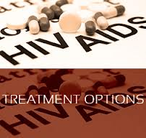

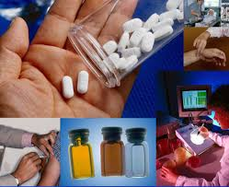
Introduction
No one HIV prevention approach will be acceptable to all people.
Research is critical to develop and test new prevention options that offer people more choices.
The best option for one person may not be the best for others.
Notes:
Participant Guide page 4.
Read the content on the slide as the animated sections are revealed. Add the following information for each of the sections:
Treatment options: HIV vulnerability varies for each person and over time. Therefore, it is important that people have options for HIV prevention so they can choose the approach that is the best fit for them.
Question mark: Choosing the right HIV prevention option may depend on cost, availability, ease of use, or needing the consent of a partner.
Research: Finding clinical research participants who are willing and able to meet the rigorous clinical trial requirements is also important, and they must be able to stay in the clinical trial for the full duration.
Tell participants after reviewing the slide content: HIV prevention methods also need to be supported by the community at the local and national levels.

Slide 12

High-Impact Prevention
The U.S. Centers for Disease Control and Prevention (CDC) is using what they call high-impact prevention.
High-impact prevention includes:
“…using combinations of scientifically proven, cost-effective, and scalable interventions targeted to the right populations in the right geographic areas.”
Notes:
Participant Guide page 5.
Review the content on the slide.

Slide 13
High-Impact Prevention
Disease surveillance
HIV testing, counseling, and referral services
Street and community outreach
Risk-reduction counseling
Prevention case management
Prevention and treatment of other sexually transmitted infections (STIs)
Notes:
Participant Guide page 5.
Tell participants before reviewing the slide content: To make high-impact prevention work, the CDC is working to implement, evaluate, strengthen, and further develop effective HIV prevention efforts nationwide and globally. The CDC is also giving financial and technical support for…

Slide 14
High-Impact Prevention
Public information and education
School-based HIV/AIDS education
International clinical trials
Technology transfer systems
Organizational capacity building
Notes:
Participant Guide page 5.
Tell participants before reviewing the slide content: The CDC also gives financial and technical support for…
Add the following information for the technology transfer systems bullet: Technology transfer systems make scientific and technological developments accessible to a variety of users.

Slide 15
The HIV Combination Prevention Toolbox
The toolbox is organized into two sections:
Tools and approaches that are “medical” in nature
Tools and approaches that are “behavioral” in nature
Notes:
Participant Guide page 6.
Note: If applicable (this section may be delivered as a stand-alone section), remind participants that we talked a little bit about medical and behavioral research earlier (in the What Is Clinical Research? Section). Now we’ll talk about specific tools in the toolbox.
Tell participants before reviewing the slide content: We have divided the combinations of interventions that can be used to prevent HIV infection into medical (meaning ones that generally would require a prescription or use of a biological product) and behavioral/physical barriers (meaning ones that are within the direct control of the person and hopefully readily available). It should be emphasized that all of these interventions are generally used in combination and all involve some behavioral activity on the part of the user. Most of the HIV prevention research being conducted by the NIH HIV/AIDS Clinical Trials Networks involves some type of medical intervention in combination with behavioral components. The HIV combination prevention toolbox shows this kind of combination of approaches. The toolbox is organized into two sections…
Add the following to “Tools and approaches that are “medical” in nature”: including medicines, medical devices, and medical procedures.
Add the following to “Tools and approaches that are “behavioral” in nature”: including risk reduction counseling and effective behavioral interventions.

Slide 16


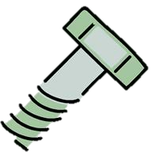








The HIV Combination Prevention Toolbox
Vaccines
Post-Exposure Prophylaxis (PEP)
Treatment as Prevention (TasP)
HIV Prevention Toolbox
Pre-Exposure Prophylaxis (PrEP)
Microbicides
Diagnosis and treatment of sexually transmitted infections (STIs)
Prevention of perinatal transmission (PMTCT)
Medical
Harm reduction
Education
Voluntary Medical Penile Circumcision (VMMC)
Needle exchange programs
Condoms and other barrier methods
Treatment/
prevention of drug/
alcohol abuse
Behavioral/Physical Barriers
Notes:
Participant Guide page 6.
Review the toolbox graphic on the slide.
Medical HIV prevention tools include:
Post-exposure prophylaxis (PEP): Taking anti-HIV drugs as soon as possible after exposure to HIV.
Pre-exposure prophylaxis (PrEP): a biomedical prevention approach for people who do not have HIV; they take medication before exposure to HIV to reduce their likelihood of acquiring HIV.
Prevention of perinatal transmission (PMTCT): Interventions to reduce infant exposure to HIV during pregnancy, labor, and breastfeeding. Note that this is sometimes known as “prevention of mother-to-child transmission,” but many find this term stigmatizing and prefer terms like “perinatal” or “vertical,” which remove the implication of blame. We have left the acronym PMTCT because many are still familiar with it.
Vaccines: A substance that teaches the body’s immune system to recognize and protect against a disease caused by an infectious agent or virus, often by stimulating the body to produce antibodies to that infection.
Treatment as Prevention: a medical prevention approach that uses antiretroviral treatment for people with HIV to decrease their chance of transmitting HIV, ideally to zero chance under conditions of viral suppression (undetectable)
Microbicides: Products being developed and tested for use in the vagina or rectum to reduce the likelihood of HIV transmission during vaginal and anal sex
Sexually Transmitted Infections (STIs) Diagnosis and Treatment: having an STI can increase one’s likelihood of contracting HIV, so treatment of STIs is important for HIV prevention.
Tell participants after reviewing the graphic: Some of these prevention tools are approved for use and some are still being tested. Research is under way.
Information related to the optional quiz (treatment as prevention): Q15: True.
Q: Many people living with HIV around the world are virally suppressed, meaning their medications have succeeded in reducing the amount of HIV in the body to levels such that a regular HIV test can no longer detect the virus. People with viral suppression cannot transmit HIV to their sex partners, even if they don't use a condom.
A: When people living with HIV take anti-retroviral medications, they can become virally suppressed. Viral suppression means that the medications are working to reduce the amount of HIV in the body to undetectable levels. Estimates indicate that more than 40% of the world's people living with HIV are virally suppressed. Studies have shown that people with viral suppression cannot transmit HIV to their sex partners—not even through acts of condomless sex. Because anti-retroviral treatment for people living with HIV can prevent HIV transmission in this way, we call it “Treatment as Prevention” (TasP). Many scientists around the world, including those at the National Institutes of Health and the Centers for Disease Control and Prevention, agree that there is zero chance of HIV transmission through sex under conditions of viral suppression.

Slide 17
The HIV Combination Prevention Toolbox
Vaccines
Post-Exposure Prophylaxis (PEP)
Treatment as Prevention (TasP)
HIV Prevention Toolbox
Pre-Exposure Prophylaxis (PrEP)
Microbicides
Diagnosis and treatment of sexually transmitted infections (STIs)
Prevention of perinatal transmission (PMTCT)
Medical
Harm reduction
Education
Voluntary Medical Penile Circumcision (VMMC)
Needle exchange programs
Condoms and other barrier methods
Treatment/
prevention of drug/
alcohol abuse
Behavioral/Physical Barriers
Notes:
Participant Guide page 6.
Tell participants before reviewing the slide content: Behavioral and physical barrier prevention tools include:
Harm Reduction: A way of dealing with behavior that damages the health of a person (and sometimes the health of their community). Harm reduction can include education about drug use, sex, and HIV.
Clean Syringes (Needle Exchange Programs): Provides clean needles to reduce the likelihood of HIV transmission through injected drugs. Needle exchange programs provide a safe way for people to turn in their used syringes for appropriate disposal and received new sterile syringes in return; some programs also provide information on how to clean syringes using bleach and water.
Condoms and Other Barrier Methods: Any method that prevents passage of blood, semen, or vaginal fluids from passing from one person to another. Condoms can be used externally (typically over a penis) or internally (typically inside a vagina or rectum).
Treatment/Prevention of Drug/Alcohol Abuse: Includes injection drug use, behavior while under the influence, and effects of drug use and addiction on a person’s overall health.
Voluntary Medical Penile Circumcision: A surgical procedure to remove the penis’s foreskin; reduces the likelihood of the insertive partner acquiring HIV through the penis during vaginal sex by approximately 60%. “Voluntary medical” means the surgery is performed on adults who consent to the procedure for this medical purpose.
Education: Education includes knowing your status, encouraging testing, and knowing how the disease is transmitted.

Slide 18
Hidden slide
Notes:
Tell participants after reviewing the slide content: The HIV combination prevention toolbox shows the importance of both medical and behavioral/physical tools. Combining multiple tools may provide the best method for HIV prevention. Some of these tools have both a medical and behavioral component. For example, PrEP is a medical tool because it involves antiretroviral medications, but there is also a behavioral component because people have to follow the prescribed plan and take the medication.

Slide 19
Effective HIV Prevention Programs
An effective community planning process
Collection of data about HIV vulnerabilities, incidence, or prevalence
HIV counseling, testing, and referral; partner counseling and referral; linkage to medical care, intervention, and prevention services
Health education and risk reduction activities, including individual-, group-, and community-level interventions
Notes:
Participant Guide page 7.
Tell participants before reviewing the slide content: Effective HIV prevention programs are comprehensive and science-based. When we talk about HIV prevention strategies and tools, we are looking at things that we already know are working, things that are being researched right now, and things that might work and that may be researched in the future. They include…
Review the animated graphic (this graphic is continued on the next slide).

Slide 20
Effective HIV Prevention Programs
Accessible services for diagnosis and treatment of other STIs
Public information and education programs
Comprehensive school health programs
Training and quality assurance
Notes:
Participant Guide page 7.
Tell participants before reviewing the slide content: Effective HIV prevention programs also include…
Continue reviewing the animated graphic (this graphic is continued on the next slide).

Slide 21
Effective HIV Prevention Programs
An HIV prevention technical assistance assessment and plan
Evaluation of major program activities, interventions, and services
Knowledge about HIV prevention research
Knowledge about research outcomes in communities most impacted by HIV
Notes:
Participant Guide page 7.
Continue reviewing the animated graphic (this graphic is continued on the next slide).
Tell participants before reviewing the slide content: Effective HIV prevention programs also include…
Add examples for two of the sections:
An HIV prevention technical assistance assessment and plan: For example, technical assistance is provided to help communities in reporting, tracking, and quality assurance of to ensure data quality.
Evaluation of major program activities, interventions, and services: For example, review and analyze information from several resources, including trends in HIV diagnoses, behavioral surveillance data, risk behavior, etc.

Slide 22
Effective HIV Prevention Programs
Two-way information:
Bringing scientific information to the community
Bringing community opinions, beliefs, and concerns to researchers
Personal responsibility:
Know your HIV status.
Seek treatment if living with HIV
Use combination treatments as prescribed for your own health and to prevent transmission to others.
If not living with HIV, use combination prevention strategies.
If not living with HIV, retest regularly. The CDC recommends that people who are vulnerable to HIV be tested every three months.
Notes:
Participant Guide page 7.
Continue reviewing the animated graphic.
Tell participants before reviewing the slide content: Effective HIV prevention programs also include…

Slide 23


What Did You Learn?
In this activity, you will think about how you can apply what you learned about HIV prevention by answering a question.
With your group:
Brainstorm the question you are assigned (you only need to brainstorm one of the questions).
Share your answers with the whole group so they can hear your ideas.
How can you use what you have learned about HIV prevention in your daily life?
If someone you know wants more information about HIV prevention, what would you tell them?
If you were concerned about someone close to you becoming HIV-positive, what would you do?
In what ways has this information about HIV prevention impacted YOU?
Notes:
Participant Guide pages 8-9.
Introduce a small group activity.
Divide the whole group into 4 smaller groups.
Assign one of the questions in the boxes to each group.
Allow approximately 5 mins for the groups to brainstorm their answers.
Encourage participants to write their brainstorm on a flip chart, white board, and/or in their Participant Guides (each question has been reproduced in the Participant Guide with space to write).
Ask someone from each group to share some/all of their answers.
Encourage the other groups to write these answers in the provided space in their Participant Guides.
Possible answers include:
Question 1: How can you use what you have learned about HIV prevention in your daily life? Understand the importance of testing; understand the tools available for HIV prevention.
Question 2: If someone you know wants more information about HIV prevention, what would you tell them? Research the various HIV/AIDS websites; talk to doctors and other health care professionals.
Question 3: If you were concerned about someone close to you becoming HIV positive, what would you do? Talk to them about condoms and PrEP; know how HIV is prevented and transmitted.
Question 4: In what ways has this information about HIV prevention impacted YOU? More aware of prevention options; more aware of the importance of taking responsibility for my actions in preventing HIV.
Activity timing: 15 mins (5 mins to brainstorm their answers; 10 mins for the whole group sharing). Total time for this activity: 15 mins
Allow for questions before ending the activity and going to the summary.

Slide 24
Summary
Comprehensive HIV prevention includes treatment, education, skills, personal responsibility, and access to tools, products, and approaches.
Different HIV prevention approaches need to be tested to find out what works best. Identifying and offering more options will allow people to determine which options fit their lifestyle, their needs, and the needs of their family and friends. Ongoing HIV prevention research supports:
More HIV prevention options
More combination HIV prevention options
More diverse research participants to expand the understanding of what works
Notes:
Participant Guide page 10.
Review the content on the slide.
Review the objectives for this section. Tell participants: In this session, you learned about:
The qualities of high-impact HIV prevention
The HIV combination prevention toolbox and what it contains
Tell participants where to find the glossary of terms and abbreviations used in this session in case they have questions about them.
Review the Frequently Asked Questions (FAQs) and additional resources for more information.
Ask participants if they have any additional resources they would like to share.
Save and add any additional resources for future use.

Slide 25

Questions?
Notes:
No Participant Guide page.
Ask participants if they have any questions. Answer all questions, if possible. If not, make a note of these questions to prepare for the next training session.

Slide 26
What Are HIV Prevention Tools and How Are They Used in HIV Prevention Research?
www.bethegeneration.org
Notes:
Participant Guide page 15.
Review the content on the slide.

Slide 27
Objectives
HIV Prevention Research and Research Successes
PrEP, TasP, and Integrated Strategies in HIV Prevention Research
Microbicides in HIV Prevention Research
Vaccines in HIV Prevention Research
Notes:
Participant Guide page 15.
Tell participants before reviewing the slide content: In this session (What Are HIV Prevention Tools and How Are They Used in Prevention Research?), you will learn about…
Review the objectives on the slide.

Slide 28


Introduction
Promoting awareness, understanding, and dialogue between researchers and members of impacted communities and advocates
Encouraging support for ongoing HIV prevention research
Developing and evaluating new HIV prevention tools and approaches
Improving HIV treatment regimens
Notes:
Participant Guide page 15.
This section of the course is aimed at awareness level only. Specific trials/research are not discussed because it is too much information for this the time available. This section is also at the end of the day, so participants will likely be tired. This content is condensed from the content in the Introduction to remind participants that everything we’ve already talked about brings us to this point. For sessions where the course has been abbreviated and includes ONLY the content about the HIV prevention tools, additional presenter instructions will be required to ensure continuity. Any references to previous sections of the course should be omitted.
Tell participants before reviewing the slide content: Research is looking at a number of ways to prevent the spread of HIV. It includes…
Review the content on the slide.

Slide 29
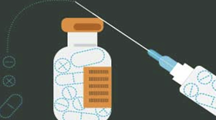
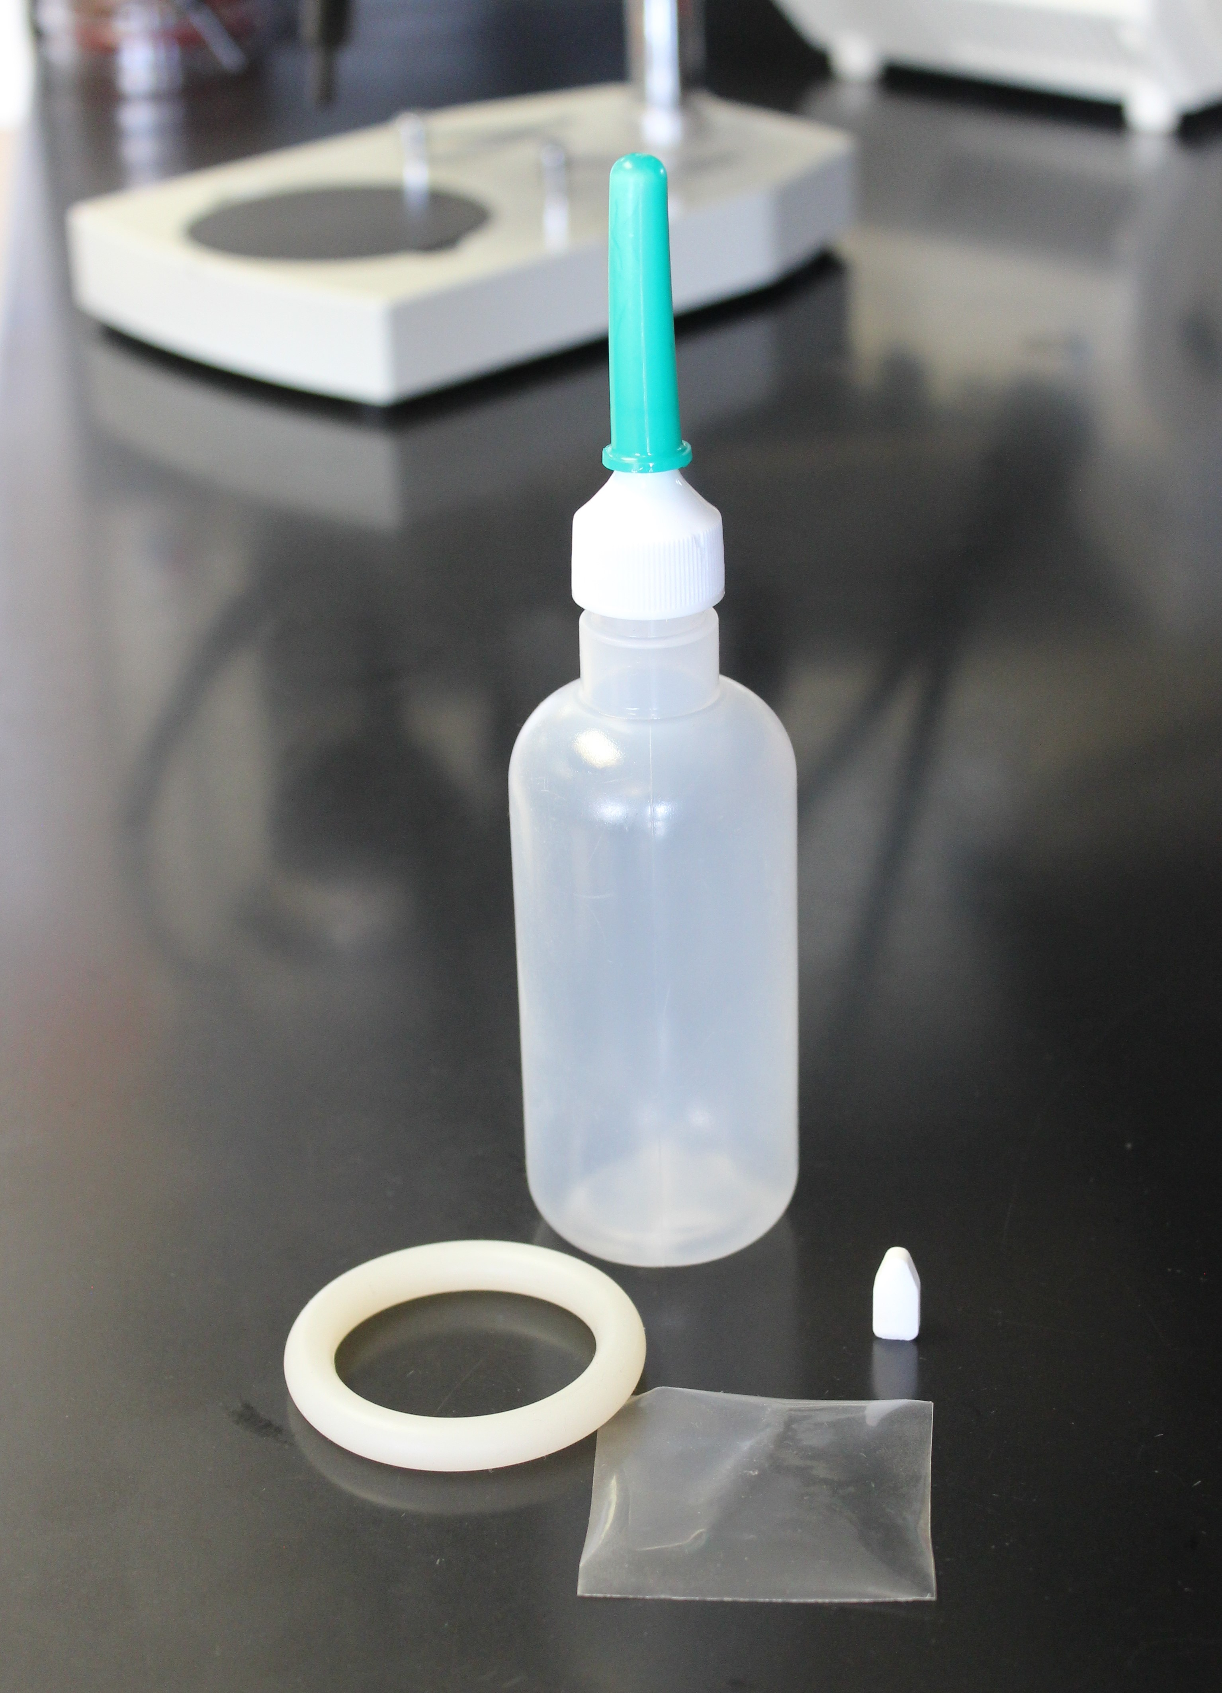
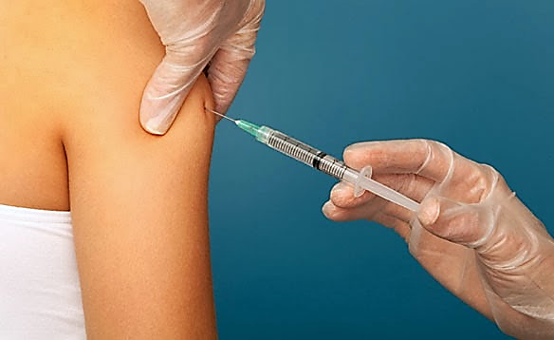
Introduction
Three Important Areas of Biomedical Prevention
PrEP, TasP &
Integrated Strategies
Microbicides
Vaccines
New formulations and delivery methods to reduce the likelihood of transmission.
Products applied vaginally or rectally that may prevent HIV transmission.
Harnessing the immune system to help prevent a person from contracting HIV.
Notes:
Participant Guide page 15-16.
Tell participants before reviewing the slide content: One of our goals today is to increase awareness of and knowledge about HIV prevention research. During this section of the course, we will focus on three important areas of biomedical prevention. When we talk about HIV prevention strategies and tools, we are looking at things that we already know are working, things that are being researched right now, and things that might work and that may be researched in the future.
Review the animated graphic on the slide. Add the following information as each section is revealed:
Provide definitions as each modality is revealed. Tell participants:
Pre-exposure prophylaxis (PrEP), TasP, & Integrated Strategies: PrEP is an HIV prevention approach for HIV negative individuals to stay HIV-negative by taking anti-HIV medicines. There are two FDA approved medications for PrEP. One is called Truvada® and the other is called Descovy ®. Each is a pill approved for daily use in the US. TasP is the use of anti-HIV medicines among people with HIV to reduce the likelihood of transmission to others. “Integrated strategies” refers to other ways of administering PrEP that are currently under research, like injections. More on those later.
Microbicides: Microbicides are products being developed and tested in different forms like vaginal rings, rectal inserts, suppositories, douches, and gels that release drugs in the body over time. They are designed for people of all genders to be applied in the vagina or rectum to help prevent HIV during sex.
An HIV vaccine would teach the body to recognize the virus and activate protective cells to prevent infection or control disease. There is no HIV vaccine right now. But some clinical trials have given hope that an effective vaccine could be developed, and newer trials are ongoing to find out.

Slide 30
Introduction
Vaccines
Post-Exposure Prophylaxis (PEP)
Treatment as Prevention (TasP)
HIV Prevention Toolbox
Pre-Exposure Prophylaxis (PrEP)
Microbicides
Diagnosis and treatment of sexually transmitted infections (STIs)
Prevention of perinatal transmission (PMTCT)
Medical
Harm reduction
Education
Voluntary Medical Penile Circumcision (VMMC)
Needle exchange
Condoms and other barrier methods
Treatment/
prevention of drug/
alcohol abuse
Behavioral/Physical Barriers
Notes:
Participant Guide page 16.
Tell participants before reviewing the slide content: We call these medical prevention tools “modalities.”
Remind participants that:
They just saw this graphic introduced to all of the prevention techniques.
Just because we’re only talking about PrEP & TasP, vaccines, and microbicides here doesn’t mean they should forget about the other prevention methods.
We said earlier that education and a combination of prevention approaches improves effectiveness.
Tell participants after reviewing the slide content: Participation in research can lead to intervention and prevention.

Slide 31
HIV Prevention Research Successes
Prevention of Perinatal Transmission (PMTCT)
The Thai HIV Vaccine Trial (RV144)
CAPRISA 004 Microbicide
iPrEx & Partners PrEP
HPTN 052 (Treatment as Prevention)
ASPIRE, The Ring Study & HOPE
HPTN 083 & HPTN 084 (Injectable PrEP)
Notes:
Participant Guide pages 17-18.
Tell participants before reviewing the slide content: A variety of HIV prevention research successes are creating a great deal of hope that we will soon be able to prevent the spread of HIV. Even when an approach or tool being tested does not work, researchers learn a great deal and can redirect their future efforts accordingly.
Presenters should be prepared to check for updated information and data on the UNAIDS, CDC, NAID, and NIAID websites and provide updates, as needed.
Introduce the overview graphic on the PPT slide. Each of the sections of the graphic will be described in detail on the following slides.

Slide 32
HIV Prevention Research Successes
PMTCT began as clinical research.
It is now considered regular care in the US and much of the world.
Prevention of Perinatal Transmission (PMTCT)
Before 1994, women with HIV had at least a 25% chance of passing HIV to their babies.
Now, in the US, there is less than a 2% chance of HIV transmission when mothers with HIV and their babies receive HIV treatment.
Notes:
Participant Guide pages 17-18.
This slide is the first piece of the overview graphic.
Review the content on the slide as it is revealed by the animation.

Slide 33
HIV Prevention Research Successes
RV144 was a clinical trial from 2003-2009 testing a combination of two HIV vaccines (the “prime” and the “boost”).
The goal of the prime/boost approach is to stimulate different parts of the body’s immune system and increase the body's overall immune response to HIV.
The Thai HIV Vaccine Trial (RV144)
RV144 is the first clinical trial to show evidence of moderate protection and the possibility for an effective vaccine.
It provided a lot of new information about how antibodies form in response to the vaccine.
The prime/boost vaccine combination lowered the rate of HIV infection by about 31%.
Notes:
Participant Guide pages 17-18.
Continue reviewing the overview graphic.
Review the content on the slide as it is revealed by the animation.

Slide 34
HIV Prevention Research Successes
CAPRISA 004 was a clinical trial from 2007-2010 testing the effectiveness of a microbicide gel product containing 1% tenofovir (an antiretroviral medication) in cisgender women used before and after vaginal sex.
CAPRISA 004 Microbicide
CAPRISA 004 is the first clinical trial to show evidence of moderate protection and the possibility of an effective vaginal microbicide.
There were 39% fewer HIV infections among women who used the CAPRISA 004 microbicide.
Notes:
Participant Guide pages 17-18.
Continue reviewing the overview graphic.
Review the content on the slide as it is revealed by the animation.

Slide 35
HIV Prevention Research Successes
iPrEx was a clinical trial from 2007-2009 to test if taking a daily tablet containing two antiretroviral drugs could prevent HIV transmission through anal sex among cisgender men who have sex with men and transgender women who have sex with men.
Partners PrEP was a clinical trial from 2008-2010 for heterosexual couples where one partner had HIV and the other did not.
The medicine proved to be safe and well-tolerated. Side effects were mild and infrequent.
iPrEx & Partners PrEP
These two trials helped pave the way for what we know today: oral PrEP is nearly 100% effective at preventing HIV when taken as prescribed.
The FDA approved this PrEP tablet for daily use in May 2012.
Notes:
Participant Guide pages 17-18.
Continue reviewing the overview graphic. iPrEx stands for “Pre-Exposure Prophylaxis Initiative”
Review the content on the slide as it is revealed by the animation.
Tell participants after reviewing the first bullet: Along with other clinical trials, these two studies helped pave the way for the approval by the FDA for use of Truvada® as PrEP.

Slide 36
HIV Prevention Research Successes
HPTN 052 was a clinical trial from 2005-2010 for couples (mostly heterosexual) where one partner had HIV and the other did not.
It involved the person with HIV taking a combination of three or four drugs from a group of 11 ARVs.
HPTN 052 (Treatment as Prevention)
There was a 96% reduction in HIV transmission overall.
There was a 100% reduction in HIV transmission under conditions of viral suppression (undetectable).
HPTN 052 was the first randomized clinical trial to demonstrate that early antiretroviral therapy can improve health outcomes for people with HIV and prevent transmission of HIV to HIV-negative sex partners.
Notes:
Participant Guide pages 17-18.
Continue reviewing the overview graphic.
Review the content on the slide as it is revealed by the animation.
After reviewing the slide content, stop for questions. The next three subsections are modality specific.

Slide 37
HIV Prevention Research Successes
ASPIRE and The Ring Study were two clinical trials (2012-2016) testing a monthly vaginal ring containing the ARV dapivirine for HIV prevention.
The two studies combined enrolled over 4,500 cisgender women in Africa and showed that the ring was safe and reduced HIV rates by 1/3.
ASPIRE, The Ring Study, & HOPE
Women who used the ring most had the greatest benefit: up to 75% reduction in HIV transmission.
HOPE was a trial in which former ASPIRE participants could use the ring open-label. Results from 1,456 women showed high adherence and suggested a 39% reduction in HIV risk.
Additional trials of the vaginal ring have occurred, and the ring is currently under regulatory review for licensure.
Notes:
Participant Guide page 17-18.
This slide is the first piece of the overview graphic.
Review the content on the slide as it is revealed by the animation.

Slide 38
HIV Prevention Research Successes
HPTN 083 was a study from 2016-2020 testing an injection of the drug cabotegravir for HIV prevention among cisgender men and transgender women who have sex with men.
The injections were given in the buttock muscle once every other month.
This was one of the first studies to set, meet, and exceed enrollment goals for Black MSM and transgender women.
HPTN 083 & HPTN 084 (Injectable PrEP)
The injections proved to be safe, well-tolerated, and equally as effective as oral PrEP.
HPTN 084 is testing the same injectable PrEP drug among cisgender women in Africa. Results are forthcoming.
Notes:
Participant Guide page 18.
This slide is the first piece of the overview graphic.
Review the content on the slide as it is revealed by the animation.
The HPTN 083 enrollment goal for Black MSM was 50% enrollment of this population at US sites (which was met). The enrollment goal for transgender women was 10% globally (which was exceeded at 12%). These goals were set, met, and exceeded only because of the advocacy of community members working in partnership with researchers.

Slide 39
Pre-Exposure Prophylaxis
(PrEP)
www.bethegeneration.org
Notes:
Participant Guide page 19.
Review the content on the slide.

Slide 40
Introduction
Vaccines
Post-Exposure Prophylaxis (PEP)
Treatment as Prevention (TasP)
HIV Prevention Toolbox
Pre-Exposure Prophylaxis (PrEP)
Microbicides
Diagnosis and treatment of sexually transmitted Infections (STIs)
Prevention of perinatal Transmission (PMTCT)
Medical
Harm Reduction
Education
Voluntary Medical Penile Circumcision (VMMC)
Needle exchange programs
Condoms and other barrier methods
Treatment/
prevention of drug/
alcohol abuse
Behavioral/Physical Barriers
Notes:
Participant Guide page 19.
Tell participants before reviewing the slide content: We said earlier that education and a combination of prevention approaches improves prevention effectiveness. The HIV combination prevention toolbox shows the importance of both medical and behavioral/physical tools. Combining multiple tools may provide the best method for HIV prevention. It is recommended that people who are prescribed PrEP also receive counseling as part of a comprehensive HIV prevention package and consistently use condoms.

Slide 41
Introduction
The PrEP prevention approach is focused on people who do not have HIV, but may be vulnerable to contracting HIV through sex and/or injection drug use (IDU).
With PrEP, people who do not have HIV take a medication.
The medication lowers their likelihood of contracting HIV through sexual contact as well as IDU.
Notes:
Participant Guide page 19.
Each of the following modalities stand alone in terms of content and can be pulled out, as needed. If presenting a modality outside of the main context of the training, discuss the toolbox graphic as an introduction. There is repetition of the graphic and some text to ensure that each modality stands alone. Repetition of the graphic is designed to remind participants which modality is being discussed and serve as a reminder of the toolbox.
Tell participants after reviewing the last bullet:
This approach is only effective if the medication is taken exactly as prescribed on a consistent, daily basis.
The idea of PrEP is not new. It is the same idea behind taking birth control pills to prevent pregnancy or taking anti-malarial drugs before traveling to areas where malaria is an issue. People can be healthy but still taking a daily medication to avoid a specific health problem, such as HIV.
PrEP is only available by prescription.
Information related to the optional quiz (referring to injection drug use (IDU)): Q10: False.
Q: PrEP is an HIV prevention method intended for use by people living with HIV.
A: PrEP is an HIV prevention strategy in which HIV‐negative people are prescribed antiretroviral medication to reduce their chances of contracting HIV. However, PrEP is meaningful for people living with HIV too; it has been shown to be an effective HIV prevention method for mixed-status partners to help HIV-negative partners stay negative. Truvada® was the first pill approved by the U.S. Food and Drug Administration as daily oral PrEP in 2012, and Descovy® was the second in 2019. Other medications are being researched as PrEP.
Information related to the optional quiz included in the Participant Guide (referring to the importance of taking medication exactly as prescribed on a consistent, daily basis): Q8: False.
Q: PrEP is a way to prevent HIV by taking HIV treatment medication after exposure to the virus.
A: Among the many ways to prevent HIV, two strategies sound very similar but are quite different: PrEP versus PEP.
PrEP stands for Pre‐Exposure Prophylaxis. It involves prescribing anti-HIV medications to people who are HIV-negative before they are exposed to HIV. People who are vulnerable to contracting HIV who take PrEP every day as prescribed greatly lower their likelihood of contracting HIV.
PEP stands for Post-exposure prophylaxis. This involves taking antiretroviral medicine after being potentially exposed to HIV to prevent the virus from establishing itself in the body. PEP must be started within 72 hours after a possible exposure to HIV.
PrEP and IDU: a study in Thailand showed a reduction in HIV contraction among PWID. Research in this area has not been extensive, but CDC recommends PrEP for people vulnerable to contracting HIV through IDU.

Slide 42
PrEP vs. PEP
HIV Exposure
PrEP is treatment before exposure
PEP is treatment after exposure
Notes:
Participant Guide page 20.
Among the many ways to prevent HIV, two strategies sound very similar but are quite different: PrEP versus PEP.
PrEP stands for Pre‐Exposure Prophylaxis. It involves prescribing anti-HIV medications to people who are HIV-negative before they are exposed to HIV. People who are vulnerable to contracting HIV who take PrEP every day as prescribed greatly lower their likelihood of contracting HIV.
PEP stands for Post-exposure prophylaxis. This involves taking antiretroviral medicine after being potentially exposed to HIV to prevent the virus from establishing itself in the body. PEP must be started within 72 hours after a possible exposure to HIV.
For more info and helpful videos explaining the differences between PrEP and PEP, see: http://www.fredhutch.org/en/research/divisions/vaccine-infectious-disease-division/research/immunology-and-vaccine-development/be-the-generation/prep-tasp.html

Slide 43
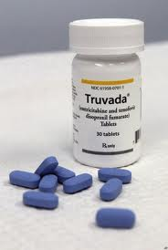
PrEP Progress
One major milestone in HIV prevention was the first approval of daily oral PrEP in the United States. This happened for the first time in 2012, marketed under the brand name Truvada®. Truvada® is a combination of two antiretroviral drugs:
Tenofovir disoproxil fumarate (also called TDF)
Emtricitabine (also called FTC)
Notes:
Participant Guide page 20.
Tell participants before reviewing the slide content: PrEP research focuses on using medications combined with other HIV prevention methods, including consistent use of condoms.
Review the content on the slide.

Slide 44
Oral PrEP Progress
January 2011
Interim guidance issues by the US Centers for Disease Control and Prevention (CDC) for men who have sex with men and transgender women who are vulnerable to HIV
July 2012
Approved by the US Food and Drug Administration (FDA) for daily use
August 2012
Interim guidance issues by the CDC for heterosexual men and women vulnerable to HIV, such as those in relationships where one person has HIV and the other does not
World Health Organization issued guidance on PrEP use
June 2013
CDC adds injection drug use to the interim guidance on PrEP use based on the results of the Bangkok Tenofovir Study
Notes:
Participant Guide page 20.
Tell participants before reviewing the slide content: Oral PrEP milestones are…
Review the animated content on the slide.
We can also add to this list the FDA approval of Descovy as PrEP in October 2019, and there are sure to be more options for PrEP approved in years to come.
Information related to the optional quiz (end of bullet under January 2011): Q9: True.
Q: Daily oral PrEP has been shown to reduce people’s chances of contracting HIV among gay men, transgender women, and inf couples where one person has HIV and the other does not.
A: Daily oral PrEP has been shown to help reduce the likelihood of contracting HIV in multiple studies, including in gay men and other men who have sex with men, transgender women, and couples where partners have different HIV statuses. Oral PrEP is highly effective with daily use, with some studies demonstrating a more than 90 percent reduction in HIV acquisition.

Slide 45
HIV Prevention Using Oral PrEP
Truvada® (also known as TDF/FTC) is FDA-approved for daily use for HIV prevention.
Truvada® should be taken as prescribed to be effective as PrEP.
It is recommended that people who are prescribed PrEP continue to use condoms to prevent other STIs.
Notes:
We will focus on Truvada instead of Descovy because Truvada is approved for anyone vulnerable to HIV acquisition, while Descovy has limited approval.
Participant Guide page 21.
Review the content on the slide.
Add the following information for the bullets:
Truvada® (also known as TDF/FTC) is FDA-approved for daily use for HIV prevention: For HIV treatment, Truvada® is approved only in combination with other ARVs.
It is recommended that people who are prescribed PrEP continue to use condoms. Like any prevention modality (including condoms), PrEP is not 100% effective in preventing HIV, and it does not prevent the transmission of other sexual transmitted infections such as syphilis or gonorrhea.

Slide 46
HIV Prevention Using Oral PrEP
How Truvada® as PrEP works
Truvada® is an oral pill consisting of two antiretroviral medications (ARVs) that protects people who do not have HIV if they are exposed to the virus
ARVs block HIV replication in multiple places in the reproductive cycle of the virus
Notes:
Participant Guide page 21.
Tell participants before reviewing the slide content: While the availability of Truvada® as a prescription for use as PrEP is a major breakthrough, there are still limitations, and there are very specific guidelines for use.
Continue reviewing the guidelines for using Truvada®.

Slide 47
HIV Prevention Using Oral PrEP
Who should use Truvada® for HIV prevention?
Anyone who is vulnerable to contracting HIV, including…
Men who have sex with men
Transgender women who have sex with cisgender men
Couples where one partner has HIV and the other does not
People who use injection drugs
Notes:
Participant Guide page 21.
Continue reviewing the guidelines for using Truvada®.
Presenters should be prepared to check for updated information and data on the UNAIDS, CDC, NAID, and NIAID websites and provide updates, as needed.

Slide 48
HIV Prevention Using Truvada®
Requirements for use
Be HIV-negative
Test for HIV at least every three months while taking Truvada®
Take Truvada® as prescribed to achieve the maximum HIV prevention benefit
Notes:
Participant Guide page 21.
Continue reviewing the guidelines for using Truvada®.
Add the following information: To get Truvada®, one must initiate a conversation with their doctor.

Slide 49
Continuing Research: PrEP & Integrated Strategies
Research in more countries and populations
Different drugs, delivery methods, and dosing schedules
Implementation research to understand PrEP in “real world” settings
Some of the goals of ongoing PrEP research include:
Notes:
Participant Guide page 22.
Tell participants before reviewing the slide content: Although PrEP has now been approved in the U.S., ongoing PrEP research is still needed. There is currently research of different oral dosing strategies, long-acting injectables, implants, and other drugs that could be used as PrEP.
Tell participants after the last section of the Implementation research part of the graphic is revealed: This research will not only continue to examine the effectiveness of PrEP, but will also examine the factors that may impact access to PrEP and decisions to use this HIV prevention tool within various groups of people, such as young men who have sex with men (YMSM).

Slide 50
What Did You Learn?
In this activity, you will brainstorm how you can apply what you learned about PrEP by answering a question.
With your group:
Brainstorm the question you are assigned (you only need to brainstorm one of the questions).
Share your answers with the whole group so they can hear your ideas.
What thoughts, questions and concerns came to your mind about PrEP as you heard/read information about this HIV prevention modality?
If you were asked to speak to an audience about PrEP, what would be the three most important messages you would want to convey?
Notes:
Participant Guide page 23.
Introduce a small group activity. Divide the class into two groups. Assign the questions to the groups (one question per small group).
Assign one of the questions in the boxes to each group.
Allow approximately 5 mins for the groups to brainstorm their answers.
Encourage participants to write their brainstorm on a flip chart, white board, and/or in their Participant Guides (each question has been reproduced in the Participant Guide with space to write).
Ask someone from each group to share some/all of their answers.
Encourage the other groups to write these answers in the provided space in their Participant Guides.
Note: This is a shortened activity using only 2 questions. There will be one larger activity at the end of the three modalities.
Possible answers include:
Question 1: What thoughts, questions and concerns came to your mind about PrEP as you heard/read information about this HIV prevention modality? The importance of getting tested; cost of the medications; importance of regular medication use.
Question 2: If you were asked to speak to an audience about PrEP, what would be the three most important messages you would want to convey? It is nearly 100% effective if taken correctly; Get tested; take the recommended medication dose as directed consistently.
Allow approximately 5 min for each person to answer the question. Ask for volunteers to share their answers. Allow approximately 5 mins to share answers.
Total time for this activity: 10 mins

Slide 51
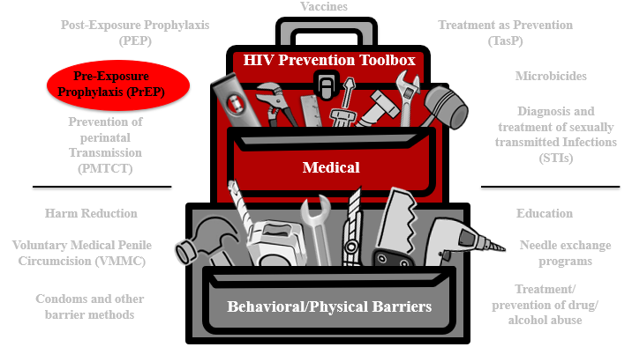
PrEP Summary
PrEP is a medical HIV prevention approach for people who don’t have HIV but are vulnerable to HIV.
Oral Truvada® was the first drug approved for PrEP and involves taking medication on a daily basis to reduce the likelihood of contracting HIV through sex or injection drug use.
Researchers are studying new PrEP approaches like injectables and implants that would last much longer than daily-dose pills.
Notes:
Participant Guide page 24.
Review the content on the slide.
Tell participants after reviewing the slide content: The HIV combination prevention toolbox reinforces the role of PrEP combined with other behavioral/physical tools. Combining multiple tools may provide the best method for HIV prevention.

Slide 52
Questions?
Notes:
No Participant Guide page.
Stop to ask/answer questions before moving to the next modality.
Ask participants if they have any questions. Answer all questions, if possible. If not, make a note of these questions to prepare for the next training session.

Slide 53
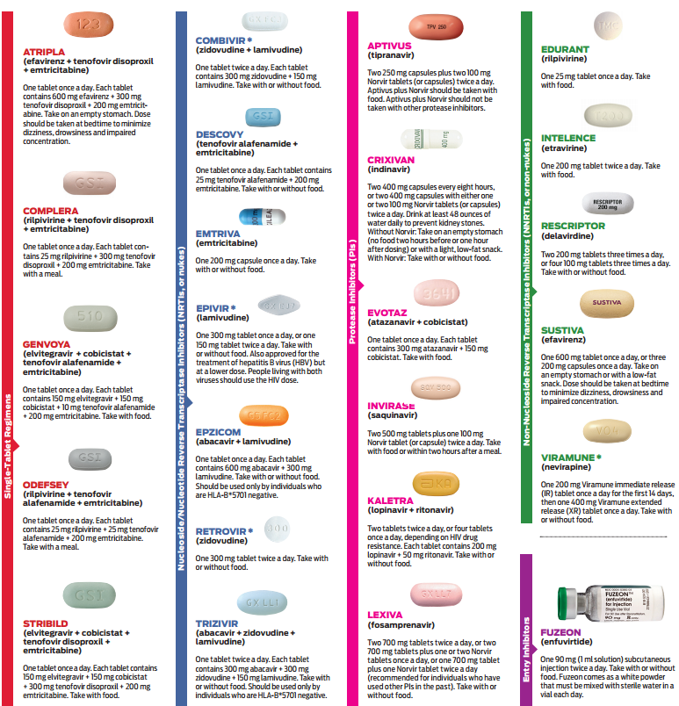
Treatment as Prevention
(TasP)
Notes:
Participant Guide P. 25

Slide 54
Introduction
Vaccines
Post-Exposure Prophylaxis (PEP)
Treatment as Prevention (TasP)
HIV Prevention Toolbox
Pre-Exposure Prophylaxis (PrEP)
Microbicides
Diagnosis and treatment of sexually transmitted Infections (STIs)
Prevention of perinatal Transmission (PMTCT)
Medical
Harm Reduction
Education
Voluntary Medical Penile Circumcision (VMMC)
Needle exchange programs
Condoms and other barrier methods
Treatment/
prevention of drug/
alcohol abuse
Behavioral/Physical Barriers
Notes:
Participant Guide page 25.
Tell participants before reviewing the slide content: We just talked about PrEP. Now let’s talk about another highly effective HIV prevention method: Treatment as Prevention, or “TasP.”
Tell participants after reviewing the slide content: While PrEP is only to be used by people who do not have HIV, TasP is an approach for people living with HIV to reduce the likelihood of passing HIV to others.

Slide 55

Introduction
The TasP prevention approach is focused on people living with HIV.
With TasP, people with HIV take medication.
The medication controls the HIV in their bodies and keeps them healthy.
The medication also lowers their likelihood of transmitting HIV to others.
Notes:
Participant Guide page 25.
Both PrEP and TasP involve people taking anti-HIV medications. The difference is that people who are HIV-negative take medications in the PrEP approach to lower their likelihood of getting HIV, while people who are living with HIV take medications to treat their condition, which also results in a reduction in the likelihood of HIV transmission to others. This is why we call it “Treatment as Prevention,” or “TasP.”
As discussed previously in the history of HIV, we have had effective combination anti-retroviral therapies for treating HIV since 1996. Today, many people with HIV take only one pill a day to successfully treat HIV and live healthy lives with life expectancy nearly equal to that of people who do not have HIV. There are now many different options for drug regimens prescribed to treat HIV, and the main purpose of anti-retroviral therapy is to control the amount of HIV in the body to keep the immune systems of people with HIV healthy, protecting against opportunistic infections and the development of AIDS. Additionally, we have learned through clinical research that ART is also highly effective in preventing the transmission of HIV to others. By successfully treating HIV in people living with the virus, we are also preventing new transmissions. This is why we call it Treatment as Prevention (TasP).

Slide 56
TasP Progress
2011
HPTN 052 becomes the first randomized clinical trial to show that early ART improves health outcomes for people with HIV and helps prevent transmission to HIV-negative partners.
2016
PARTNER study results reveal zero transmissions under conditions of viral suppression after at least 58,000 distinct acts of penetrative sex without condoms.
2016-beyond
NIH, CDC, US state and local health departments, and organizations around the world support the science behind the global U=U campaign (Undetectable = Untransmittable).
2017-beyond
Opposites Attract study results reveal zero transmissions under viral suppression among mixed-status cis gay couples after 16,889 acts of condomless anal sex without PrEP.
The PARTNER 2 study followed, showing zero transmissions after 77,000 such acts. Undetectable really does equal untransmittable.
Notes:
Participant Guide page 26.
Review the animated content on the slide.
HPTN 502: In 2011, the HPTN 052 study became the first randomized clinical trial to show that early ART improves health outcomes for people with HIV
It also showed that ART helps prevent transmission to HIV-negative sex partners. In the study, ART reduced HIV transmission by 96% overall. Stunningly, it also reduced HIV transmission by 100% when study participants taking ART had achieved viral suppression, meaning the ART was working such that the amount of HIV in the body had durably dropped below 200 copies per mm³. This is also known as “undetectable.”
This study paved the way for a massive global campaign called U=U, which means “undetectable equals untransmittable.” In other words, people with HIV who have an undetectable viral load cannot transmit HIV to their sex partners. The U=U concept applies only to sexual transmission of HIV; having an undetectable viral load is not 100% protective against HIV transmission by other means (e.g. injection drug use or breastfeeding).
PARTNER: In 2016, the PARTNER study showed zero HIV transmissions under conditions of viral suppression after at least 58,000 distinct acts of penetrative sex without condoms. This study reinforced what we learned from HPTN 052 about TasP and U=U.
PARTNER 2: In 2017 and beyond, more studies with mixed HIV status couples continued to confirm that undetectable really does equal untransmittable. The earlier studies had enrolled mostly heterosexual couples, but the U=U message was shown to be true for cisgender gay male couples too in studies like Opposites Attract and PARTNER 2. Combined, these studies showed zero transmissions under conditions of viral suppression after nearly 100,000 acts of condomless anal sex without PrEP.

Slide 57
The Treatment Cascade in the U.S.
1.1 million people with HIV
935,000 (85%) know their status
682,000 (62%) have started HIV medical care
528,000 (48%) have stayed in HIV medical care
539,000
(49%)
-CDC, 2017
(https://www.cdc.gov/nchhstp/newsroom/2017/HIV-Continuum-of-Care.html)
…have a suppressed viral load (<200 copies/ml)
Notes:
Participant Guide page 27.
The research findings about TasP have helped us to better understand the importance of the treatment cascade. About half of the people living with HIV in the US have a suppressed viral load, which means they cannot transmit HIV to others as long as their viral load stays suppressed. The better we can help more people know their status, link them to HIV care, start ART, and achieve viral suppression, not only will we help people with HIV stay healthy, but we will also drastically reduce rates of new HIV transmissions.
Adding PrEP into the landscape for people who do not have HIV but are vulnerable to getting it has the potential to turn around the trajectory of the epidemic. Remember that there is an entire combination HIV prevention toolbox including biomedical and behavioral interventions; using multiple strategies in combination has the best chance of ending the epidemic.
This approach is most effective if the medication is taken exactly as prescribed.
The gold standard for effective ART is called “viral suppression,” also referred to as “undetectable.” This means that the ART is working such that the amount of virus in the body is reduced so low that an average HIV test can no longer detect the virus. Under this condition of viral suppression, HIV cannot be transmitted!

Slide 58
Continuing Research: Treatment as Prevention
Develop products that:
Are/are not ARV-based
Conduct more research on:
Drug resistance
Understand issues around:
Address adherence issues
Reach the most vulnerable populations
Alternate dosing
Delivery methods (for example, injections and implants)
ART access and availability
Cost
Barriers to linkage and retention in HIV medical care
Stigma
Notes:
Participant guide page 28.
Research into treatment for people with HIV continues, including research looking specifically at treatment as prevention. We know that only about half of people with HIV in the US have reached viral suppression, so additional strategies are needed to improve treatment. If every person with HIV in the US could reach viral suppression, we could effectively end the sexual transmission of HIV. But that is not the world we currently live in; we need a multitude of products, dosing, delivery methods, and so forth because no single product will be right for everyone.

Slide 59
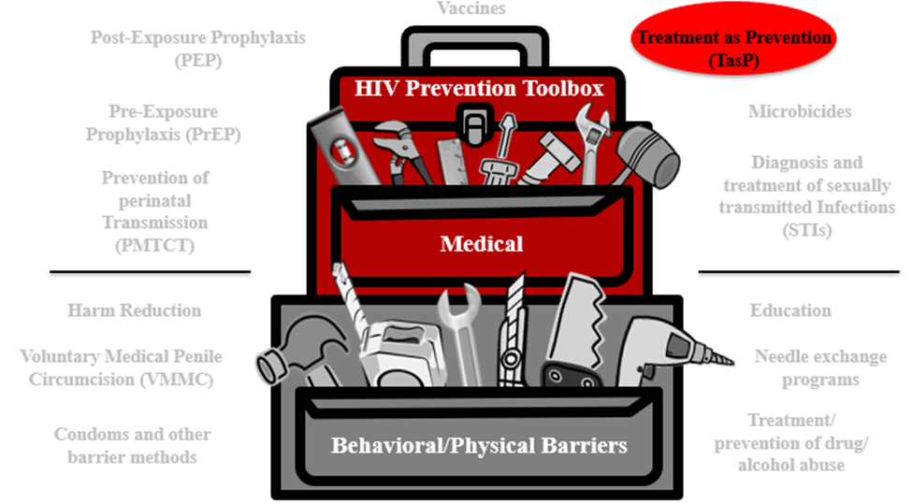
TasP Summary
TasP is a medical HIV prevention approach for people with HIV to reduce the likelihood of transmission to others.
Many treatment options are available for TasP, but gaps persist in the HIV treatment cascade.
Researchers are studying new treatment approaches to address these gaps like injectable ART and ART implants.
Notes:
Participant Guide page 29.
Review the content on the slide.
Tell participants after reviewing the slide content: The HIV combination prevention toolbox reinforces the role of TasP combined with other behavioral/physical tools. Combining multiple tools may provide the best method for HIV prevention.

Slide 60

Continuing Research: PrEP & Integrated Strategies
A number of public and private organizations, in partnership and individually, are working together to find solutions that can help prevent HIV.
The HIV Prevention Trials Network (HPTN), funded by the National Institute of Allergy and Infectious Diseases (NIAID), National Institute of Mental Health (NIMH), and the National Institute of Drug Abuse (NIDA) is dedicated to discover and develop new and innovative research strategies to reduce the acquisition and transmission of HIV.
Notes:
Participant Guide page 29.
Review the content on the slide.
Together, PrEP and TasP have the potential to end the HIV epidemic as we know it. However, the PrEP and TasP approaches we currently have are not reaching those who need them most. Research continues to strive to find improved PrEP and TasP methods to end the epidemic.

Slide 61
What Did You Learn?
In this activity, you will brainstorm how you can apply what you learned about TasP by answering a question.
With your group:
Brainstorm the question you are assigned (you only need to brainstorm one of the questions).
Share your answers with the whole group so they can hear your ideas.
What thoughts, questions, and concerns came to your mind about TasP as you heard/read information about this HIV prevention modality?
If you were asked to speak to an audience about TasP, what would be the three most important messages you would want to convey?
Notes:
Participant Guide page 30.
Introduce a small group activity. Divide the class into two groups. Assign the questions to the groups (one question per small group).
Assign one of the questions in the boxes to each group.
Allow approximately 5 mins for the groups to brainstorm their answers.
Encourage participants to write their brainstorm on a flip chart, white board, and/or in their Participant Guides (each question has been reproduced in the Participant Guide with space to write).
Ask someone from each group to share some/all of their answers.
Encourage the other groups to write these answers in the provided space in their Participant Guides.
Note: This is a shortened activity using only 2 questions. There will be one larger activity at the end of the modalities.
Possible answers include:
Question 1: What thoughts, questions and concerns came to your mind about TasP as you heard/read information about this HIV prevention modality? The importance of getting tested; cost of the medications; importance of regular medication use.
Question 2: If you were asked to speak to an audience about TasP, what would be the three most important messages you would want to convey? Get tested; take the recommended medication dose as directed consistently, U=U.
Allow approximately 5 min for each person to answer the question. Ask for volunteers to share their answers. Allow approximately 5 mins to share answers.
Total time for this activity: 10 mins

Slide 62
Questions?
Notes:
No Participant Guide page.
Stop to ask/answer questions before moving to the next modality.
Ask participants if they have any questions. Answer all questions, if possible. If not, make a note of these questions to prepare for the next training session.

Slide 63
Microbicides
www.bethegeneration.org
Notes:
Participant Guide page 31.
Introduce the next modality: Microbicides.

Slide 64
Introduction
Vaccines
Post-Exposure Prophylaxis (PEP)
Treatment as Prevention (TasP)
HIV Prevention Toolbox
Pre-Exposure Prophylaxis (PrEP)
Microbicides
Diagnosis and treatment of sexually Transmitted Infections (STIs)
Prevention of perinatal transmission (PMTCT)
Medical
Harm reduction
Education
Voluntary Medical Penile Circumcision (VMMC)
Needle exchange programs
Condoms and other barrier methods
Treatment/
prevention of drug/
alcohol abuse
Behavioral/Physical Barriers
Notes:
Participant Guide page 31.
Tell participants after reviewing the slide content: Just because we’re only talking about biomedical HIV prevention doesn’t mean you should forget about the other prevention methods.
We said earlier that education and a combination of prevention approaches improves effectiveness, which includes combination prevention.
Participation in research can lead to intervention and prevention.
Tell participants after reviewing the slide content: The HIV combination prevention toolbox shows the importance of both medical and behavioral/physical tools. Combining multiple tools may provide the best method for HIV prevention.

Slide 65
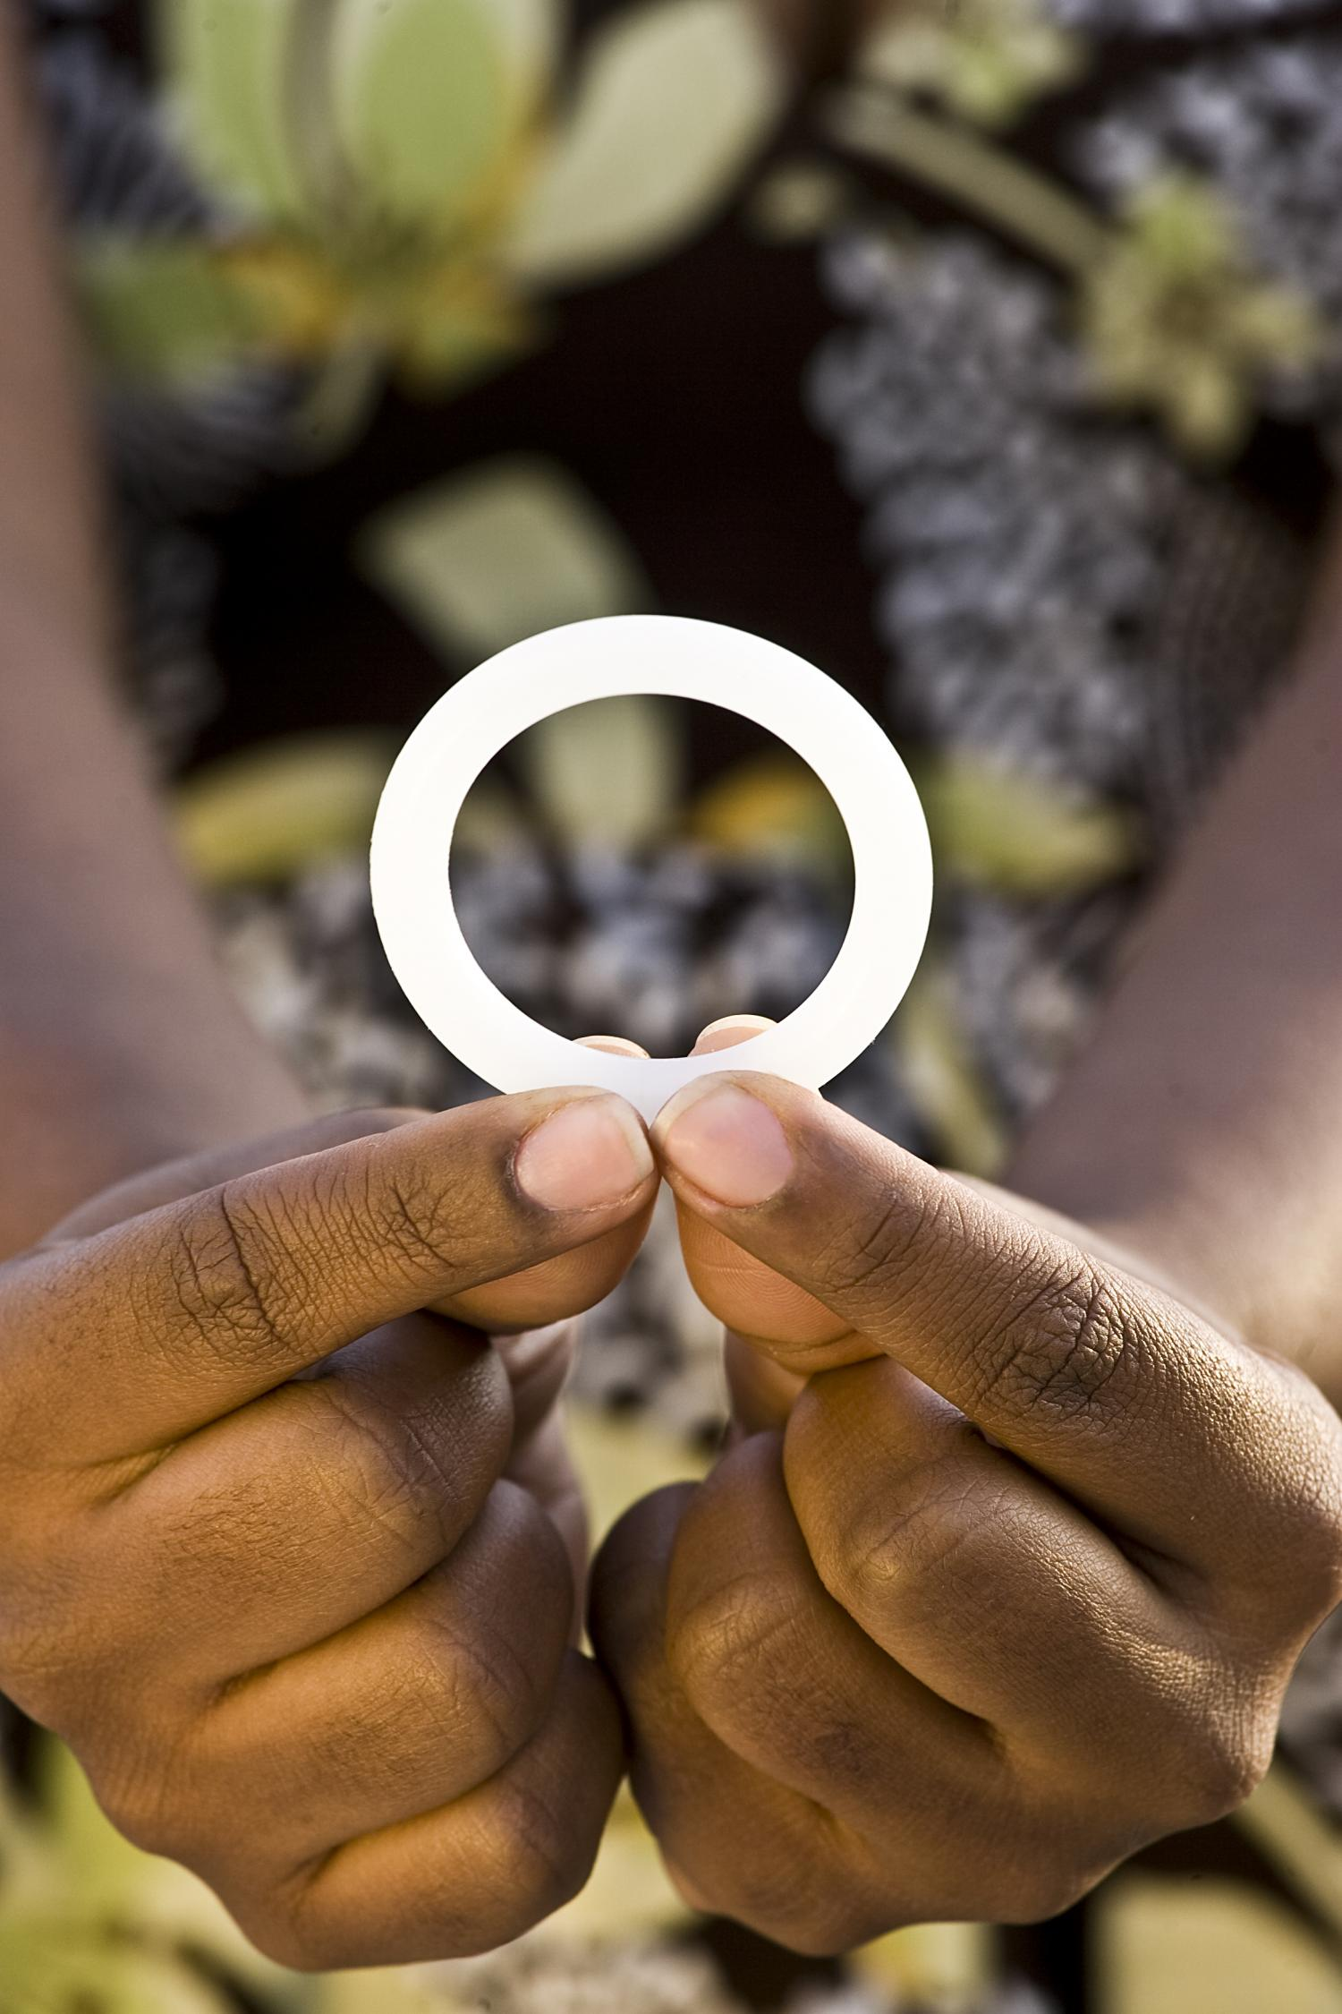
Introduction
Microbicides are products applied inside the vagina or rectum to reduce the likelihood of HIV transmission during vaginal and anal sex. Microbicides can include:
Films, gels, douches, fast-dissolving inserts, and suppositories
Vaginal rings, which are furthest along in development and may be licensed soon
Notes:
Participant Guide page 31.
Review the content on the slide.
Microbicides are products applied inside the vagina or rectum to protect against HIV through sex. They are different from other PrEP products because they only deliver anti-HIV drugs to the sites of potential HIV transmission with very little drug absorbed into the body, whereas pills, injectables, and implants deliver drugs systemically (throughout the entire body). Microbicides could fulfill the need for a non-systemic and/or short-acting method for HIV prevention that could be used around the time of sex.
The image featured here is of the dapivirine vaginal ring, the study product from the three vaginal ring studies we discussed earlier: ASPIRE, The Ring Study, and HOPE. It’s a flexible silicone monthly ring that slowly releases the drug dapivirine inside the vagina. Regulatory approval is currently being sought for the ring based on multiple studies with more than 6,600 cisgender women, finding that the ring has as strong safety profile and reduces HIV transmission—especially when used consistently.

Slide 66

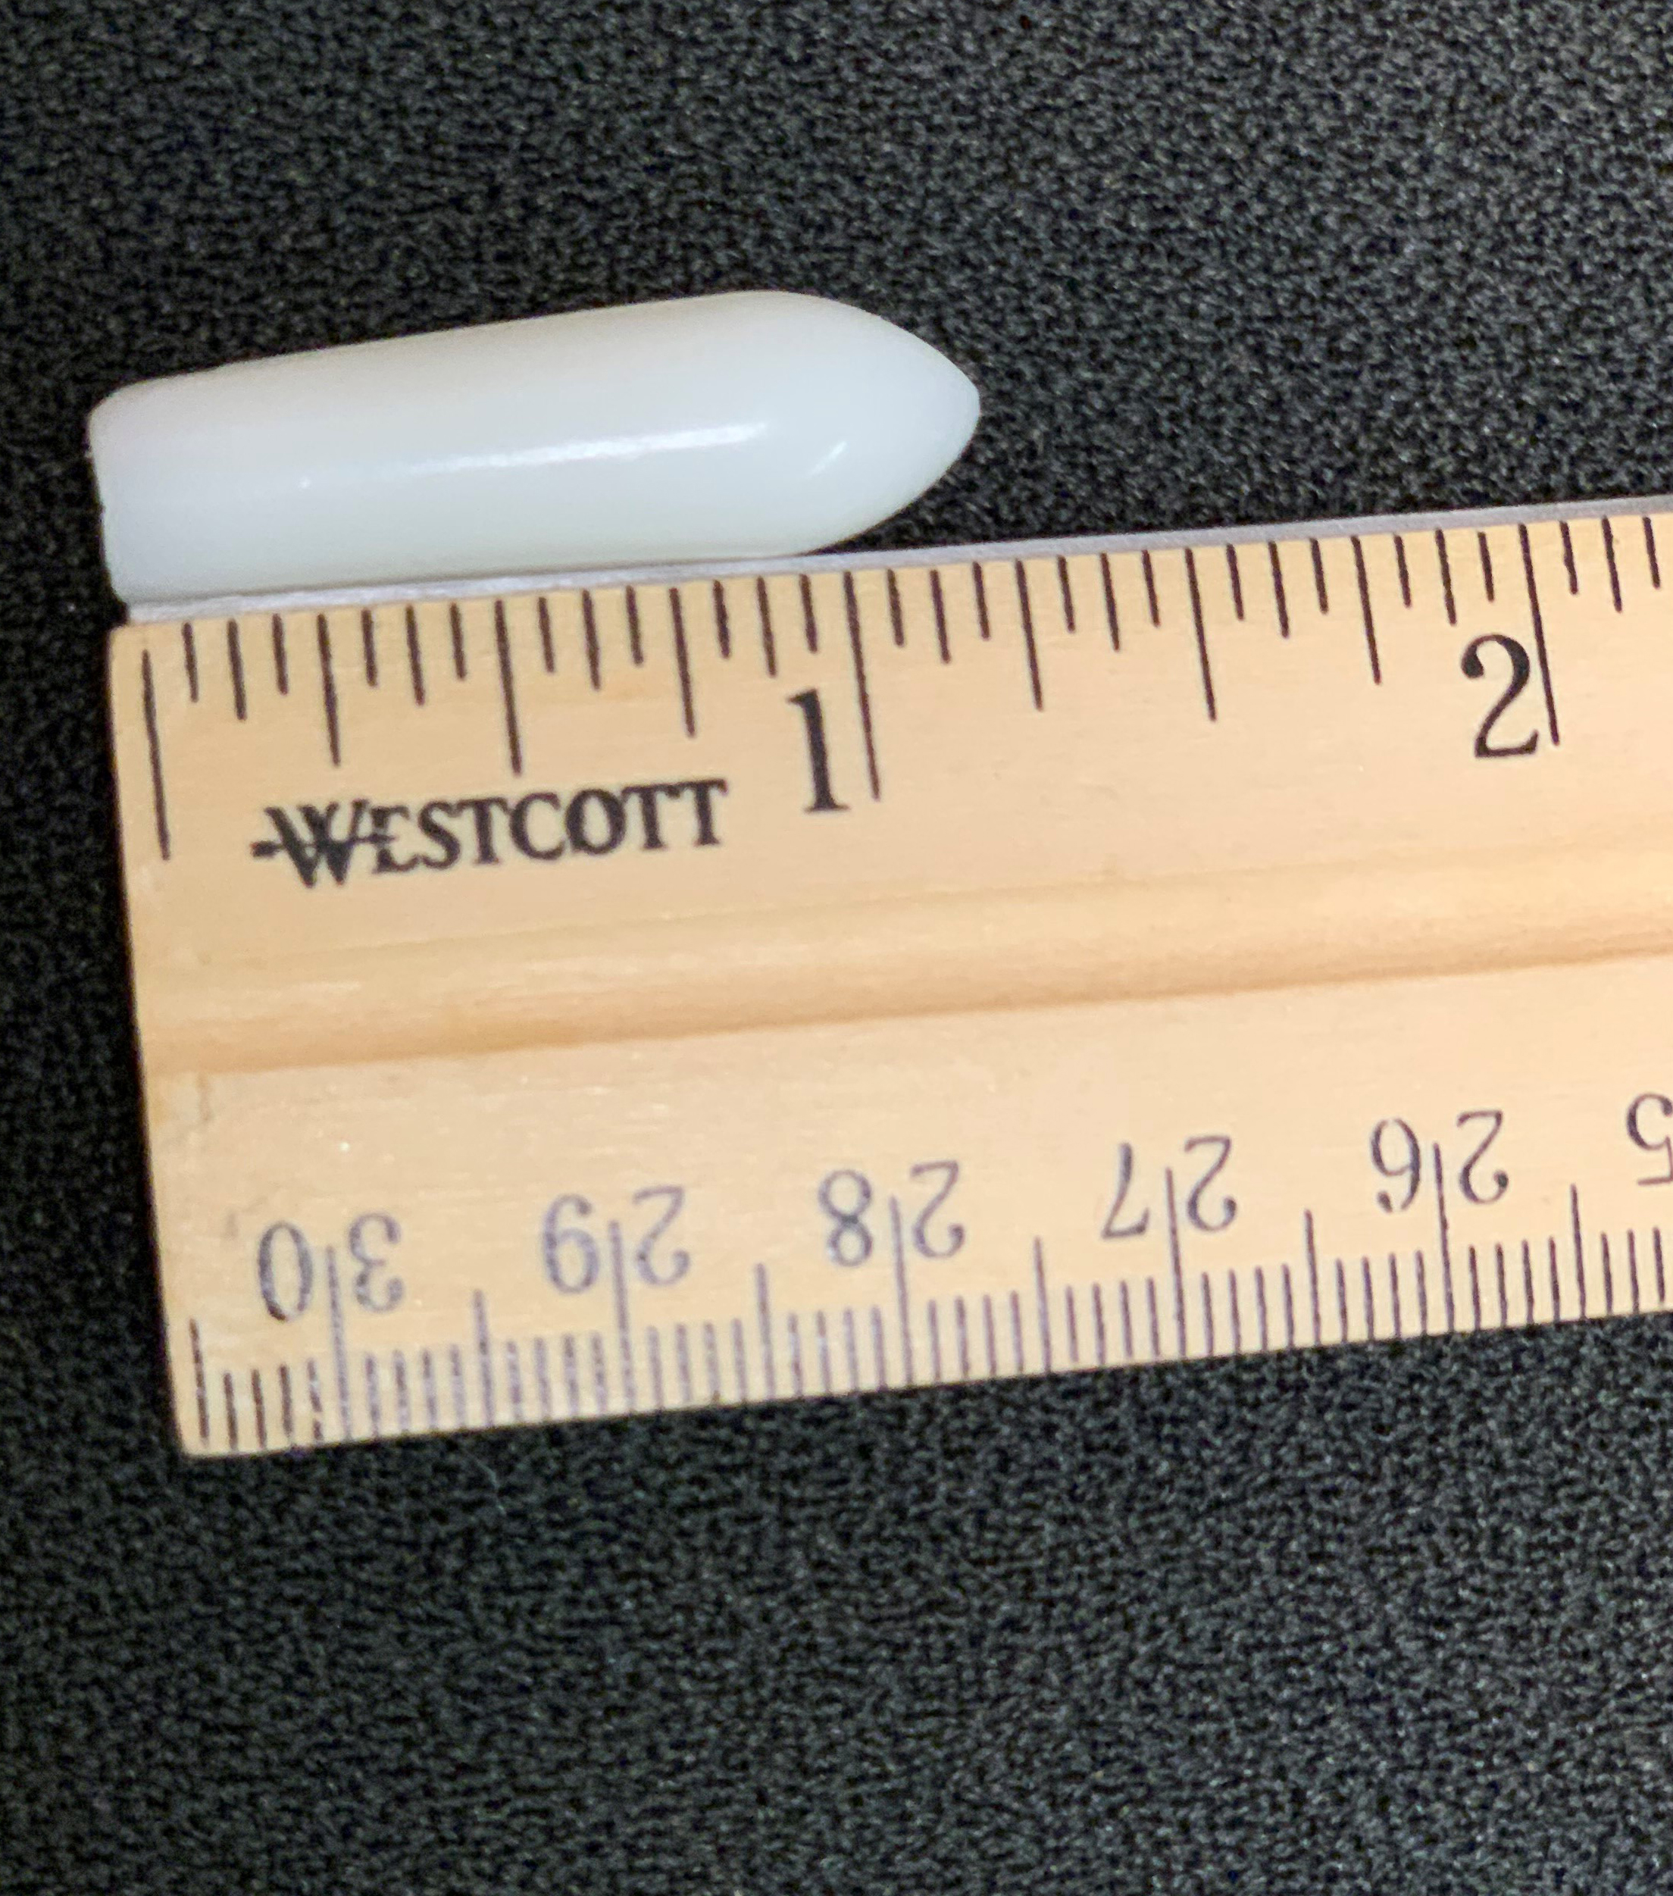
Introduction
Most microbicides being tested today contain antiretroviral (ARV) drugs.
ARVs block HIV replication in multiple places in the reproductive cycle of the virus.
These drugs have been shown to protect people who do not have HIV if they are exposed to the virus by disrupting HIV’s life cycle, thus preventing HIV from taking hold in the body.
Notes:
Participant Guide page 31.
Review the content on the slide.
Tell participants after reviewing the second bullet: Tell participants after reviewing the slide content: For example, ARVs are used in Pre-Exposure Prophylaxis, or PrEP.
Information related to the optional quiz (see the first bullet): Q13: True.
Q: Most microbicides tested today contain HIV antiretroviral drugs which are also used to treat people living with HIV/AIDS.
A: Different types of microbicides are being tested in clinical trials, but those that incorporate antiretroviral (ARV) drugs are furthest along in development and testing. The idea behind ARV-based microbicides is that some of the same drugs used to treat HIV may also help prevent people without HIV from contracting it.

Slide 67
Why Are Microbicides Important?
Vaginal microbicides
Designed to prevent HIV acquisition through the vagina
Rectal microbicides
Designed to prevent HIV acquisition through the rectum
Notes:
Participant Guide page 32.
Tell participants before reviewing the slide content: Microbicides are not yet available for use outside clinical trials. The microbicides under study are used vaginally and/or rectally to protect the user from HIV transmission during sex.
Tell participants after reviewing the “Vaginal microbicides” content:
Cisgender women represent about 20 percent of new HIV cases in the U.S.
Cis women are more likely than cis men to contract HIV through heterosexual sex.
Tell participants after reviewing the “Rectal microbicides” content:
Rectal microbicides are designed to prevent HIV among people of all genders during anal sex.
An estimated 5-10% of the world’s population engages in anal sex.
Because the lining of the wall of the rectum is different from the lining of the vagina, rectal-specific microbicides and formulations are being tested in clinical trials in addition to products for vaginal use.
The likelihood of contracting HIV during condomless/PrEPless anal sex is 10 to 20 times greater than condomless/PrEPless vaginal sex. Because the rectal lining is only one-cell thick, the virus can more easily reach cells.
Information related to the optional quiz Q11: False.
Q: Microbicides refer to pills taken orally to prevent people from contracting HIV.
A: Microbicides are being developed to reduce a person’s likelihood of contracting HIV or other sexually transmitted infections when applied topically inside the vagina or rectum. Vaginal microbicides are primarily being tested as rings, while rectal microbicides are being tested as gels, douches, and suppositories. Unlike microbicides, oral pre‐exposure prophylaxis (PrEP) is an HIV prevention approach that involves the use of an antiretroviral pill by people who are HIV-negative.
Information related to the optional quiz (rectal microbicides): Q12: False.
Q: Microbicides are only being tested among women.
A: Microbicides are being tested among women and men--transgender and cisgender alike--and gender non-binary people. Within these populations, microbicides research is being conducted on products for use during vaginal sex as well as anal sex. According to estimates, 5 to 10 percent of the world’s population engages in anal sex, including cisgender and transgender women and men and gender non-binary people.

Slide 68
Why Are Microbicides Important?
“If proven effective…microbicides could protect against HIV in people who are unable or reluctant to use condoms. Unlike condoms, they could provide an alternative way to reduce risk that is not controlled by one’s sexual partner and possibly enhance sexual pleasure, helping to motivate consistent use.”
- MTN Rectal Microbicide Fact Sheet
Notes:
Participant Guide page 32.
Review the content on the slide.

Slide 69
Why Are Microbicides Important? continued
Microbicides and women
For trans and cis women around the world, some prevention tools are not practical.
Because of gender-based violence and other factors, it can be difficult for women to:
Insist that partners use condoms
Limit their or their partner’s HIV exposure
Test or treat themselves or their partners for sexually transmitted infections (STIs)
Notes:
Participant Guide page 32.
Review the content on the slide.
Tell participants there are many complex societal, economic, and cultural reasons why women specifically need multiple forms of HIV prevention tools.

Slide 70
Why Are Microbicides Important?
Microbicides and men
Men who have sex with men:
Make up about 70% of all new cases of HIV in the US
Represent more than 50% of the people currently living with HIV in the US
Globally, are 19 times more likely to contract HIV than the general population
Consistent condom use is a problem for many men. Microbicides may offer an alternative and could be formulated like a lubricants and douches, which many men already use for anal sex
Notes:
Participant Guide page 32.
Review the content on the slide.
Note that there is not adequate data to report on transgender men.

Slide 71
Challenges with Microbicides
Dependence on human behavior requiring regular application
Cultural and regional preferences
Rectal microbicides research is in the early phase of clinical development due in part to scientific challenges related to the biology of the rectum and cultural reluctance to address anal sex.
Notes:
Participant Guide page 33.
Tell participants before reviewing the slide content: HIV prevention in general has challenges, and microbicides are no exception.
Review the content on the slide.
Research is under way to explore issues related to STIs and contraception.

Slide 72
Continuing Research: Microbicides
Develop products that:
Are/are not ARV-based
Conduct more research on:
Drug resistance
Understand issues around:
Are contraceptive, non-contraceptive, and broad-spectrum against several sexually transmitted diseases
Designed for vaginal and/or rectal use
Alternate dosing
Delivery methods (for example, rectal douches)
Access and availability
Cost
Regular HIV testing requirements
Need for prescriptions for ARV-based microbicides
Effects on pregnancy and breastfeeding
Notes:
Participant Guide page 34.
Tell participants before reviewing the slide content: Next steps in vaginal and rectal microbicides research are to…
Review the content on the slide.

Slide 73

Continuing Research: Microbicides
A number of public and private organizations, in partnership and individually, are working together to find microbicides that can help prevent HIV.
The Microbicide Trials Network (MTN), funded by the National Institute of Allergy and Infectious Diseases (NIAID), brings together international investigators, community stakeholders, and industry partners who focus on developing and evaluating microbicides. The MTN is focused on evaluating non-systemic and multi-purpose products with studies designed to support potential regulatory approval of products.
Notes:
Participant Guide page 34.
Review the content on the slide.
Presenters should be prepared to check for updated information and data on the UNAIDS, CDC, NAID, and NIAID websites and provide updates, as needed.
Information related to the optional quiz Q14: True.
Q: There are possible health risks associated with participating in biomedical HIV prevention studies.
A: There are risks involved in participating in any clinical trial. Researchers in the HIV prevention field strive to minimize these risks by incorporating a multi‐tiered safety review process into clinical studies, engaging in the informed consent process to ensure that participants understand the risks associated with the study, and by conducting them under the watchful eye of regulatory and research authorities.

Slide 74
What Did You Learn?
In this activity, you will brainstorm how you can apply what you learned about microbicides by answering a question.
With your group:
Brainstorm the question you are assigned (you only need to brainstorm one of the questions).
Share your answers with the whole group so they can hear your ideas.
What thoughts, questions, and concerns came to your mind about microbicides as you heard/read information about this HIV prevention modality?
If you were asked to speak to an audience about microbicides, what would be the three most important messages you would want to convey?
Notes:
Participant Guide page 35.
Presenter notes: Introduce a small group activity.
Divide the class into two groups. Assign the questions to the groups (one question per small group).
Assign one of the questions in the boxes to each group.
Allow approximately 5 mins for the groups to brainstorm their answers.
Encourage participants to write their brainstorm on a flip chart, white board, and/or in their Participant Guides (each question has been reproduced in the Participant Guide with space to write).
Ask someone from each group to share some/all of their answers.
Encourage the other groups to write these answers in the provided space in their Participant Guides.
Note: This is a shortened activity using only 2 questions. There will be one larger activity at the end of the modalities.
Possible answers include:
Question 1: What thoughts, questions and concerns came to your mind about microbicides as you heard/read information about this HIV prevention modality? The importance of testing, research, and using combination prevention methods.
Question 2: If you were asked to speak to an audience about microbicides what would be the three most important messages you would want to convey? The importance of testing, research, and using combination prevention methods; length of time to develop effective microbicides; the need to develop effective vaginal AND anal microbicides.
Allow approximately 5 min for each person to answer the question. Ask for volunteers to share their answers. Allow approximately 5 mins to share answers.
Total time for this activity: 10 mins
After this activity, stop to ask/answer questions before moving to the final activity for this section.

Slide 75
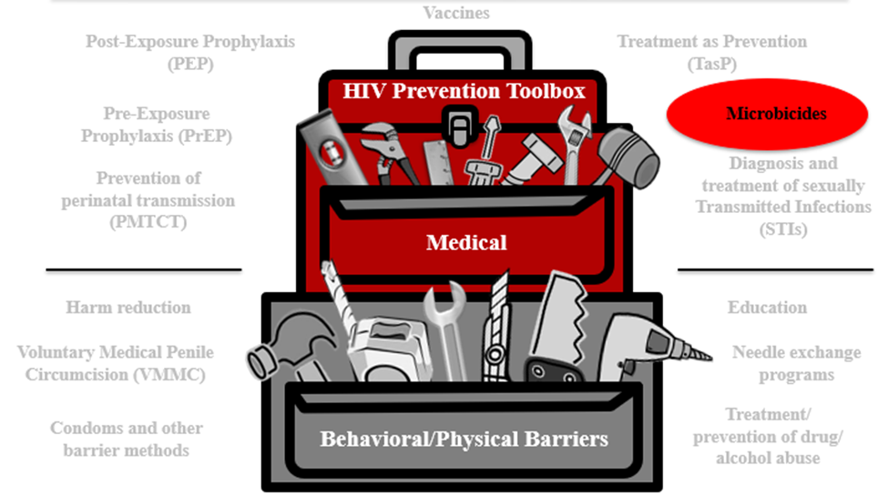
Microbicides Summary
Microbicides are products being developed and tested for use in the vagina and rectum to reduce the likelihood of HIV transmission during vaginal and anal sex.
Notes:
Participant Guide page 36.
Review the content on the slide.
Tell participants after reviewing the slide content: The HIV combination prevention toolbox reinforces the role of microbicides combined with other behavioral/physical tools. Combining multiple tools may provide the best method for HIV prevention.

Slide 76
Questions?
Notes:
No Participant Guide page.
Stop to ask/answer questions before moving to the activity.
Ask participants if they have any questions. Answer all questions, if possible. If not, make a note of these questions to prepare for the next training session.

Slide 77
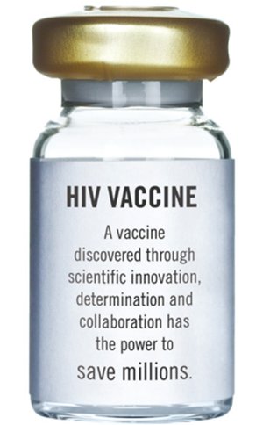
Vaccines
www.bethegeneration.org
Notes:
Participant Guide page 37.
Introduce the next modality: Vaccines.

Slide 78
Introduction
Vaccines
Post-Exposure Prophylaxis (PEP)
Treatment as Prevention (TasP)
HIV Prevention Toolbox
Pre-Exposure Prophylaxis (PrEP)
Microbicides
Diagnosis and treatment of sexually transmitted infections (STIs)
Prevention of perinatal transmission (PMTCT)
Medical
Harm reduction
Education
Voluntary Medical Penile Circumcision (VMMC)
Needle exchange programs
Condoms and other barrier methods
Treatment/
prevention of drug/
alcohol abuse
Behavioral/Physical Barriers
Notes:
Participant Guide page 37.
Tell participants after reviewing the slide content: Just because we’re only talking about biomedical HIV prevention doesn’t mean you should forget about the other prevention methods.
We said earlier that education and a combination of prevention approaches improves effectiveness, which includes combination prevention.
Participation in research can lead to intervention and prevention.
Tell participants after reviewing the slide content: The HIV combination prevention toolbox shows the importance of both medical and behavioral/physical tools. Combining multiple tools may provide the best method for HIV prevention.

Slide 79
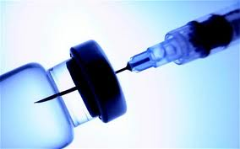
Introduction
A vaccine is a substance that teaches the body’s immune system to recognize and protect against a disease caused by an infectious agent or virus, often by stimulating the body to produce antibodies and T-cells against that infection.
A safe and effective preventive vaccine is believed to be the best way to control the HIV/AIDS epidemic in the long term. There is a lot of important research going on to find a safe and effective HIV vaccine.
However, there is currently no licensed vaccine against HIV.
Notes:
Participant Guide page 37.
Review the content on the slide.
Information related to the optional quiz (However, there is currently no…): Q4: False.
Q: Scientists have already developed a vaccine that prevents HIV.
A: Currently, there is not a vaccine to prevent HIV. Some HIV vaccine studies have been conducted that did not produce results needed to effectively prevent HIV. Ongoing research is being conducted to find a safe and effective preventive HIV vaccine. In order to find one, researchers will need thousands of volunteers to participate in clinical trials.

Slide 80
How Would a Vaccine Work?
Teach the body to recognize HIV
Tell the body to sound an alarm
Send fighter cells to go into action
Result: HIV is controlled or killed
Notes:
Participant Guide page 38.
Tell participants before reviewing the slide content: HIV vaccines would work to…
Review the content on the slide as it is revealed.
Information related to the optional quiz: Q6: True.
Q: HIV vaccines under study would train the body to recognize the HIV virus if a person is exposed to the virus.
A: Vaccines would teach the body to recognize the virus, sounding an internal “alarm” which would call fighter cells into action and ultimately help prevent or control an HIV infection.
Information related to the optional quiz: Q7: True.
Q: HIV vaccines do not contain live human immunodeficiency virus (HIV).
A: HIV vaccines do not contain either live or killed forms of the virus. The vaccines are synthetic (lab‐made) compounds designed to look like pieces from real HIV, triggering the body’s immune responses that would help your body recognize and fight the virus should it enter your system. There is no whole virus, real virus, or infected material in the vaccine, so there is no way that it could give a study participant HIV.

Slide 81
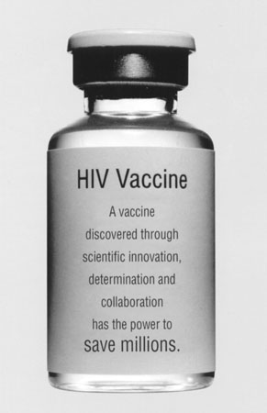
Why Do We Need a Vaccine?
ART can be complex, costly, and have side effects.
HIV can develop resistance to ARVs.
ARVs and PrEP depend on long-term patient adherence; a vaccine could provide protection with minimal action from the patient.
A preventive HIV vaccine could help save millions of lives and billions of dollars each year in treatment costs.
Notes:
Participant Guide page 38.
Review the content on the slide.
An HIV vaccine is the best long-term hope for controlling and/or ending the HIV epidemic.

Slide 82
HIV Vaccines—the Future
Vaccines are important to control the spread of HIV.
Preventive vaccines are tested with people who do not have HIV.
HIV vaccines may one day be able to prevent or delay AIDS in people with HIV too.
Notes:
Participant Guide page 39.
Review the content on the slide.
Information related to the optional quiz Q5: False.
Q: Volunteers for preventive HIV vaccine clinical trials cannot get HIV from the vaccines being tested.
A: The HIV vaccines used in clinical trials cannot cause people to contact HIV or AIDS, and volunteers are not exposed to HIV through the study. Just like anyone else, however, volunteers in clinical trials can contract HIV from other people through behaviors like condomless/PrEP-less sex or injection drug use.

Slide 83
HIV Vaccines—the Future
How an HIV vaccine might work
Prevent HIV in most people
Possible benefits
Even if a vaccine only protects some people, it would have a major impact on controlling the HIV/AIDS epidemic
Prevent HIV disease progression after people contract HIV
A partially effective vaccine could decrease the number of people who contract HIV
There would be fewer people with HIV to pass the virus on to others
One example showed that if a 50% effective vaccine was given to 30% of the population in developing countries between 2015-2030, it could prevent 25% of the new HIV cases that would otherwise occur.
Notes:
Participant Guide page 39.
Review the content on the slide.

Slide 84
Challenges in Developing an HIV Vaccine
HIV can “hide” from the immune system that protects the body.
HIV attacks the same immune cells that the body uses to defend itself against infections.
There are many different varieties of HIV.
HIV changes rapidly, even in a single person.
There is no perfect model for testing HIV vaccines in animals, because HIV impacts people in ways that are different from the animal versions.
The human immune system is not designed to clear HIV, so we are not sure what the immune response is that would be needed for protection; we have to do better than “mother nature.”
Notes:
Participant Guide page 40.
Tell participants before reviewing the slide content: Remember, there is currently no licensed vaccine against HIV or AIDS. Most vaccines we use today (polio, rubella, mumps) took more than 25 years to develop. Some challenges in developing HIV vaccines are…
Review the content on the slide.

Slide 85
Continuing Research: HIV Vaccines
Adapt the RV144 regimen for better protection
Study “mosaic” vaccine candidates to cover a variety of global HIV strains
Inform future prevention strategies via antibody-mediated prevention studies (AMP)
Some of the goals of ongoing HIV vaccine research include:
Notes:
Participant Guide page 41.
Review the content on the slide.
Adapt RV144 regimen: HVTN 702 was a clinical trial based on the Thai Trial (RV 144). The goal was to have greater and more sustained protection than that which was found in the Thai Trial. Researchers adapted this experimental vaccine to the HIV subtype that predominates in southern Africa, where it was tested. The research team had hoped for better results, but unfortunately, it was announced in January 2020 that the experimental vaccine being studied in HVTN 702 did not work to prevent HIV. While these results are disappointing, we can still learn from them. We now know that this particular vaccine design did not work in this particular context.
We learned that the vaccine was highly safe and well-tolerated. The researchers will continue to analyze the data to learn more about what is needed for an HIV vaccine to work.
Global HIV strains: HVTN 705 is a clinical trial studying a “mosaic” vaccine to see if it will be safe and effective for protection against a variety of HIV strains, or “clades.” It is also being tested in southern Africa.
HVTN 706, known as “Mosaico,” is another study testing a “mosaic” vaccine. This study is taking place in the US, Latin America, and Europe.
Antibody-mediated prevention (AMP): About 20% of people with HIV can develop broadly-neutralizing antibodies after several years living with the virus (https://www.hiv.gov/hiv-basics/hiv-prevention/potential-future-options/hiv-vaccines). Broadly neutralizing antibodies, or “bNAbs,” are produced by the immune system to attack or “neutralize” active HIV in the body. bNAbs cannot reach latent HIV, also known as the “reservoir” of HIV in a person’s body. The idea with AMP is to take some of these antibodies and manufacture more of them in labs so they can be given via IV infusion to HIV-negative people and observe how they do or do not protect against HIV taking hold in people who receive them. These studies may provide a proof-of-concept for future vaccine and other prevention strategies, showing how vaccines or other strategies might work if we can induce a preventive antibody response. Some bNAbs are also being studied for treatment to see if they can be used alongside ARVs to achieve viral suppression in people living with HIV.

Slide 86

Continuing Research: Vaccines
A number of public and private organizations, in partnership and individually, are working together to find a vaccine that could end the epidemic.
The HIV Vaccine Trials Network (HVTN), funded by the National Institute of Allergy and Infectious Diseases (NIAID), is an international collaboration that conducts all phases of clinical trials to test HIV vaccines.
Notes:
Participant Guide page 41.
Review the content on the slide.
Tell participants after reviewing the slide content: HVTN clinical research sites are located at leading research institutions throughout the world. The HVTN’s mission is to fully characterize the safety, immunogenicity, and efficacy of HIV vaccine candidates as rapidly as possible for prevention of HIV globally.
Presenters should be prepared to check for updated information and data on the UNAIDS, CDC, NAID, and NIAID websites and provide updates, as needed.

Slide 87
What Did You Learn?
In this activity, you will brainstorm how you can apply what you learned about vaccines by answering a question.
With your group:
Brainstorm the question you are assigned (you only need to brainstorm one of the questions).
Share your answers with the whole group so they can hear your ideas.
What thoughts, questions, and concerns came to your mind about vaccines as you heard/read information about this HIV prevention modality?
If you were asked to speak to an audience about vaccines, what would be the three most important messages you would want to convey?
Notes:
Participant Guide page 43.
Presenter notes: Introduce a small group activity.
Divide the class into two groups. Assign the questions to the groups (one question per small group).
Assign one of the questions in the boxes to each group.
Allow approximately 5 mins for the groups to brainstorm their answers.
Encourage participants to write their brainstorm on a flip chart, white board, and/or in their Participant Guides (each question has been reproduced in the Participant Guide with space to write).
Ask someone from each group to share some/all of their answers.
Encourage the other groups to write these answers in the provided space in their Participant Guides.
Note: This is a shortened activity using only 2 questions. There will be one larger activity at the end of the three modalities.
Possible answers include:
Question 1: What thoughts, questions and concerns came to your mind about vaccines as you heard/read information about this HIV prevention modality? How long it might take to develop an effective vaccine; the importance of supporting and participating in research that will result in an effective vaccine.
Question 2: If you were asked to speak to an audience about vaccines what would be the three most important messages you would want to convey? The importance of using other prevention tools until a vaccine is available; the importance of participating and supporting vaccine research, the different strategies being researched (antibodies, mosaic, etc).
Allow approximately 5 min for each person to answer the question. Ask for volunteers to share their answers. Allow approximately 5 mins to share answers.
Total time for this activity: 10 mins

Slide 88
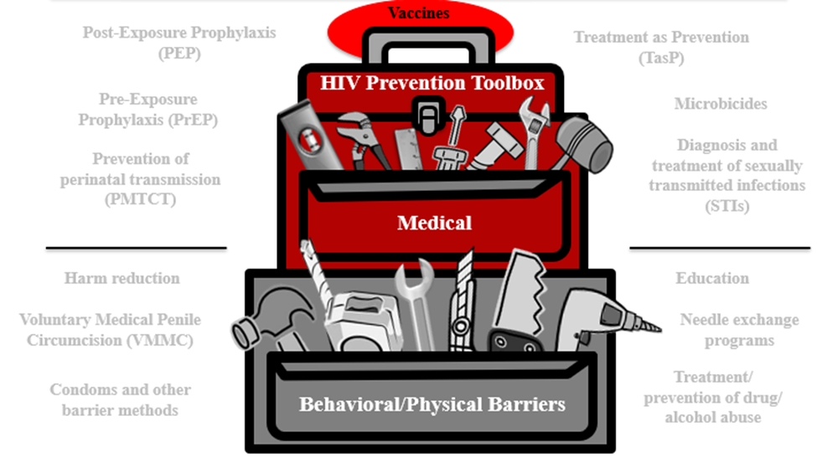
Vaccines Summary
A vaccine teaches the body’s immune system to recognize and protect against a disease caused by an infectious agent or virus, often by stimulating the body to produce antibodies and T-cells against that infection.
Notes:
Participant Guide page 44.
Review the content on the slide.
Tell participants after reviewing the slide content: The HIV combination prevention toolbox reinforces the role of vaccines combined with other behavioral/physical tools. Combining multiple tools may provide the best method for HIV prevention.

Slide 89
Questions?
Notes:
No Participant Guide page.
Stop to ask/answer questions before moving to the next modality.
Ask participants if they have any questions. Answer all questions, if possible. If not, make a note of these questions to prepare for the next training session.

Slide 90
Prevention Tools Activity
In this activity, you will think about all of the different HIV prevention tools you have learned about.
You will receive a card with one of the tools from the HIV combination prevention toolbox.
Follow the instructions in the Participant Guide to complete the activity.
Notes:
Participant Guide pages 45-46.
Introduce a whole group activity.
Review the activity instructions on the slide.
This activity is the final activity of the course. It is dependent on the information learned in “What Is HIV Prevention?” Use this activity ONLY for participants who have seen “What Is HIV Prevention?” AND What Are HIV Prevention Tools and How Are They Used in HIV Prevention Research?” (this section).
This activity requires one set of cards (HIV Combination Prevention Toolbox Activity Cards, copied black and white on paper or card stock, single sided, and cut). There are 13 cards total.
Have people seated and distribute one card HIV Combination Prevention Toolbox Activity Card to each person. There are 13 cards. Use as many or few as needed. If there are more than 13 people in the class, put 2 people together to do the activity.
Tell people to answer the first two questions in their Participant Guides and the “Why do you think so?” question. Thinking of the prevention technique as “both” was not discussed in the training, so answers can vary.
Stop and ask for volunteers to share their answers if they selected “both.”
This part of the activity should take approximately 5 mins.
Then review the next set of instructions (items 3-5 in the Participant Guide).
Be sure to walk around the room to answer questions.
Tell participants they can ask their neighbors questions, if needed.
Allow approximately 10 mins for this part of the activity.

Slide 91
Hidden slide
Notes:
Next ask each person to:
Tell everyone what prevention tool they had.
Tell which words ARE related to the tool.
Share all words they marked with a question mark.
For each of the question mark words, they should ask the whole class for help in deciding if the word is an example or not.
Note: Use the Prevention Tools Activity Answer Sheet for recommended answers.
Be prepared for answers that are only slightly related to the prevention tools. For example, “education” should be related to every tool. STIs could be related to every tool in some way.
This part of the activity should take about 20 mins.
Total activity timing: 35 mins.

Slide 92
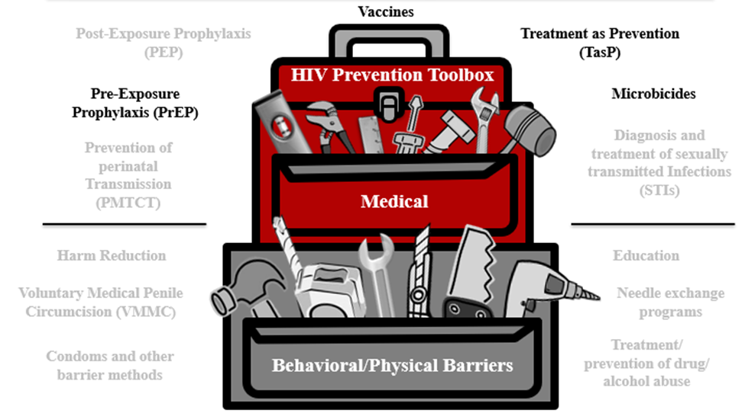
Summary
HIV prevention research is important to find safe and effective approaches to prevent the spread of HIV. These approaches can include:
Promoting awareness, understanding, and dialogue
Supporting research
Developing new prevention technologies
Notes:
Participant Guide page 47.
Review the content on the slide.
Review the objectives for this section. Tell participants: In this session, you learned about:
Prevention research and HIV prevention research successes
The role of pre-exposure prophylaxis (PrEP) in HIV prevention research
The role of treatment as prevention (TasP) in HIV prevention research
The role of microbicides in HIV prevention research
The role of vaccines in HIV prevention research
Tell participants where to find the glossary of terms and abbreviations used in this session in case they have questions about them.
Review the Frequently Asked Questions (FAQs) and additional resources for more information.
Ask participants if they have any additional resources they would like to share.
Save and add any additional resources for future use.

Slide 93
Conclusion
www.bethegeneration.org
Notes:
Participant Guide page 53.
Review the content on the slide.

Slide 94
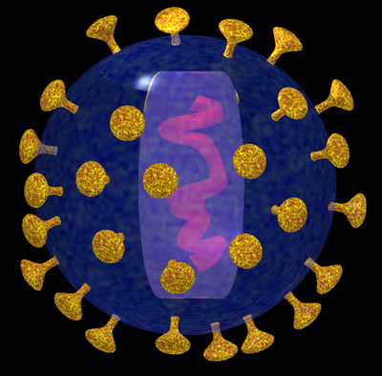
Conclusion
You have now completed the workshop about HIV Prevention Research.
This vital research is designed to find safe and effective methods to prevent HIV and AIDS.
Preventing HIV is our best hope for ending the HIV/AIDS epidemic.
Notes:
Participant Guide page 53.
Review the slides for the conclusion. Review the content on the slide.

Slide 95


Conclusion
Successful partnerships among the following can make a difference:
Community leaders
Local and national organizations
Health professionals
Educators
Notes:
Participant Guide page 53.
Tell participants before reviewing the slide content: It is also important to promote awareness and understanding of this research and to build public support for this work. Researchers often partner with a variety of individuals and groups in the community for this awareness, understanding, and support.
Review the content on the slide.

Slide 96

What Is Clinical Research?
Development of new ways to treat, prevent, and control disease
The evaluation of new interventions for:
  Safety
  Efficacy (the capacity to produce a desired effect/effectiveness)
  Adherence (whether or not people use the intervention as designed)
  Preventing and controlling disease
Notes:
Participant Guide page 54.
Tell participants before reviewing the slide content: Research is a systematic investigation to establish facts. Clinical research refers to clinical trials in people and helps develop solutions to improve the health of people all over the world. Clinical research includes…
Review the content on the slide.
Tell participants after reviewing the slide content: Clinical research over the past 100 years has improved the health and lives of people around the world. Clinical research provides the means to make sure HIV research is conducted safely and effectively. Clinical research is an important step in finding ways to prevent and treat HIV/AIDS.

Slide 97

What Is Community Engagement?
Community engagement ensures that the:
Community’s concerns and needs are shared with researchers
Community is aware of, can learn about, and have input into the research process
Notes:
Participant Guide page 54.
Tell participants before reviewing the slide content: Community engagement focuses on reaching and involving everyone from all walks of life and perspectives. Community engagement is especially important during clinical trials. During HIV/AIDS outreach activities, community engagement brings together those people affected and impacted by HIV/AIDS.
Review the content on the slide.

Slide 98
What Is HIV Prevention and the HIV Combination Prevention Toolbox?
Different HIV prevention approaches need to be tested to find out what works best. Identifying and offering more options will allow people to determine which options fit their lives, their needs, and the needs of their family and friends. Ongoing HIV prevention research supports:
More HIV prevention options
More combination HIV prevention options
More diverse research participants to expand the understanding of what works
Notes:
Participant Guide page 55.
Tell participants before reviewing the slide content: Comprehensive HIV prevention includes treatment, information, skills, personal responsibility, and access to tools, products, and approaches.
Review the content on the slide.

Slide 99
What Are HIV Prevention Tools and How Are They Used in HIV Prevention Research?
HIV prevention research is important to find safe and effective approaches to prevent the spread of HIV. These approaches can include:
Promoting awareness, understanding, and dialogue
Supporting research
Developing new prevention technologies
Notes:
Participant Guide page 55.
Check slide heading format for this slide before presenting. The heading takes up two lines, so the background has been revised to accommodate two lines.
Review the content on the slide.

Slide 100

What Are HIV Prevention Tools and How Are They Used in HIV Prevention Research?
Three Important Areas of Biomedical Prevention
PrEP & Integrated Strategies
Microbicides
Vaccines
New formulations and delivery methods to reduce the likelihood of transmission.
Products applied vaginally and rectally that may prevent HIV transmission.
Harnessing the immune system to help prevent a person from contracting HIV.
Notes:
Participant Guide page 55.
Check slide heading format for this slide before presenting. The heading takes up two lines, so the background has been revised to accommodate two lines.
Review the content on the slide.
Tell participants while reviewing the graphic:
The PrEP prevention approach is focused on people who do not have HIV, but may be vulnerable to exposure to HIV through sexual contact and injection drug use (IDU). With PrEP, people who do not have HIV receive a prescription to take a medication. The medication may lower their likelihood of contracting HIV.
Treatment as Prevention (TasP) is an approach for people living with HIV to reduce the likelihood of passing HIV to others. With TasP, people with HIV take medication. The medication controls the HIV in their bodies and keeps them healthy. The medication also lowers their likelihood of transmitting HIV to others through sex.
Microbicides are designed to reduce HIV transmission during vaginal and anal sex. Most microbicides being tested today contain antiretroviral (ARV) drugs. These drugs have been shown to help prevent HIV acquisition if someone is exposed to the virus.
A safe and effective preventive vaccine is believed to be the best way to control the HIV/AIDS epidemic in the long term. A vaccine uses a substance that teaches the body’s immune system to recognize and protect against a disease caused by an infectious agent or virus, often by stimulating the body to produce antibodies and T-cells against that infection. There is a lot of important research going on to find a safe and effective HIV vaccine.

Slide 101
For More Information
For more information on HIV prevention research, visit:
Be The Generation www.bethegeneration.org
Legacy Project www.facebook.com/HANCLegacyProject
Office of HIV/AIDS Network Coordination www.hanc.info
HIV Prevention Trials Network www.hptn.org
HIV Vaccines Trials Network www.hvtn.org
Microbicide Trials Network www.mtnstopshiv.org
AVAC www.avac.org
Notes:
Participant Guide page 56.
Review the content on the slide.

Slide 102
Hidden slide
Notes:
The optional quiz can be used again here (see quiz handout). There are 15 questions.
Allow approximately 15 mins for participants to complete the quiz and review the answers as a group.

Slide 103
Questions?...and
Thank You!
Notes:
No Participant Guide page.
Distribute the workshop evaluation (if applicable).
Ask participants if they have any questions. Answer all questions, if possible. If not, make a note of these questions to prepare for the next training session.

