Slide 1

HIV Prevention Research
Presenter:
Subtitle will go here
Notes:
No Participant Guide page.
Welcome participants to the course: Welcome to this workshop about HIV (Human Immunodeficiency Virus) prevention research.
Tell participants to make themselves comfortable.
Thank participants for coming to the workshop. Remind participants that the course will be more interesting and fun if they ask questions and share their experiences.
Distribute a copy of the Participant Guide to each attendee. Tell participants they can write their names on their copy, that the Participant Guide is a reference for the workshop and includes space for them to take notes during the workshop.
Explain that the Participant Guide contains a lot of information. Ask participants to look at the Table of Contents and review with them the topics covered in the course. Then show participants the Glossary at the back of the Participant Guide.

Slide 2
INTRODUCTION
This project was initially created under the National Institute of Allergy and Infectious Diseases (NIAID) HIV Vaccine Research Education Initiative (NHVREI) and later managed by the Be the Generation Bridge project. The project is now managed by the Legacy Project at the Office of HIV/AIDS Network Coordination (HANC), which works with the NIH-funded HIV/AIDS Clinical Trials Networks to create a more integrated, collaborative, and flexible research structure. Learn more at
www.bethegeneration.org
Notes:
Participant Guide page 4.
Review the content on the slide.

Slide 3
What Will We Do in This Workshop?
Provide a basic overview of HIV/AIDS.
Describe clinical research.
Describe community engagement.
Define and describe HIV prevention tools and the latest in biomedical HIV prevention research.
Notes:
Participant Guide page 4.
Tell participants before reviewing the slide content: In this workshop, we will provide basic information about HIV prevention research in simple terms. We will present information, and you will be able to ask questions. We will also do activities together to help you remember what you learn…
Review the objectives on the slide.
Tell participants: This workshop is designed to give you an opportunity to:
Apply the information you learn in activities and discussions.
Ask questions about information you do not understand.
Practice what you learn.
This Participant Guide includes information, facts, and space to write your own notes, as well as a glossary. The glossary includes many words, abbreviations, and definitions that may not be familiar to you.
Presenter notes: The optional quiz can be used here (see quiz handout) or when participants arrive. The quiz can be given at the beginning of the presentation and at the end of the presentation. There are 15 questions. Walk around to observe participants’ progress on the quiz; it should take 10 minutes or less to complete. The quiz answers will be reviewed at the end of the presentation.
Notes have been inserted in the PPT that provide the content needed to answer each of the questions in the quiz. These notes are titled: “Information related to the optional quiz.” Presenters should add the answers to the presentation if the optional quiz is included.

Slide 4
Agenda
Morning
Agenda
Introduction:
What is HIV/AIDS?
What Is Clinical Research?
Break
Afternoon
What is Community Engagement?
What is HIV Prevention/the HIV Prevention Toolbox?
What are HIV Prevention Tools? How are They Used in HIV Prevention Research?
Break
Notes:
No Participant Guide page.
Review the high-level agenda for the workshop. Be prepared to change this slide if the workshop is given with a different time structure.
Review the logistics of breaks and lunch, depending on the location.

Slide 5
Housekeeping
Nearest Exits
Restrooms
Parking Lot
Breaks and Lunch
Remember to:
Ask questions
Share what you know
Participate in all activities
Notes:
No Participant Guide page.
Review the content on the slide.
Provide information depending on the location.
Parking Lot: this is for questions that come up during the training that you may not have time to answer during a particular section but can return to later. Typically this is done by putting up a flip chart paper and having people write their questions on the paper or a post-it.

Slide 6
Icebreaker
What is your name?
Your pronouns?
Tell us something special about yourself.
What do you do?
Notes:
No Participant Guide page.
After everyone is settled, set up a whole group activity to introduce participants to each other (take approximately 5 mins). Go around the room and ask each person to stand up and state their name, pronouns, what they do, and something special about themselves. Begin with yourself to provide an example. Or, feel free to use a different introduction activity or “ice breaker,” if desired.

Slide 7
WHAT IS HIV/AIDS?
www.bethegeneration.org
Notes:
Participant Guide page 5.
Review the content on the slide.

Slide 8
Objectives
HIV & AIDS
How HIV is transmitted
How to prevent HIV transmission
Activity
History of HIV/AIDS
Supporting people with HIV/AIDS
Notes:
Participant Guide page 5.
Tell participants before reviewing the slide content: In this session (What Is HIV/AIDS?), you will learn about…
Review the objectives on the slide.

Slide 9
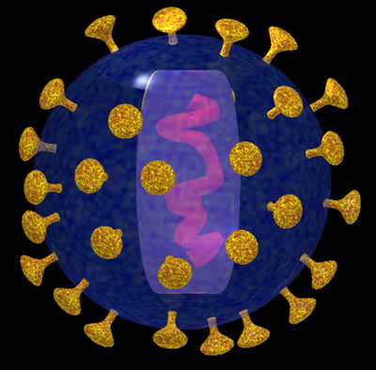
HIV & AIDS
The human immunodeficiency virus, or HIV, is the virus that causes AIDS.
Notes:
Participant Guide page 5.
Review the content on the slide.
Tell participants:

Slide 10

HIV & AIDS
HIV stands for Human Immunodeficiency Virus:
It is a virus specific to humans.
After it gets into your body, it makes you less able to fight infections.
Anyone can have HIV.
Due to a variety of factors (social,
structural, geographical, biological,
behavioral), some populations are
more vulnerable to HIV than others.
Notes:
Participant Guide page 6.
Review the content on the slide.

Slide 11
HIV & AIDS
AIDS stands for Acquired Immunodeficiency Syndrome:
Acquired means you can get this illness if you have HIV.
Immunodeficiency means a weakness in the body's system that fights diseases.
Syndrome means a group of health problems that make up a disease.
Notes:
Participant Guide page 6.
Review the content on the slide.
Tell participants: AIDS is caused by a virus called HIV (Human Immunodeficiency Virus). If you contract HIV, your body will try to fight the infection. However, the challenging thing about HIV is that it attacks the same parts of the immune system that would normally fight the infection. It also replicates and mutates in ways that help it escape your immune system’s defenses.

Slide 12
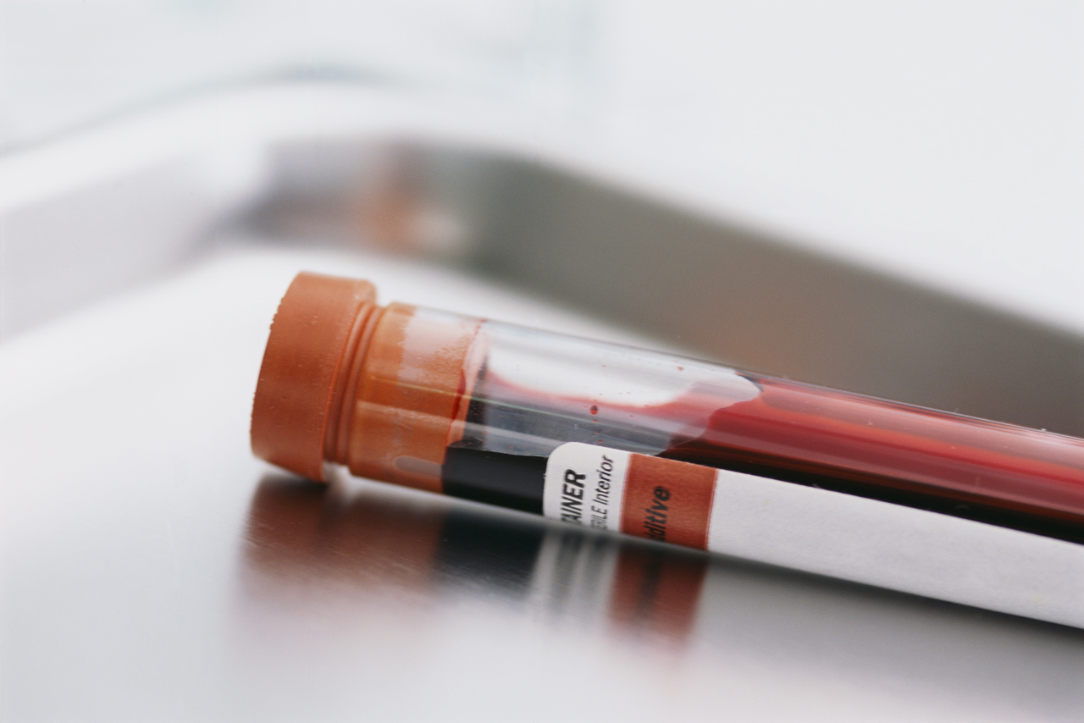
HIV & AIDS
A person with HIV develops antibodies to fight the virus.
A blood test for HIV looks for these antibodies.
HIV tests can also look for HIV molecules called antigens.
When tests find HIV antibodies and/or antigens, this is known as an HIV-positive result, meaning the virus is present.
Notes:
Participant Guide page 6.
Review the content on the slide.
Tell participants: When inside the body, HIV attacks and destroys the infection-fighting cytotoxic T-lymphocytes (T-cells), of the body’s immune system. The immune system is the body’s way to fight disease. Loss of T-cells makes it difficult for the immune system to fight infections.
Having HIV is not the same thing as having AIDS. AIDS develops over time as the HIV virus wears down the body’s immune system and destroys the T-cells. A person can progress from having the virus to having an AIDS diagnosis when the body’s immune system becomes highly compromised by the effects of the virus. This process can take ten or more years in the absence of treatment.
People are diagnosed as having AIDS when their T-cell count is 200 or less. By comparison, CD4+ T-cell counts can vary in healthy persons but are usually between 700-1300 cells /mm³.
(Presenter note: Other sources state varying data (e.g., the aids.gov website states 500-1000 cells/mm³).
There is currently no scalable cure for HIV/AIDS*, but there are ways to help control the virus.
*Note that a very small number of people (2 people as of 2019) have been cured of HIV, but the cure strategy that they underwent can not be applied to most PLHIV (which is why it has only worked in two people). The strategy involves a bone marrow transplant, which should only be performed in PLHIV who also have a form of cancer such as leukemia or lymphoma. Bone marrow transplants can have dangerous side effects, and they’re very expensive. So while two people have been cured of HIV, we still do not have a cure that would work for the vast majority of PLHIV in the world.

Slide 13
How HIV is Transmitted
HIV can be transmitted…
Through vaginal and anal sex
Through needles or syringes containing HIV
Perinatally (during pregnancy, labor, delivery, or breastfeeding)
Rarely through oral sex, blood transfusions, and other contact with blood containing HIV
Notes:
Participant Guide page 7
Ask participants if they know where HIV can be found in the human body. Allow a very short time (1-2 mins) for responses before continuing with the presentation. Do provide feedback to participant responses.
Tell participants: HIV is found in blood and other bodily fluids (such as semen, vaginal fluids, and breast milk). HIV is not found in saliva or urine. HIV cannot live for long outside the body. To contract HIV, bodily fluid containing HIV must enter another person’s body. The virus can enter the body through the bloodstream or by passing through delicate mucous membranes (such as inside the vagina, mouth, rectum, or urethra).
Review the content on the slide.

Slide 14
How HIV is NOT Transmitted
HIV is NOT Transmitted by:
Insect bites
Sneezing, coughing, shaking hands, or playing sports
Kissing
Sharing drinking glasses, musical instruments, or kitchen utensils
Swimming pools, showers, toilet seats
Saliva
Injecting drugs with sterile works
Notes:
Participant Guide page 7.
Review the content on the slide.

Slide 15

How HIV is Transmitted
Remember, HIV does not reproduce outside a living person. It does not survive in open air.
No HIV
Notes:
Participant Guide page 7.
Review the content on the slide.

Slide 16

What Is HIV Prevention Research?
HIV prevention research is designed to find safe and effective methods to prevent HIV and AIDS. HIV prevention methods include:
Biomedical (medicines, vaccines, approaches, and tools to fight disease that include biological and medical characteristics)
Behavioral (sex education, HIV testing, reducing partners, etc)
Successful partnerships among the following can make a difference:
Community leaders
Local and national organizations
Health professionals
Educators
Notes:
Participant Guide page 8.
Tell participants after reading the first two bullets: Because this research is conducted by scientists who develop and test prevention approaches using drugs or other products, it is referred to as biomedical HIV prevention research. The term “biomedical prevention research” will be referred to as “HIV prevention research” and “HPR” during this presentation.
Preventing HIV is our best hope for stopping the HIV/AIDS epidemic.
Tell participants before reviewing the content about “successful partnerships”: It is also important to promote dialogue, awareness, and understanding of this research and to build public support for this work. Researchers often partner with a variety of individuals and groups in the community for this awareness, understanding, and support…

Slide 17


How to Prevent HIV
HIV testing and counseling
Correct and consistent condom use with internal/external condoms
Using antiretroviral drugs
Sex education
Family planning
Needle exchange
And more…
Notes:
Participant Guide page 9.
Tell participants before reviewing the slide content: Methods of HIV prevention include…
Review the content on the slide. Additional information about some of the bullets is provided below:
HIV testing and counseling: HIV testing and counseling raise awareness and knowledge.
Condoms: Did you know? In 2018, the FDA renamed “male” and “female” condoms “external” and “internal” condoms. This is great because it finally recognizes condoms as tools that prevent HIV and STIs during vaginal and anal sex for people of all genders.
ARV drugs: can be used by PLHIV for treatment as prevention, pregnant folks to prevent transmission to babies, and by HIV-negative people as pre- and post-exposure prophylaxis (more on all of this later)
Family planning: Family planning helps prevent perinatal transmission of HIV.
Sterile needles and works: can be provided by needle exchange programs
More info to accompany participant guide:
Voluntary medical penile circumcision: Penile circumcision provides only partial effectiveness for preventing HIV, and this partial effectiveness only prevents from infection into the penis during vaginal sex.
There is not yet any research to support whether or not penile circumcision offers any protective benefit to receptive partners (vaginally). The one trial that was testing this hypothesis was stopped early because of harm (men were resuming sex too soon after circumcision, so women were acquiring HIV). There is also no data regarding anal sex (no clinical trials have examined this to date).
Screening the blood supply: Blood and blood products containing HIV are safely discarded and not used for transfusions.

Slide 18

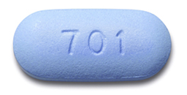
How to Prevent HIV
Using antiretroviral drugs for:
Treatment as prevention (TasP)
Pregnant & breastfeeding mothers
Pre-exposure prophylaxis (PrEP)
Post-exposure (PEP) prophylaxis
Notes:
Participant Guide page 9.
Tell participants before reviewing the slide content: Methods of HIV prevention also include…
Information related to the optional quiz: Q15: True.
Q: Many people living with HIV around the world are virally suppressed, meaning their medications have succeeded in reducing the amount of HIV in the body to levels such that a regular HIV test can no longer detect the virus. People with viral suppression cannot transmit HIV to their sex partners, even if they don’t use a condom.
A: Treatment as prevention (TasP) describes approaches used to reduce the probability of a person with HIV transmitting the virus to another person. It generally requires taking medications that are safe and effective in treating people who have HIV. Several studies with large numbers of participants have shown that people with undetectable viral loads cannot transmit HIV to partners through sex, even without condoms. One study even demonstrated zero HIV transmissions under conditions of viral suppression after over 58,000 acts of condomless sex!

Slide 19
How to Prevent HIV
Formula instead of breastfeeding for mothers with HIV*
Open communication
Treating drug addiction
Reducing behavioral factors
Notes:
Participant Guide page 9.
Tell participants before reviewing the slide content: Methods of HIV prevention also include…
Review the content on the slide. Additional information about some of the bullets is provided below:
Formula instead of breastfeeding: To prevent HIV transmission to infants through breast milk. This is only recommended for mothers living with HIV who can always access clean water and formula (see more below). Open communication: For example, among sexual partners about their HIV status and how they will reduce exposure to HIV.
Reducing behavioral risks: For example, by encouraging sex practices involving condom/PrEP use), by reducing the numbers of sexual partners a person has, not mixing sex and drugs/alcohol, and by not sharing needles.
More on breastfeeding: Breastfeeding is always best, but some doctors recommend formula in cases where mothers with HIV have access to clean water and formula. While HIV transmission through breastfeeding on ART is extremely rare, there is 0% chance of transmission through formula. Formula can be dangerous, however, because it can be easily contaminated (for example, by mixing with contaminated water). It is far more dangerous to give a baby formula mixed with contaminated water than it is for a mother with HIV who is taking ART to breastfeed. The NIH has declared that ART “can virtually eliminate transmission to babies,” but the chance of HIV transmission through breastfeeding is not zero, even under conditions of viral suppression in the blood (https://www.nih.gov/news-events/news-releases/hiv-therapy-breastfeeding-mothers-can-virtually-eliminate-transmission-babies). PLHIV have to decide what is best for their babies given their circumstances; more information is available here: https://www.thewellproject.org/hiv-information/can-i-breastfeed-while-living-hiv-overview-infant-feeding-options

Slide 20
How HIV Is Transmitted
In this activity, you will have a chance to find out more about how HIV is transmitted. The more you know about how HIV is transmitted will help you understand why HIV prevention is important.
You will hear one statement.
Decide if you think the statement is true or false:
  If you think the statement is true, move to the “True” sign.
  If you think the statement is false, move to the “False” sign.
  If you are not sure what the answer is, stay where you are.
Notes:
Participant Guide page 10.
Introduce a whole group activity.
Review the activity instructions on the slide.
Use the Question and Answer Sheet for this activity. These two sheets are for the presenter only.
If possible, put up two signs in different parts of the room: one sign should say “YES,” and the other sign should say “NO.” Or, write the words on a flip chart or white board.
This activity requires people to stand up and move around, so put the signs in areas where people can stand together. The activity provides an opportunity for people to be active.
Read one of the Questions on the Question and Answer Sheet (do not read the answer yet).
Ask participants to move to the area of the room where the sign is.
Wait until everyone has moved. Be sure to tell participants that they can stay where they are and it is ok not to know the answers.
Depending on the class makeup and their level of knowledge, you can:
Ask participants to give you the right answer.
Give the answer (provided on the Question and Answer Sheet).
Discuss what people do/do not know.
If participants are fairly experienced and comfortable, ask which prevention strategies should be used.

Slide 21
Hidden slide
Notes:
DO NOT MAKE JUDGEMENTS ABOUT WHAT PEOPLE DO/DO NOT KNOW.
After asking and answering the questions, tell participants to write down what new information they learned to help them remember.
Debrief the activity by reminding people that the more they know about HIV and how it is transmitted helps them. The information can also be shared with others. And, the more we can talk about HIV, transmission, and prevention, the more likely we are to prevent it.
Activity timing: 10-30 mins. This activity can be shortened, if needed, by choosing fewer questions.

Slide 22
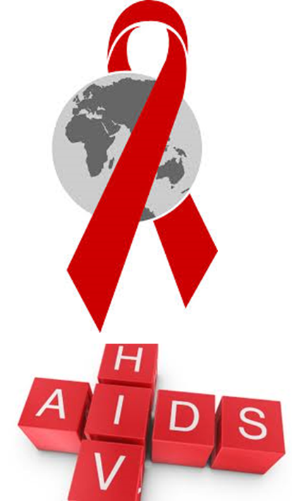
History of HIV/AIDS
The first cases of what we now call AIDS were reported in the US in June 1981.
Just over a year later (July 1982), a group of federal officials, university researchers, community activists, and others gave this disease name: acquired immunodeficiency syndrome, or AIDS.
In 1984, researchers discovered HIV as the cause of AIDS and developed a blood test to diagnose HIV seropositivity.
Notes:
Participant Guide page 11.
Review the content on the slide.

Slide 23
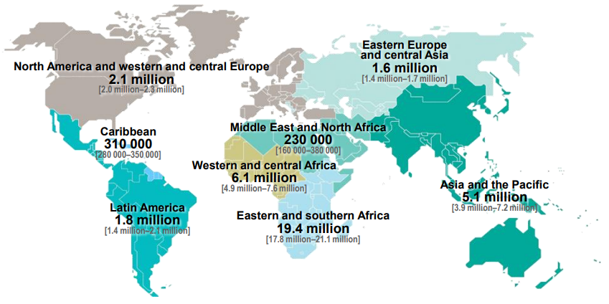
History of HIV/AIDS
Total: 36.7 million adults and children estimated to be living with HIV, 2016
Source: UNAIDS
Notes:
Participant Guide page 11.
Tell participants before reviewing the slide content: AIDS is now a global epidemic. It has become one of the greatest threats to human health and development. The map shows adults and children estimated to be living with HIV in 2016. Although HIV and AIDS are found in all parts of the world, some areas are more affected than others.
Review the map on the slide. Point out the very large number for sub-Saharan Africa. Focus this discussion on the global data.
Emphasize the disparity between the HIV/AIDS burden in sub-Saharan Africa and the rest of the world.
Note: This map is updated periodically and posted on the UNAIDS site. Search “epidemiology slides” to access the latest file. The site is usually updated after Dec. 1 and reflects data from the previous year. Note as of 2019, the most current info is from 2016 (https://www.unaids.org/sites/default/files/media_asset/UNAIDS_2017_core-epidemiology-slides_en.pdf).
Presenters should be prepared to check for updated information and data on the UNAIDS, CDC, NAID, and NIAID websites and provide updates, as needed.

Slide 24
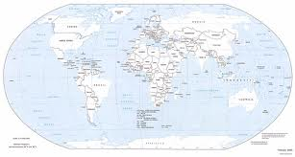
History of HIV/AIDS
HIV has killed more than 35 million people worldwide.
HIV/AIDS is most prevalent in sub-Saharan Africa.
40 million people died during World War II.
20 million people died worldwide during the flu epidemic of 1918.
Notes:
Participant Guide page 11.
Tell participants before reviewing the slide content: HIV/AIDS continues to take a huge toll on people all over the world. The facts are…
Review the top two boxes on the slide.
Tell participants before reviewing the bottom two boxes on the slide: By comparison, approximately…
HIV/AIDS killed 1 million people in 2016.
Presenters should be prepared to check for updated information and data on the UNAIDS, CDC, NAID, and NIAID websites and provide updates, as needed.

Slide 25
Past 35 Years: Challenges and Successes Globally
1981:
The US Centers for Disease Control (CDC) releases its first public report about what we now know as AIDS.
121 people died from the disease by the end of the year.
1982:
Acquired Immuno- deficiency Syndrome (AIDS) is named.
AIDS is reported among people who have received blood transfusions in the US.
1983:
The first AIDS cases among non-drug using women and children appear.
One thousand people in the US have died of AIDS.
Notes:
Participant Guide page 12.
Review the content on the slide. The years/bullets are animated.

Slide 26
1980s, continued
1984:
Scientists identify HIV and link it to the cause of AIDS.
Cases of HIV are described in Africa.
1985:
HIV blood tests become available.
Rock Hudson is the first major celebrity to announce that he has AIDS.
AIDS is reported in China.
1986:
More than 38,000 AIDS cases have been reported worldwide.
1987:
AZT is identified as the first drug used to treat AIDS.
1988:
US government conducts its first national AIDS education campaign.
The first World AIDS Day takes place.
Notes:
Participant Guide page 12.
Continue reviewing the content on the slide. The years/bullets are animated.

Slide 27
1990s
1994:
1995:
1996:
1997:
  Study 076 of the Pediatric AIDS Clinical Trials Group found that AZT treatment of pregnant women decreased the rate of HIV transmission to newborns from about 25% to 8%.
  First protease inhibitor (saquinavir) was approved in record time by the US Federal Drug Administration, ushering in a new era of highly active antiretroviral therapy (HAART).
  The Joint United Nations Programme on AIDS (UNAIDS) is established.
  Patients show success in using a combination of several types of treatment medications called antiretrovirals (ARVs).
  The World Health Organization (WHO) releases the first medical guidelines to prevent perinatal transmission of HIV.
  An estimated 22 million people are living with HIV worldwide.
  Nevirapine research for the prevention of perinatal transmission starts in Uganda.
Notes:
Participant Guide pages 12-13.
Continue reviewing the content on the slide. The years/bullets are animated.
Tell participants after the 1996 second bullet…
This is the main type of treatment for HIV or AIDS. It is not a cure, but it can keep people healthy. The treatment consists of drugs that have to be taken every day for the rest of a person’s life.
The aim of antiretroviral treatment is to keep the amount of HIV in the body at a low level. This stops any weakening of the immune system and helps it recover from damage that HIV might have caused already.
The drugs are often referred to as: antiretrovirals, ARVs, anti-HIV or anti-AIDS drugs.
We now know that HIV treatment with ARVs can prevent people with HIV from transmitting the virus to their sex partners.

Slide 28
2000-2007
2002:
Botswana is the first African country to begin a national AIDS treatment program.
2003:
The first HIV vaccine (AIDSVAX) to be tested in a large clinical trial is found ineffective.
2005:
46,684 AIDS-related deaths worldwide in 2005.
Penile circumcision clinical trials start in Africa.
2006:
Only 28% of people with HIV in developing countries are receiving treatment.
2007:
An estimated 33 million people are living with HIV worldwide.
Notes:
Participant Guide page 13.
Continue reviewing the content on the slide. The years/bullets are animated.

Slide 29
2009-2010
2009:
  RV144 shows an HIV vaccine regimen is approximately 32% effective in preventing HIV acquisition, which shows that a preventive vaccine against HIV is possible.
2010:
  Researchers conduct the iPrEx clinical trial showing a 44% reduction in new HIV cases among HIV-negative participants if they took a daily dose of Truvada® (also known as TDF/FTC). This is one of several clinical trials providing proof of concept for pre-Exposure Prophylaxis (PrEP).
  CAPRISA 004 research shows there were 39% fewer new HIV cases among women who used 1% tenofovir gel before and after sex (proof of concept for a vaginal microbicide).
Notes:
Participant Guide page 13.
Continue reviewing the content on the slide. The years/bullets are animated.

Slide 30
2011
2011:
  There are 700,000 fewer new HIV cases across the world in 2011 than in 2001.
  22,800 AIDS-related deaths are reported worldwide in 2011.
  A 51% decline in AIDS-related deaths is reported since 2005 as a result of HIV treatment programs.
  Results of the HPTN052 clinical trial show that, if a person with HIV adheres to an effective antiretroviral therapy regimen, the chance of transmitting the virus to an HIV-negative sex partner can be reduced by 96% (showing proof of concept for treatment as prevention). Among participants in this trial with an undetectable viral load, zero HIV transmissions to sex partners occurred, paving the way for the U=U campaign.
Notes:
Participant Guide page 13.
Continue reviewing the content on the slide. The years/bullets are animated so only the year and its bullet(s) appear on the slide.

Slide 31
2012-2013
2012:
  Truvada® (also known as TDF/FTC) is approved for daily use for HIV prevention by the US Food and Drug Administration (FDA).
2013:
  VOICE (Vaginal and Oral Interventions to Control the Epidemic) shows three daily HIV antiretroviral prevention approaches are not effective for the women in the trial.
Notes:
Participant Guide page 13.
Continue reviewing the content on the slide. The years/bullets are animated so only the year and its bullet(s) appear on the slide.
VOICE: the three daily regimens were 1) Oral TDF alone 2) Oral TDF/FTC 3) Vaginal TFV gel

Slide 32
Global Goals
Fewer deaths
Reduction in perinatal transmission
Progress
Reduction in new HIV cases
More investments
90-90-90
Community engagement
Stigma, Discrimination,
Disparities
HIV
prevention services needed
Barriers
HIV
treatment needed
Miles to go
Low
HIV testing
rates
Notes:
Participant Guide page 14.
Tell participants before reviewing the graphic on the slide…In 2018, UNAIDS published their annual report to look at the next three years in terms of achieving it’s the global targets.
Each of the pieces of the graphic are animated and start with the black “Progress” circle in the top right corner.
Reveal the graphic and then provide additional commentary given below:
Progress: On the positive side, there has been and will continue to be progress
90-90-90: UNAIDS released this goal for 2020 where 90% of PLHIV in the world will have an HIV diagnosis, 90% of those with a diagnosis will receive HIV care, and 90% of those receiving care will reach viral suppression. This was a highly ambitious goal, and countries and communities around the world were at various stages of progress toward this goal at the beginning of 2020. By the end of 2017, globally, the percentages were 75% of PLHIV knew their status, 79% of those were accessing treatment, and 81% of those had reached viral suppression. This translates to 47% of all PLHIV in the world having reached viral suppression. Also in 2017, it was announced that King County (which is home to Seattle) had become the first major metropolitan area in the world to reach 90-90-90. Social and structural disparities must be addressed for other localities to meet this ambitious goal.
There has been progress in reducing new HIV cases: Globally, new HIV cases have declined by 18% since 2010. This is progress in the right direction, but still far less than the 75% reduction that was needed to achieve the 90-90-90 goals by 2020.
By 2018, there were fewer HIV-related deaths worldwide.
Globally, 1.4 million new cases of HIV among children have been averted since 2010, due in large part to prevention of perinatal transmission successes
More investments of time and resources needed. Many countries have increased services.
Community engagement and energy impacts results.
All of these things increase access to HIV treatments, and all of these things lead to positive results for people.
Many people living with HIV do not know their HIV status, which means there is still more work needed.
Low HIV testing rates negatively impact progress.
Stigma, discrimination, and disparities still impact the most vulnerable communities and prevent us from achieving 90-90-90 goals globally
Source: https://www.unaids.org/sites/default/files/media_asset/miles-to-go_en.pdf

Slide 33
Hidden slide
Notes:
HIV prevention services are needed to reduce new cases.
HIV treatment is needed to improve the health of those who already have HIV: millions of people are eligible and waiting for treatment.
Marginalization is a result of not reaching key populations impacted by HIV.
All of these areas are gaps that need to be filled to successfully close the gaps we continue to face
Presenters should be prepared to check for updated information and data on the UNAIDS, CDC, NAID, and NIAID websites and provide updates, as needed.

Slide 34

HIV/AIDS in the U.S.
People living with HIV
New HIV cases
Among Asians and Native Hawaiians/Pacific Islanders
Among men who have sex with men
Among transgender persons
Among American Indians and Alaska Natives (AI/AN)
Among African Americans
Among Hispanic/Latinx People
Notes:
Participant Guide page 15.
Tell participants before reviewing the slide content: In 2018-2019, the U.S. Centers for Disease Control and Prevention published the following updates about HIV/AIDS in the U.S….
Each of the boxes on the graphic is animated. Starting at the first box at the top left, add the following information for each of the boxes:
People living with HIV:
1,140,400 people aged 13 years and older are living with HIV.
1 in 7 people living with HIV are unaware of their HIV-positive status
New HIV cases:
There are approximately 40,000 new HIV transmissions every year
Among gay men and other MSM
Men who have sex with men (MSM) continue to bear the greatest burden of HIV incidence; about 70% of new HIV cases in the US are among MSM.
Among transgender persons:
The percentage of transgender people receiving an HIV diagnosis is 3 times the national average
Approximately 44% of Black transgender women, 26% of Hispanic/Latina transgender women, and 7% of white transgender women are living with HIV
Among African Americans
The rate of new HIV cases among African American males is 8 times higher than for white males.
80.3% of new HIV cases among African American males were among MSM.
African American females accounted for 11% of all new HIV cases in the U.S. and 60% of all new HIV cases among females.
Among Hispanic/Latinx People
The rate of new HIV cases for Hispanic males is 4.3 times higher than that for white males.
The rate of new HIV cases for Hispanic females was 3.1 times that of white females.
Among American Indians and Alaska Natives
75% of new HIV cases among AI/AN males are attributed to male-to-male sexual contact.
69% of the new HIV cases among AI/AN females were attributed to heterosexual contact.
Among Asians and Native Hawaiians/Pacific Islanders
The number of Asians receiving an HIV diagnosis has increased in recent years, driven primarily by an increase in HIV diagnoses among Asian MSM.
In 2017, there were 58 HIV diagnoses among NHOPI, 39 of which were attributed to male-to-male sexual contact
HIV affects NHOPI in ways that are not always apparent because of small population sizes

Slide 35
The Treatment Cascade in the U.S.
1.1 million people living with HIV
935,000 (85%) know their status
682,000 (62%) have started HIV medical care
528,000 (48%) have stayed in HIV medical care
539,000
(49%)
…have a suppressed viral load (<200 copies/ml)
-CDC, 2017
(https://www.cdc.gov/nchhstp/newsroom/2017/HIV-Continuum-of-Care.html)
Notes:
Participant Guide page 16.
Tell participants before reviewing the slide content: The treatment cascade shows the number of people living with HIV in the U.S. who have been diagnosed as having HIV, who receive medical care and treatment, and who reach viral suppression.
Review each row of the graphic as it is revealed. Emphasize the diminishing number of people and percentages and the significance of these diminishing numbers. Important questions at each point in the pyramid are:
How many people have HIV? 1.1 million or 100%
How many people know they have HIV? 935,000, or 85%
Of those, how many have started HIV medical care? 682,000, or 62%
Of those, how many have stayed in HIV medical care? 528,000, or 48%
How many are able to adhere to their treatment plan and achieve viral suppression? 539,000, or 49%

Slide 36
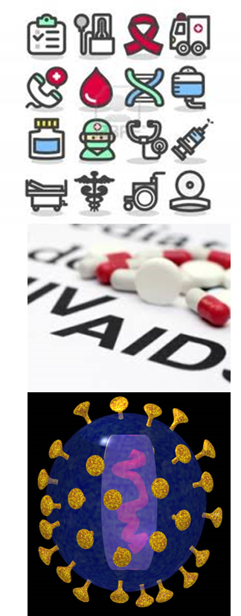
The Treatment Cascade in the US
People with HIV can stay healthy longer if the amount of virus in the body is reduced.
Controlling the virus reduces the chances of passing HIV to others. Four clinical trials (HPTN 052, PARTNER, PARTNER 2, and Opposites Attract) showed that people who are on ART vastly reduce their likelihood of passing HIV to their sex partners, and those with an undetectable viral load cannot pass HIV to their HIV-negative sex partners, even if they don’t use condoms or PrEP.
Medical care and ART can prevent the development of AIDS.
Notes:
Participant Guide page 16.
Tell participants before reviewing the slide content: The significance of the treatment cascade is that it shows gaps in HIV testing, care, and treatment. Continuing HIV care is important because…
Review the content on the slide as each bullet is revealed.
At the end of the second bullet, add the following information: Antiretroviral therapy uses medications for the treatment of HIV. For example, by blocking HIV replication, blocking primary entry into the host cell (entry inhibitors), etc. That is why people take a combination of medications, because they work in different ways.

Slide 37
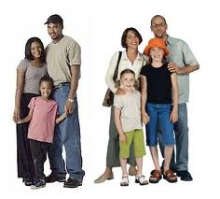




How to Support People Living with HIV/AIDS
People living with HIV/AIDS participate in every aspect of society.
They are part of families, schools, and neighborhoods.
Notes:
Participant Guide page 17.
Review the content on the slide.
Before going to the next slide, tell participants: But due to their health status, many people with HIV experience unfair treatment and prejudice. Stigma and discrimination against people living with HIV/AIDS contribute negatively to the health and well-being of our community as a whole. Some people are reluctant to get tested for HIV for fear of how they will be treated if they are diagnosed. Creating supportive communities where people with HIV/AIDS feel respected and have access to the care they deserve is another vital tool in the goal of reaching an HIV/AIDS-free generation.

Slide 38
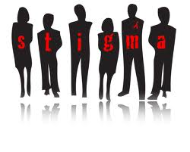

How to Support People Living with HIV/AIDS
Stigma and discrimination occur when we start to act differently because we are afraid of something or do not understand something.
Notes:
Participant Guide page 17.
Review the content on the slide.

Slide 39
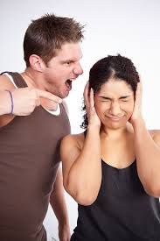
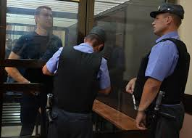
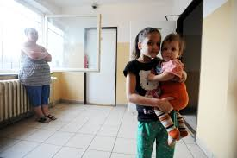
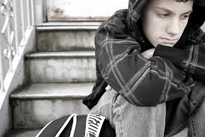
How to Support People Living with HIV/AIDS
Social isolation
Poor treatment in health care and education settings
Psychological distress
Low self-esteem, which can lead to poor health outcomes
Negative effect on the success of HIV testing and treatment
Job loss
Travel restrictions
Verbal and physical abuse
Criminalization
Notes:
Participant Guide page 17.
Tell participants before reviewing the slide content: Stigma and discrimination refer to negative attitudes, prejudice, maltreatment, and abuse directed at people living with HIV and AIDS. Some consequences of stigma and discrimination are…
Review the content on the slide.
Additional information about some of the bullets is provided below:
Low self-esteem: For example, people may internalize the negative messages they hear about persons with HIV and start to believe they truly have less value as human beings. This low self-esteem leads to lower rates of seeking health care and adhering to that care, because they start to believe their lives are not worth living.
Job loss: People with HIV/AIDS may experience co-worker and employer discrimination including isolation and recruitment, hiring, and promotion refusal.
Travel restrictions: Some countries have laws that restrict entry, stay, and residence of people with HIV/AIDS.
Verbal and physical abuse: Abuse can occur in the workplace, within a family, and in the community.

Slide 40
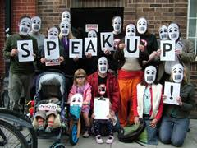
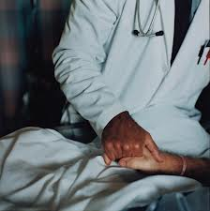
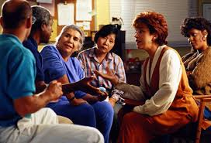
How to Support People Living with HIV/AIDS
Break the silence, and talk about your fears and the fears of others.
Treat people with HIV like anyone else with a health issue: demonstrate respect, empathy, and compassion.
Destigmatize and correct language: listen to how people with HIV describe themselves and their condition.
Get informed about how to prevent HIV.
Notes:
Participant Guide page 17.
Tell participants before reviewing the slide content: On a personal level, a person’s health status is private. Just as we should not ask how or why someone has cancer or diabetes, we should not ask how or why someone has HIV/AIDS. And, we should not make assumptions about how people acquired HIV or the kind of life they lead. Ways to prevent HIV/AIDS stigma and discrimination include…
Review the content on the slide.

Slide 41


What Would You Do?
In this activity, you will think about different situations you may encounter and how you would handle them. Use what you have already learned about HIV/AIDS to do this activity.
With your group:
Look at the scenario and questions on the card you are given.
Discuss them with your group.
Write down notes that you feel are important.
Share your answers with the whole group so they can hear your ideas.
Notes:
This slide has been left in the presentation in the case that presenters moved the class through the previous slides with time to spare. Most likely, presenters will not have time for this activity and should move on to the next slide. At this point in the training, about 1 hour and 15 minutes should have elapsed from the opening introduction. If you’ve reached this point in an hour or less, the activity on this slide can be done.
Participant Guide page 18.
Introduce a small group activity.
Tell participants before reviewing the activity instructions: HIV/AIDS forces us to confront parts of life we are uncomfortable with, like sexuality, sickness, and death. People with HIV know all of this. They know that their friends and family avoid certain subjects with them. They notice that people stop touching them. They hear people talk about "innocent” victims of AIDS and wonder if they are among the guilty. They feel themselves gradually being pushed outside, not called, left alone, cast off by society.
It's normal to have some fear or troubling thoughts and uncertainties about what to do or say. You shouldn't be ashamed. Everyone is unsure of how to act in new situations. If you haven't known anyone with HIV before, you're probably not going to know what to do when you first meet someone who does have HIV.
Review the activity instructions on the slide and in the Participant Guide.
Activity instructions: Distribute one of the activity cards to each table group (there are 4). Allow 5-10 mins for people to discuss with their groups and approximately 5 mins per group for them to share their answers with everyone.
There are no right or wrong answers for this activity.
Total time for this activity: 30 mins.

Slide 42

What Did You Learn?
Write down your thoughts about the question you are assigned (you only need to answer one of the questions).
Share your answers with the whole group so they can hear your ideas.
In this activity, you will think about how you can apply what you learned about HIV/AIDS by answering a question.
How can you use what you learned today about HIV/AIDS in your daily life?
How has what you learned today impacted YOU?
Notes:
Participant Guide page 19.
Introduce an individual activity.
Go around the room and assign question 1 or question 2 to participants. The easiest way to assign the questions is to either point to each person and say 1 or 2, or have participants count off themselves.
Possible answers include:
Question 1: How can you use what you have learned about HIV/AIDS in your daily life?: Answer questions friends and family may have; know how HIV is spread, and how it is not spread.
Question 2: How has what you learned today impacted YOU? Be more aware of how I interact with and support those who have HIV/AIDS; reduced anxiety about how HIV is spread.
Allow approximately 5 mins for each person to answer the question
Ask for volunteers to share their answers. As people share their answers, tell people they can take notes in the space provided. Allow approximately 10 mins to share answers.
Total time for this activity: 10 mins
Allow for questions before ending the activity and going to the summary.

Slide 43
Summary
Medically speaking, HIV is a lot like other viruses, including those that cause the flu or the common cold. But there is an important difference. Over time, your immune system can get rid of most viruses. But the human immune system cannot get rid of HIV by itself.
HIV can hide for long periods of time in cells, use them to make more copies of itself, and then destroy those cells. Over time, HIV destroys so many cells that the body can no longer fight infections and diseases.
Efforts to prevent, control, and eliminate HIV/AIDS are continuing worldwide.
Stigma is still a major barrier to eliminating HIV.
Notes:
Participant Guide page 20.
Review the content on the slide.
Review the objectives for this section. Tell participants: In this session, you learned about:
HIV and AIDS
How HIV is transmitted
How HIV is prevented
The history of HIV/AIDS, including challenges and successes
Interacting with people living with HIV/AIDS
Tell participants where to find the glossary of terms and abbreviations used in this session in case they have questions about them.
Review the Frequently Asked Questions (FAQs) and additional resources for more information.
Ask participants if they have any additional resources they would like to share.
Save and add any additional resources for future use.

Slide 44

Questions?
Notes:
No Participant Guide page.
Ask participants if they have any questions. Answer all questions, if possible. If not, make a note of these questions to prepare for the next training session.

Slide 45
WHAT IS CLINICAL RESEARCH?
www.bethegeneration.org
Notes:
Participant Guide page 25.
Review the content on the slide.

Slide 46
Objectives
The importance of clinical research
What clinical research includes
Clinical trials
The clinical research process
The importance of ethics in clinical research
Notes:
Participant Guide page 25.
Tell participants before reviewing the slide content: In this session (What Is Clinical Research?), you will learn about…
Review the objectives on the slide.

Slide 47

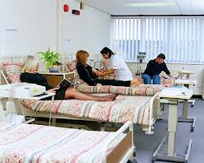
Introduction
Research is a systematic investigation to establish facts.
Clinical research refers to clinical trials involving people as participants. It helps develop solutions to improve the health of people all over the world.
Notes:
Participant Guide page 25.
Review the content on the slide.
After reviewing the content on the slide, tell participants: Research follows the scientific method. The scientific method includes asking and answering questions by observing and testing. For example, if your car won’t start, you could use the scientific method to find out why. In this example, you might follow these steps:
Purpose/problem (I want my car to start)
Hypothesis (My car might be out of gas. If I put gas in my car, it will start.)
Materials needed to check my hypothesis (gas can, gas, money to buy gas, a ride to/from the gas station)
Procedure (I will call my friend for a ride to the gas station. I will fill my gas can. I will pay the gas station attendant. I will go back to my car. I will put in the gas. I will try to restart the car.)
Results (My car started.)
Conclusion (My car needs gas to start.)

Slide 48
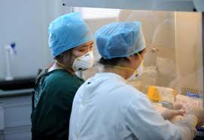

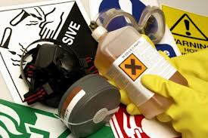
Introduction
Clinical research includes:
Development of new ways to treat, prevent, and control disease
The evaluation of new interventions for:
  Safety
  Efficacy (the capacity to produce a desired effect/effectiveness)
  Acceptability and adherence (whether or not people use the product as designed)
  Preventing and controlling disease
Notes:
Participant Guide page 25.
Review the content on the slide.
At the end of the second bullet, add the following: An intervention is any measure whose purpose is to improve health or alter the course of disease…

Slide 49
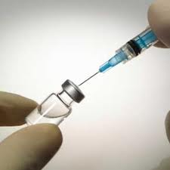
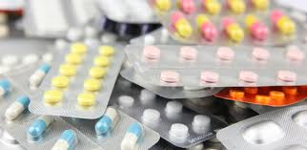
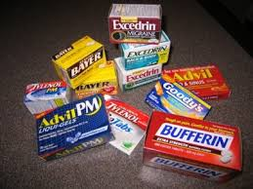
Introduction
Global eradication of smallpox
Vaccines for measles and polio
Discovery of Tylenol and Ibuprofen for headache relief and reducing fevers
Antibiotics to treat infections
Improved medicines and treatments for many types of cancer
Improved medicines and treatments for HIV and AIDS
Notes:
Participant Guide page 25.
Tell participants before reviewing the slide content: Clinical research over the past 100 years has improved the health and lives of people around the world. The benefits of clinical research are far too many to list here, but here are a few of them…
Review the content on the slide.

Slide 50
Why Is Research Important?
Biomedical
Drugs (medications)
Behavioral
Understand how social factors and behavior relate to disease
Vaccines
X-rays and other diagnostic tests
Physical examinations
Giving blood or other tissue/fluid samples
Study the impacts of changing behavioral and social factors on health outcomes
Encourage healthy behavior
Notes:
Participant Guide page 26.
Tell participants before reviewing the slide content: Research is important because it investigates how something works and affects the people it is intended to help. Research may be…
Review the content on the slide. Before reviewing the sections, tell participants:
Biomedical: Biomedical research is designed to understand and treat or prevent a disease or health condition.
Behavioral: Behavioral research involves investigation to: (read slide content)
Tell participants after reviewing the slide content: Each clinical trial answers scientific questions about preventing, screening for, diagnosing, managing, and/or treating a disease. The goal of research is to develop interventions to improve health.

Slide 51
What Is the Clinical Research Process?
Pre-Clinical (with animals)
Phase I
30-50 people
12-18 months
Phase II
200-400 people
Up to 2 years
Phase III
3,000-5,000 people
3-4 years
Notes:
Participant Guide page 27.
Tell participants before reviewing the slide content: The entire research process is very lengthy, and it can take many years for a new treatment or prevention strategy to receive full approval by the Food & Drug Administration (FDA) of the U.S. government. This approval is required before something can be made available for general use. Clinical research with people happens in multiple steps. Emphasize the length of time needed and multiple steps…
Use the following information to review the graphic. The graphic is animated and aligns with the content below:
Pre-Clinical (with animals): Research occurs in various stages that takes a number of years. Initial laboratory work is followed by animal clinical trials (collectively known as pre-clinical research) and then clinical trials in humans. For example, when testing an HIV vaccine:
Phase I: Phase I involves approximately 30 to 50 healthy, HIV-negative participants who are unlikely to contract HIV. It tests the safety of the preventive vaccine.
Phase II: Phase II involves about 200-400 participants with varying degrees of vulnerability to contracting HIV to see if the vaccine causes an immune response.
Phase III: After a successful Phase II clinical trial, a Phase III clinical trial can take place. This involves several thousand participants who are highly vulnerable to contracting HIV to assess if the vaccine works in preventing HIV.
Tell participants the following information before going to the next slide: When moving from Phase I to Phase 3, as the trial grows in size, it should also grow in diversity (represented by different colors in the graphic). The only way to know if any intervention will work in all kinds of people is to test it in all kinds of people. Diversity encompasses age range, gender diversity, racial/ethnic diversity, geography (does it work the same in people in different parts of the world), etc.

Slide 52
What Is the Clinical Research Process?
Pre-Clinical Testing
Investigational New Drug Application (IND)
Phase I (Assess Safety)
Phase II (Test for Early Effectiveness & Safety)
Phase III (Large Scale Testing)
Licensing (Approval to Use)
Approval (Available for Prescription)
Post Marketing Studies (Special Studies and Long-Term Effectiveness/Use
Notes:
Participant Guide pages 27-28.
Tell participants before reviewing the slide content: The clinical research process includes…
Review the content on the slide. Stop after each step to ask if participants have any questions. If any participants have experience in the clinical research process, ask them to provide examples for each of the steps. The steps in the process have been animated. At each of the steps, add the following information:
Pre-Clinical Testing: In laboratory and animal clinical trials to:
Find out if there is a potential benefit of a drug, vaccine, or other intervention
Explore general safety
Investigational New Drug Application (IND): An investigational new drug application (IND) must be filed that:
Describes the results of pre-clinical testing
Clearly defines how future human clinical trials will be conducted
Phase I (Assess Safety): For the first time, the testing is done in people. The goals of phase I are to:
Assess safety for people
Select the optimal dose to be used in future clinical trials (an optimal dose produces a desired effect without unfavorable effects)
Observe how the human body reacts
Find out what side effects occur as dosage levels are changed

Slide 53
Hidden slide
Notes:
Phase II (Test for Early Effectiveness and Safety): If an intervention is shown to be safe during Phase I, it must be tested further in Phase II. Phase II tests in a larger group of people for:
Continued safety
Early efficacy (“efficacy” is like “effectiveness,” but “efficacy” occurs in the very specific circumstances of a clinical trial, and “effectiveness” is what you find in the real world)
Acceptability (clinical trial design, scientific value, and whether or not the intervention is acceptable to the people who are using it)
Phase III (Large-Scale Testing): This testing provides a better understanding of:
Efficacy
Risks and benefits
Comparison to the standard intervention
Licensing (Approval To Use): After all clinical trial phases are complete and, if the research demonstrates that the strategy is safe and efficacious (derived from the word “efficacy”), a New Drug Application (NDA)/Biologics License Application (BLA) is filed with the FDA. The NDA/BLA contains all scientific information compiled over the course of the clinical trials.
Approval (Available for Prescription): After FDA approval of the NDA/BLA, the intervention becomes available. Even if an intervention is approved, it must continue to comply with regulatory requirements. Reviews continue to ensure safety over time.
Post-Marketing Studies (Special Studies and Long-Term Effectiveness/Use): The studies/clinical trials can monitor:
Long-term effects
The impact on a person’s quality of life

Slide 54
Hidden slide
Notes:
Some clinical trials help determine the cost-effectiveness of an intervention compared to other traditional and/or new therapies. These clinical trials may be performed in special populations not previously studied (for example, children or the elderly).
Information related to the optional quiz (Phase I (Assess Safety, last bullet)): Q2: True.
Q: Before people volunteer for HIV prevention clinical trials, they are given detailed information on the side effects they might experience.
A: Some studies test new products or devices to evaluate their safety. In these cases, volunteers are told to report any side effects they experience. Participants in these studies are closely watched for all possible side effects. Studies that test whether a product or device works to prevent HIV (efficacy studies) are only conducted after determining that the product is safe. Even safe products may have some side effects (e.g. nausea, headaches, etc.). Volunteers are informed about known side effects that were seen in earlier studies, and they are also told that there may be side effects that the researchers don’t know about. Participants are monitored for any side effects throughout their study participation and asked to report adverse events immediately to the clinical team.

Slide 55


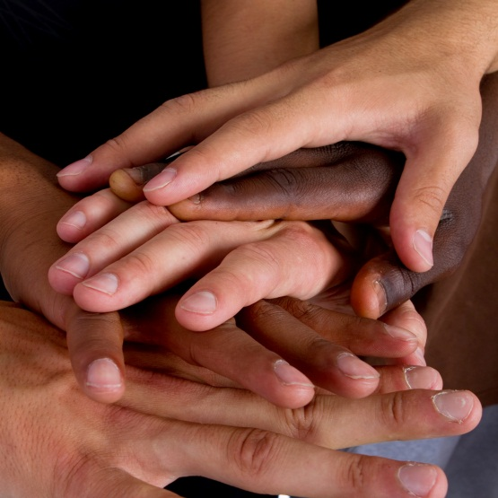

What Is a Clinical Trial?
After testing in laboratories and animal studies, the most promising interventions or prevention methods are moved into clinical trials.
A clinical trial is sometimes called a clinical study.
Clinical trial
Clinical study
Notes:
Participant Guide page 28.
Tell participants before reviewing the slide content: During a clinical trial, information is learned about an intervention, its risks, and its effectiveness and/or efficacy. Clinical trials can only be conducted if there is an uncertainty about the outcome—they cannot be conducted if the outcome is already known from a previous clinical trial. Some clinical trials are conducted to confirm the results of an initial clinical trial…
Review the content on the slide.

Slide 56
What Is a Clinical Trial?
Research that tests how well an intervention works in a group of people
Tests for new methods of screening, prevention, or diagnosis
Is conducted in phases to learn about:
  Safety and the optimal doses
  The effectiveness of an intervention
  Whether or not people are willing to use the intervention (also known as “acceptability”)
Notes:
Participant Guide page 28.
Tell participants before reviewing the slide content: A clinical trial is…
Review each of the bullets. Allow for questions before going to the next bullet.
Depending on the experience level of participants, ask for an example or further information.
Tell participants after reviewing the bullets: During a clinical trial, information is learned about an intervention, its risks, and whether or not it works for an individual or larger population.

Slide 57

Who Can Participate in a Clinical Trial?
People of different ages, genders, races/ethnicities, geographic locations…
Notes:
Participant Guide page 29.
Tell participants before reviewing the slide content: Each clinical trial has specific criteria for who can participate but we want clinical trials to have diverse participants. This includes:
Age range
Gender
Race/ethnicity
Geographic location: Part of what guides the locales that participate in a trial is the question of whether the intervention works the same way in people from different regions, where there are differences in nutrition, environmental impacts, other endemic diseases/co-infections, different strains of HIV in circulation, etc. We really want to understand whether the responses are the same globally.
Tell participants after reviewing the bullets: Some research needs people:
Who have the illnesses or conditions to be studied in the clinical trial
Who do not have the disease being studied

Slide 58
Diversity Is Important
Some biological traits may affect how well a medicine works.
Sometimes these traits differ based on heritage or geography.
People may differ because of the environmental conditions in which they live.
The immune system changes naturally as people age, so it is important to conduct clinical trials in different age groups.
Men, women, and transgender individuals have different immune system responses that can be influenced by different hormones and other factors, so it is important to include people from diverse sex and gender backgrounds in clinical trials.
Trust in biomedical products begins with the research process.
Notes:
Participant Guide page 29.
Tell participants before reviewing the slide content: Diverse representation among clinical trial volunteers is important…
After the third bullet, tell participants: Each clinical trial has specific eligibility criteria that outline who can and cannot participate in a clinical trial. Sometimes pre-existing conditions, age, and other factors may restrict participation…
Information related to the optional quiz applies to the second bullet: Q3: True.
Q: The involvement of ethnically and racially diverse participants in HIV clinical trials is a priority for researchers.
A: Diverse representation among clinical trial volunteers is important to researchers for several reasons. Some biological characteristics may affect how well a medicine works. Sometimes these characteristics may differ based on heritage. For example, African Americans are more prone to the disease called Sickle Cell Anemia. Racial and ethnic groups may also differ in the environmental conditions in which they live. Diverse participation will help determine if these biological and environmental conditions influence how well new prevention methods work. Racial and ethnic diversity is important to helping researchers ensure that approaches are culturally appropriate, that any new discoveries will work for a diverse public, and that diverse racial and ethnic groups are aware of new research being conducted.

Slide 59
What Is a Protocol?
Clinical research is conducted according to a very well-defined plan called a protocol. The protocol acts like a “recipe” for conducting the clinical trial. The protocol describes:
?
What will be done?
How will it be conducted?
Who can participate?
Why is each part of the clinical trial necessary?
How do we safeguard participants’ health?
How will safety be monitored?
Notes:
Participant Guide page 30.
Review the content on the slide.
Information related to the optional quiz: Q1: False.
Q: Scientists test how well drugs and vaccines prevent HIV by encouraging clinical trial volunteers to engage in high-risk behavior.
A: All clinical trial participants receive extensive counseling about what they can do to reduce their chances of contracting HIV. Volunteers are reminded that we do not know if the medication/product is effective, and they should not assume they are protected by it. Some participants may receive a placebo. Placebos are inactive substances used in studies to compare the effects of the tested product in one group of people against another group who did not get the test product. Even when HIV vaccines, microbicides, or other prevention tools are developed, education, condoms and lube, and other prevention efforts will still be needed.

Slide 60
What Is a Protocol?
A protocol also describes what questions the clinical trial is designed to answer:
?
Who is eligible to participate in the clinical trial and the research objectives
Details about tests, procedures, medications, and dosages
Details about how the data and samples that are collected will be analyzed in order to answer the research objectives
The length of the clinical trial and what information will be gathered
Notes:
Participant Guide page 30.
Review the content on the slide.
Tell participants before reviewing the slide content: The same protocol is used by every doctor or research center taking part in that specific clinical trial. …

Slide 61
What Is a Protocol?
What is known about the intervention from previous clinical trials in animals and/or humans
A detailed rationale for why the clinical trial is warranted
How safety will be monitored, and who will do it
The methods that will be used to obtain informed consent from people who are interested in joining the clinical trial and a sample consent form written in simple language that explains the clinical trial
?
Notes:
Participant Guide page 30.
Review the content on the slide.
Tell participants after reviewing the slide content: People who might participate in a clinical trial may want to know what actually happens from their perspective, for example:
How they would find out about a clinical trial in their area
How they decide to participate
Where it takes place
If there is compensation
Risks and benefits of participation

Slide 62



Safety and Well-Being of Participants
Notes:
Participant Guide page 31.
Review the content on the slide.
Tell participants before reviewing the slide content: Clinical trials have safeguards in place to protect the safety and well-being of participants…
For each of the images shown on the slide (they are animated starting at the top left):
Institutional review boards (also called Ethics Committees) and Data and Safety Monitoring Boards (DSMB) are independent groups who protect the safety and well-being of clinical trial volunteers by carefully reviewing the details of the clinical trial from start to finish. Data and Safety Monitoring Boards review data from the clinical trial while it is happening to ensure ongoing participant safety.
The FDA, which regulates all U.S. government-sponsored clinical trials, carefully reviews all clinical trials for potential safety issues and comparable groups in other countries.
The U.S. Office of Human Research Protection provides educational programs and materials, regulatory oversight and advice on ethical and regulatory issues in research.

Slide 63
What Are Research Ethics?
Ethics
Respect for persons
Beneficence
Justice
Notes:
Participant Guide page 31.
Tell participants before reviewing the slide content: Human research ethics are grounded in three principles that are the foundation of all regulations or guidelines governing research done with people. These principles apply to all geographic, cultural, economic, legal, and political boundaries…
Each of the circles is animated. Add the following information about each of the circles:
Respect for persons: Respect for persons includes the right and capacity of all individuals to make their own choices and decisions. It also includes respect for a person’s culture, beliefs, and the community a participant belongs to.
Beneficence: Beneficence makes researchers responsible for participants’ physical, mental, and social well-being during the clinical trial. Benefits for the participant are weighed against potential risks (also known as a risk/benefit analysis). Also included are the potential benefits to the community.
Justice: Justice requires researchers to distribute risks and benefits equitably for both participants and communities. Low-resource communities should not be used for the benefit of more privileged communities. Research participants should be equitably recruited.

Slide 64
What Did You Learn?
In this activity, you will think about how you can apply what you learned about clinical research by answering a question.
With your group:
Brainstorm the question you are assigned (you only need to brainstorm one of the questions).
Share your answers with the whole group so they can hear your ideas.
How can you use what you have learned about clinical research in your daily life?
If someone you know wants to participate in a clinical trial, what would you tell them?
In what ways do ethics play a part in your life, and why are ethics important in research?
In what ways has this information about clinical research impacted YOU?
Notes:
Participant Guide pages 32-33.
Introduce a small group activity.
Divide the whole group into 4 smaller groups.
Assign one of the questions in the boxes to each group.
Allow approximately 5 mins for the groups to brainstorm their answers.
Encourage participants to write their brainstorm on a flip chart, white board, and/or in their Participant Guides (each question has been reproduced in the Participant Guide with space to write).
Ask someone from each group to share some/all of their answers.
Encourage the other groups to write these answers in the provided space in their Participant Guides.
Possible answers include:
Question 1: How can you use what you have learned about clinical research in your daily life?: Answer questions from friends and family, consider participating in clinical research, if an opportunity arises, appreciate the extensive time and energy spent on the research process before the FDA approval.
Question 2: If someone you know wants to participate in a clinical trial, what would you tell them?: Review the clinical trial with the person to make sure they fully understand the commitment and risks; reinforce the efforts made to protect the person; support the person emotionally and provide encouragement when needed.
Question 3: In what ways do ethics play a part in your life and why are ethics important?: Ethics = honesty in dealing with people; ethics = trust; trust = faith and willingness to take risk; ethics exist in all areas of human relationships.
Question 4: In what ways has this information about clinical research impacted YOU?: The section about ethics provides confidence in the clinical research process; the clear and detailed clinical research process demonstrates professionalism and concern about anyone I know who is participating in clinical research; I would consider participating in clinical research.
Activity timing: 10 mins (5 mins for the brainstorm; 5 mins for the select sharing)
Total time for this activity: 10 mins
Allow for questions before ending the activity and going to the summary.

Slide 65
Summary
Clinical research provides the means to make sure HIV research is conducted safely and effectively. Clinical research is an important step in finding ways to prevent and treat HIV/AIDS.
Notes:
Participant Guide page 34.
Review the content on the slide.
Review the objectives for this section. Tell participants: In this session, you…
Learned about the importance of clinical research
What clinical research includes
The role of clinical trials in research
The clinical research process
The importance of ethics in clinical research
Reviewed important terms and abbreviations used in clinical research
Discovered links to additional information
Completed an activity to apply what you learned
Tell participants where to find the glossary of terms and abbreviations used in this session in case they have questions about them.
Review the Frequently Asked Questions (FAQs) and additional resources for more information.
Ask participants if they have any additional resources they would like to share.
Save and add any additional resources for future use.

Slide 66
Questions?
Notes:
No Participant Guide page.
Ask participants if they have any questions. Answer all questions, if possible. If not, make a note of these questions to prepare for the next training session.

Slide 67
WHAT IS COMMUNITY ENGAGEMENT?
www.bethegeneration.org
Notes:
Participant Guide page 38.
Review the content on the slide.

Slide 68
Objectives
Community engagement and its goals
What community groups do
Who belongs to a community
What a Community Advisory Board (CAB) does
Notes:
Participant Guide page 38.
This section of the course is fairly short in order to keep it at the awareness level. It functions as a transition from the previous sections before going into the more-specific prevention tools. At this point in the course, this section is following lunch.
Tell participants before reviewing the slide content: In this session (What Is Community Engagement?), you will learn about…
Review the objectives on the slide.

Slide 69
Introduction
What Is a Community?
A community shares common:
Geography
Racial or ethnic makeup
Values, culture, beliefs, and interests
Notes:
Participant Guide page 38.
Tell participants before reviewing the slide content: People can belong to many communities at the same time. Communities and the makeup of a population are always changing. The important thing to remember is that a community shares a variety of perspectives.
Review the content on the slide.

Slide 70
People in Communities
Community members offer different perspectives:
Social
Spiritual
Emotional
Reflective of lived experiences
Notes:
Participant Guide page 39.
Tell participants before reviewing the slide content: People in a community share many things. But people with differing opinions and experiences are important, too. Community members are important to HIV/AIDS research and outreach. They include people who are living with or affected by HIV. Their voices are important to understand the full impact of HIV/AIDS on those who are most impacted by it.
Review the content on the slide.

Slide 71
Who is in the HIV/AIDS Research Community?
Populations in and for which the Research is Being Conducted
People with HIV
People without HIV
Key Stakeholders and Political Leaders
Often included in educational and outreach activities
Can be informed of research plans, goals, and the potential impact
Support of this Broader Community
Essential to the ongoing success of the clinical research process
Partnerships within any given region
Not Easy to Define
Views and perspectives are widely divergent
Not homogeneous
May have competing interests and priorities
May not always fit a single definition
Notes:
Participant Guide page 40.
Tell participants before reviewing the slide content: HIV/AIDS affects many aspects of life. Community engagement plays an important role in HIV/AIDS research by making sure that a variety of groups and people are working with research staff on many fronts.
Review the content on the slide.
Tell participants after reviewing the slide content: It is not always groups that work together to provide input, and it is not just because HIV affects different aspects of life. Because people want and should have a say in the type of research conducted in their community, and to help make the research better for them, people representing their community can be involved in different aspects of the research process. Groups work together out of necessity, too. Limited financial resources mean that collaborations and partnerships can be the only ways to financially do the work.

Slide 72
Who Is in Your Community?
Look at the list of shared interests and identities in the Participant Guide.
When you think of the community or communities you belong to, which of the following do you generally share with others in those communities (circle all that apply).
In this activity, you will think about how many communities you are part of.
Notes:
Participant Guide page 41.
Introduce an individual activity.
The first part of the activity is individual. Give participants about 5 mins to answer the question and circle their communities.
As a whole group, ask for volunteers to select one of their communities that is important to them, and ask them to share a little bit about why it is important to their sense of community.
Provide an example that’s personal for you or use the following example: “I plan to retire next year, so I just joined a number of local senior groups to get an idea of what is available in my community. It is important for me to feel valuable, so I plan to do some volunteering and traveling.”
Debrief the activity by reminding participants that a variety of viewpoints and experiences are critical for people and their communities to be successful. Community helps us feel safe and provides a sense of belonging.
Activity timing: 10 mins.

Slide 73



HIV/AIDS Community Engagement
Community engagement comes in many forms and occurs:
Locally
Nationally
Globally
There are multiple ways of engaging communities. Community Advisory Boards (CABs) are one way that research teams work with communities.
Notes:
Participant Guide page 42.
Review the content on the slide.

Slide 74
What Form Does Community Engagement Take?
Community Advisory Board or Group
A group of community members that regularly meets with research staff
Community Forum
Health fair, town hall meeting, seminar, or educational forum
Focus Group
Facilitated session to gather information on a specific topic or from a specific group of individuals
Consultation
A larger group meeting to seek input/advice or gather information
Notes:
Participant Guide pages 42-43.
Tell participants before reviewing the slide content: There are also other approaches and partnerships that help researchers make sure that the broader community has…
Information about ongoing and planned research
An increased understanding of and support for these research activities
An opportunity to provide input into the research process and share ideas or concerns
Review the content on the slide.
Tell participants after reviewing the slide content: A clinical trials network is made up of researchers from universities, hospitals, and clinics in different areas of a country or parts of the world who work together to answer the same research questions. A clinical research site is a location where participants in a study come for study visits and procedures. In order to receive funding from NIAID, the HIV/AIDS clinical trials research networks, as well as the sites that work with them, must demonstrate that they engage with the community and seek the community’s input into the clinical trials they conduct.
CABs meet with research staff at the Network level or site level.

Slide 75
Working Together
General Roles and Responsibilities
Community | Research Staff
Facilitate information exchange | Coordinate CAB activities
Provide input on research plans/specific studies | Facilitate CAB understanding of research
Increase understanding of community | Foster information exchange
Provide linkages to facilitate partnerships | Keep CAB apprised of all research plans and updates
Help translate complex ideas into lay language | Develop strategies for CAB recruitment and retention
Relay information about research and results | Relay information about research and results
Notes:
Participant Guide page 44.
Tell participants before reviewing the graphic on the slide: Community members and network leadership work together in HIV prevention research.
Review the content on the slide.

Slide 76
Principles of Community Engagement
Set clear goals.
Learn about the community.
Develop cultural humility.
Foster transparency.
Build partnerships and trust.
Provide and promote capacity building.
Maintain a long-term commitment.
Notes:
Participant Guide page 45.
Tell participants before reviewing the content on the slide: The United Nations Programme on AIDS (UNAIDS) and AVAC have developed guidelines for trial sponsors, funders, and researchers to follow when planning, implementing, and disseminating research results to the community.
Review the content on the slide.

Slide 77
Goals of Community Engagement
Build trust among the research team and community members.
Increase knowledge of the people in the area where clinical trials are being conducted.
Explain research and clinical trials in easy-to-understand language.
Help people to better understand the scope, importance, and need for research.
Give people a voice in the research process.
Notes:
Participant Guide page 45.
Tell participants before reviewing the slide content: The goals of community engagement are to…
Review the content on the slide.
Tell participants after reviewing the slide content: Successful community engagement ensures that clinical research proceeds smoothly.

Slide 78
Community Advisory Boards (CABs)
Share the interests and needs of the community with the research team.
Represent people living with or affected by HIV.
Share the interests and needs of the research/ researchers with their communities.
Notes:
Participant Guide page 46.
Tell participants before reviewing the slide content: CABs are independent advisory groups that meet regularly with research team representatives, inform community stakeholders about proposed and ongoing research, and provide feedback to research teams about local norms and beliefs, as well as local views and concerns that arise in specific trials. CABs were established to…
Review the content in the animated content on the slide.
Tell participants after the second piece of the graphic is reviewed (“Represent people…”): CABs may contribute their opinions about the appropriateness of the research question or if they believe it to be important to their community, but it is not their role to define the question. The “A” in CABs stands for “advise”.

Slide 79
Community Advisory Boards (CABs)
Review local procedures and customs.
Review how the clinical trial is planned and what it consists of, why a clinical trial is being conducted, how long it will take, who can participate, what will be involved, etc.
Review how the clinical trial will be implemented.
Review how to educate and inform others about research plans.
Review how participants will be recruited to join the clinical trial.
Notes:
Participant Guide page 46.
Tell participants before reviewing the slide content: CABs are independent advisory groups that meet regularly with research team representatives, inform community stakeholders about proposed and ongoing research, and provide feedback to research teams about local norms and beliefs, as well as local views and concerns that arise in specific trials. CABs were established to…
Read the content on the slide.
Tell participants after reviewing the second bullet: “What will be involved” includes procedures, medicine, shots, etc.

Slide 80
Community Advisory Boards (CABs)
Share information with and get feedback from specific communities.
Share information with the research team about the communities’ needs, questions, and concerns.
Promote understanding among researchers of the value added by community engagement.
Notes:
Participant Guide page 46.
Tell participants before reviewing the slide content: CABs do the following…

Slide 81
What Did You Learn?
Write down your thoughts about the question you are assigned (you only need to answer one of the questions).
Share your answers with the whole group so they can hear your ideas.
In this activity, you will think about how you can apply what you learned about community engagement by answering a question.
Imagine that you have been asked to give a presentation at a community meeting about a new HIV prevention clinical trial. What information would you include in your presentation?
Imagine that you have been asked to become a CAB member. What would you like to find out about before deciding?
Notes:
Participant Guide page 47.
Presenter notes: Introduce an individual activity.
Go around the room and assign question 1 or question 2 to participants. The easiest way to assign the questions is to either point to each person and say 1 or 2, or have participants count off themselves.
Possible answers include:
Question 1: Imagine that you have been asked to give a presentation at a community meeting about a new HIV prevention clinical trial. What information would you include in your presentation? Explain research and clinical trials in easy-to-understand language; help people to better understand the scope and importance of the need for research.
Question 2: Imagine that you have been asked to become a CAB member. What would you like to find out about before deciding? How much time is needed, how will what I do help others.
Allow approximately 5 mins for each person to answer the question. Ask for volunteers to share their answers. As people share their answers, tell people they can take notes in the space provided.
Allow approximately 10 mins to share answers.
Total time for this activity: 10 mins
Allow for questions before ending the activity and going to the summary.

Slide 82
Summary
Community engagement focuses on reaching and involving everyone from all walks of life and perspectives. Community engagement is especially important during clinical trials. During HIV/AIDS outreach activities, community engagement brings together people affected by HIV/AIDS. Community engagement ensures that the:
Community’s concerns and needs are shared with researchers
Community is aware of, can learn about, and have input into the research process
Notes:
Participant Guide page 48.
Review the content on the slide.
Tell participants after reviewing the slide content: CABs are one form of community engagement. They are used by NIH-funded networks.
Review the objectives for this section. Tell participants: In this session, you learned about:
Community engagement and its goals
What community groups do
Who belongs to a community
What a Community Advisory Board (CAB) does
Tell participants where to find the glossary of terms and abbreviations used in this session in case they have questions about them.
Review the Frequently Asked Questions (FAQs) and additional resources for more information.
Ask participants if they have any additional resources they would like to share.
Save and add any additional resources for future use.

Slide 83
Questions?
Notes:
No Participant Guide page.
Ask participants if they have any questions. Answer all questions, if possible. If not, make a note of these questions to prepare for the next training session.

Slide 84
What Is HIV Prevention and the HIV Combination Prevention ToolBOX?
www.bethegeneration.org
Notes:
Participant Guide page 51.
Review the content on the slide.

Slide 85
Objectives
The qualities of high-impact HIV prevention
The HIV combination prevention toolbox and what it contains
Notes:
Participant Guide page 51.
Tell participants before reviewing the slide content: In this session (What Is HIV Prevention and the HIV Combination Prevention Toolbox?), you will learn about…
Review the objectives on the slide.

Slide 86
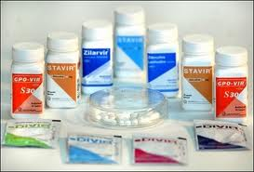
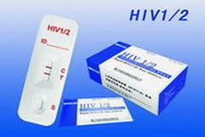

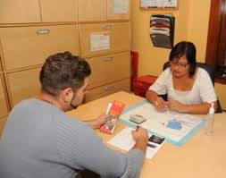
Introduction
HIV prevention includes: medicines, medical devices, medical procedures, physical barriers, and behavioral approaches.
Medical devices/ medical procedures
Physical barriers
Behavioral approaches
Medicines
Notes:
Participant Guide page 51.
Review the content on the slide.

Slide 87
Introduction
Comprehensive HIV prevention includes multiple approaches instead of just one or two approaches.
Notes:
Participant Guide page 51.
Tell participants after reviewing the slide content: Combination prevention incorporates biomedical, behavioral, and other interventions all designed to reduce HIV transmission. This kind of comprehensive and combination HIV prevention is referred to as “high-impact HIV prevention.”
Review the content on the slide.

Slide 88
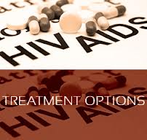

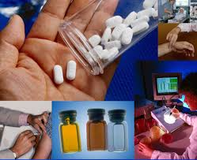
Introduction
No one HIV prevention approach will be acceptable to all people.
Research is critical to develop and test new prevention options that offer people more choices.
The best option for one person may not be the best for others.
Notes:
Participant Guide page 51.
Read the content on the slide as the animated sections are revealed. Add the following information for each of the sections:
Treatment options: HIV vulnerability varies for each person and changes over time. Therefore, it is important that people have options for HIV prevention so they can choose the approach that is the best fit for them.
Question mark: Choosing the right HIV prevention option may depend on cost, availability, ease of use, or needing the consent of a partner.
Research: Finding clinical research participants who are willing and able to meet the rigorous clinical trial requirements is also important.
Tell participants after reviewing the slide content: HIV prevention methods also need to be supported by the community at the local and national levels.

Slide 89

High-Impact Prevention
The U.S. Centers for Disease Control and Prevention (CDC) is using high-impact prevention.
High-impact prevention includes:
“…using combinations of scientifically proven, cost-effective, and scalable interventions targeted to the right populations in the right geographic areas.”
Notes:
Participant Guide page 52.
Review the content on the slide.

Slide 90
High-Impact Prevention
Disease surveillance
HIV testing, counseling, and referral services
Street and community outreach
Risk-reduction counseling
Prevention case management
Prevention and treatment of other sexually transmitted infections (STIs)
Notes:
Participant Guide page 52.
Tell participants before reviewing the slide content: To make high-impact prevention work, the CDC is working to implement, evaluate, strengthen, and further develop effective HIV prevention efforts nationwide and globally. The CDC is also giving financial and technical support for…

Slide 91
High-Impact Prevention
Public information and education
School-based HIV/AIDS education
International clinical trials
Technology transfer systems
Organizational capacity building
Notes:
Participant Guide page 52.
Tell participants before reviewing the slide content: The CDC also gives financial and technical support for…
Add the following information for the technology transfer systems bullet: Technology transfer systems make scientific and technological developments accessible to a variety of users.

Slide 92
The HIV Combination Prevention Toolbox
The toolbox is organized into two sections:
Tools and approaches that are “medical” in nature
Tools and approaches that are “behavioral” in nature
Notes:
Participant Guide page 53.
Note: If applicable (this section may be delivered as a stand-alone section), remind participants that we talked a little bit about medical and behavioral research earlier (in the What Is Clinical Research? Section). Now we’ll talk about specific tools in the toolbox.
Tell participants before reviewing the slide content: We have divided the combinations of interventions that can be used to prevent HIV infection into medical (meaning ones that generally would require a prescription or use of a biological product) and behavioral/physical barriers (meaning ones that are within the direct control of the person and hopefully readily available). It should be emphasized that all of these interventions are generally used in combination and all involve some behavioral activity on the part of the user. Most of the HIV prevention research being conducted by the NIH HIV/AIDS Clinical Trials Networks involves some type of medical intervention in combination with behavioral components. The HIV combination prevention toolbox shows this kind of combination of approaches. The toolbox is organized into two sections…
Add the following to “Tools and approaches that are “medical” in nature”: including medicines, medical devices, and medical procedures.
Add the following to “Tools and approaches that are “behavioral” in nature”: including risk reduction counseling and effective behavioral interventions.

Slide 93


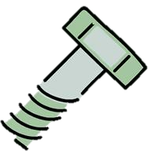








The HIV Combination Prevention Toolbox
Vaccines
Post-Exposure Prophylaxis (PEP)
Treatment as Prevention (TasP)
HIV Prevention Toolbox
Pre-Exposure Prophylaxis (PrEP)
Microbicides
Diagnosis and treatment of sexually transmitted infections (STIs)
Prevention of perinatal transmission (PMTCT)
Medical
Harm reduction
Education
Voluntary Medical Penile Circumcision (VMMC)
Needle exchange programs
Condoms and other barrier methods
Treatment/
prevention of drug/
alcohol abuse
Behavioral/Physical Barriers
Notes:
Participant Guide page 53.
Review the toolbox graphic on the slide.
Medical HIV prevention tools include:
Post-exposure prophylaxis (PEP): Taking anti-HIV drugs as soon as possible after exposure to HIV.
Pre-exposure prophylaxis (PrEP): a biomedical prevention approach for people who do not have HIV; they take medication before exposure to HIV to reduce their likelihood of acquiring HIV.
Prevention of perinatal transmission (PMTCT): Interventions to reduce infant exposure to HIV during pregnancy, labor, and breastfeeding. Note that this is sometimes known as “prevention of mother-to-child transmission,” but many find this term stigmatizing and prefer terms like “perinatal” or “vertical,” which remove the implication of blame. We have left the acronym PMTCT because many are still familiar with it.
Vaccines: A substance that teaches the body’s immune system to recognize and protect against a disease caused by an infectious agent or virus, often by stimulating the body to produce antibodies to that infection.
Treatment as Prevention: a medical prevention approach that uses antiretroviral treatment for people with HIV to decrease their chance of transmitting HIV, ideally to zero chance under conditions of viral suppression (undetectable)
Microbicides: Products being developed and tested for use in the vagina or rectum to reduce the likelihood of HIV transmission during vaginal and anal sex
Sexually Transmitted Infections (STIs) Diagnosis and Treatment: having an STI can increase one’s likelihood of contracting HIV, so treatment of STIs is important for HIV prevention.
Tell participants after reviewing the graphic: Some of these prevention tools are approved for use and some are still being tested. Research is under way.
Information related to the optional quiz (treatment as prevention): Q15: True.
Q: Many people living with HIV around the world are virally suppressed, meaning their medications have succeeded in reducing the amount of HIV in the body to levels such that a regular HIV test can no longer detect the virus. People with viral suppression cannot transmit HIV to their sex partners, even if they don't use a condom.
A: When people living with HIV take anti-retroviral medications, they can become virally suppressed. Viral suppression means that the medications are working to reduce the amount of HIV in the body to undetectable levels. Estimates indicate that more than 40% of the world's people living with HIV are virally suppressed. Studies have shown that people with viral suppression cannot transmit HIV to their sex partners—not even through acts of condomless sex. Because anti-retroviral treatment for people living with HIV can prevent HIV transmission in this way, we call it “Treatment as Prevention” (TasP). Many scientists around the world, including those at the National Institutes of Health and the Centers for Disease Control and Prevention, agree that there is zero chance of HIV transmission through sex under conditions of viral suppression.

Slide 94
The HIV Combination Prevention Toolbox
Vaccines
Post-Exposure Prophylaxis (PEP)
Treatment as Prevention (TasP)
HIV Prevention Toolbox
Pre-Exposure Prophylaxis (PrEP)
Microbicides
Diagnosis and treatment of sexually transmitted infections (STIs)
Prevention of perinatal transmission (PMTCT)
Medical
Harm reduction
Education
Voluntary Medical Penile Circumcision (VMMC)
Needle exchange programs
Condoms and other barrier methods
Treatment/
prevention of drug/
alcohol abuse
Behavioral/Physical Barriers
Notes:
Participant Guide page 53.
Tell participants before reviewing the slide content: Behavioral and physical barrier prevention tools include:
Harm Reduction: A way of dealing with behavior that damages the health of a person (and sometimes the health of their community). Harm reduction can include education about drug use, sex, and HIV.
Clean Syringes (Needle Exchange Programs): Provides clean needles to reduce the likelihood of HIV transmission through injected drugs. Needle exchange programs provide a safe way for people to turn in their used syringes for appropriate disposal and received new sterile syringes in return; some programs also provide information on how to clean syringes using bleach and water.
Condoms and Other Barrier Methods: Any method that prevents passage of blood, semen, or vaginal fluids from passing from one person to another. Condoms can be used externally (typically over a penis) or internally (typically inside a vagina or rectum).
Treatment/Prevention of Drug/Alcohol Abuse: Includes injection drug use, behavior while under the influence, and effects of drug use and addiction on a person’s overall health.
Voluntary Medical Penile Circumcision: A surgical procedure to remove the penis’s foreskin; reduces the likelihood of the insertive partner acquiring HIV through the penis during vaginal sex by approximately 60%. “Voluntary medical” means the surgery is performed on adults who consent to the procedure for this medical purpose.
Education: Education includes knowing your status, encouraging testing, and knowing how the disease is transmitted.

Slide 95
Hidden slide
Notes:
Tell participants after reviewing the slide content: The HIV combination prevention toolbox shows the importance of both medical and behavioral/physical tools. Combining multiple tools may provide the best method for HIV prevention. Some of these tools have both a medical and behavioral component. For example, PrEP is a medical tool because it involves antiretroviral medications, but there is also a behavioral component because people have to follow the prescribed plan and take the medication.

Slide 96
Effective HIV Prevention Programs
An effective community planning process
Collection of data about HIV vulnerabilities, incidence, or prevalence
HIV counseling, testing, and referral; partner counseling and referral; linkage to medical care, prevention, and intervention services
Health education and risk reduction activities, including individual-, group-, and community-level interventions
Notes:
Participant Guide page 54.
Tell participants before reviewing the slide content: Effective HIV prevention programs are comprehensive and science-based. When we talk about HIV prevention strategies and tools, we are looking at things that we already know are working, things that are being researched right now, and things that might work and that may be researched in the future. They include…
Review the animated graphic (this graphic is continued on the next slide).

Slide 97
Effective HIV Prevention Programs
Accessible services for diagnosis and treatment of other STIs
Public information and education programs
Comprehensive school health programs
Training and quality assurance
Notes:
Participant Guide page 54.
Tell participants before reviewing the slide content: Effective HIV prevention programs also include…
Continue reviewing the animated graphic (this graphic is continued on the next slide).

Slide 98
Effective HIV Prevention Programs
An HIV prevention technical assistance assessment and plan
Evaluation of major program activities, interventions, and services
Knowledge about HIV prevention research
Knowledge about research outcomes in communities most impacted by HIV
Notes:
Participant Guide page 54.
Continue reviewing the animated graphic (this graphic is continued on the next slide).
Tell participants before reviewing the slide content: Effective HIV prevention programs also include…
Add examples for two of the sections:
An HIV prevention technical assistance assessment and plan: For example, technical assistance is provided to help communities in reporting, tracking, and quality assurance of to ensure data quality.
Evaluation of major program activities, interventions, and services: For example, review and analyze information from several resources, including trends in HIV diagnoses, behavioral surveillance data, risk behavior, etc.

Slide 99
Effective HIV Prevention Programs
Two-way information:
Bringing scientific information to the community
Bringing community opinions, beliefs, and concerns to researchers
Personal responsibility:
Know your HIV status.
Seek treatment if living with HIV
Use combination treatments as prescribed for your own health and to prevent transmission to others.
If not living with HIV, use combination prevention strategies.
If not living with HIV, retest regularly. The CDC recommends that people who are vulnerable to HIV be tested every three months.
Notes:
Participant Guide page 54.
Continue reviewing the animated graphic.
Tell participants before reviewing the slide content: Effective HIV prevention programs also include…

Slide 100
What Did You Learn?
In this activity, you will think about how you can apply what you learned about HIV prevention by answering a question.
With your group:
Brainstorm the question you are assigned (you only need to brainstorm one of the questions).
Share your answers with the whole group so they can hear your ideas.
How can you use what you have learned about HIV prevention in your daily life?
If someone you know wants more information about HIV prevention, what would you tell them?
If you were concerned about someone close to you becoming HIV-positive, what would you do?
In what ways has this information about HIV prevention impacted YOU?
Notes:
Participant Guide pages 55-56.
Introduce a small group activity.
Divide the whole group into 4 smaller groups.
Assign one of the questions in the boxes to each group.
Allow approximately 5 mins for the groups to brainstorm their answers.
Encourage participants to write their brainstorm on a flip chart, white board, and/or in their Participant Guides (each question has been reproduced in the Participant Guide with space to write).
Ask someone from each group to share some/all of their answers.
Encourage the other groups to write these answers in the provided space in their Participant Guides.
Possible answers include:
Question 1: How can you use what you have learned about HIV prevention in your daily life? Understand the importance of testing; understand the tools available for HIV prevention.
Question 2: If someone you know wants more information about HIV prevention, what would you tell them? Research the various HIV/AIDS websites; talk to doctors and other health care professionals.
Question 3: If you were concerned about someone close to you becoming HIV positive, what would you do? Talk to them about condoms and PrEP; know how HIV is prevented and transmitted.
Question 4: In what ways has this information about HIV prevention impacted YOU? More aware of prevention options; more aware of the importance of taking responsibility for my actions in preventing HIV.
Activity timing: 15 mins (5 mins to brainstorm their answers; 10 mins for the whole group sharing). Total time for this activity: 15 mins
Allow for questions before ending the activity and going to the summary.

Slide 101
Summary
Comprehensive HIV prevention includes treatment, education, skills, personal responsibility, and access to tools, products, and approaches.
Different HIV prevention approaches need to be tested to find out what works best. Identifying and offering more options will allow people to determine which options fit their lifestyle, their needs, and the needs of their family and friends. Ongoing HIV prevention research supports:
More HIV prevention options
More combination HIV prevention options
More diverse research participants to expand the understanding of what works
Notes:
Participant Guide page 57.
Review the content on the slide.
Review the objectives for this section. Tell participants: In this session, you learned about:
The qualities of high-impact HIV prevention
The HIV combination prevention toolbox and what it contains
Tell participants where to find the glossary of terms and abbreviations used in this session in case they have questions about them.
Review the Frequently Asked Questions (FAQs) and additional resources for more information.
Ask participants if they have any additional resources they would like to share.
Save and add any additional resources for future use.

Slide 102
Questions?
Notes:
No Participant Guide page.
Ask participants if they have any questions. Answer all questions, if possible. If not, make a note of these questions to prepare for the next training session.

Slide 103
What Are HIV Prevention Tools and How Are They Used in HIV Prevention Research?
www.bethegeneration.org
Notes:
Participant Guide page 62.
Review the content on the slide.

Slide 104
Objectives
HIV Prevention Research and Research Successes
PrEP, TasP, and Integrated Strategies in HIV Prevention Research
Microbicides in HIV Prevention Research
Vaccines in HIV Prevention Research
Notes:
Participant Guide page 62.
Tell participants before reviewing the slide content: In this session (What Are HIV Prevention Tools and How Are They Used in Prevention Research?), you will learn about…
Review the objectives on the slide.

Slide 105
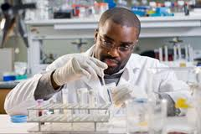
Introduction
Promoting awareness, understanding, and dialogue between researchers and members of impacted communities and advocates
Encouraging support for ongoing HIV prevention research
Developing and evaluating new HIV prevention tools and approaches
Improving HIV treatment regimens
Notes:
Participant Guide page 62.
This section of the course is aimed at awareness level only. Specific trials/research are not discussed because it is too much information for this the time available. This section is also at the end of the day, so participants will likely be tired. This content is condensed from the content in the Introduction to remind participants that everything we’ve already talked about brings us to this point. For sessions where the course has been abbreviated and includes ONLY the content about the HIV prevention tools, additional presenter instructions will be required to ensure continuity. Any references to previous sections of the course should be omitted.
Tell participants before reviewing the slide content: Research is looking at a number of ways to prevent the spread of HIV. It includes…
Review the content on the slide.

Slide 106
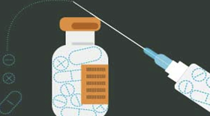
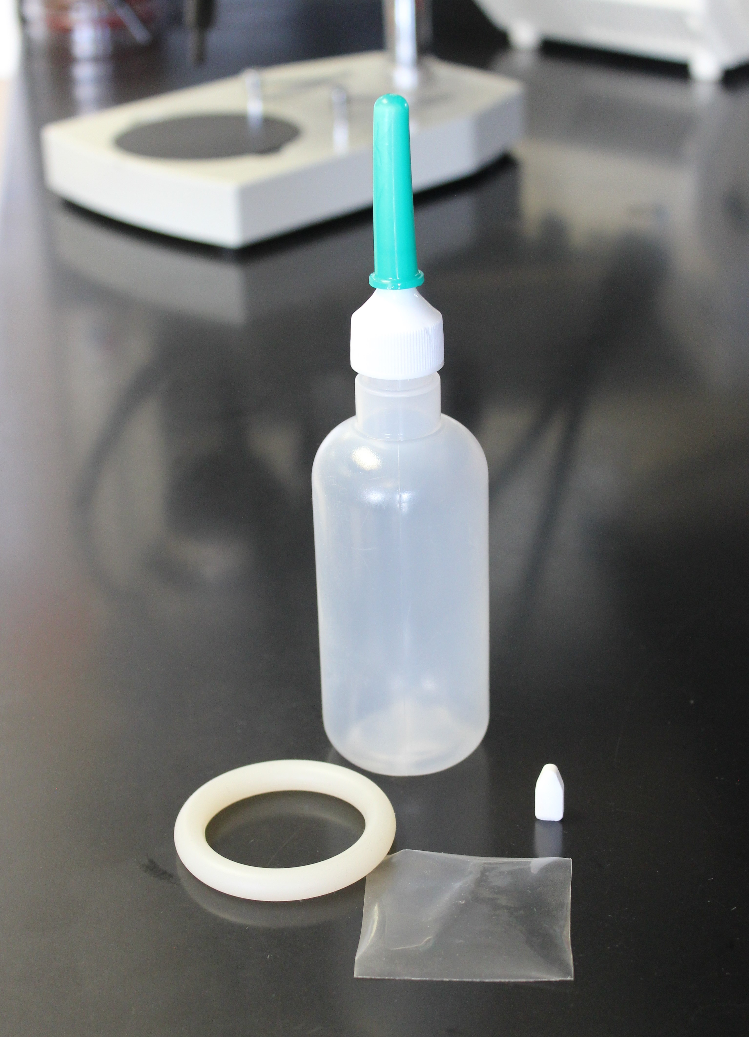
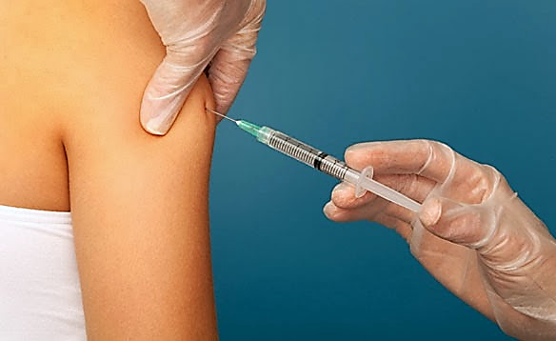
Introduction
Three Important Areas of Biomedical Prevention
PrEP, TasP & Integrated Strategies
Microbicides
Vaccines
New formulations and delivery methods to reduce the likelihood of transmission.
Products applied vaginally or rectally that may prevent HIV transmission.
Harnessing the immune system to help prevent a person from contracting HIV.
Notes:
Participant Guide page 62-63.
Tell participants before reviewing the slide content: One of our goals today is to increase awareness of and knowledge about HIV prevention research. During this section of the course, we will focus on three important areas of biomedical prevention. When we talk about HIV prevention strategies and tools, we are looking at things that we already know are working, things that are being researched right now, and things that might work and that may be researched in the future.
Review the animated graphic on the slide. Add the following information as each section is revealed:
Provide definitions as each modality is revealed. Tell participants:
Pre-exposure prophylaxis (PrEP), TasP, & Integrated Strategies: PrEP is an HIV prevention approach for HIV negative individuals to stay HIV-negative by taking anti-HIV medicines. There are two FDA approved medications for PrEP. One is called Truvada® and the other is called Descovy ®. Each is a pill approved for daily use in the US. TasP is the use of anti-HIV medicines among people with HIV to reduce the likelihood of transmission to others. “Integrated strategies” refers to other ways of administering PrEP that are currently under research, like injections. More on those later.
Microbicides: Microbicides are products being developed and tested in different forms like vaginal rings, rectal inserts, suppositories, douches, and gels that release drugs in the body over time. They are designed for people of all genders to be applied in the vagina or rectum to help prevent HIV during sex.
An HIV vaccine would teach the body to recognize the virus and activate protective cells to prevent infection or control disease. There is no HIV vaccine right now. But some clinical trials have given hope that an effective vaccine could be developed, and newer trials are ongoing to find out.

Slide 107
Introduction
Vaccines
Post-Exposure Prophylaxis (PEP)
Treatment as Prevention (TasP)
HIV Prevention Toolbox
Pre-Exposure Prophylaxis (PrEP)
Microbicides
Diagnosis and treatment of sexually transmitted infections (STIs)
Prevention of perinatal transmission (PMTCT)
Medical
Harm reduction
Education
Voluntary Medical Penile Circumcision (VMMC)
Needle exchange
Condoms and other barrier methods
Treatment/
prevention of drug/
alcohol abuse
Behavioral/Physical Barriers
Notes:
Participant Guide page 63.
Tell participants before reviewing the slide content: We call these medical prevention tools “modalities.”
Remind participants that:
They just saw this graphic introduced to all of the prevention techniques.
Just because we’re only talking about PrEP & TasP, microbicides, and vaccines here doesn’t mean they should forget about the other prevention methods.
We said earlier that education and a combination of prevention approaches improves effectiveness.
Tell participants after reviewing the slide content: Participation in research can lead to intervention and prevention.

Slide 108
HIV Prevention Research Successes
Prevention of perinatal transmission (PMTCT)
The Thai HIV Vaccine Trial (RV144)
CAPRISA 004 Microbicide
iPrEx & Partners PrEP
HPTN 052 (Treatment as Prevention)
ASPIRE, The Ring Study, & HOPE
HPTN 083 & HPTN 084 (Injectable PrEP)
Notes:
Participant Guide pages 64-65.
Tell participants before reviewing the slide content: A variety of HIV prevention research successes are creating a great deal of hope that we will soon be able to prevent the spread of HIV. Even when an approach or tool being tested does not work, researchers learn a great deal and can redirect their future efforts accordingly.
Presenters should be prepared to check for updated information and data on the UNAIDS, CDC, NAID, and NIAID websites and provide updates, as needed.
Introduce the overview graphic on the PPT slide. Each of the sections of the graphic will be described in detail on the following slides.

Slide 109
HIV Prevention Research Successes
PMTCT began as clinical research.
It is now considered regular care in the US and much of the world.
Prevention of perinatal transmission (PMTCT)
Before 1994, women with HIV had at least a 25% chance of passing HIV to their babies.
Now, in the US, there is less than a 2% chance of HIV transmission when mothers with HIV and their babies receive HIV treatment.
Notes:
Participant Guide page 64.
This slide is the first piece of the overview graphic.
Review the content on the slide as it is revealed by the animation.

Slide 110
HIV Prevention Research Successes
RV144 was a clinical trial from 2003-2009 testing a combination of two HIV vaccines (the “prime” and the “boost”).
The goal of the prime/boost approach is to stimulate different parts of the body’s immune system and increase the body's overall immune response to HIV.
The Thai HIV Vaccine Trial (RV144)
RV144 is the first clinical trial to show evidence of moderate protection and the possibility for an effective vaccine.
It provided a lot of new information about how antibodies form in response to the vaccine.
The prime/boost vaccine combination lowered the rate of HIV infection by about 31%.
Notes:
Participant Guide page 64.
Continue reviewing the overview graphic.
Review the content on the slide as it is revealed by the animation.

Slide 111
HIV Prevention Research Successes
CAPRISA 004 was a clinical trial from 2007-2010 testing the effectiveness of a microbicide gel product containing 1% tenofovir (an antiretroviral medication) in cisgender women used before and after vaginal sex.
CAPRISA 004 Microbicide
CAPRISA 004 is the first clinical trial to show evidence of moderate protection and the possibility of an effective vaginal microbicide.
There were 39% fewer HIV transmissions among women who used the CAPRISA 004 microbicide.
Notes:
Participant Guide page 64.
Continue reviewing the overview graphic.
Review the content on the slide as it is revealed by the animation.

Slide 112
HIV Prevention Research Successes
iPrEx was a clinical trial from 2007-2009 to test if taking a daily tablet containing two antiretroviral drugs could prevent HIV transmission through anal sex among cisgender men who have sex with men and transgender women who have sex with men.
Partners PrEP was a clinical trial from 2008-2010 for heterosexual couples where one partner had HIV and the other did not.
The medicine proved to be safe and well-tolerated. Side effects were mild and infrequent.
iPrEx & Partners PrEP
These two trials helped pave the way for what we know today: oral PrEP is nearly 100% effective at preventing HIV when taken as prescribed.
The FDA approved this PrEP tablet for daily use in May 2012.
Notes:
Participant Guide page 65.
Continue reviewing the overview graphic.
Review the content on the slide as it is revealed by the animation.
Tell participants after reviewing the first bullet: Along with other clinical trials, the iPrEx clinical trial helped pave the way for the approval by the FDA for use of Truvada® as PrEP.

Slide 113
HIV Prevention Research Successes
HPTN 052 was a clinical trial from 2005-2010 for couples (mostly heterosexual) where one partner had HIV and the other did not.
It involved the person with HIV taking a combination of three or four drugs from a group of 11 ARVs.
HPTN 052 (Treatment as Prevention)
There was a 96% reduction in HIV transmission overall.
There was a 100% reduction in HIV transmission under conditions of viral suppression (undetectable).
HPTN 052 was the first randomized clinical trial to demonstrate that early antiretroviral therapy can improve health outcomes for people with HIV and prevent transmission of HIV to HIV-negative sex partners.
Notes:
Participant Guide page 65.
Continue reviewing the overview graphic.
Review the content on the slide as it is revealed by the animation.
After reviewing the slide content, stop for questions. The next three subsections are modality specific.

Slide 114
HIV Prevention Research Successes
ASPIRE and The Ring Study were two clinical trials (2012-2016) testing a monthly vaginal ring containing the ARV dapivirine for HIV prevention.
The two studies combined enrolled over 4,500 cisgender women in Africa and showed that the ring was safe and reduced HIV rates by 1/3.
ASPIRE, The Ring Study, & HOPE
Women who used the ring most had the greatest benefit: up to 75% reduction in HIV transmission.
HOPE was a trial in which former ASPIRE participants could use the ring open-label. Results from 1,456 women showed high adherence and suggested a 39% reduction in HIV risk.
Additional trials of the vaginal ring have occurred, and the ring is currently under regulatory review for licensure.
Notes:
Participant Guide page 65.
This slide is the first piece of the overview graphic.
Review the content on the slide as it is revealed by the animation.

Slide 115
HIV Prevention Research Successes
HPTN 083 was a study from 2016-2020 testing an injection of the drug cabotegravir for HIV prevention among cisgender men and transgender women who have sex with men.
The injections were given in the buttock muscle once every other month.
This was one of the first studies to set, meet, and exceed enrollment goals for Black MSM and transgender women.
HPTN 083 & HPTN 084 (Injectable PrEP)
The injections proved to be safe, well-tolerated, and equally as effective as oral PrEP.
HPTN 084 is testing the same injectable PrEP drug among cisgender women in Africa. Results are forthcoming.
Notes:
Participant Guide page 65.
Continue reviewing the overview graphic.
Review the content on the slide as it is revealed by the animation.

Slide 116
Pre-Exposure Prophylaxis
(PrEP)
www.bethegeneration.org
Notes:
Participant Guide page 66.
Review the content on the slide.

Slide 117
Introduction
Vaccines
Post-Exposure Prophylaxis (PEP)
Treatment as Prevention (TasP)
HIV Prevention Toolbox
Pre-Exposure Prophylaxis (PrEP)
Microbicides
Diagnosis and treatment of sexually transmitted Infections (STIs)
Prevention of perinatal Transmission (PMTCT)
Medical
Harm Reduction
Education
Voluntary Medical Penile Circumcision (VMMC)
Needle exchange programs
Condoms and other barrier methods
Treatment/
prevention of drug/
alcohol abuse
Behavioral/Physical Barriers
Notes:
Participant Guide page 66.
Tell participants before reviewing the slide content: We said earlier that education and a combination of prevention approaches improves prevention effectiveness. The HIV combination prevention toolbox shows the importance of both medical and behavioral/physical tools. Combining multiple tools may provide the best method for HIV prevention. It is recommended that people who are prescribed PrEP also receive counseling as part of a comprehensive HIV prevention package and consistently use condoms.

Slide 118
Introduction
The PrEP prevention approach is focused on people who do not have HIV, but may be vulnerable to contracting HIV through sex and/or injection drug use (IDU).
With PrEP, people who do not have HIV take a medication.
The medication lowers their likelihood of contracting HIV through sexual contact as well as IDU.
Notes:
Participant Guide page 66.
Each of the following modalities stand alone in terms of content and can be pulled out, as needed. If presenting a modality outside of the main context of the training, discuss the toolbox graphic as an introduction. There is repetition of the graphic and some text to ensure that each modality stands alone. Repetition of the graphic is designed to remind participants which modality is being discussed and serve as a reminder of the toolbox.
Tell participants after reviewing the last bullet:
This approach is only effective if the medication is taken exactly as prescribed on a consistent, daily basis.
The idea of PrEP is not new. It is the same idea behind taking birth control pills to prevent pregnancy or taking anti-malarial drugs before traveling to areas where malaria is an issue. People can be healthy but still taking a daily medication to avoid a specific health problem, such as HIV.
PrEP is only available by prescription.
Information related to the optional quiz (referring to injection drug use (IDU)): Q10: False.
Q: PrEP is an HIV prevention method intended for use by people living with HIV.
A: PrEP is an HIV prevention strategy in which HIV‐negative people are prescribed antiretroviral medication to reduce their chances of contracting HIV. However, PrEP is meaningful for people living with HIV too; it has been shown to be an effective HIV prevention method for mixed-status partners to help HIV-negative partners stay negative. Truvada® was the first pill approved by the U.S. Food and Drug Administration as daily oral PrEP in 2012, and Descovy® was the second in 2019. Other medications are being researched as PrEP.
Information related to the optional quiz included in the Participant Guide (referring to the importance of taking medication exactly as prescribed on a consistent, daily basis): Q8: False.
Q: PrEP is a way to prevent HIV by taking HIV treatment medication after exposure to the virus.
A: Among the many ways to prevent HIV, two strategies sound very similar but are quite different: PrEP versus PEP.
PrEP stands for Pre‐Exposure Prophylaxis. It involves prescribing anti-HIV medications to people who are HIV-negative before they are exposed to HIV. People who are vulnerable to contracting HIV who take PrEP every day as prescribed greatly lower their likelihood of contracting HIV.
PEP stands for Post-exposure prophylaxis. This involves taking antiretroviral medicine after being potentially exposed to HIV to prevent the virus from establishing itself in the body. PEP must be started within 72 hours after a possible exposure to HIV.
PrEP and IDU: a study in Thailand showed a reduction in HIV contraction among PWID. Research in this area has not been extensive, but CDC recommends PrEP for people vulnerable to contracting HIV through IDU.

Slide 119
PrEP vs. PEP
HIV Exposure
PrEP is treatment before exposure
PEP is treatment after exposure
Notes:
Participant Guide page 67.
Among the many ways to prevent HIV, two strategies sound very similar but are quite different: PrEP versus PEP.
PrEP stands for Pre‐Exposure Prophylaxis. It involves prescribing anti-HIV medications to people who are HIV-negative before they are exposed to HIV. People who are vulnerable to contracting HIV who take PrEP every day as prescribed greatly lower their likelihood of contracting HIV.
PEP stands for Post-exposure prophylaxis. This involves taking antiretroviral medicine after being potentially exposed to HIV to prevent the virus from establishing itself in the body. PEP must be started within 72 hours after a possible exposure to HIV.
For more info and helpful videos explaining the differences between PrEP and PEP, see: http://www.fredhutch.org/en/research/divisions/vaccine-infectious-disease-division/research/immunology-and-vaccine-development/be-the-generation/prep-tasp.html

Slide 120
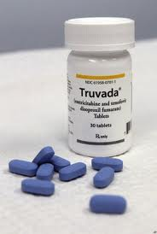
PrEP Progress
One major milestone in HIV prevention was the first approval of daily oral PrEP in the United States. This happened for the first time in 2012, marketed under the brand name Truvada®. Truvada® is a combination of two antiretroviral drugs:
Tenofovir disoproxil fumarate (also called TDF)
Emtricitabine (also called FTC)
Notes:
Participant Guide page 67.
Tell participants before reviewing the slide content: PrEP research focuses on using medications combined with other HIV prevention methods, including consistent use of condoms.
Review the content on the slide.

Slide 121
Oral PrEP Progress
January 2011
Interim guidance issued by the US Centers for Disease Control and Prevention (CDC) for men who have sex with men and transgender women who are vulnerable to HIV
July 2012
Approved by the US Food and Drug Administration (FDA) for daily use
August 2012
Interim guidance issued by the CDC for heterosexual men and women vulnerable to HIV, such as those in relationships where one person has HIV and the other does not
World Health Organization issued guidance on PrEP use
June 2013
CDC added injection drug use to the interim guidance on PrEP use based on the results of the Bangkok Tenofovir Study
Notes:
Participant Guide page 67.
Tell participants before reviewing the slide content: oral PrEP milestones are…
Review the animated content on the slide.
We can also add to this list the FDA approval of Descovy as PrEP in October 2019, and there are sure to be more options for PrEP approved in years to come.
Information related to the optional quiz (end of bullet under January 2011): Q9: True.
Q: Daily oral PrEP has been shown to reduce people’s chances of contracting HIV among gay men, transgender women, and inf couples where one person has HIV and the other does not.
A: Daily oral PrEP has been shown to help reduce the likelihood of contracting HIV in multiple studies, including in gay men and other men who have sex with men, transgender women, and couples where partners have different HIV statuses. Oral PrEP is highly effective with daily use, with some studies demonstrating a more than 90 percent reduction in HIV acquisition.

Slide 122
HIV Prevention Using Oral PrEP
Truvada® (also known as TDF/FTC) is FDA-approved for daily use for HIV prevention.
Truvada® must be taken as prescribed to be effective as PrEP.
It is recommended that people who are prescribed PrEP continue to use condoms to prevent other STIs.
Notes:
We will focus on Truvada instead of Descovy because Truvada is approved for anyone vulnerable to HIV acquisition, while Descovy has limited approval.
Participant Guide page 68.
Review the content on the slide.
Add the following information for the bullets:
Truvada® (also known as TDF/FTC) is FDA-approved for daily use for HIV prevention: For HIV treatment, Truvada® is approved only in combination with other ARVs.
It is recommended that people who are prescribed PrEP continue to use condoms. Like any prevention modality (including condoms), PrEP is not 100% effective in preventing HIV, and it does not prevent the transmission of other sexual transmitted infections such as syphilis or gonorrhea.

Slide 123
HIV Prevention Using Oral PrEP
How Truvada® as PrEP works
Truvada® is an oral pill consisting of two antiretroviral medications (ARVs) that protects people who do not have HIV if they are exposed to the virus
ARVs block HIV replication in multiple places in the reproductive cycle of the virus
Notes:
Participant Guide page 68.
Tell participants before reviewing the slide content: While the availability of Truvada® as a prescription for use as PrEP is a major breakthrough, it still has limitations (particularly around access), and there are specific guidelines for use.
Continue reviewing the guidelines for using Truvada®.

Slide 124
HIV Prevention Using Oral PrEP
Who should use Truvada® for HIV prevention?
Anyone who is susceptible to contracting HIV, including…
Men who have sex with men
Transgender women who have sex with cisgender men
Couples where one partner has HIV and the other does not
People who use injection drugs
Notes:
Participant Guide page 68.
Continue reviewing the guidelines for using Truvada®.
Presenters should be prepared to check for updated information and data on the UNAIDS, CDC, NAID, and NIAID websites and provide updates, as needed.

Slide 125
HIV Prevention Using Truvada®
Requirements for use
Be HIV-negative (must get tested prior to use)
Test for HIV at least every three months while taking Truvada®
Take Truvada® daily to achieve the maximum HIV prevention benefit
Notes:
Participant Guide page 68.
Continue reviewing the guidelines for using Truvada®.
Add the following information: To get Truvada®, one must initiate a conversation with their doctor.

Slide 126
Continuing Research: PrEP & Integrated Strategies
Research in more countries and populations
Different drugs, delivery methods, and dosing schedules
Implementation research to understand PrEP in “real world” settings
Some of the goals of ongoing PrEP research include:
Notes:
Participant Guide page 69.
Tell participants before reviewing the slide content: Although PrEP has now been approved in the U.S., ongoing PrEP research is still needed. There is currently research of different oral dosing strategies, long-acting injectables, implants, and other drugs that could be used as PrEP.
Tell participants after the last section of the Implementation research part of the graphic is revealed: This research will not only continue to examine the effectiveness of PrEP, but will also examine the factors that may impact access to PrEP and decisions to use this HIV prevention tool within various groups of people, such as young men who have sex with men (YMSM).

Slide 127
What Did You Learn?
In this activity, you will brainstorm how you can apply what you learned about PrEP by answering a question.
With your group:
Brainstorm the question you are assigned (you only need to brainstorm one of the questions).
Share your answers with the whole group so they can hear your ideas.
What thoughts, questions, and concerns came to your mind about PrEP as you heard/read information about this HIV prevention modality?
If you were asked to speak to an audience about PrEP, what would be the three most important messages you would want to convey?
Notes:
Participant Guide page 70.
Introduce a small group activity. Divide the class into two groups. Assign the questions to the groups (one question per small group).
Assign one of the questions in the boxes to each group.
Allow approximately 5 mins for the groups to brainstorm their answers.
Encourage participants to write their brainstorm on a flip chart, white board, and/or in their Participant Guides (each question has been reproduced in the Participant Guide with space to write).
Ask someone from each group to share some/all of their answers.
Encourage the other groups to write these answers in the provided space in their Participant Guides.
Note: This is a shortened activity using only 2 questions. There will be one larger activity at the end of the three modalities.
Possible answers include:
Question 1: What thoughts, questions and concerns came to your mind about PrEP as you heard/read information about this HIV prevention modality? The importance of getting tested; cost of the medications; importance of regular medication use.
Question 2: If you were asked to speak to an audience about PrEP, what would be the three most important messages you would want to convey? It is nearly 100% effective if taken correctly; Get tested; take the recommended medication dose as directed consistently.
Allow approximately 5 min for each person to answer the question. Ask for volunteers to share their answers. Allow approximately 5 mins to share answers.
Total time for this activity: 10 mins

Slide 128
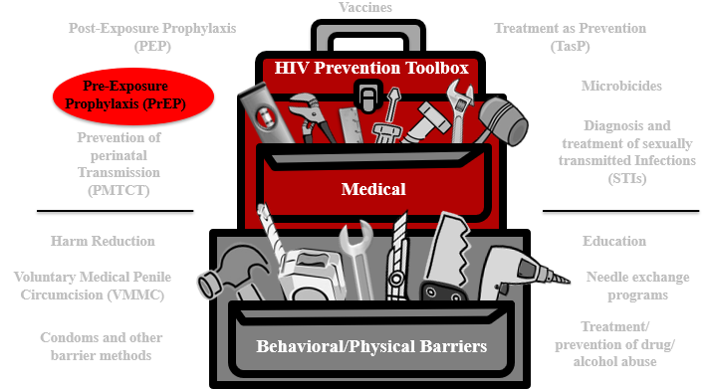
PrEP Summary
PrEP is a medical HIV prevention approach for people who don’t have HIV but are vulnerable to HIV.
Oral Truvada® was the first drug approved for PrEP and involves taking medication on a daily basis to reduce the likelihood of contracting HIV through sex or injection drug use.
Researchers are studying new PrEP approaches like injectables and implants that would last much longer than daily-dose pills.
Notes:
Participant Guide page 71.
Review the content on the slide.
Tell participants after reviewing the slide content: The HIV combination prevention toolbox reinforces the role of PrEP combined with other behavioral/physical tools. Combining multiple tools may provide the best method for HIV prevention.

Slide 129
Questions?
Notes:
No Participant Guide page.
Stop to ask/answer questions before moving to the next modality.
Ask participants if they have any questions. Answer all questions, if possible. If not, make a note of these questions to prepare for the next training session.

Slide 130
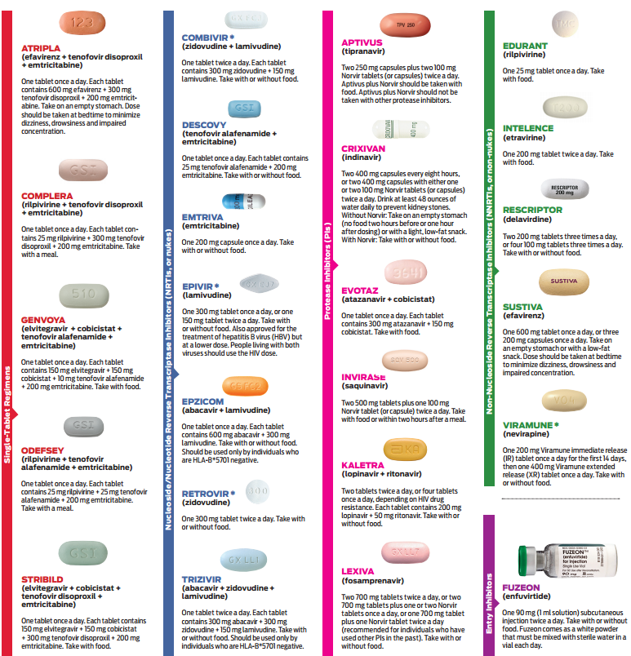
Treatment as Prevention
(TasP)
Notes:
Participant Guide P. 72

Slide 131
Introduction
Vaccines
Post-Exposure Prophylaxis (PEP)
Treatment as Prevention (TasP)
HIV Prevention Toolbox
Pre-Exposure Prophylaxis (PrEP)
Microbicides
Diagnosis and treatment of sexually transmitted Infections (STIs)
Prevention of perinatal Transmission (PMTCT)
Medical
Harm Reduction
Education
Voluntary Medical Penile Circumcision (VMMC)
Needle exchange programs
Condoms and other barrier methods
Treatment/
prevention of drug/
alcohol abuse
Behavioral/Physical Barriers
Notes:
Participant Guide page 72.
Tell participants before reviewing the slide content: We just talked about PrEP. Now let’s talk about another highly effective HIV prevention method: Treatment as Prevention, or “TasP.”
Tell participants after reviewing the slide content: While PrEP is only to be used by people who do not have HIV, TasP is an approach for people living with HIV to reduce the likelihood of passing HIV to others.

Slide 132

Introduction
The TasP prevention approach is focused on people living with HIV.
With TasP, people with HIV take medication.
The medication controls the HIV in their bodies and keeps them healthy.
The medication also lowers their likelihood of transmitting HIV to others.
Notes:
Participant Guide page 72.
Both PrEP and TasP involve people taking anti-HIV medications. The difference is that people who are HIV-negative take medications in the PrEP approach to lower their likelihood of getting HIV, while people who are living with HIV take medications to treat their condition, which also results in a reduction in the likelihood of HIV transmission to others. This is why we call it “Treatment as Prevention,” or “TasP.”
As discussed previously in the history of HIV, we have had effective combination anti-retroviral therapies for treating HIV since 1996. Today, many people with HIV take only one pill a day to successfully treat HIV and live healthy lives with life expectancy nearly equal to that of people who do not have HIV. There are now many different options for drug regimens prescribed to treat HIV, and the main purpose of anti-retroviral therapy is to control the amount of HIV in the body to keep the immune systems of people with HIV healthy, protecting against opportunistic infections and the development of AIDS. Additionally, we have learned through clinical research that ART is also highly effective in preventing the transmission of HIV to others. By successfully treating HIV in people living with the virus, we are also preventing new transmissions. This is why we call it Treatment as Prevention (TasP).

Slide 133
TasP Progress
2011
HPTN 052 becomes the first randomized clinical trial to show that early ART improves health outcomes for people with HIV and helps prevent transmission to HIV-negative partners.
2016
PARTNER study results reveal zero transmissions under conditions of viral suppression after at least 58,000 distinct acts of penetrative sex without condoms.
2016-beyond
NIH, CDC, US state and local health departments, and organizations around the world support the science behind the global U=U campaign (Undetectable = Untransmittable).
2017-beyond
Opposites Attract study results reveal zero transmissions under viral suppression among mixed-status cis gay couples after 16,889 acts of condomless anal sex without PrEP.
The PARTNER 2 study followed, showing zero transmissions after 77,000 such acts. Undetectable really does equal untransmittable.
Notes:
Participant Guide page 73.
Review the animated content on the slide.
HPTN 502: In 2011, the HPTN 052 study became the first randomized clinical trial to show that early ART improves health outcomes for people with HIV
It also showed that ART helps prevent transmission to HIV-negative sex partners. In the study, ART reduced HIV transmission by 96% overall. Stunningly, it also reduced HIV transmission by 100% when study participants taking ART had achieved viral suppression, meaning the ART was working such that the amount of HIV in the body had durably dropped below 200 copies per mm³. This is also known as “undetectable.”
This study paved the way for a massive global campaign called U=U, which means “undetectable equals untransmittable.” In other words, people with HIV who have an undetectable viral load cannot transmit HIV to their sex partners. The U=U concept applies only to sexual transmission of HIV; having an undetectable viral load is not 100% protective against HIV transmission by other means (e.g. injection drug use or breastfeeding).
PARTNER: In 2016, the PARTNER study showed zero HIV transmissions under conditions of viral suppression after at least 58,000 distinct acts of penetrative sex without condoms. This study reinforced what we learned from HPTN 052 about TasP and U=U.
PARTNER 2: In 2017 and beyond, more studies with mixed HIV status couples continued to confirm that undetectable really does equal untransmittable. The earlier studies had enrolled mostly heterosexual couples, but the U=U message was shown to be true for cisgender gay male couples too in studies like Opposites Attract and PARTNER 2. Combined, these studies showed zero transmissions under conditions of viral suppression after nearly 100,000 acts of condomless anal sex without PrEP.

Slide 134
The Treatment Cascade in the U.S.
1.1 million people with HIV
935,000 (85%) know their status
682,000 (62%) have started HIV medical care
528,000 (48%) have stayed in HIV medical care
539,000
(49%)
-CDC, 2017
(https://www.cdc.gov/nchhstp/newsroom/2017/HIV-Continuum-of-Care.html)
…have a suppressed viral load (<200 copies/ml)
Notes:
Participant Guide page 74.
The research findings about TasP have helped us to better understand the importance of the treatment cascade. About half of the people living with HIV in the US have a suppressed viral load, which means they cannot transmit HIV to others as long as their viral load stays suppressed. The better we can help more people know their status, link them to HIV care, start ART, and achieve viral suppression, not only will we help people with HIV stay healthy, but we will also drastically reduce rates of new HIV transmissions.
Adding PrEP into the landscape for people who do not have HIV but are vulnerable to getting it has the potential to turn around the trajectory of the epidemic. Remember that there is an entire combination HIV prevention toolbox including biomedical and behavioral interventions; using multiple strategies in combination has the best chance of ending the epidemic.
This approach is most effective if the medication is taken exactly as prescribed.
The gold standard for effective ART is called “viral suppression,” also referred to as “undetectable.” This means that the ART is working such that the amount of virus in the body is reduced so low that an average HIV test can no longer detect the virus. Under this condition of viral suppression, HIV cannot be transmitted!

Slide 135
Continuing Research: Treatment as Prevention
Develop products that:
Are/are not ARV-based
Conduct more research on:
Drug resistance
Understand issues around:
Address adherence issues
Reach the most vulnerable populations
Alternate dosing
Delivery methods (for example, injections and implants)
ART access and availability
Cost
Barriers to linkage and retention in HIV medical care
Stigma
Notes:
Participant guide page 75.
Research into treatment for people with HIV continues, including research looking specifically at treatment as prevention. We know that only about half of people with HIV in the US have reached viral suppression, so additional strategies are needed to improve treatment. If every person with HIV in the US could reach viral suppression, we could effectively end the sexual transmission of HIV. But that is not the world we currently live in; we need a multitude of products, dosing, delivery methods, and so forth because no single product will be right for everyone.

Slide 136
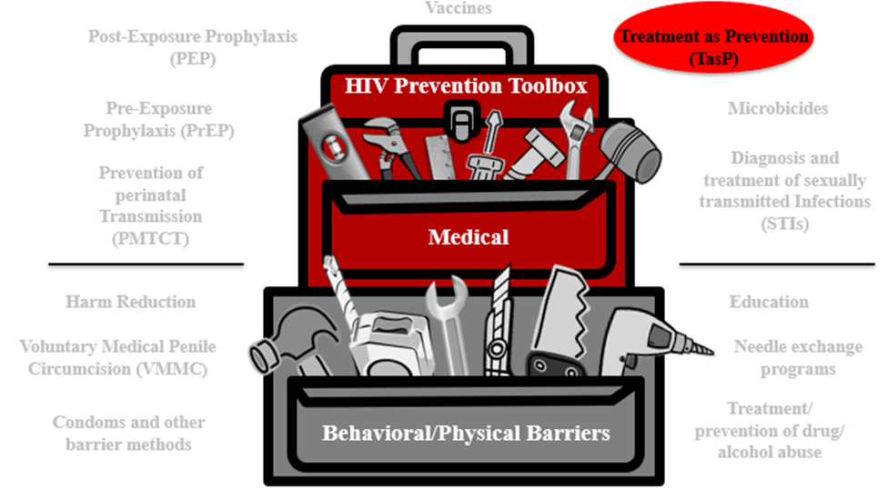
TasP Summary
TasP is a medical HIV prevention approach for people with HIV to reduce the likelihood of transmission to others.
Many treatment options are available for TasP, but gaps persist in the HIV treatment cascade.
Researchers are studying new treatment approaches to address these gaps like injectable ART and ART implants.
Notes:
Participant Guide page 76.
Review the content on the slide.
Tell participants after reviewing the slide content: The HIV combination prevention toolbox reinforces the role of TasP combined with other behavioral/physical tools. Combining multiple tools may provide the best method for HIV prevention.

Slide 137

Continuing Research: PrEP & Integrated Strategies
A number of public and private organizations, in partnership and individually, are working together to find solutions that can help prevent HIV.
The HIV Prevention Trials Network (HPTN), funded by the National Institute of Allergy and Infectious Diseases (NIAID), National Institute of Mental Health (NIMH), and the National Institute of Drug Abuse (NIDA) is dedicated to discover and develop new and innovative research strategies to reduce the acquisition and transmission of HIV.
Notes:
Participant Guide page 76.
Review the content on the slide.
Together, PrEP and TasP have the potential to end the HIV epidemic as we know it. However, the PrEP and TasP approaches we currently have are not reaching those who need them most. Research continues to strive to find improved PrEP and TasP methods to end the epidemic.

Slide 138
What Did You Learn?
In this activity, you will brainstorm how you can apply what you learned about TasP by answering a question.
With your group:
Brainstorm the question you are assigned (you only need to brainstorm one of the questions).
Share your answers with the whole group so they can hear your ideas.
What thoughts, questions, and concerns came to your mind about TasP as you heard/read information about this HIV prevention modality?
If you were asked to speak to an audience about TasP, what would be the three most important messages you would want to convey?
Notes:
Participant Guide page 77.
Introduce a small group activity. Divide the class into two groups. Assign the questions to the groups (one question per small group).
Assign one of the questions in the boxes to each group.
Allow approximately 5 mins for the groups to brainstorm their answers.
Encourage participants to write their brainstorm on a flip chart, white board, and/or in their Participant Guides (each question has been reproduced in the Participant Guide with space to write).
Ask someone from each group to share some/all of their answers.
Encourage the other groups to write these answers in the provided space in their Participant Guides.
Note: This is a shortened activity using only 2 questions. There will be one larger activity at the end of the modalities.
Possible answers include:
Question 1: What thoughts, questions and concerns came to your mind about TasP as you heard/read information about this HIV prevention modality? The importance of getting tested; cost of the medications; importance of regular medication use.
Question 2: If you were asked to speak to an audience about TasP, what would be the three most important messages you would want to convey? Get tested; take the recommended medication dose as directed consistently, U=U.
Allow approximately 5 min for each person to answer the question. Ask for volunteers to share their answers. Allow approximately 5 mins to share answers.
Total time for this activity: 10 mins

Slide 139
Questions?
Notes:
No Participant Guide page.
Stop to ask/answer questions before moving to the next modality.
Ask participants if they have any questions. Answer all questions, if possible. If not, make a note of these questions to prepare for the next training session. This is a good spot to stop for a break.

Slide 140
Microbicides
www.bethegeneration.org
Notes:
Participant Guide page 78.
Introduce the next modality: Microbicides.

Slide 141
Introduction
Vaccines
Post-Exposure Prophylaxis (PEP)
Treatment as Prevention (TasP)
HIV Prevention Toolbox
Pre-Exposure Prophylaxis (PrEP)
Microbicides
Diagnosis and treatment of sexually Transmitted Infections (STIs)
Prevention of perinatal transmission (PMTCT)
Medical
Harm reduction
Education
Voluntary Medical Penile Circumcision (VMMC)
Needle exchange programs
Condoms and other barrier methods
Treatment/
prevention of drug/
alcohol abuse
Behavioral/Physical Barriers
Notes:
Participant Guide page 78.
Tell participants after reviewing the slide content: Just because we’re only talking about biomedical HIV prevention doesn’t mean you should forget about the other prevention methods.
We said earlier that education and a combination of prevention approaches improves effectiveness, which includes combination prevention.
Participation in research can lead to intervention and prevention.
Tell participants after reviewing the slide content: The HIV combination prevention toolbox shows the importance of both medical and behavioral/physical tools. Combining multiple tools may provide the best method for HIV prevention.

Slide 142
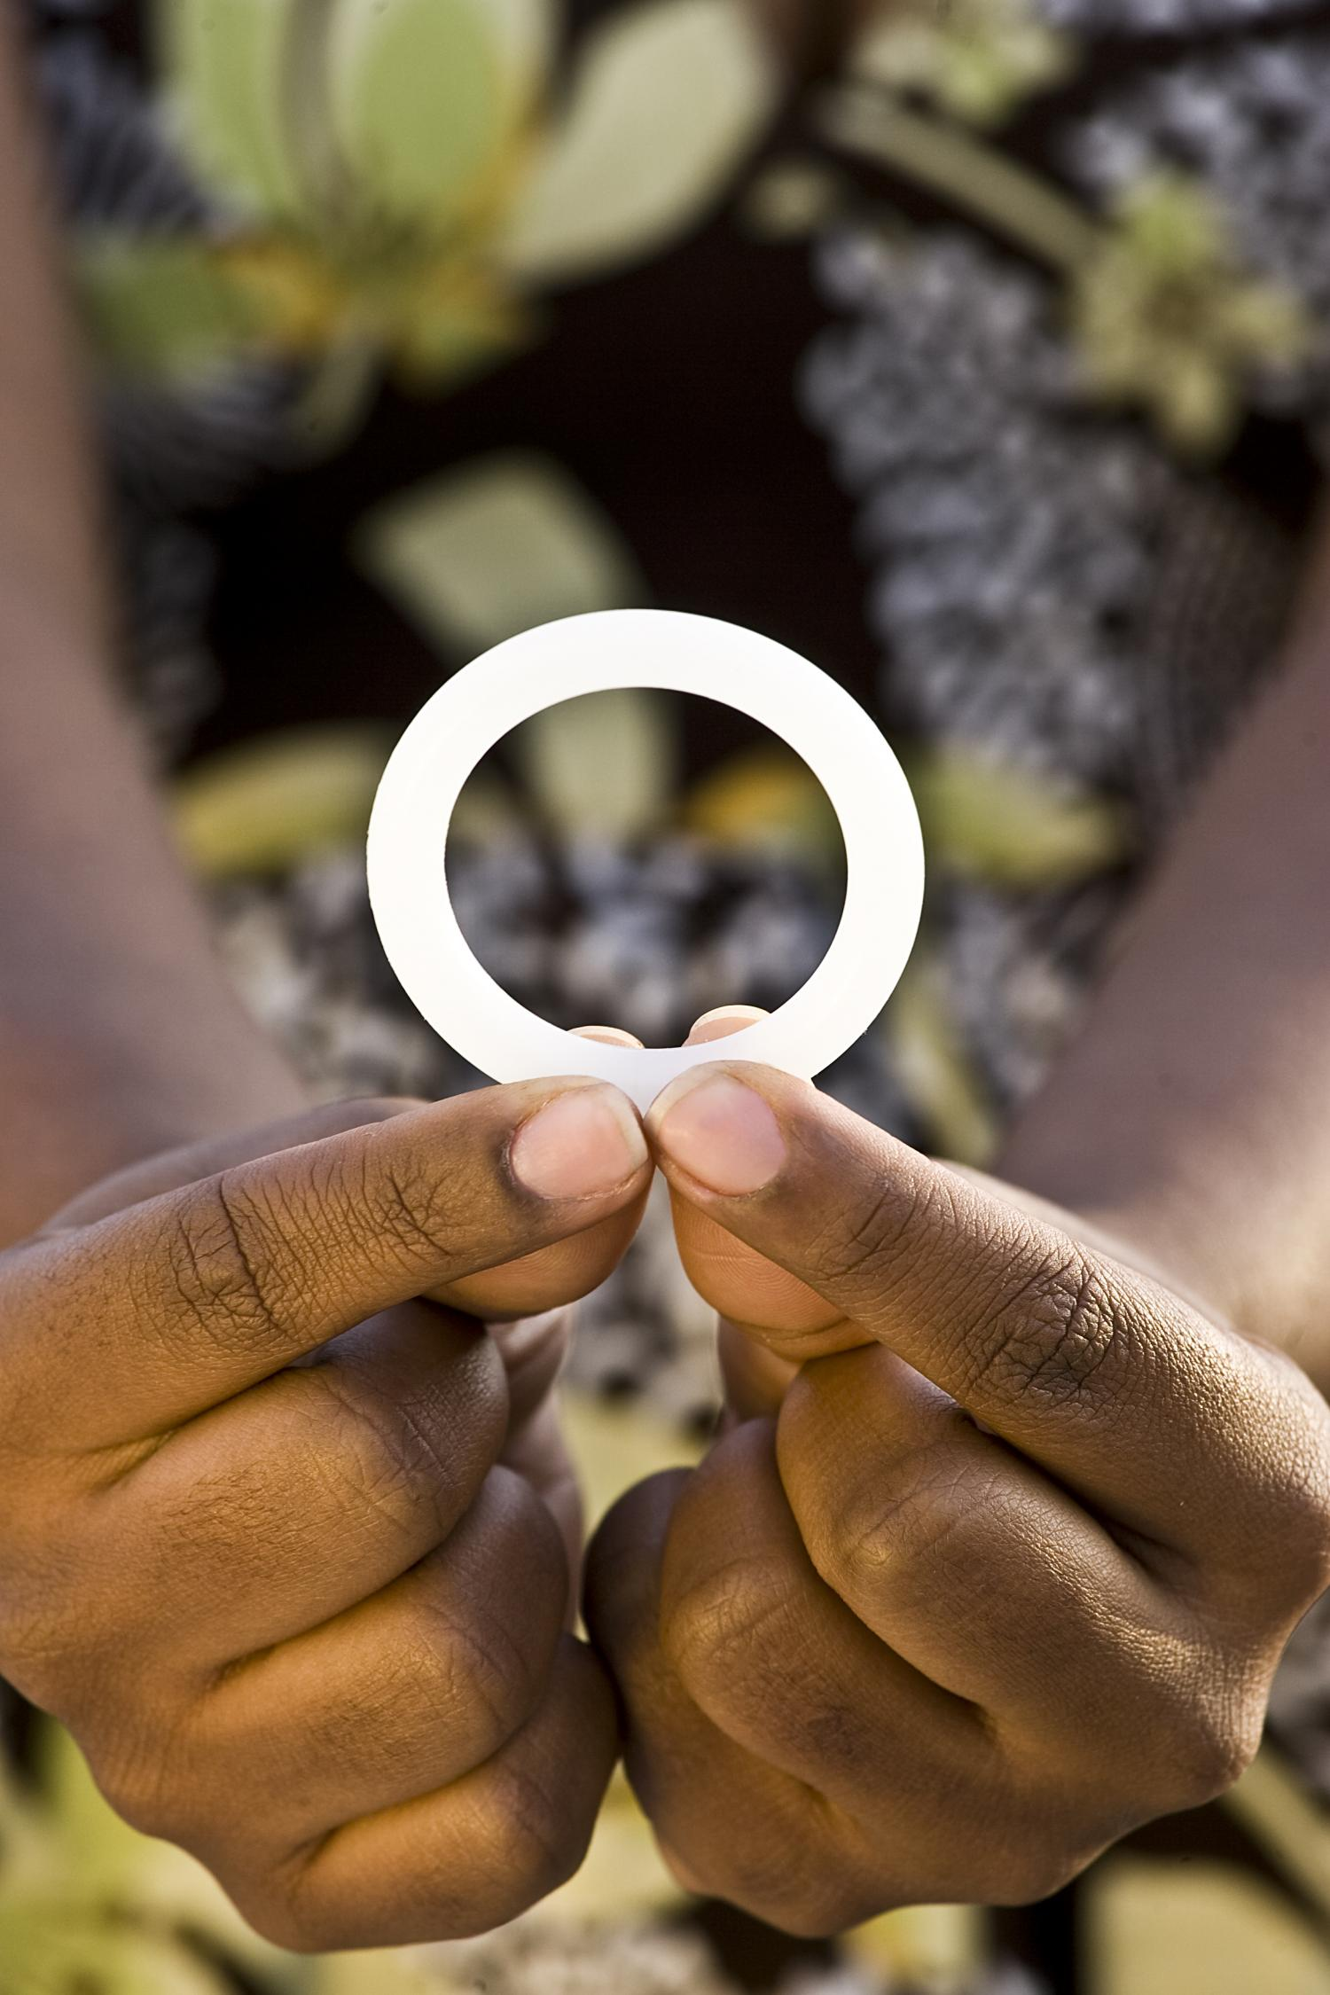
Introduction
Microbicides are products applied inside the vagina or rectum to reduce the likelihood of HIV transmission during vaginal and anal sex. Microbicides can include:
Films, gels, douches, fast-dissolving inserts, and suppositories
Vaginal rings, which are furthest along in development and may be licensed soon
Notes:
Participant Guide page 78.
Review the content on the slide.
Microbicides are products applied inside the vagina or rectum to protect against HIV through sex. They are different from other PrEP products because they only deliver anti-HIV drugs to the sites of potential HIV transmission with very little drug absorbed into the body, whereas pills, injectables, and implants deliver drugs systemically (throughout the entire body). Microbicides could fulfill the need for a non-systemic and/or short-acting method for HIV prevention that could be used around the time of sex.
The image featured here is of the dapivirine vaginal ring, the study product from the three vaginal ring studies we discussed earlier: ASPIRE, The Ring Study, and HOPE. It’s a flexible silicone monthly ring that slowly releases the drug dapivirine inside the vagina. Regulatory approval is currently being sought for the ring based on multiple studies with more than 6,600 cisgender women, finding that the ring has as strong safety profile and reduces HIV transmission—especially when used consistently.

Slide 143
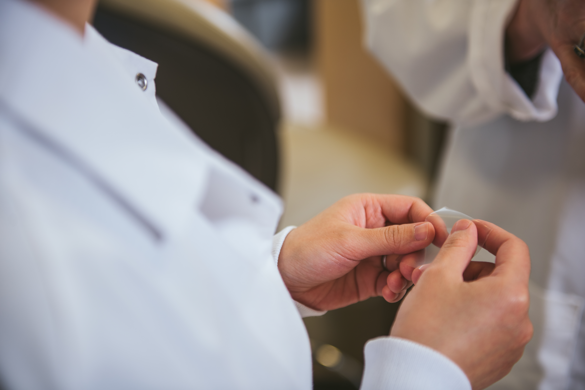
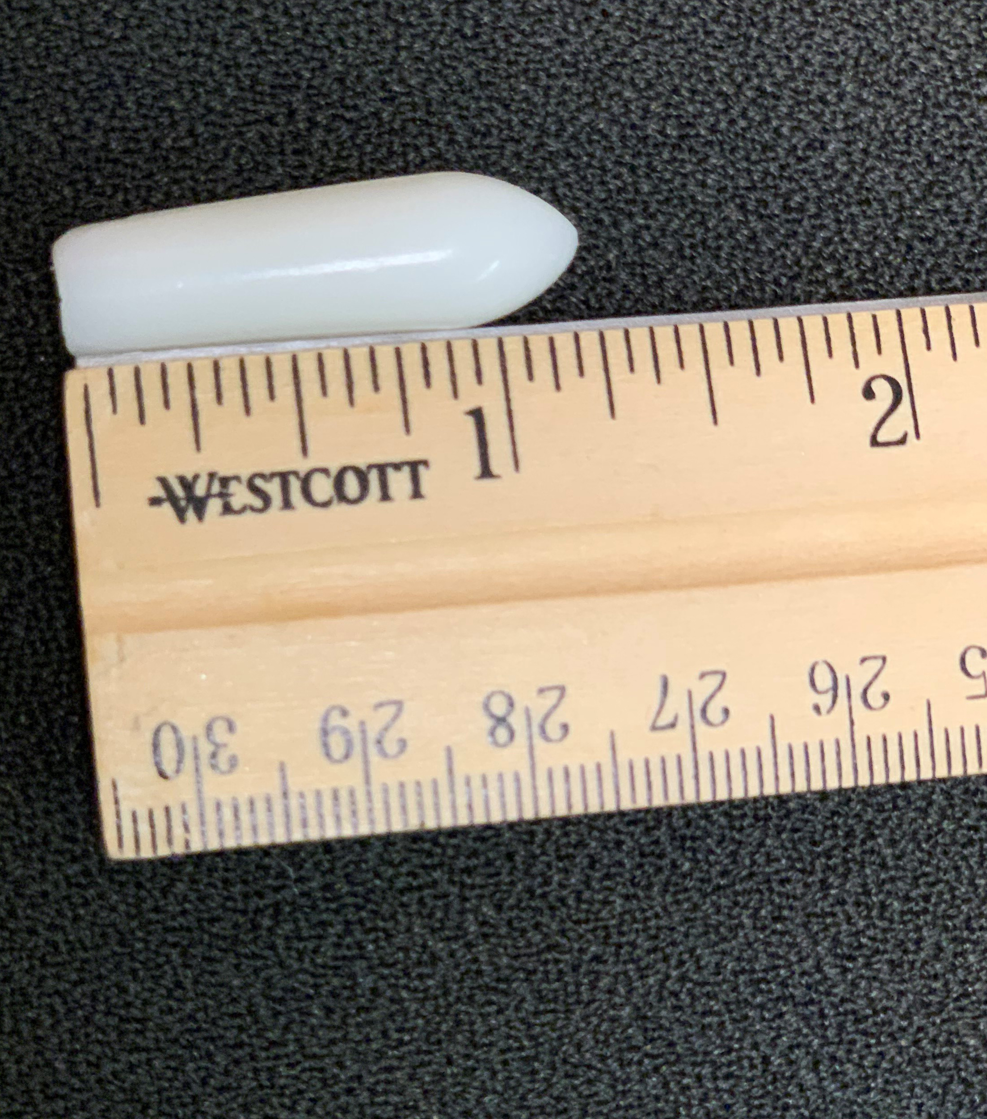
Introduction
Most microbicides being tested today contain antiretroviral (ARV) drugs.
ARVs block HIV replication in multiple places in the reproductive cycle of the virus.
These drugs have been shown to protect people who do not have HIV if they are exposed to the virus by disrupting HIV’s life cycle, thus preventing HIV from taking hold in the body.
Notes:
Participant Guide page 78.
Review the content on the slide.
Tell participants after reviewing the second bullet: Tell participants after reviewing the slide content: For example, ARVs are used in Pre-Exposure Prophylaxis, or PrEP.
Information related to the optional quiz (see the first bullet): Q13: True.
Q: Most microbicides tested today contain HIV antiretroviral drugs which are also used to treat people living with HIV/AIDS.
A: Different types of microbicides are being tested in clinical trials, but those that incorporate antiretroviral (ARV) drugs are furthest along in development and testing. The idea behind ARV-based microbicides is that some of the same drugs used to treat HIV may also help prevent people without HIV from contracting it.

Slide 144
Why Are Microbicides Important?
Vaginal microbicides
Designed to prevent HIV acquisition through the vagina
Rectal microbicides
Designed to prevent HIV acquisition through the rectum
Notes:
Participant Guide page 79.
Tell participants before reviewing the slide content: Microbicides are not yet available for use outside clinical trials. The microbicides under study are used vaginally and/or rectally to protect the user from HIV transmission during sex.
Tell participants after reviewing the “Vaginal microbicides” content:
Cisgender women represent about 20 percent of new HIV cases in the U.S.
Cis women are more likely than cis men to contract HIV through heterosexual sex.
Tell participants after reviewing the “Rectal microbicides” content:
Rectal microbicides are designed to prevent HIV among people of all genders during anal sex.
An estimated 5-10% of the world’s population engages in anal sex.
Because the lining of the wall of the rectum is different from the lining of the vagina, rectal-specific microbicides and formulations are being tested in clinical trials in addition to products for vaginal use.
The likelihood of contracting HIV during condomless/PrEPless anal sex is 10 to 20 times greater than condomless/PrEPless vaginal sex. Because the rectal lining is only one-cell thick, the virus can more easily reach cells.
Information related to the optional quiz Q11: False.
Q: Microbicides refer to pills taken orally to prevent people from contracting HIV.
A: Microbicides are being developed to reduce a person’s likelihood of contracting HIV or other sexually transmitted infections when applied topically inside the vagina or rectum. Vaginal microbicides are primarily being tested as rings, while rectal microbicides are being tested as gels, douches, and suppositories. Unlike microbicides, oral pre‐exposure prophylaxis (PrEP) is an HIV prevention approach that involves the use of an antiretroviral pill by people who are HIV-negative.
Information related to the optional quiz (rectal microbicides): Q12: False.
Q: Microbicides are only being tested among women.
A: Microbicides are being tested among women and men--transgender and cisgender alike--and gender non-binary people. Within these populations, microbicides research is being conducted on products for use during vaginal sex as well as anal sex. According to estimates, 5 to 10 percent of the world’s population engages in anal sex, including cisgender and transgender women and men and gender non-binary people.

Slide 145
Why Are Microbicides Important?
“If proven effective…microbicides could protect against HIV in people who are unable or reluctant to use condoms. Unlike condoms, they could provide an alternative way to reduce risk that is not controlled by one’s sexual partner and possibly enhance sexual pleasure, helping to motivate consistent use.”
- MTN Rectal Microbicide Fact Sheet
Notes:
Participant Guide page 79.
Review the content on the slide.

Slide 146
Why Are Microbicides Important?
Microbicides & women
For trans and cis women around the world, some prevention tools are not practical.
Because of gender-based violence and other factors, it can be difficult for women to:
Insist that partners use condoms
Limit their or their partner’s HIV exposure
Test or treat themselves or their partners for sexually transmitted infections (STIs)
Notes:
Participant Guide page 79.
Review the content on the slide.
Tell participants there are many complex societal, economic, and cultural reasons why women specifically need multiple forms of HIV prevention tools.

Slide 147
Why Are Microbicides Important?
Microbicides and men
Men who have sex with men:
Make up about 70% of all new cases of HIV in the US
Represent more than 50% of the people currently living with HIV in the US
Globally, are 19 times more likely to contract HIV than the general population.
Consistent condom use doesn’t work for many men. Microbicides may offer an alternative and could be formulated like lubricants and douches, which many men already use for anal sex.
Notes:
Participant Guide page 79.
Review the content on the slide.
Note that there is not adequate data to report on transgender men.

Slide 148
Challenges with Microbicides
Dependence on human behavior requiring regular application
Cultural and regional preferences
Rectal microbicides research is in the early phase of clinical development due in part to scientific challenges related to the biology of the rectum and cultural reluctance to address anal sex.
Notes:
Participant Guide page 80.
Tell participants before reviewing the slide content: HIV prevention in general has challenges, and microbicides are no exception.
Review the content on the slide.
Research is under way to explore issues related to STIs and contraception.

Slide 149
Continuing Research: Microbicides
Develop products that:
Are/are not ARV-based
Conduct more research on:
Drug resistance
Understand issues around:
Are contraceptive, non-contraceptive, and broad-spectrum against several sexually transmitted diseases
Designed for vaginal and/or rectal use
Alternate dosing
Delivery methods (for example, rectal douches)
Access and availability
Cost
Regular HIV testing requirements
Need for prescriptions for ARV-based microbicides
Effects on pregnancy and breastfeeding
Notes:
Participant Guide page 81.
Tell participants before reviewing the slide content: Next steps in vaginal and rectal microbicides research are to…
Review the content on the slide.

Slide 150

Continuing Research: Microbicides
A number of public and private organizations, in partnership and individually, are working together to find microbicides that can help prevent HIV.
The Microbicide Trials Network (MTN), funded by the National Institute of Allergy and Infectious Diseases (NIAID), brings together international investigators, community stakeholders, and industry partners who focus on developing and evaluating microbicides. The MTN is focused on evaluating non-systemic and multi-purpose products with studies designed to support potential regulatory approval of products.
Notes:
Participant Guide page 81.
Review the content on the slide.
Presenters should be prepared to check for updated information and data on the UNAIDS, CDC, NAID, and NIAID websites and provide updates, as needed.
Information related to the optional quiz Q14: True.
Q: There are possible health risks associated with participating in biomedical HIV prevention studies.
A: There are risks involved in participating in any clinical trial. Researchers in the HIV prevention field strive to minimize these risks by incorporating a multi‐tiered safety review process into clinical studies, engaging in the informed consent process to ensure that participants understand the risks associated with the study, and by conducting them under the watchful eye of regulatory and research authorities.

Slide 151
What Did You Learn?
In this activity, you will brainstorm how you can apply what you learned about microbicides by answering a question.
With your group:
Brainstorm the question you are assigned (you only need to brainstorm one of the questions).
Share your answers with the whole group so they can hear your ideas.
What thoughts, questions, and concerns came to your mind about microbicides as you heard/read information about this HIV prevention modality?
If you were asked to speak to an audience about microbicides, what would be the three most important messages you would want to convey?
Notes:
Participant Guide page 82.
Presenter notes: Introduce a small group activity.
Divide the class into two groups. Assign the questions to the groups (one question per small group).
Assign one of the questions in the boxes to each group.
Allow approximately 5 mins for the groups to brainstorm their answers.
Encourage participants to write their brainstorm on a flip chart, white board, and/or in their Participant Guides (each question has been reproduced in the Participant Guide with space to write).
Ask someone from each group to share some/all of their answers.
Encourage the other groups to write these answers in the provided space in their Participant Guides.
Note: This is a shortened activity using only 2 questions. There will be one larger activity at the end of the modalities.
Possible answers include:
Question 1: What thoughts, questions and concerns came to your mind about microbicides as you heard/read information about this HIV prevention modality? The importance of testing, research, and using combination prevention methods.
Question 2: If you were asked to speak to an audience about microbicides what would be the three most important messages you would want to convey? The importance of testing, research, and using combination prevention methods; length of time to develop effective microbicides; the need to develop effective vaginal AND anal microbicides.
Allow approximately 5 min for each person to answer the question. Ask for volunteers to share their answers. Allow approximately 5 mins to share answers.
Total time for this activity: 10 mins
After this activity, stop to ask/answer questions before moving to the final activity for this section.

Slide 152
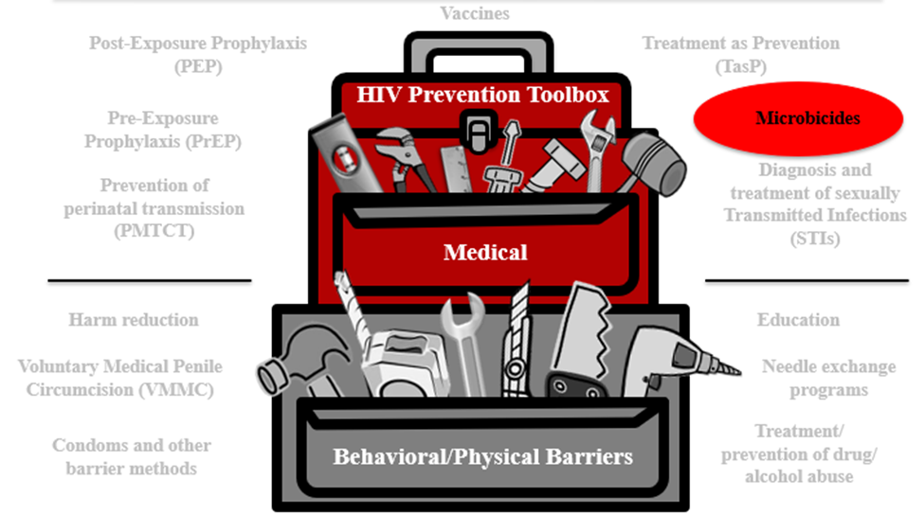
Microbicides Summary
Microbicides are products being developed and tested for use in the vagina and rectum to reduce HIV transmission during vaginal and anal sex.
Notes:
Participant Guide page 83.
Review the content on the slide.
Tell participants after reviewing the slide content: The HIV combination prevention toolbox reinforces the role of microbicides combined with other behavioral/physical tools. Combining multiple tools may provide the best method for HIV prevention.

Slide 153
Questions?
Notes:
No Participant Guide page.
Stop to ask/answer questions before moving to the activity.
Ask participants if they have any questions. Answer all questions, if possible. If not, make a note of these questions to prepare for the next training session.

Slide 154
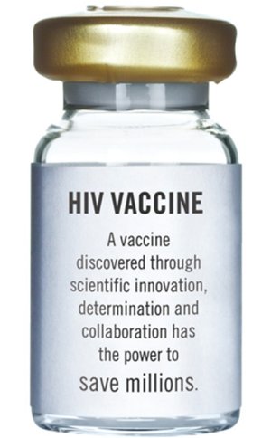
Vaccines
www.bethegeneration.org
Notes:
Participant Guide page 84.
Introduce the second modality: Vaccines.

Slide 155
Introduction
Vaccines
Post-Exposure Prophylaxis (PEP)
Treatment as Prevention (TasP)
HIV Prevention Toolbox
Pre-Exposure Prophylaxis (PrEP)
Microbicides
Diagnosis and treatment of sexually transmitted infections (STIs)
Prevention of perinatal transmission (PMTCT)
Medical
Harm reduction
Education
Voluntary Medical Penile Circumcision (VMMC)
Needle exchange programs
Condoms and other barrier methods
Treatment/
prevention of drug/
alcohol abuse
Behavioral/Physical Barriers
Notes:
Participant Guide page 84.
Tell participants after reviewing the slide content: Just because we’re only talking about biomedical HIV prevention doesn’t mean you should forget about the other prevention methods.
We said earlier that education and a combination of prevention approaches improves effectiveness, which includes combination prevention.
Participation in research can lead to intervention and prevention.
Tell participants after reviewing the slide content: The HIV combination prevention toolbox shows the importance of both medical and behavioral/physical tools. Combining multiple tools may provide the best method for HIV prevention.

Slide 156
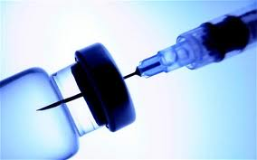
Introduction
A vaccine is a substance that teaches the body’s immune system to recognize and protect against a disease caused by an infectious agent or virus, often by stimulating the body to produce antibodies and T-cells against that infection.
A safe and effective preventive vaccine is believed to be the best way to control the HIV/AIDS epidemic in the long term. There is a lot of important research going on to find a safe and effective HIV vaccine.
However, there is currently no licensed vaccine against HIV.
Notes:
Participant Guide page 84.
Review the content on the slide.
Information related to the optional quiz (However, there is currently no…): Q4: False.
Q: Scientists have already developed a vaccine that prevents HIV.
A: Currently, there is not a vaccine to prevent HIV. Some HIV vaccine studies have been conducted that did not produce results needed to effectively prevent HIV. Ongoing research is being conducted to find a safe and effective preventive HIV vaccine. In order to find one, researchers will need thousands of volunteers to participate in clinical trials.

Slide 157
How Would a Vaccine Work?
Teach the body to recognize HIV
Tell the body to sound an alarm
Send fighter cells to go into action
Result: HIV is controlled or killed
Notes:
Participant Guide page 85.
Tell participants before reviewing the slide content: HIV vaccines would work to…
Review the content on the slide as it is revealed.
Information related to the optional quiz: Q6: True.
Q: HIV vaccines under study would train the body to recognize the HIV virus if a person is exposed to the virus.
A: Vaccines would teach the body to recognize the virus, sounding an internal “alarm” which would call fighter cells into action and ultimately help prevent or control an HIV infection.
Information related to the optional quiz: Q7: True.
Q: HIV vaccines do not contain live human immunodeficiency virus (HIV).
A: HIV vaccines do not contain either live or killed forms of the virus. The vaccines are synthetic (lab‐made) compounds designed to look like pieces from real HIV, triggering the body’s immune responses that would help your body recognize and fight the virus should it enter your system. There is no whole virus, real virus, or infected material in the vaccine, so there is no way that it could give a study participant HIV.

Slide 158
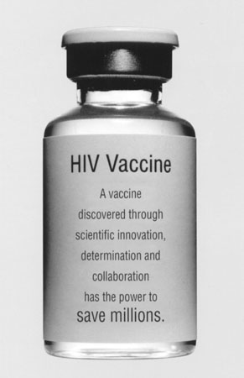
Why Do We Need a Vaccine?
ART can be complex, costly, and have side effects.
HIV can develop resistance to ARVs.
ARVs and PrEP depend on long-term patient adherence; a vaccine could provide protection with minimal action from the patient.
A preventive HIV vaccine could help save millions of lives and billions of dollars each year in treatment costs.
Notes:
Participant Guide page 85.
Review the content on the slide.
An HIV vaccine is the best long-term hope for controlling and/or ending the HIV epidemic.

Slide 159
HIV Vaccines—the Future
Vaccines are important to control the spread of HIV.
Preventive vaccines are tested with people who do not have HIV.
HIV vaccines may one day be able to prevent or delay AIDS in people with HIV too.
Notes:
Participant Guide page 86.
Review the content on the slide.
Information related to the optional quiz Q5: False.
Q: Volunteers for preventive HIV vaccine clinical trials cannot get HIV from the vaccines being tested.
A: The HIV vaccines used in clinical trials cannot cause people to contact HIV or AIDS, and volunteers are not exposed to HIV through the study. Just like anyone else, however, volunteers in clinical trials can contract HIV from other people through behaviors like condomless/PrEP-less sex or injection drug use.

Slide 160
HIV Vaccines—the Future
How an HIV vaccine might work
Prevent HIV in most people
Possible benefits
Even if a vaccine only protects some people, it would have a major impact on controlling the HIV/AIDS epidemic
Prevent HIV disease progression after people contract HIV
A partially effective vaccine could decrease the number of people who contract HIV
There would be fewer people with HIV to pass the virus on to others
One example showed that if a 50% effective vaccine was given to 30% of the population in developing countries between 2015-2030, it could prevent 25% of the new HIV cases that would otherwise occur.
Notes:
Participant Guide page 86-87.
Review the content on the slide.

Slide 161
Challenges in Developing an HIV Vaccine
HIV can “hide” from the immune system that protects the body.
HIV attacks the same immune cells that the body uses to defend itself against infections.
There are many different varieties of HIV.
HIV changes rapidly, even in a single person.
There is no perfect model for testing HIV vaccines in animals, because HIV impacts people in ways that are different from the animal versions.
The human immune system is not designed to clear HIV, so we are not sure what the immune response is that would be needed for protection; we have to do better than “mother nature.”
Notes:
Participant Guide page 87.
Tell participants before reviewing the slide content: Remember, there is currently no licensed vaccine against HIV or AIDS. Most vaccines we use today (polio, rubella, mumps) took more than 25 years to develop. Some challenges in developing HIV vaccines are…
Review the content on the slide.

Slide 162
Continuing Research: HIV Vaccines
Adapt the RV144 regimen for better protection
Study “mosaic” vaccine candidates to cover a variety of global HIV strains
Inform future prevention strategies via antibody-mediated prevention studies (AMP)
Some of the goals of ongoing HIV vaccine research include:
Notes:
Participant Guide page 88.
Review the content on the slide.
Adapt RV144 regimen: HVTN 702 was a clinical trial based on the Thai Trial (RV 144). The goal was to have greater and more sustained protection than that which was found in the Thai Trial. Researchers adapted this experimental vaccine to the HIV subtype that predominates in southern Africa, where it was tested. The research team had hoped for better results, but unfortunately, it was announced in January 2020 that the experimental vaccine being studied in HVTN 702 did not work to prevent HIV. While these results are disappointing, we can still learn from them. We now know that this particular vaccine design did not work in this particular context.
We learned that the vaccine was highly safe and well-tolerated. The researchers will continue to analyze the data to learn more about what is needed for an HIV vaccine to work.
Global HIV strains: HVTN 705 is a clinical trial studying a “mosaic” vaccine to see if it will be safe and effective for protection against a variety of HIV strains, or “clades.” It is also being tested in southern Africa.
HVTN 706, known as “Mosaico,” is another study testing a “mosaic” vaccine. This study is taking place in the US, Latin America, and Europe.
Antibody-mediated prevention (AMP): About 20% of people with HIV can develop broadly-neutralizing antibodies after several years living with the virus (https://www.hiv.gov/hiv-basics/hiv-prevention/potential-future-options/hiv-vaccines). Broadly neutralizing antibodies, or “bNAbs,” are produced by the immune system to attack or “neutralize” active HIV in the body. bNAbs cannot reach latent HIV, also known as the “reservoir” of HIV in a person’s body. The idea with AMP is to take some of these antibodies and manufacture more of them in labs so they can be given via IV infusion to HIV-negative people and observe how they do or do not protect against HIV taking hold in people who receive them. These studies may provide a proof-of-concept for future vaccine and other prevention strategies, showing how vaccines or other strategies might work if we can induce a preventive antibody response. Some bNAbs are also being studied for treatment to see if they can be used alongside ARVs to achieve viral suppression in people living with HIV.

Slide 163

Continuing Research: Vaccines
A number of public and private organizations, in partnership and individually, are working together to find a vaccine that could end the epidemic.
The HIV Vaccine Trials Network (HVTN), funded by the National Institute of Allergy and Infectious Diseases (NIAID), is an international collaboration that conducts all phases of clinical trials to test HIV vaccines.
Notes:
Participant Guide page 88.
Review the content on the slide.
Tell participants after reviewing the slide content: HVTN clinical research sites are located at leading research institutions throughout the world. The HVTN’s mission is to fully characterize the safety, immunogenicity, and efficacy of HIV vaccine candidates as rapidly as possible for prevention of HIV globally.
Presenters should be prepared to check for updated information and data on the UNAIDS, CDC, NAID, and NIAID websites and provide updates, as needed.

Slide 164
What Did You Learn?
In this activity, you will brainstorm how you can apply what you learned about vaccines by answering a question.
With your group:
Brainstorm the question you are assigned (you only need to brainstorm one of the questions).
Share your answers with the whole group so they can hear your ideas.
What thoughts, questions, and concerns came to your mind about vaccines as you heard/read information about this HIV prevention modality?
If you were asked to speak to an audience about vaccines, what would be the three most important messages you would want to convey?
Notes:
Participant Guide page 90.
Presenter notes: Introduce a small group activity.
Divide the class into two groups. Assign the questions to the groups (one question per small group).
Assign one of the questions in the boxes to each group.
Allow approximately 5 mins for the groups to brainstorm their answers.
Encourage participants to write their brainstorm on a flip chart, white board, and/or in their Participant Guides (each question has been reproduced in the Participant Guide with space to write).
Ask someone from each group to share some/all of their answers.
Encourage the other groups to write these answers in the provided space in their Participant Guides.
Note: This is a shortened activity using only 2 questions. There will be one larger activity at the end of the three modalities.
Possible answers include:
Question 1: What thoughts, questions and concerns came to your mind about vaccines as you heard/read information about this HIV prevention modality? How long it might take to develop an effective vaccine; the importance of supporting and participating in research that will result in an effective vaccine.
Question 2: If you were asked to speak to an audience about vaccines what would be the three most important messages you would want to convey? The importance of using other prevention tools until a vaccine is available; the importance of participating and supporting vaccine research, the different strategies being researched (antibodies, mosaic, etc).
Allow approximately 5 min for each person to answer the question. Ask for volunteers to share their answers. Allow approximately 5 mins to share answers.
Total time for this activity: 10 mins

Slide 165
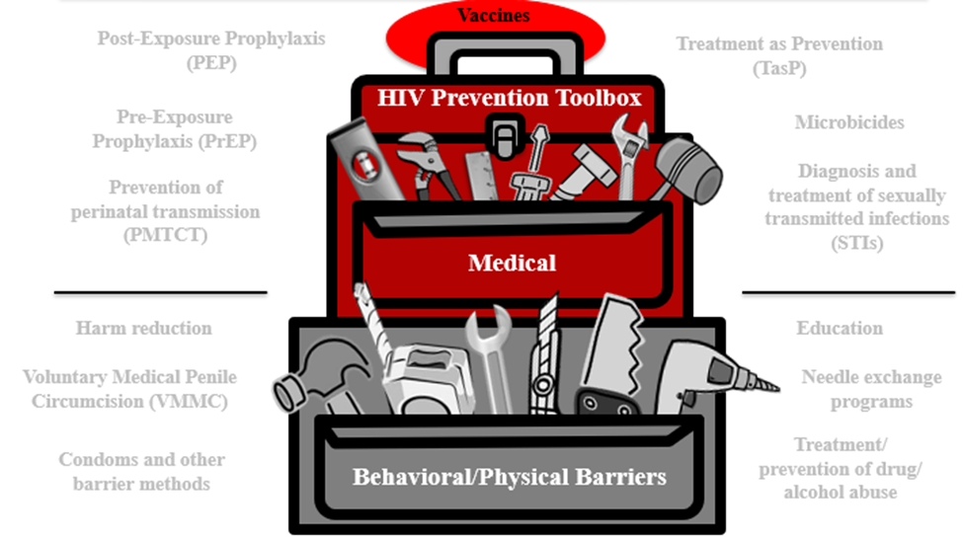
Vaccines Summary
A vaccine teaches the body’s immune system to recognize and protect against a disease caused by an infectious agent or virus, often by stimulating the body to produce antibodies and T-cells against that infection.
Notes:
Participant Guide page 91.
Review the content on the slide.
Tell participants after reviewing the slide content: The HIV combination prevention toolbox reinforces the role of vaccines combined with other behavioral/physical tools. Combining multiple tools may provide the best method for HIV prevention.

Slide 166
Questions?
Notes:
No Participant Guide page.
Stop to ask/answer questions before moving on.
Ask participants if they have any questions. Answer all questions, if possible. If not, make a note of these questions to prepare for the next training session.

Slide 167
Prevention Tools Activity
In this activity, you will think about all of the different HIV prevention tools you have learned about.
You will receive a card with one of the tools from the HIV combination prevention toolbox.
Follow the instructions in the Participant Guide to complete the activity.
Notes:
Participant Guide pages 92-93.
Introduce a whole group activity.
Review the activity instructions on the slide.
This activity is the final activity of the course. It is dependent on the information learned in “What Is HIV Prevention?” Use this activity ONLY for participants who have seen “What Is HIV Prevention?” AND What Are HIV Prevention Tools and How Are They Used in HIV Prevention Research?” (this section).
This activity requires one set of cards (HIV Combination Prevention Toolbox Activity Cards, copied black and white on paper or card stock, single sided, and cut). There are 13 cards total.
Have people seated and distribute one card HIV Combination Prevention Toolbox Activity Card to each person. There are 13 cards. Use as many or few as needed. If there are more than 13 people in the class, put 2 people together to do the activity.
Tell people to answer the first two questions in their Participant Guides and the “Why do you think so?” question. Thinking of the prevention technique as “both” was not discussed in the training, so answers can vary.
Stop and ask for volunteers to share their answers if they selected “both.”
This part of the activity should take approximately 5 mins.
Then review the next set of instructions (items 3-5 in the Participant Guide).
Be sure to walk around the room to answer questions.
Tell participants they can ask their neighbors questions, if needed.
Allow approximately 10 mins for this part of the activity.

Slide 168
Hidden slide
Notes:
Next ask each person to:
Tell everyone what prevention tool they had.
Tell which words ARE related to the tool.
Share all words they marked with a question mark.
For each of the question mark words, they should ask the whole class for help in deciding if the word is an example or not.
Note: Use the Prevention Tools Activity Answer Sheet for recommended answers.
Be prepared for answers that are only slightly related to the prevention tools. For example, “education” should be related to every tool. STIs could be related to every tool in some way.
This part of the activity should take about 20 mins.
Total activity timing: 35 mins.

Slide 169
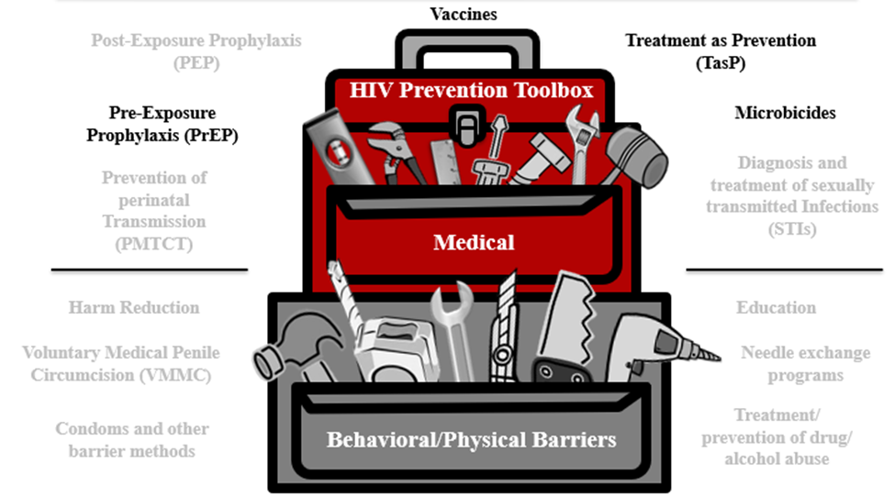
Summary
HIV prevention research is important to find safe and effective approaches to prevent the spread of HIV. These approaches can include:
Promoting awareness, understanding, and dialogue
Supporting research
Developing new prevention technologies
Notes:
Participant Guide page 94.
Review the content on the slide.
Review the objectives for this section. Tell participants: In this session, you learned about:
Prevention research and HIV prevention research successes
The role of pre-exposure prophylaxis (PrEP) in HIV prevention research
The role of treatment as prevention (TasP) in HIV prevention research
The role of microbicides in HIV prevention research
The role of vaccines in HIV prevention research
Tell participants where to find the glossary of terms and abbreviations used in this session in case they have questions about them.
Review the Frequently Asked Questions (FAQs) and additional resources for more information.
Ask participants if they have any additional resources they would like to share.
Save and add any additional resources for future use.

Slide 170
Conclusion
www.bethegeneration.org
Notes:
Participant Guide page 100.
Review the content on the slide.

Slide 171
Conclusion
You have now completed the workshop about HIV prevention research.
This vital research is designed to find safe and effective methods to prevent HIV and AIDS.
Preventing HIV is our best hope for ending the HIV/AIDS epidemic.
Notes:
Participant Guide page 100.
Review the slides for the conclusion. Review the content on the slide.

Slide 172

Conclusion
Successful partnerships among the following can make a difference:
Community leaders
Local and national organizations
Health professionals
Educators
Notes:
Participant Guide page 100.
Tell participants before reviewing the slide content: It is also important to promote awareness and understanding of this research and to build public support for this work. Researchers often partner with a variety of individuals and groups in the community for this awareness, understanding, and support.
Review the content on the slide.

Slide 173
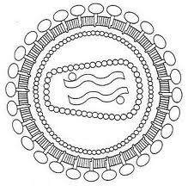
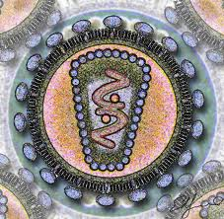
What Is HIV/AIDS?
Scientifically, HIV is a lot like other viruses, including those that cause the flu or the common cold.
But there is an important difference.
Over time, your immune system can get rid of most viruses.
But the human immune system cannot get rid of HIV by itself.
HIV is also stigmatized, which continues to be a barrier to ending the epidemic.
Notes:
Participant Guide page 100.
Review the content on the slide.
Tell participants after reviewing the slide content: HIV can hide for long periods of time in cells, use them to make more copies of itself and then destroy those cells. Over time, HIV destroys so many cells that the body can no longer fight infections and diseases.
Efforts to prevent, control, and eliminate HIV/AIDS are continuing worldwide.

Slide 174

What Is Clinical Research?
Development of new ways to treat, prevent, and control disease
The evaluation of new interventions for:
  Safety
  Efficacy (the capacity to produce a desired effect/effectiveness)
  Adherence (whether or not people use the intervention as designed)
  Preventing and controlling disease
Notes:
Participant Guide page 101.
Tell participants before reviewing the slide content: Research is a systematic investigation to establish facts. Clinical research refers to clinical trials in people and helps develop solutions to improve the health of people all over the world. Clinical research includes…
Review the content on the slide.
Tell participants after reviewing the slide content: Clinical research over the past 100 years has improved the health and lives of people around the world. Clinical research provides the means to make sure HIV research is conducted safely and effectively. Clinical research is an important step in finding ways to prevent and treat HIV/AIDS.

Slide 175
What Is Community Engagement?
Community engagement ensures that the:
Community’s concerns and needs are shared with researchers
Community is aware of, can learn about, and have input into the research process
Notes:
Participant Guide page 101.
Tell participants before reviewing the slide content: Community engagement focuses on reaching and involving everyone from all walks of life and perspectives. Community engagement is especially important during clinical trials. During HIV/AIDS outreach activities, community engagement brings together those people affected and impacted by HIV/AIDS.
Review the content on the slide.

Slide 176
What Is HIV Prevention and the HIV Combination Prevention Toolbox?
Different HIV prevention approaches need to be tested to find out what works best. Identifying and offering more options will allow people to determine which options fit their lives, their needs, and the needs of their family and friends. Ongoing HIV prevention research supports:
More HIV prevention options
More combination HIV prevention options
More diverse research participants to expand the understanding of what works
Notes:
Participant Guide page 102.
Tell participants before reviewing the slide content: Comprehensive HIV prevention includes treatment, information, skills, personal responsibility, and access to tools, products, and approaches.
Review the content on the slide.

Slide 177
What Are HIV Prevention Tools and How Are They Used in HIV Prevention Research?
HIV prevention research is important to find safe and effective approaches to prevent the spread of HIV. These approaches can include:
Promoting awareness, understanding, and dialogue
Supporting research
Developing new prevention technologies
Notes:
Participant Guide page 102.
Check slide heading format for this slide before presenting. The heading takes up two lines, so the background has been revised to accommodate two lines.
Review the content on the slide.

Slide 178
What Are HIV Prevention Tools and How Are They Used in HIV Prevention Research?
Three Important Areas of Biomedical Prevention
PrEP & Integrated Strategies
Microbicides
Vaccines
New formulations and delivery methods to reduce the likelihood of transmission.
Products applied vaginally or rectally that may prevent HIV transmission.
Harnessing the immune system to help prevent a person from contracting HIV.
Notes:
Participant Guide page 102.
Check slide heading format for this slide before presenting. The heading takes up two lines, so the background has been revised to accommodate two lines.
Review the content on the slide.
Tell participants while reviewing the graphic:
The PrEP prevention approach is focused on people who do not have HIV, but may be exposed to HIV through sexual contact and injection drug use (IDU). With PrEP, people who do not have HIV receive a prescription to take a medication before exposure to HIV. If taken as prescribed, the medication lowers their likelihood of contracting HIV.
Treatment as Prevention (TasP) is an approach for people living with HIV to reduce the likelihood of passing HIV to others. With TasP, people with HIV take medication. The medication controls the HIV in their bodies and keeps them healthy. The medication also lowers their likelihood of transmitting HIV to others through sex.
Microbicides are designed to reduce HIV transmission during vaginal and anal sex. Most microbicides being tested today contain antiretroviral (ARV) drugs. These drugs have been shown to help prevent HIV acquisition if someone is exposed to the virus.
A safe and effective preventive vaccine is believed to be the best way to control the HIV/AIDS epidemic in the long term. A vaccine uses a substance that teaches the body’s immune system to recognize and protect against a disease caused by an infectious agent or virus, often by stimulating the body to produce antibodies and T-cells against that infection. There is a lot of important research going on to find a safe and effective HIV vaccine.

Slide 179
For More Information
For more information on HIV prevention research, visit:
Be The Generation www.bethegeneration.org
Legacy Project www.facebook.com/HANCLegacyProject
Office of HIV/AIDS Network Coordination www.hanc.info
HIV Prevention Trials Network www.hptn.org
HIV Vaccines Trials Network www.hvtn.org
Microbicide Trials Network www.mtnstopshiv.org
AVAC www.avac.org
Notes:
Participant Guide page 103.
Review the content on the slide.

Slide 180
Hidden slide
Notes:
The optional quiz can be used again here (see quiz handout). There are 15 questions.
Allow approximately 15 mins for participants to complete the quiz and review the answers as a group.

Slide 181
Questions?...and
Thank You!
Notes:
No Participant Guide page.
Distribute the workshop evaluation (if applicable).
Ask participants if they have any questions. Answer all questions, if possible. If not, make a note of these questions to prepare for the next training session.

