Slide 1

E-Consent with COVID-19
Chris Jonsson
Program Manager
University of Washington
Positive Research

Slide 2
Creating e-Consent in Early Pandemic
Do you remember when everyone was in lockdown? Including your research team?
Do you remember when paper couldn’t leave the room?
Do you remember when we were making it up as we went along?
The pandemic in the early months were a complicated, evolving process where new information about COVID-19 made you change your process a week after you made it.

Slide 3
Reasons for e-Consent
In-Patient Treatment studies in early pandemic, paper couldn’t leave room
At home screenings to reduce staff exposure to COVID-19 in patients with acute disease
Consenting being performed outside of clinic hours

Slide 4
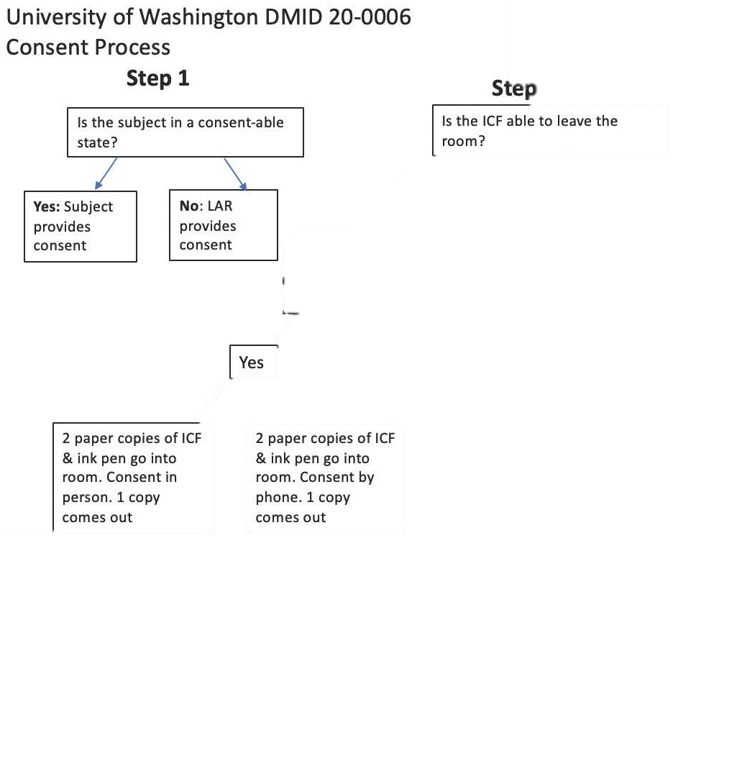
Consent Process Decision Chart

Slide 5
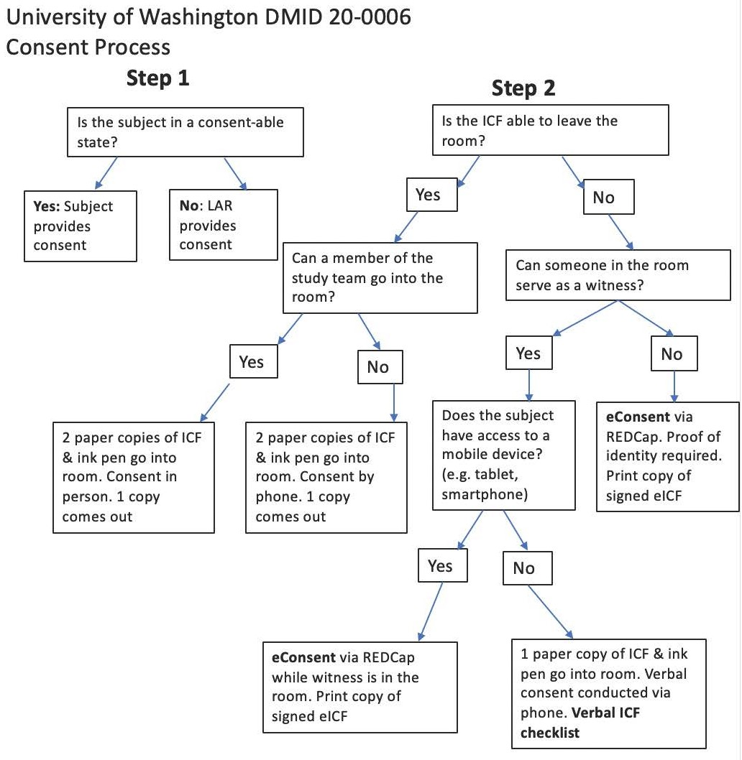
Consent Process Decision Chart

Slide 6
What we learned
It was a convenient way for participant to review a consent electronically prior to the consenting process
Important to iron out technical and other glitches prior to initiating an eConsent process
Our process could not support an e-signature from the consenter as well

Slide 7
Our IRB requirements
E-Consent could only contain IRB approved information. We uploaded images of each page of the consent into RedCAP.
There had to be a robust audit trail.
Participant needed a copy of the signed version of the consent with both participant and consenter.

Slide 8
Top 3 things to consider when starting e-consent process
Does your institution have an e-signature compliant version of the program you will use? Not all REDCap versions were compliant in the beginning.
Do you have a robust SOP for e-Consent including how to document the audit trail, signature, identity, witness or LAR, if needed?
How many languages will you consent in? Can your e-consent process support non-English?

Slide 9
Where we are now
All HIV treatment studies are still using paper-based consents, no plans to change
PDFs of consents emailed to participants ahead of screening if desired

Slide 10
e-Consent Process
Fatima Mayat
Perinatal HIV Research Unit (PHRU)
28 March 2022

Slide 11
SISONKE (Together) Open Label Trial
Phase 3B open label implementation study
Conceptualized when the South African national roll-out faltered because of Beta Variant of Concern (VOC)
Collaboration:
  South African Medical Research Council (SAMRC)
  Desmond Tutu HIV Centre,
  CAPRISA
  with numerous partners including National Department of Health, Right to Care, National Health Laboratory Services
  Public and private sectors – in and out of hospital

Slide 12
OVERALL AIM
To assess the effectiveness of Ad26.COV2.S vaccine on severe COVID, hospitalizations and deaths in Health Care Workers (HCWs) compared with the unvaccinated HCW and other essential worker populations in SA
To evaluate the impact of Variants of Concern on vaccine effectiveness
To evaluate safety in the field

Slide 13
METHODS: PARTICIPATION CRITERIA
Inclusion
    Age 18 and older.
    HCW in the private or public service.
    Willingness to comply with study procedures.
    Capable of giving electronic or personal informed consent.
Exclusion
    Any significant acute or chronic medical condition
    Pregnant or planning a pregnancy within 3 months.
    Current participation in another conflicting study
    History of severe adverse reaction with a vaccine and/or severe allergic reaction to any vaccine component.
Sub-study: 6 groups of HCW
    250 aged 18-55
    250 aged >55 years
    250 living with HIV
    250 with comorbidities
    200 pregnant (16-34 weeks)
    200 breastfeeding

Slide 14
17 DAYS FROM INCEPTION TO START
 | SAHPRA | Wits HREC | Pharma Ethics | SAMRC Ethics | UKZN-BREC | SMUREC- MECRU | UCT-HREC | Stellenbosch
Application date | 08-Feb-21 | 09-Feb-21 | 09-Feb-21 | 08-Feb-21 | 08-Feb-21 | 09-Feb-21 | 08-Feb-21 | 08-Feb-21
#Queries and comments until initial approval | 17 | 16 | 7 | 32 | 33 | 0 | 23 | 30
Approval date | 12-Feb-21 | 15-Feb-21 | 16-Feb-21 | 12-Feb-21 | 16-Feb-21 | 18-Feb-21 | 16-Feb-21 | 17-Feb-21
#Days | 4 | 6 | 7 | 4 | 8 | 9 | 8 | 9

Slide 15


J JnJ
METHODS
Electronic Vaccine Data System (EVDS)
EVDS
Out
1. HCW self registers
2. Notification sent to all beneficiaries to confirm registration, vaccination site and registration code
3. Eligible beneficiary within catchment area receives SMS to opt in to JnJ program
END
JnJ Consent
Refer JnJ consent module for detail
4. Complete JnJ consent process
5. Voucher issued
Record the Vaccination Code from the Vaccinee SMS
receive a message that they received the 1st dose of the Vaccine and schedules the dose for the 2nd dose appointment
Vaccination day (EVDS)
6. HCW vacinee receives SMS to present to Vaccine site administration desk (details in SMS)
7. Eligibility confirmed
8. Vaccinator completes consent and questionnaire on system
9.Vaccinator administers vaccine
Relevant information captured on EVDS
END

Slide 16
Sisonke e-Consent Benefits and Successes
Rapid large-scale recruitment and enrollment: ~496 424 HCWs in 3 months
Cost-benefit:
  HUMAN RESOURCES
  Time
  Administration Cost – printing, physical storage of records
Platform was provided by the National Department of Health
  Expertise
  Technical support

Slide 17
Sisonke e-Consent Challenges and Limitations
We overestimated technical capabilities of HCWs
Resource or other constraint of HCWs
  Technical knowledge
  Data/Wi-Fi availability
  Smartphone access
  Electricity
Resource or other constraint of vaccination sites and staff
  Technical knowledge of staff
  Data/Wi-Fi availability
  Electricity
  Back-up systems needed
While we took all steps to ensure the participant leaflet and assessment of understanding was read thoroughly, there needed to be a verification system at the vaccination site..

Slide 18
Solutions to Overcome Sisonke e-Consent Challenges and Limitations
Helpdesks at vaccinations sites to provide technical support
Hard copy ICFs available at vaccination sites
Vaccination sites manned by both research and NDOH staff
Ensured various group counselling sessions as part of the vaccination process
E.g. Process at Chris Hani Baragwanath Academic Hospital Vaccination Site
  Initial lay counselling session to discuss some vaccine points but also administrative requirements
  Second group session by doctor or investigator
  Post vaccination observation period – nurse discussed what side-effects to expect, safety desk number, etc
Verification process - HCW (employment/role), identity documents confirmation, voucher code verification
Back-up systems

Slide 19
Summary of Sisonke e-Consent
Definitely allowed for cost and time saving
Rapid study implementation
Need to fully understand population or study participants
Technical expertise of participants (and staff) is crucial
Infrastructure and resources to support process including back-up options
Multi-tiered hybrid model may be best
Verification process

Slide 20
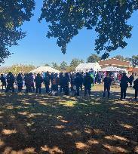

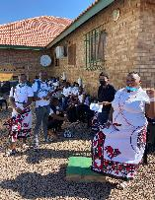
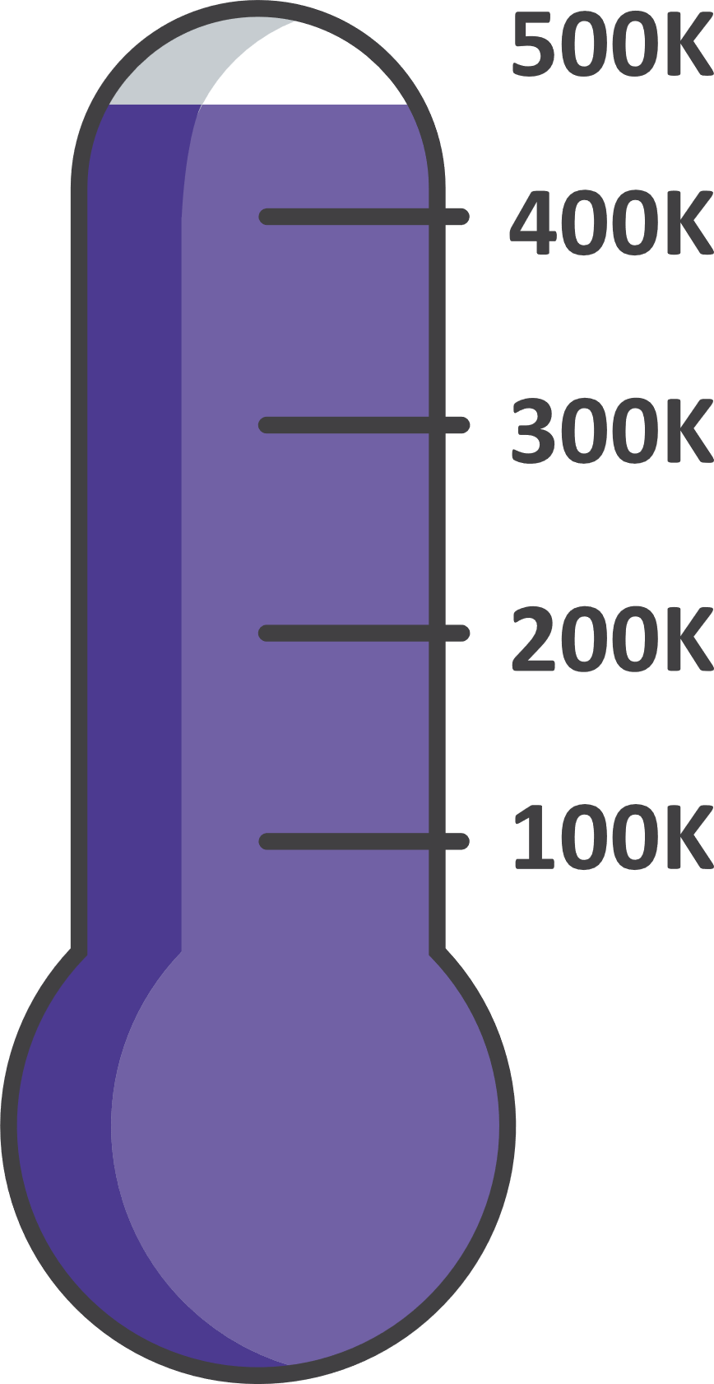
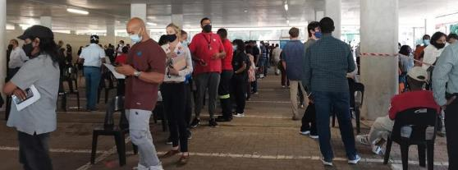
Sisonke 1 Completed 17th May 2021
122
sites touched in total including rural extensions and mobiles
496 424
vaccinated health workers

Slide 21
ACKNOWLEDGEMENTS
Johnson & Johnson
Paul Stoffels, Johan van Hoof, Abeda Williams and team
USG/NIH
Anthony Fauci, David Kessler, Robert Johnson, Larry Corey
RSA government
Treasury, NDOH, Natjoints Security Cluster
Biovac
Dr Morena Makhoana and team
Biocair
Leonard Lazarus and team
Funders:
Treasury/NDOH
Solidarity Fund
Bill and Melinda Gates Foundation
Elma Vaccine and Immunization Foundation
Michael and Susan Dell Foundation
US collaborators:
Larry Corey, Dan Barouch, Peter Gilbert, Holly Janes

Slide 22
SISONKE STUDY TEAM
Protocol Leadership
Glenda Gray
Linda-Gail Bekker
Ameena Goga
Nigel Garrett
Ian Sanne
Lara Fairall
Jackie Odhiambo
Fatima Mayat
Kentse Khuto
Bert Le Roux
Sisonke Data team
Tarylee Reddy
Ishen Seocharan
Nonhlanhla Yende-Zuma
Safety Team
Simbarashe Takuva
Azwidhwi Takalani
Imke Engelbrecht
Mark Faesen
NICD Epidemiology and Lab team
Cheryl Cohen
Harry Moultrie
Michelle Groome
Trevor Bell
Anne von Gottberg
Jinal Bhiman
SMC
Jeremy Nel, Chris Beyrer, Sipho Dlamini, Yunus Moosa, Francesca Conradie
PSRT
Barry Jacobson, Jonny Peters, Azwi Takalani, Vernon Louw, Jessica Opie, Pradeep Rowji
National Department of Health
Milani Wolmarans
Petro Rousseau
Kevin Naicker
Western Cape Epi group
Andrew Boulle
Mary-Ann Davies
MRC Burden of Disease Unit
Debbie Bradshaw
Pamela Groenewald
KRISP – sequencing lab
Richard Lessells
Tulio D’Oliveira

Slide 23
E-Consent:
Perspectives from
Clinical Research Sites
Rita Sondengam, MPH, MA
Site Manager at Bronx Prevention Center (BPC)
ICAP at Mailman School of Public Health, CUIMC
Bronx, NY

Slide 24
AGENDA
Using eConsent for CoVPN 5002
Pre implementation
BPC site process for eConsent
  IRB Approval for eConsent
  Informed Consent Process/Flow
  Documentation of eConsent process
Key Considerations
Challenges and Lessons Learned

Slide 25
About CoVPN 5002
COVPN 5002 (MINIMAL RISK RESEARCH)
The COVID-19 Prevention Network (CoVPN) 5002 was a venue-based community prevalence study to estimate the number of people who have or have had the SARS-CoV-2 virus in 15 different communities in the United States, including the Bronx and Harlem. The study enrolled approximately 26,000 people from around the country.
Population:
Adults and children (> 2 months of age) in the neighborhood ( specific communities)
Study Location:
Catchment areas surrounding the BPC (CRS)
Study procedures were conducted in the field (on a mobile unit and tents)
The study procedures included:
  blood collection for SARS-CoV-2 antibody testing
  nasal mid turbinate swab collection for SARS-CoV-2 RNA testing
  the administration of a tablet-based survey

Slide 26
Using REDCap for eConsent in CoVPN 5002
REDCap platform was centrally managed by SCHARP and accessed by study staff on tablets
  Compliant with all requirements under FDA Part 11 regulation (e.g. restricted access, administrative controls, training, identity verification, etc.)
Informed consent discussions were conducted in-person
  In the field (2 tents or van) or at the CRS
Assessment of Understanding
REDCap was available on the tablet which was passed between staff and participants
  Participant e-Signatures were completed directly on the tablet
  Staff e-Signatures were completed directly on the tablet
The system allowed for the completed consent to be emailed or printed
The system allowed for storage of eConsent during the trial and post-trial
Consent activities:
  Agreement to join the study
  Permission to use extra samples
  Permission to be contacted about future studies
In addition to the eICFs, these forms were available in REDCap to assist with study procedures:
  Consent Checklist
  Locator Form

Slide 27
IRB Approval
The eConsent process was requested in the IRB application and was approved as part of the consent process.
The following was submitted to the IRB:
A detailed description of the circumstances in which eConsent would be used and a complete description of the eConsent process (how, what, when)
Details concerning how the subject’s signature would be obtained and documented
The process for providing the participant with a signed copy of the informed consent
A description of the backup plan to consent subjects if eConsent was unavailable at the time of the consent process
The version of the ICF to be used
How the tablet will be secured
Privacy of the participant
Platform will be used for remote monitoring

Slide 28
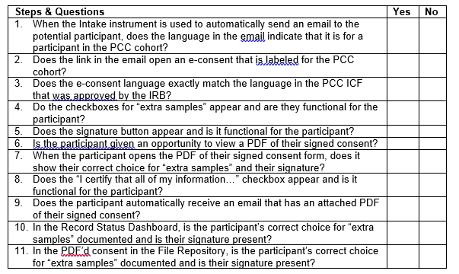
Pre Implementation of eConsent
Training Tools
eConsent user guide
Ability to practice incorporated during the development of the econsent
  Checklists for Testing econsent
  Communication between the data management center and the site
Mock visits to test the econsent
Development of SOPs

Slide 29
Informed consent process and visit flow using eConsent
ID Verification
Open appropriate Consent Form and conduct Consent Discussion
Open and complete Assessment of Understanding
Return to Consent Form and complete with participant and staff signatures
Email pt a PDF of their completed consent form
Open and partially complete Consent Checklist
Open and complete Consent Checklist
Open and complete Locator Form

Slide 30
Appropriate documentation of eConsent process
Informed Consent Checklist (Automated)
The checklist was on the tablet and summarized the eConsent process to ensure an accurate implementation of the consent process, including statements about:
How and when the informed consent process took place
Who was involved in the process
If the participant was given adequate time to consider participation in the study
If the participant was offered a copy of the signed consent form (via email)
The date and time of the informed consent process (time and date stamp)
Whether the participant can read, to assess the literacy of the participant
What language the informed consent discussion was conducted in
Whether the eConsent process followed the SOP for informed consent
Whether any study procedures were conducted prior to the consent process
Signature of staff member
End time of eConsent process
Date and time the checklist was signed by staff member
Some entries were marked as required

Slide 31
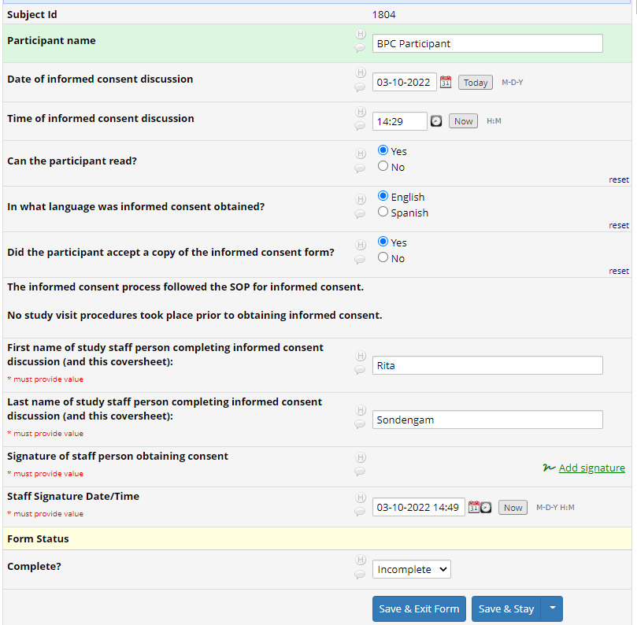
Required entries but not flagged if incomplete
Automated error/reminder message if incomplete

Slide 32
Appropriate Documentation of eConsent - Valid Subject Signature
REDCap had e-Signature capability, which was embedded in the consent form.
Signature field completed with a stylus or finger
eConsent had name of the signer
eConsent had a signature field
eConsent signature field had to be signed by:
  Subject; or
  Subject’s Legally Authorized Representative; or
  In the case of a child, the parent(s) or legal guardian of the child
  In the case of illiteracy, an impartial witness
  The person who discussed and obtained consent
  Time and date stamp entered by participant or LAR to permit verification that consent was obtained before the subject began study procedures
  Ability to erase signature and resign

Slide 33
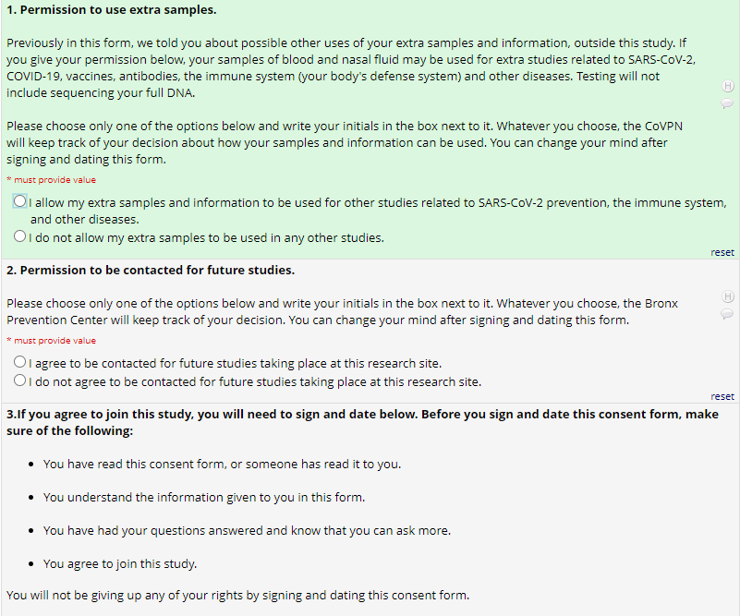
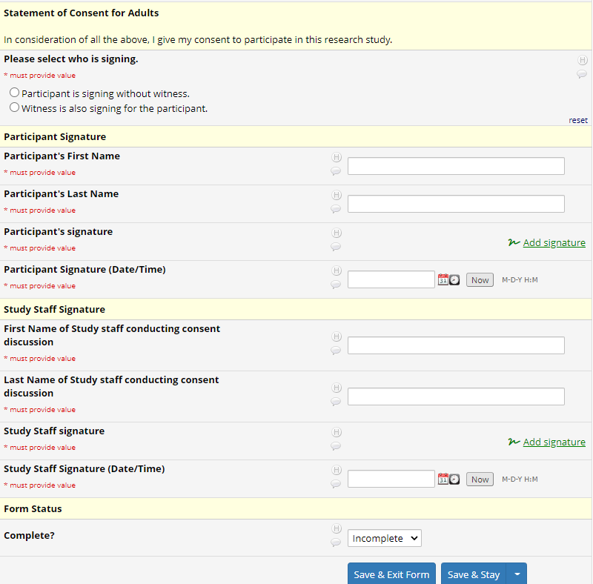
Adult Consent Form

Slide 34
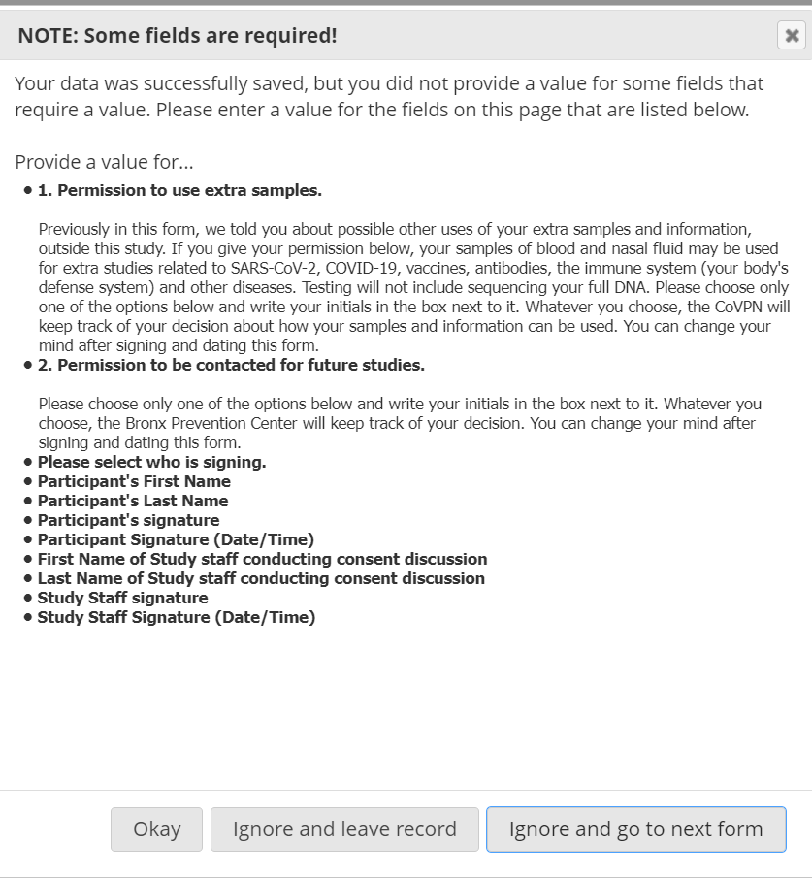
Automated reminder regarding missing fields in the Consent Form

Slide 35
Considerations
Assessment of Understanding (Automated)
7 True/False questions to assess the subjects’ understanding of the study was programmed in REDCap
It was a separate document administered at the end of the informed consent discussion, prior to signing the eConsent
Data Security
Each study personnel had their own tablet, which remained in their possession throughout the entire ICF process. Participants only handled the tablet during signing (participant could not use their own device).
The tablet and REDCap account were both password-protected.
The study team obtained verbal permission to send the eConsent via email to participants.
User friendliness
The eConsent form was easy to navigate, allowing the staff member to proceed forward or backward within the system but all forms had to be saved manually.
Responses could be changed within the eConsent form before submitting, or saved for completion at a later time
Study personnel helped the subject navigate the consent by clicking on links for the subject

Slide 36

Considerations Cont’d
Privacy
The ICF process had to be conducted in a manner and location that ensured participant privacy
In tents (10x20); outside the tent; in van; socially distanced
Logistics
Had to always have correct blank paper consents on hand
Mobile hot spots for internet had to be charged overnight
Tablets had to be charged overnight
Version control of consent form

Slide 37
eConsent has the ability to:
Supplement or replace paper-based consent and reduce risk of problems with data quality, i.e. missing fields and regulatory issues
Allow for real-time collection of informed consent data from remote locations and in the field, i.e. digital timestamping of data
Document the consent of the participant or their legally authorized representative (LAR)
Improve management of consent tracking, i.e. withdrawal, version control, reconsent
Provide audit trail and offer real-time tracking
Evaluate the participant’s comprehension of the information presented
Facilitate the participant’s retention and comprehension of the information
Promote timely entry of eConsent data into site and sponsor study databases
Reduce human error by incorporating automated checks and warnings

Slide 38
Challenges
Reliance on internet in the field
  Unreliable WiFi slowed workflow and impacted efficiency while moving between forms, frustrating pts and staff
Lack of printing in the field
  PDFs of signed consents didn't always send
  Not all participants had email accounts
eConsent was presented as a continuous screen, not separated into ‘pages’ (like printed copies)
  Separating pages or sections can improve discussion and understanding
The assessment of understanding was a separate document, staff had to leave consent form in order to complete the assessment
New ICF versions would require update in REDCap, potentially delaying enrollment of new pts
Consenting big families
  Staff had to repeat parental information, no built-in-method to link parents/guardians to children

Slide 39
AZD1222
Lessons Learned
Sites need to ensure documentation is consistent between paper-based consents and eConsents.
Consider regulatory risk, security protection, operational changes to system management, including access and authentication.
Provide enough time for training.
Device management
Reconsent options
eConsent should incorporate electronic strategies to encourage subjects to access and read all the consent material and to demonstrate their understanding before signing consent.
  Require subjects to answer multiple choice questions about the research study at the end of each page or at the end of the each section
  Require minimum time to be spent on each consent section to give sufficient time for discussion and Q&A
Some subjects may have difficulty navigating electronic systems because of digital familiarity, poor eyesight, or impaired motor skills. It is important to consider the population under study and whether eConsent may be a good option.
If there are technical difficulties with the platform or internet connection, paper-based consent processes may be needed as a back-up. Subjects must have the option to use paper-based or eConsent methods throughout the informed consent process.
Ensure that forms have ability to document participant questions/concerns throughout consent process.
eConsent should enable diagrams, charts, tutorials, and videos to increase participant comprehension.
eConsent should have glossary/dictionary function.
Required entries should be flagged when left incomplete.
Plan for remote monitoring ahead of time: platform, IRB approval.
Use consent checklist to route to the correct consent(s).

Slide 40
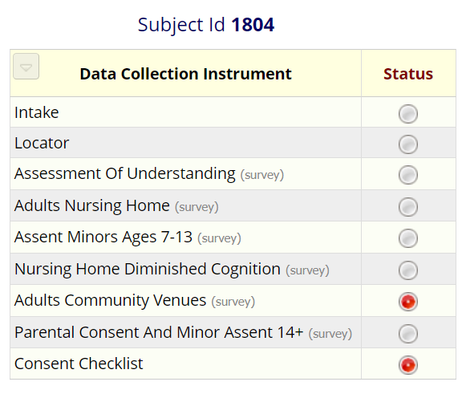
AZD1222
Lessons Learned (continued)
Especially in the beginning, staff would open and start to complete the incorrect Consent Form. Even though eConsent should help prevent mistakes, the layout on REDCap was not user friendly.
By including age and type of participant (Adult at community venue, Parent, Adult at a Nursing Home), the Consent Checklist could have been used to reduce human error by graying out inappropriate consent forms.

Slide 41

Thank You!
Thank you to
Dr. Jessica Justman
Dr. Ellen Morrison
Dr. Nandita Sugandhi
Rita Sondengam,
Ann Kahn
Maria Rivas
Ana Victoria Cruz
Saranya Naidu
Logan Posey
Amber Yıldızel

