Slide 1
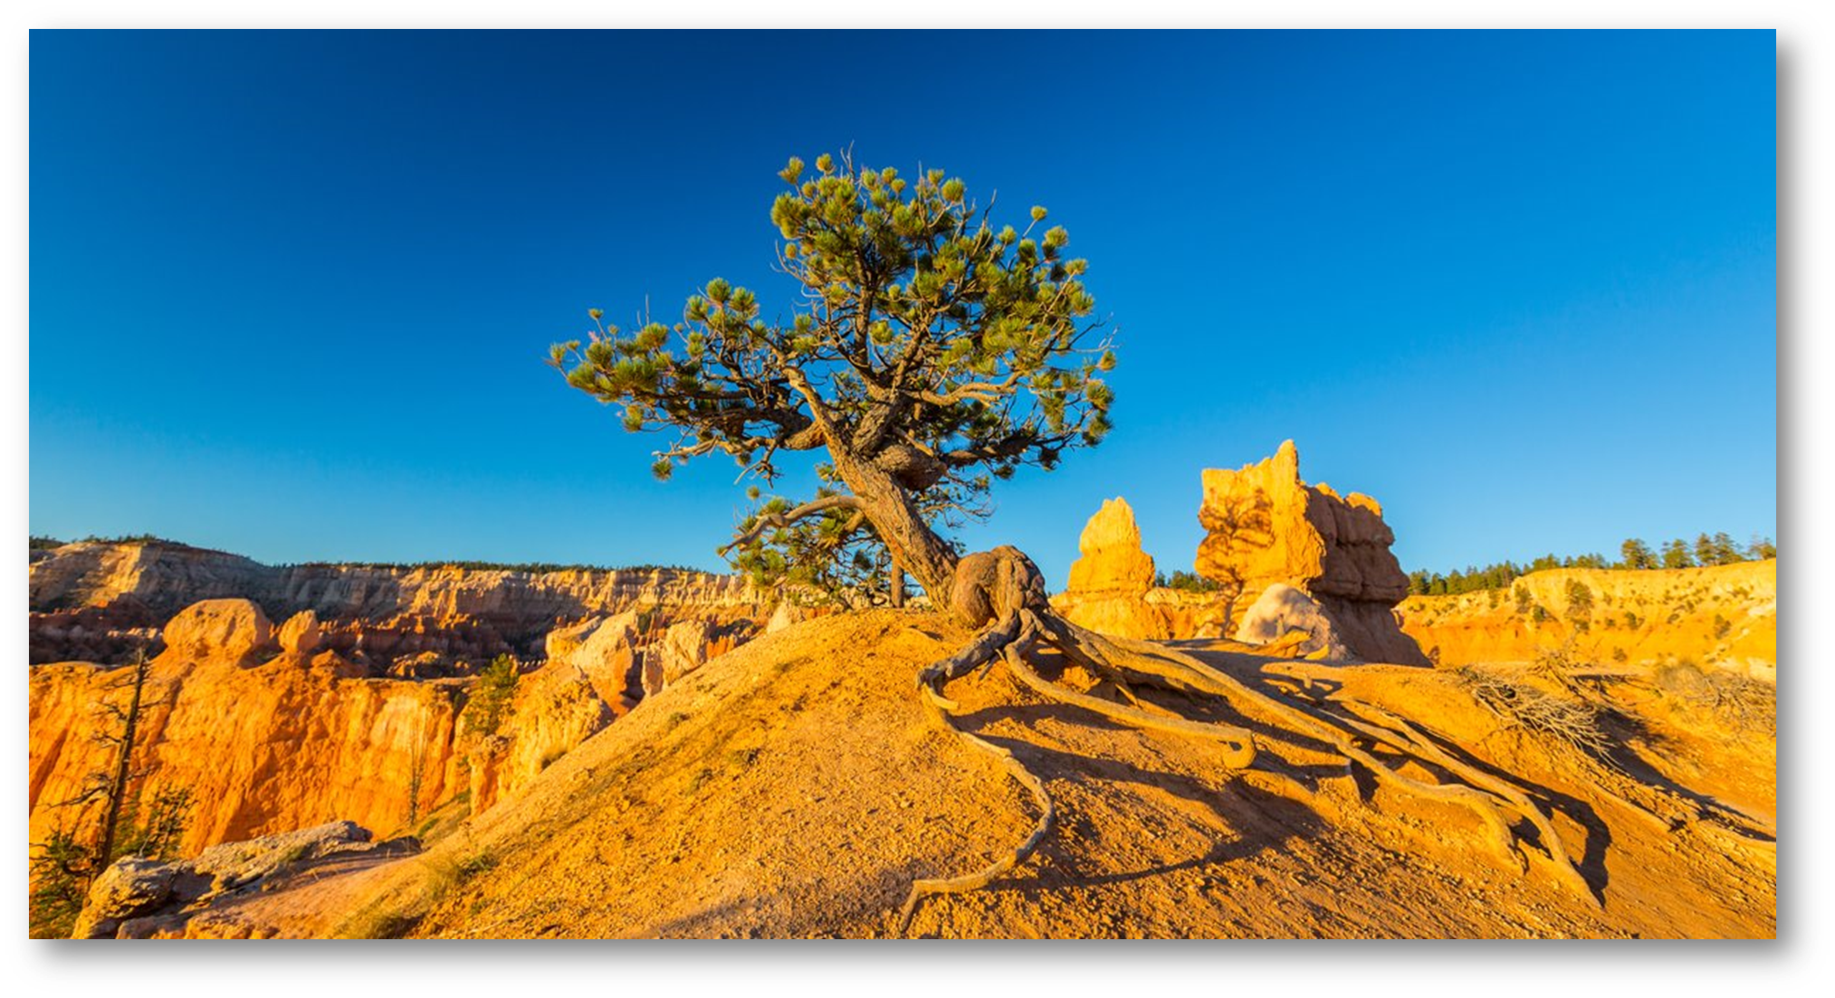
Welcome
-DAIDS Applied Research Training-
The views expressed in written conference materials or publications and by speakers and moderators at HHS-sponsored conferences do not necessarily reflect the official policies of the Department of Health and Human Services (HHS), nor does mention of trade names, commercial practices, or organizations imply endorsement by the U.S. Government.

Slide 2
Causes, Solutions, and Forces
- Problems and Solutions -
The views expressed in written conference materials or publications and by speakers and moderators at HHS-sponsored conferences do not necessarily reflect the official policies of the Department of Health and Human Services (HHS), nor does mention of trade names, commercial practices, or organizations imply endorsement by the U.S. Government.

Slide 3
Three Step Process
Good Documentation Practices (GDP) Activity
Identity Reasons for Poor GDP Compliance
Use Brainwriting Technique
Identify Themes and Potential Solutions
Improve GDP Compliance
Use Affinity Diagram and Brainstorming
Use Force Field Analysis
3

Slide 4
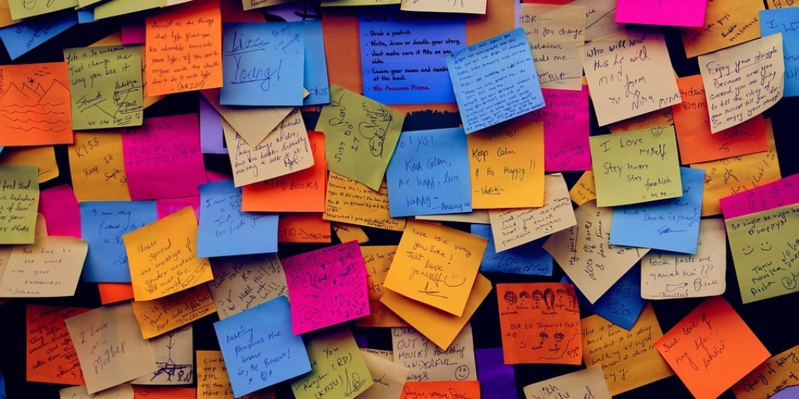
Why do GDP Errors Occur?
INSTRUCTIONS:
Write ONE (1) answer per Post-It® Note
Post notes to wall
Group ideas into themes
Name the themes
4
Notes:
In this exercise you will answer the following:
Why do we make Good Documentation Practice errors?
Working alone and silently, write one answer per post-it note
Continue recording ideas until you have exhausted all possibilities or time is up
Post your notes on the team wall space with all other table team data
Read all entries and begin grouping items into groups by major themes
Working as a team, identify and name the major root cause categories for GDP errors
Pick a spokesperson to share your team findings
ASK: What questions do you have at this time?
NOTE: FACILITATOR TO INCLUDE A NUMBER OF STICKIE NOTES WITH BASIC THEME OF EMPLOYEE TURNOVER ISSUE IN CASE STUDENTS DON’T INCLUDE THIS IN THEIR SPONTANEOUS RESPONSES
FACILITATOR: Ask one team to identify the different cause “themes” they identified – then ask the other teams if they identified ADDITIONAL root causes (The goal is to have each table work on 3 different root causes during the next step of the process – 12 TOTAL)

Slide 5
How can we reduce GDP errors?
INSTRUCTIONS:
Consider THREE (3) error themes
Brainstorm THREE (3) to FIVE (5) solutions
Post potential solutions for errors
5
Notes:
In this exercise you will answer the following:
How can we reduce Good Documentation Errors?
Working together as a team, review the root causes identified and assigned by the facilitator from in the first activity
Ask the team to clarify or expand on any information provided
For each assigned cause, brainstorm 3 to 5 potential solutions
Post potential solutions with suspected GDP root causes
Pick a spokesperson to report findings
ASK: What questions do you have at this time?
FACILITATOR: Ask one team to identify the different cause “themes” they identified – then ask the other teams if they identified ADDITIONAL root causes (The goal is to have each table work on 3 different root causes during the next step of the process – 12 TOTAL)

Slide 6
Force Field Analysis
INSTRUCTIONS:
Brainstorm forces that drive us towards solutions
Brainstorm forces that prevent us from change
Post Pro/Con forces on wall charts
6
Notes:
In this exercise you will consider the forces that drive us towards or away from GDP compliance.
Working together as a team, brainstorm ideas about the forces that drive us towards GDP compliance using the solutions generated in the previous step
Brainstorm ideas that restrict our ability to improve GDP compliance
Record the force field answers on the team flipchart
Select a team spokesperson to report findings to the room

Slide 7
Thank you for your participation!
The views expressed in written conference materials or publications and by speakers and moderators at HHS-sponsored conferences do not necessarily reflect the official policies of the Department of Health and Human Services (HHS), nor does mention of trade names, commercial practices, or organizations imply endorsement by the U.S. Government.
Notes:
FACLITATOR INSTRUCTIONS IMMEDIATELY AFTER THE SESSION:
Take photographs of all artifacts produced by table groups and email them to “martha.matthewsmartin@ppdi.com”
FACILITATOR INSTRUCTIONS DURING LUNCH BREAK:
Remove 3M stickie notes from the “Root Cause” wall posting area, maintaining the groupings and titles identified by table teams
Using the automatic numbering stamp, number each stickie note with a unique number before placing in the table group artifact envelope
Remove the Force Field wall poster into the table group artifact envelope
Remove the artifacts from the “Solution” wall posting and place them in the artifact envelope
Submit all artifact envelopes to PPD staff for further processing

