Slide 1




Welcome
-DAIDS Applied Research Training-
The views expressed in written conference materials or publications and by speakers and moderators at HHS-sponsored conferences do not necessarily reflect the official policies of the Department of Health and Human Services (HHS), nor does mention of trade names, commercial practices, or organizations imply endorsement by the U.S. Government.

Slide 2

Safety / Safety Oversight
The views expressed in written conference materials or publications and by speakers and moderators at HHS-sponsored conferences do not necessarily reflect the official policies of the Department of Health and Human Services (HHS), nor does mention of trade names, commercial practices, or organizations imply endorsement by the U.S. Government.

Slide 3
Adverse Events
Any untoward medical occurrence of any unfavorable and unintended sign, symptom, or disease temporally associated with the use of an Investigational Product (IP), whether or not related to the IP.
Evaluate AEs for:
Outcome
Intensity
Start date
Action taken with IP
Stop date
Seriousness
Association with IP/Causality
Notes:
Go over the information in the slide and additional information included below with participants:
Allows timely methodical evaluation of clinical safety data for study participants both individually and as a group
Maximizes individual participation safety
Develops accurate drug toxicity profiles
Compliance with regulatory requirements
Causality - Is there a reasonable possibility that the AE may have been caused by the investigational product?

Slide 4
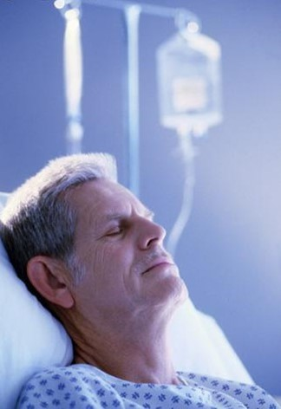
Serious Adverse Event
Adverse Event that at any dose meets any of the following regulatory defined criteria:
  Results in death
  Is life threatening
  Requires inpatient hospitalization or prolongs hospitalization
  Results in persistent or significant disability or incapacity
  Results in a congenital anomaly or birth defect
  Other important medical events as per investigators discretion
  ‘CHILDO’
  Congenial birth defect
  Hospitalization
  Incapacity
  Life threatening
  Death
  Other important medical event
Notes:
Review slide notes with participants.

Slide 5
“Sponsor may consider establishing an independent data monitoring committee (DSMB) to assess the progress of a clinical trial including the safety data.”
Safety Oversight
Ongoing Surveillance
Assurance
AEs/SAEs
Notes:
Review slide information and the below information with participants.
DSMB – Data & Safety Monitoring Board
1st box: Ongoing safety surveillance throughout the course of the trial
An independent group of experts in the disease under study, biostatisticians, Sponsor Representatives
2nd box: Assurance that procedures are in place to:
Protect safety of participants
Assure validity and integrity of study
3rd box: Adverse Events and Serious Adverse Events are reviewed throughout the course of all clinical trials for any potential trends
Data management listing review
DSMBs/IDMCs, ISMs/LSM
DSMB – Data & Safety Monitoring Board
Review cumulative safety data at least annually:
Evidence of study related Adverse Events
Data quality, completeness and timeliness
Adequacy of compliance with goals for recruitment and retention
Protocol adherence
Factors (such as protocol deviations) that might affect study outcomes or compromise confidentiality

Slide 6

All SAEs are reported to the Sponsor and the IRB/IEC according to the IRB requirements
Most Sponsors require SAEs to be reported within 24 hours of awareness of event by any site personnel
ALWAYS REMEMBER…….
Notes:
Go over slide information.

Slide 7

Best Practices
01
Educate Subject as to their responsibility in reporting AEs and SAEs
02
Recognize difference between ‘intensity’ and ‘causality’
03
Know the protocol-required AE intensity rating and comply with SAE reporting timeframe
04
Ensure all documentation is ‘ALCOAC’ compliant and Investigator must assess ‘causality’
04
05
Ability to recognize an SAE – ‘CHILDO’
Notes:
Review best Practices and invite participants to share what best practices do they commonly use.

Slide 8
Activity Directions
Review the play as a whole group
Respond to questions as a table group
Review the second scenario as a table group
Respond to scenario 2 questions as a table group

