Slide 1



February 2021

Slide 2

Objectives
1. What is the
SCORE Manual?
6. Outreach Efforts and Acknowledgements
2. Goals of the SCORE
Manual
5. Location of SCORE Manual
3. Content of SCORE Manual
4. DAIDS Policy Updates

Slide 3
What is the SCORE
Manual?
Site Clinical Operations & Research Essentials
Central Resource
-Consolidates existing DAIDS requirements and updates content
-Introduces new DAIDS requirements
-Provides supporting documents and redirection to existing resources (DAERS & Pharmacy Manuals)

Slide 4

Consolidate DAIDS procedural requirements
Promote efficiency
Increase adherence to ICH/GCP and applicable regulations
Reflect current state of regulations
Facilitate consistency in protocol implementation across sites
Aligns with new DAIDS framework for high-level policies
Goals
of the SCORE Manual

Slide 5

Table of Contents
SCORE Manual
18 Sections
Introduction to DAIDS Systems
  DAIDS Learning Portal (DLP)
  NIAID CRMS Modules (Site Hub, CSM, DPRS, DAERS)
  Best Practices
Investigator Responsibilities
  IoR, CRS Leader, CTU PI roles
  Investigator agreements
CRS Personnel Qualifications, Training & Responsibilities
  Delegation of Duties (DOD) Log
  Training documentation
  Changes in Key Personnel

Slide 6
Site Activation Process
  OCSO Site Activation
  Network Protocol Activation
  Approval of additional locations
Pharmacy Requirements
  General Pharmacy Requirements
  Link to Pharmacy Guidelines
  Clinical Research Product Management Center (CRPMC)
Electronic Systems
  References Electronic Information Sytems Policy (EIS)
  CRS implementation = Dec 2021
CRS Facility Requirements
  Clinic & Laboratory
  Equipment Maintenance
  Environmental Monitoring
  Emergency Procedures
  Additional Locations
SCORE Manual
18 Sections

Slide 7
Laboratory Requirements
  References policies for lab and biospecimen management
  GCLP standards
Source Documentation Updated Content!
  Updates 2007 policy content
  Electronic records
  Good documentation Practice (GDP)
Essential Documents
  Filing of essential documents
  Storage and retention of research records
Quality Management New Requirements!
  Site-Required SOPs
  Clinical Quality Management Plan (CQMP) Requirements
  QA Summary Report Requirements
SCORE Manual
18 Sections

Slide 8
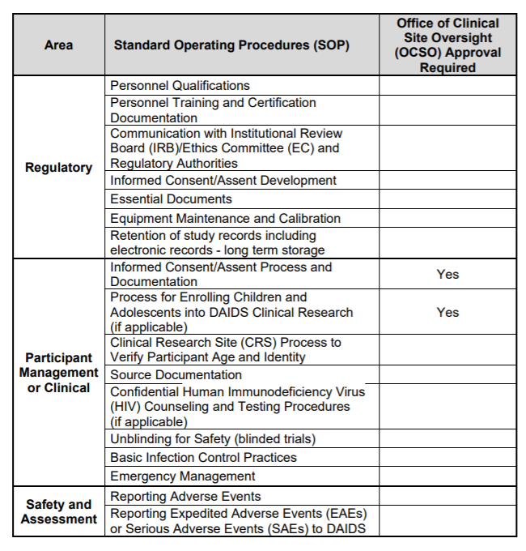
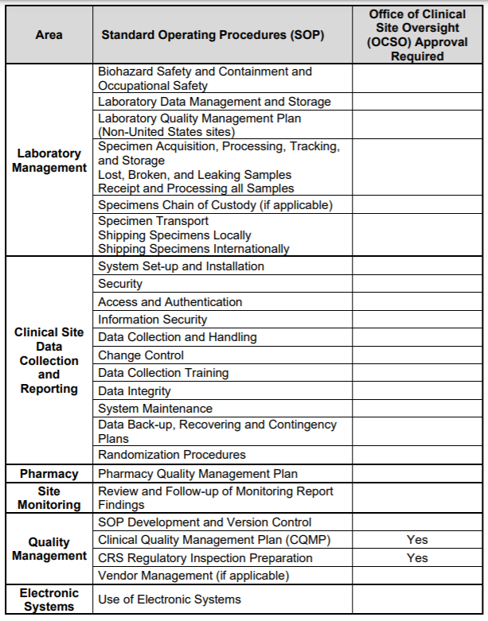
New Required SOP
New Submission to DAIDS
  New DAIDS Requirements - SOPs

Slide 9
SCORE Manual
18 Sections
Protocol Registration and IRB / EC Communications
  References Protocol Registration Manual
Informed Consent of Participants Updated Content!
  CRS specific consent forms
  Overall IC Process
  Electronic Consent and Enrolling minors
Screening, Enrollment/Randomization & Unblinding of Participants
  Co-enrollment
  Age and Identity Verification New Requirement!

Slide 10
Protocol Compliance
  Identifying and reporting non-compliance and suspected research misconduct
Premature Termination or Suspension of a Clinical Trial
  Who can terminate or suspend
  CRS responsibilities
Site Visits
  Monitoring visits
  CRS closeout visits and
  Audits (for cause, routine, mock inspection)
CRS Inspection Readiness
  Becoming and remaining inspection ready
  What to expect before/during/after FDA/EMA inspections
SCORE Manual
18 Sections

Slide 11

SCORE Manual Appendices and FAQs
Section Appendices
  Required Site SOPs
  Guidance/Instruction Documents
  Templates
  Checklists
  Tools
  Flow Charts
FAQ Topics
  DoD Logs
  CQMP and QA Summary
  Age & Identity Verification

Slide 12

Updates to DAIDS Policies
1. Source Documentation
2. Clinical Quality Management Plans
3. DOD Log (Delegation of Duties)
4. Requirements for Site MOP
(Manual of Procedures)
5. On-Site Monitoring
Requirements
6. Enrolling Children in Clinical Research;
Clinical Site Requirements
Obsoleted Policies
(as of 1/26/21)
High level
Defines Scope and Purpose
Effective as of January 26, 2021
New SCORE
Manual Policy

Slide 13
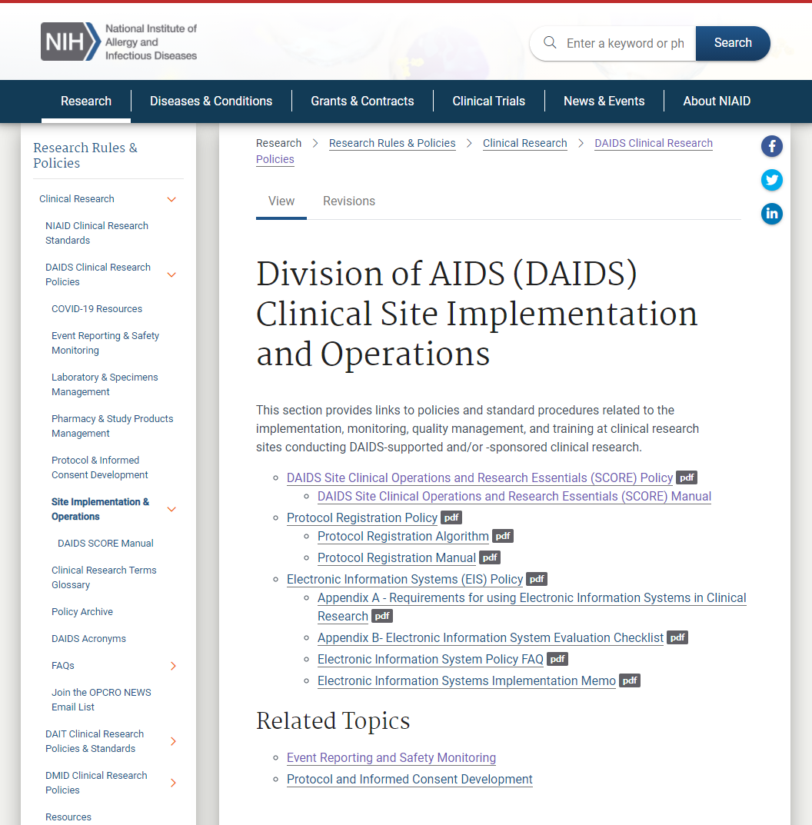
  SCORE Manual & Policy Location

Slide 14
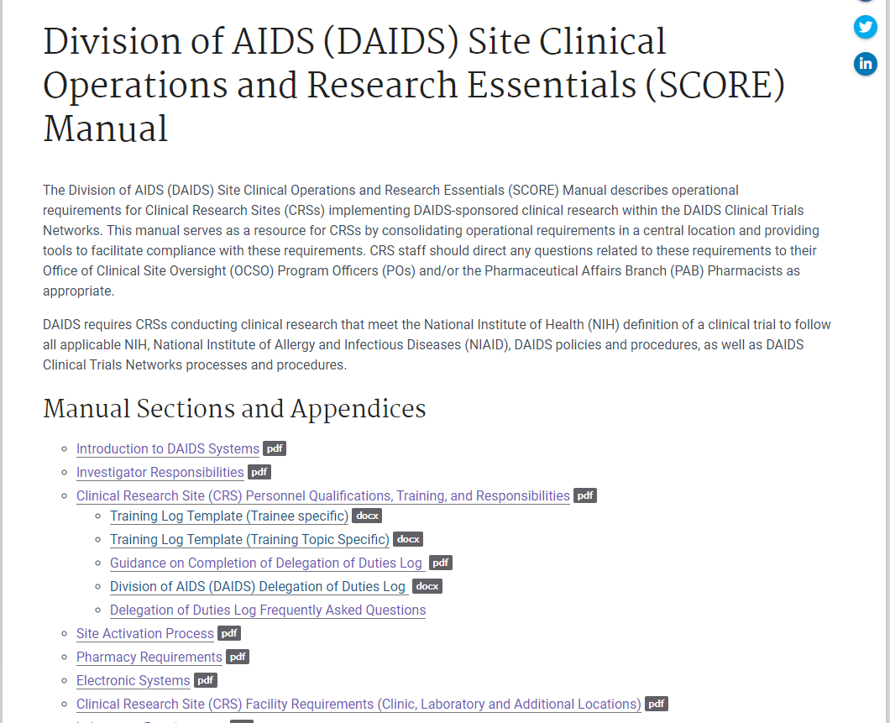
  SCORE Manual & Policy Location

Slide 15
Outreach Activities
Awareness Announcements
Clinical Trial Units
Manual Champion Plus
HANC
Leadership and Cross Network Calls
Outreach Activities
DAIDS Working Group Presentations
Clinical Research Sites

Slide 16

Collaborative Effort!
DAIDS Working Group
PPD
Internal Subject Matter Experts
27 SCORE Manual Champions Plus

Slide 17
SCORE Manual Champions
Emily Barr – IMPAACT
Baiba Berzins – ACTG
Catherine Bunce - HVTN
Gift Chareka – ACTG, HVTN, HPTN, IMPAACT, MTN
Leslie Degnan – ACTG, HPTN, IMPAACT, MTN
Brett Gray – ACTG, HVTN, HPTN
Dumisile Huwa – ACTG, HPTN, IMPAACT, MTN
Emmanuel Kapesa – HVTN
Sharon Kohrs – ACTG, HPTN
Dr. Violet Korutaro – HPTN, IMPAACT
Lisa Levy – MTN
Katie McCarthy - IMPAACT
MaryBeth McCauley – HPTN
Kimberly Marsh – HVTN
Mahnaz Motevalli – HPTN, IMPAACT
Maria Musisi – HPTN, IMPAACT, MTN
Kalendri Naidoo - ACTG, HVTN, HPTN, IMPAACT, MTN
Sylvia Davila Nieves – ACTG
Smita Nimkar – ACTG, IMPAACT
Lisa Patton - ACTG
Shelly Ramirez – HVTN
Kieara Ramtahal – HVTN
Scott Rose – HPTN
Tanasha Sullivan – ACTG, HVTN, HPTN
Edna Viegas – HVTN
Ilene Wiggins – HVTN
Avery Wimpelberg – ACTG
Milan Vu – HANC

Slide 18

A heartfelt
Thank You!
DAIDS WG
  Gregg Roby
  Manizhe Payton
  Doreen Campbell
  Jess Landis
  Donna Germuga
  Katherine Shin
  Ruth Ebiasah
  Jessica Fair
  Janet O’Brien
  PPD
  Priscilla Silva
  Seema Garg
  Amy Meacham
  Heather McWhorter
  Kim Havens
  Bambra Stokes
  Mary Wiley
  Marti Martin

Slide 19
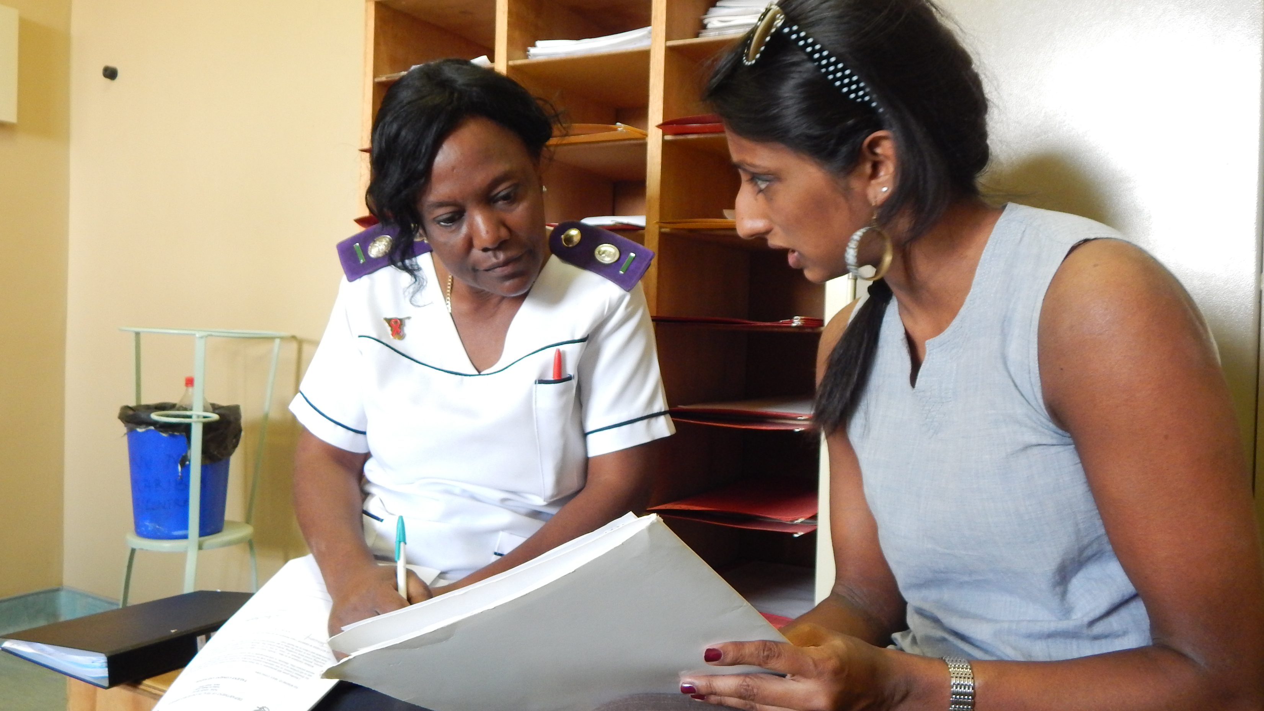
  Comments and Questions?
Photo: National Center for HIV, STD & TB Prevention, Karibib Health Center on the TB/HIV program, CDC

