Slide 1
DAIDS
Electronic Information Systems (EIS) Policy Training
June 2021

Slide 2
Welcome – Dr. Carol Worrell
Director, Office for Policy in Clinical Research Operations (OPCRO)
Division of AIDS/NIAID/NIH

Slide 3
Office for Policy in Clinical Research Operations (OPCRO)
Carol Worrell
Director
Clinical Research Resources Branch (CRRB)
Carole Andres, Chief
Technical Interface to contractors to ensure appropriate delivery of services according to contract requirements
Protection of Participants, Evaluation, and Policy Branch (ProPEP)
Jui Shah, Branch Chief
SME on:
Clinical Trials Agreement Team (CTAT)
Jonathan Green, CTA Team Leader
Safety and Pharmacovigilance Team (SPT)
Sindhu Gopalan, Safety Team Leader
Clinical Data Management (CDM)
Dhawala Kovuri* Senior CDM Advisor
Oversee CDM activities at the data management centers (DMCs)
Review resource requirements for clinical trials, and coordinate access to resources
Provide resources for clinical research training
RAB members sign the Form FDA 1571 for DAIDS INDs.
Liaison with Health Authorities
Protocol Registration Team (PRT) management
Regulatory affairs oversight, management, guidance, and surveillance
Develops and maintains DAIDS policy documents
OHRP liaison
CTAs and other agreements
Safety reporting
Safety data reconciliation
Safety distributions
Collaborates with DMCs to improve clinical data management (CDM) process efficiency, effectiveness, and quality
Regulatory Affairs Branch (RAB)
Mary Anne Luzar, Chief
Human subject's protections matters
IRB/EC Requirements & HSP GCP compliance
CDM Liaison for DAIDS and DMCs
Dara Potter
Deputy Director
* Contractor

Slide 4
Background
Division of AIDS (DAIDS) has been assessing its clinical trial oversight to ensure consistency with all requirements
Electronic information systems requirement
Food and Drug Administration (FDA) Regulation -21 CFR Part 11 has been in effect since 1997
Led to the development of Electronic Information Systems (EIS) Policy at the DAIDS.

Slide 5
Acknowledgements
Thank you:
  All collaborators for working with us to meet the regulatory requirements
  Data Management Centers (DMCs) for reviewing and providing input early in the policy’s development and for working with DAIDS to deliver the training
  Office of HIV/AIDS Network Coordination (HANC) for the coordination and support
  DAIDS EIS Policy Working Group.

Slide 6
DAIDS EIS Policy Working Group Members
A special thanks to the following persons who devoted their time and effort to support the EIS policy development:
Carol Worrell (Co-chair) | Donna Germuga
Dhawala Kovuri (Co-chair) | Cindy Coates
Dara Potter | Phil Renzullo
Jui Shah | Akinlolu Ojumu
Sindhu Gopalan | Michael Gilbreath
Bola Adedeji | Roberta Black
Tania Lombo Rodriguez | Judi Miller
Hao Zhang | Keith Crawford
Tanisha Savage | Other DAIDS contributors

Slide 7
Thank you!

Slide 8
EIS Policy Development and Implementation
Dhawala Kovuri
Senior Clinical Data Management (CDM) Advisor, OPCRO, DAIDS

Slide 9
EIS Policy Background
The EIS policy was developed for electronic systems used in the conduct of NIAID DAIDS’ Network clinical trials
Developed in collaboration with DAIDS EIS policy working group, which included OCSO, OPCRO, and Program
Review and feedback from internal and external DAIDS collaborators.

Slide 10
EIS Policy Development
The Draft policy was shared with DMCs, CRS and DAIDS collaborators in October 2019 and comments were addressed
Final policy was effective August 8th, 2020
Appendix elaborates on the technical details and requirements
Checklist to help collaborators implement the policy
FAQs developed to address anticipated queries.

Slide 11
EIS policy implementation
Phased roll-out of the policy
Implementation memo sent on August 7th, 2020
Timelines:
  DMCs: October 1st, 2020
  Other collaborators: December 1st, 2021
    Clinical trial networks, CRSs, Labs, Contractors
Timeline extended for sites to allow for training prior to implementation
DAIDS worked closely with the DMCs to provide training to internal and external stakeholders.

Slide 12
EIS Policy Scope
The EIS policy describes the requirements for electronic systems used in the conduct of NIAID DAIDS Network studies conducted within the Clinical Trials Networks, unless otherwise specified in a formal agreement
Electronic systems which fall under the scope of this policy include systems from which clinical trial data may be submitted to the FDA, EMA or any other regulatory authorities or systems that collect, manage, store, or generate data that can be used to reconstruct a clinical trial.

Slide 13
EIS Policy resources
Link to the EIS Policy: Electronic Information Systems (EIS) Policy
Implementation Memo: Electronic Information Systems Implementation Memo
Link to FAQ: Electronic Information System Policy FAQ
Submission of checklist: DAIDSCRSSEISChecklist.sm@ppdi.com
Queries: DAIDSCRSSEISChecklist.sm@ppdi.com
Regulation: 21 CFR Part 11

Slide 14
Questions?

Slide 15
Thank you!

Slide 16
Completing DAIDS EIS Evaluation Checklists
Site and Laboratory Training
June 2021

Slide 17

Agenda
21 CFR Part 11
What systems require a DAIDS EIS Evaluation Checklist
How to complete the DAIDS Evaluation Checklist

Slide 18
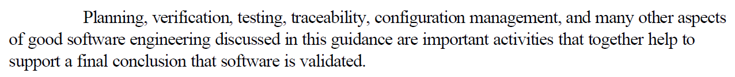
21 CFR Part 11
Federal regulation identifying what measures are necessary for electronic records to be acceptable for clinical trials
Requires validation of systems used “to create, modify, maintain, or transmit electronic records”
— General Principles of Software Validation; Final Guidance for Industry and FDA Staff

Slide 19
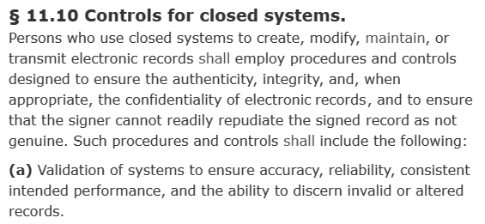
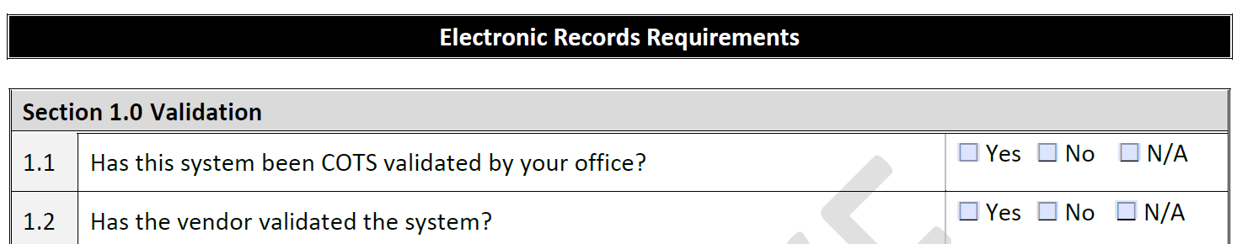
21 CFR Part 11
DAIDS is increasing standardization/oversight to ensure compliance from all trial stakeholders
DAIDS EIS Evaluation Checklist is based on 21 CFR Part 11 controls

Slide 20
Systems Requiring a DAIDS EIS Evaluation Checklist
Electronic systems subject to 21 CFR Part 11
  Systems that collect data that will be submitted to a regulatory authority
  Systems that hold records (e.g. Essential Documents) that can be used to reconstruct the trial
Each system subject to 21 CFR Part 11 will require a separate evaluation checklist
Examples will be provided at the end of the presentation

Slide 21
DMC End User Validation
The DMCs will be validating select systems on behalf of site users
Validation certificates will be provided on DMC portal websites

Slide 22

Questions

Slide 23
Contact information and System Risk Assessment

Slide 24
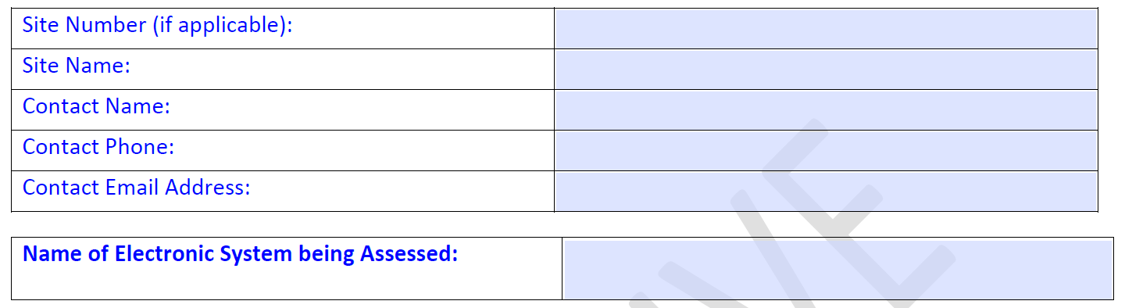
Contact Section
Contact Name: The person at your organization who can answer questions pertaining to the system and your intended use of it

Slide 25
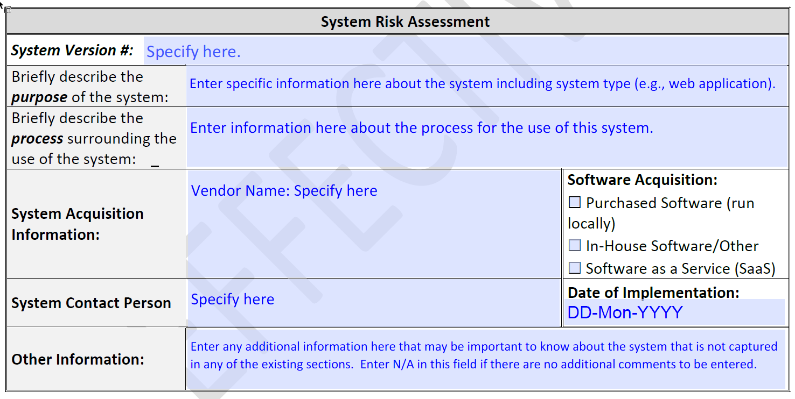
System Risk Assessment
Most current system version
Date when most current version was installed or adopted
Same as contact person listed in contact section

Slide 26
System Risk Assessment
Purchased Software –
Commercial software installed
in a local environment
In-House Software/Other –
Software developed by your
organization
Software as a Service (SaaS) – Commercial software run outside your local environment (e.g. on the web)

Slide 27
Sections 1.0 — 9.0: Validation, Access and Record Protection, Audit Trails, System Checks, Training

Slide 28
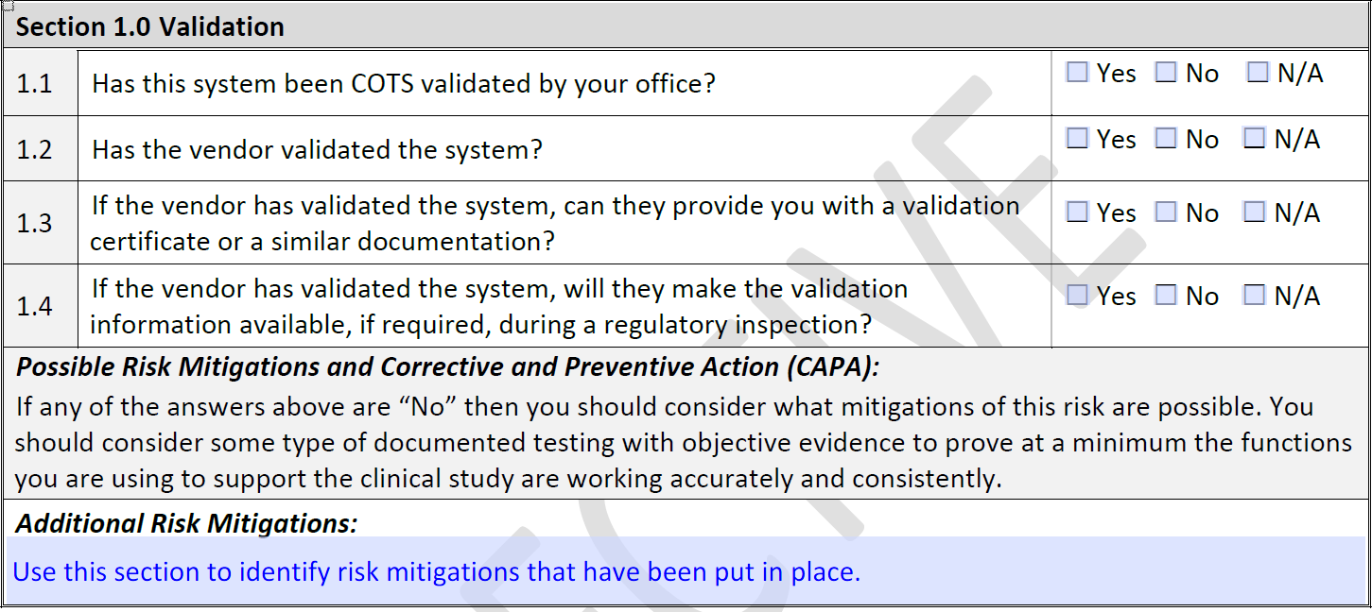
Risk Mitigations
If you answer “No” to any of the relevant questions in each section, explain how you will mitigate these risks

Slide 29
Example Risk Mitigations
Risk: Vendor does not provide validation certificate
  Risk Mitigation: Site independently maintains records of Commercial Off-the-Shelf (COTS) validation documents and vendor validation documentation
Risk: Laboratory is unable to place data on an encrypted USB drive due to hardware incompatibility
  Risk Mitigation: Laboratory has implemented a secure cloud-based file transfer system

Slide 30
Section 1.0: Validation

Slide 31
Section 1.0: Validation
What is considered validation?
  Ensuring that a system works as intended
  Documented process of identifying software requirements, testing those requirements, and reporting test results
  Should be performed for an initial, deployed version; a change control process should be performed for subsequent version releases

Slide 32
Section 1.0: Validation
What is Commercial Off-the-Shelf (COTS) validation?
  User-end validation to ensure that commercial software is fit for use as intended
  Usually supplements developer validation performed by the vendor

Slide 33
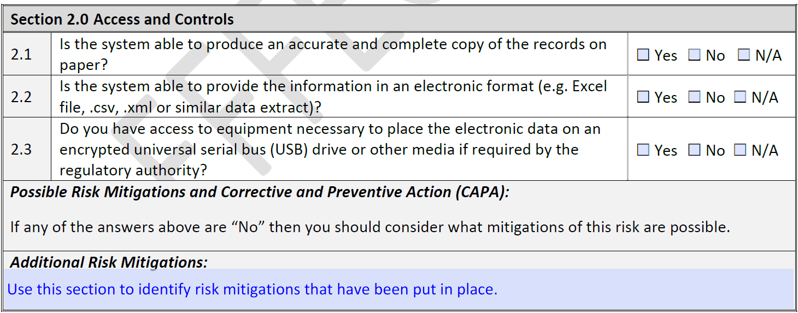
Section 2.0: Access and Controls

Slide 34
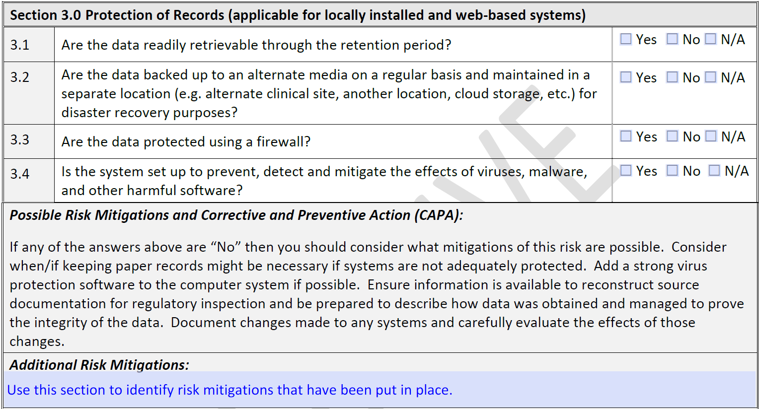
Section 3.0: Protection of Records

Slide 35
Section 3.0: Protection of Records
What is “the retention period”?
  For studies subject to Food and Drug Administration (FDA) guidelines, 2 years after approval of marketing application or discontinuation of investigation
  For regulatory studies, confirm with Site OCSO PO at DAIDS whether they are subject to European Medicines Agency (EMA) retention requirements
  For more information, see Storage and Retention of Clinical Research Records Policy (DAIDS POL-A15-OPC-015.00)

Slide 36
Section 3.0: Protection of Records
What is considered “backup”?
  Copies of records are regularly transferred to a location outside of the system
How do you know whether the system is set up to protect against viruses and malware?
  System configuration
  Environment configuration
Discuss backup and system protection with your system administrators and IT personnel

Slide 37
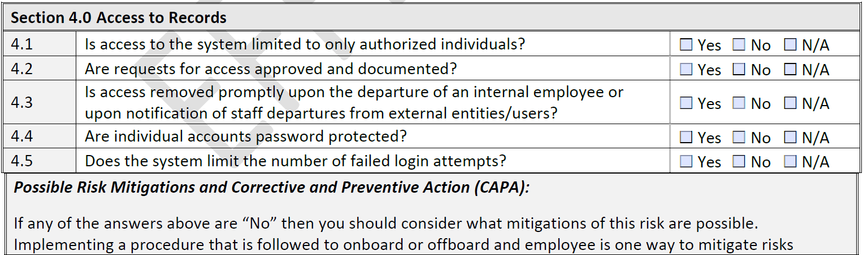
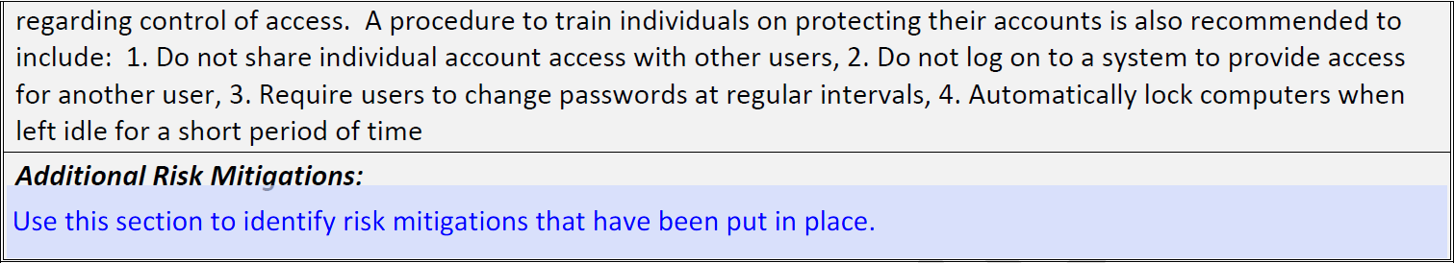
Section 4.0: Access to Records

Slide 38
Section 4.0: Access to Records
Access should be granted by role, and individual users assigned to roles
Documenting requests for access and access removal
  Name of access recipient
  Permissions to be added/removed
  Approver
Preferable to document requests where they can easily be retrieved (i.e. not through email)

Slide 39
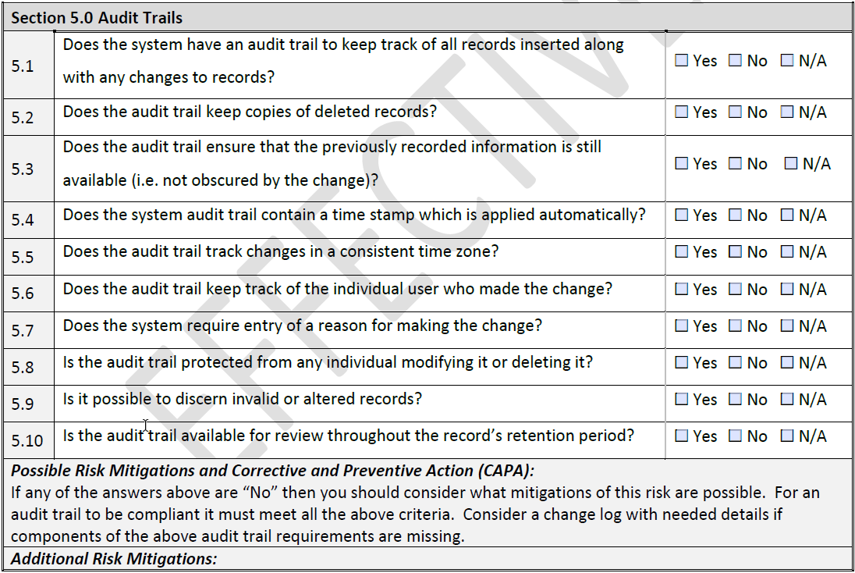
Section 5.0: Audit Trails

Slide 40
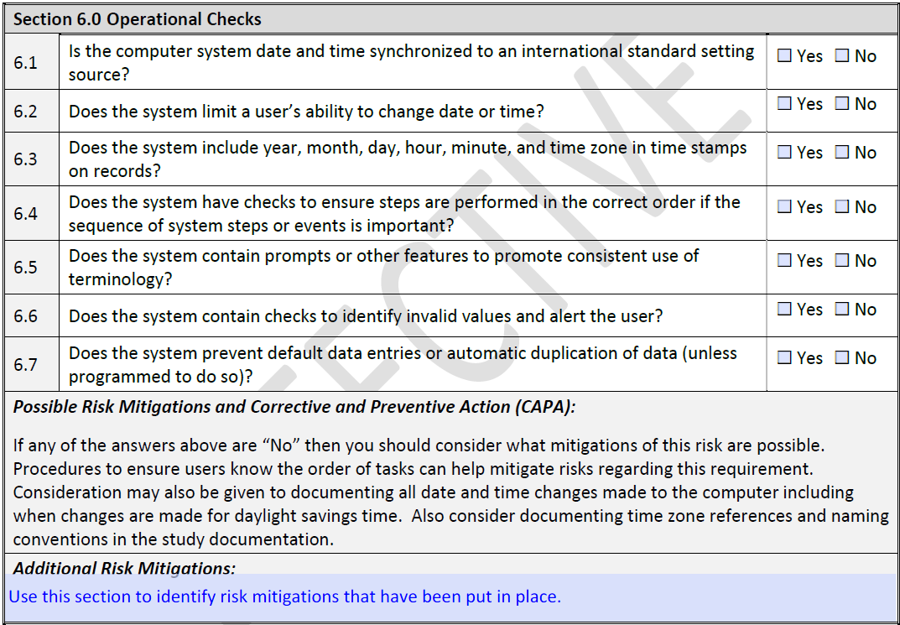
Section 6.0: Operational Checks

Slide 41
Section 6.0: Operational Checks
What does it mean to have checks to ensure steps are performed in the correct order?
  System enforces stages (e.g. Draft, In Review, Approval)
  System provides warnings if user tries to advance before a step is complete
What does it mean to include prompts to ensure consistent use of terminology?
  Using selectable options instead of free-text fields
  Help text

Slide 42
Section 6.0: Operational Checks
What does it mean to include checks to identify invalid values and alert the user?
  Warning text when value is out of range, in the wrong format, or otherwise not valid
What does it mean to prevent default data entries?
  When options are selectable, the default value is blank (no selection)
E150368
ERROR: You have entered alphabetic characters. This field only accepts numeric characters.
Allergic Reaction
Babesiosis
Colic
Select

Slide 43
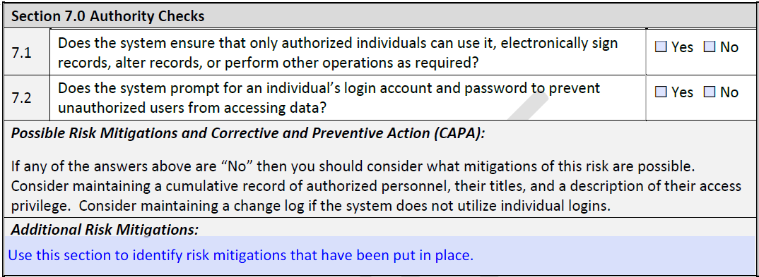
Section 7.0: Authority Checks

Slide 44
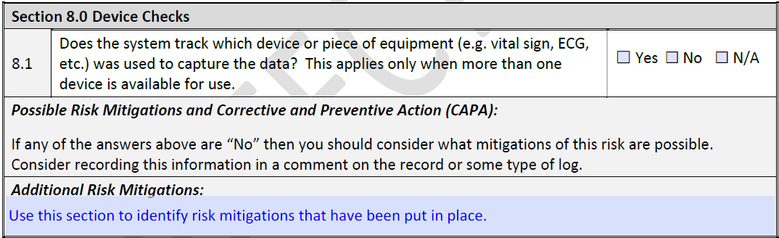
Section 8.0: Device Checks

Slide 45
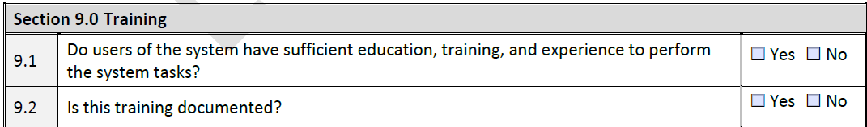
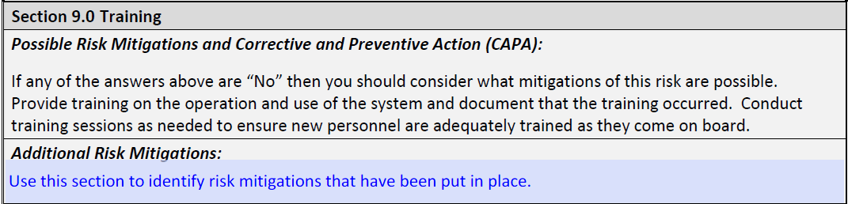
Section 9.0: Training

Slide 46
Section 9.0: Training
What is considered adequate documentation of training?
  Training records should be maintained centrally for easy retrieval
Training record includes
  Name of user
  Name of training event
  Date of training event
  Confirmation of attendance

Slide 47
Questions

Slide 48
Sections 10.0 — 12.0: policies, System documentation and controls for open systems

Slide 49
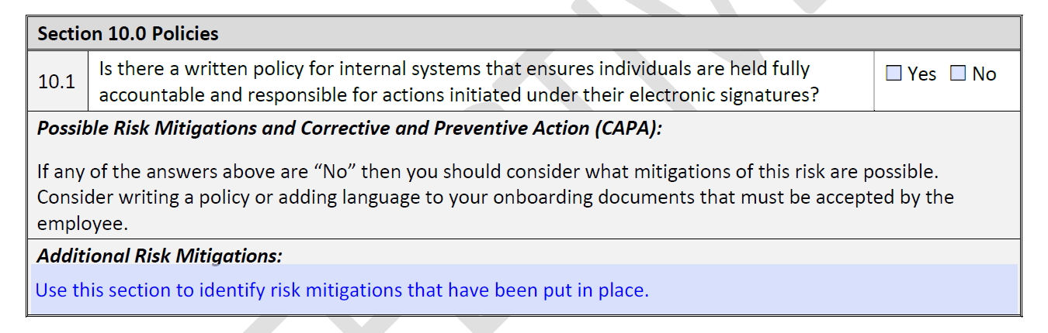
Section 10.0: Policies
What is a written policy?
Standard operating procedure (SOP) that is version-controlled and requires formal signature by the individual using the system

Slide 50
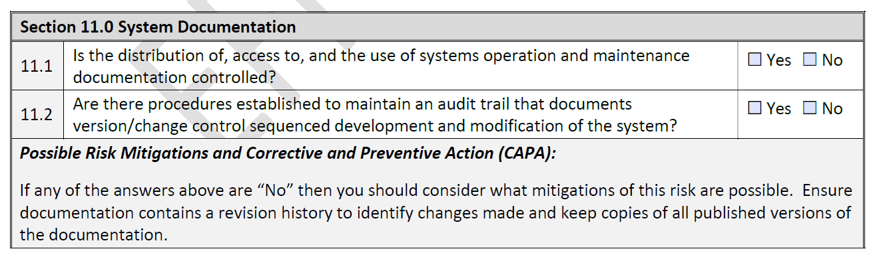
Section 11.0: System Documentation
Are all aspects of systems operation and maintenance documented in written, version-controlled procedures?
Are procedures in place that document a version history of any changes or modifications to the system?

Slide 51
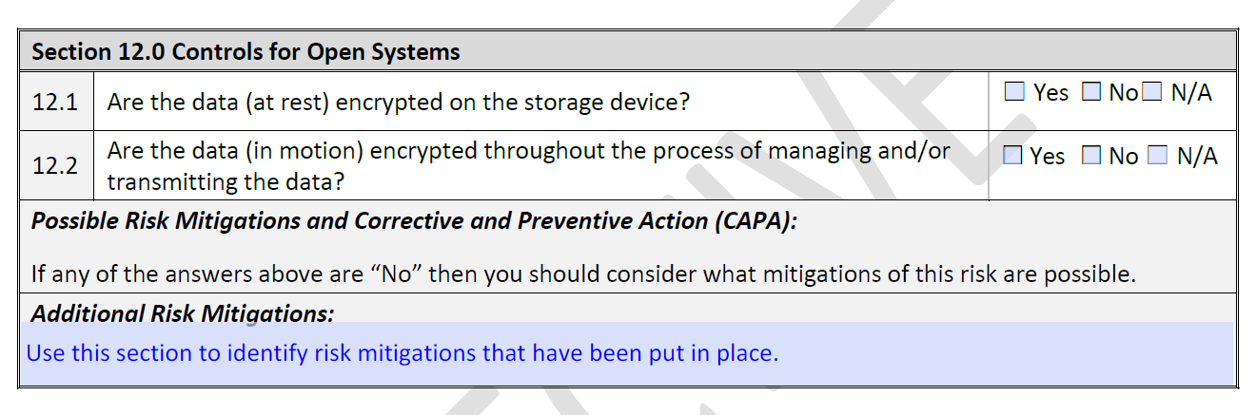


Section 12.0: Controls for Open Systems
At rest: data that is not actively moving from device to device
In motion: data that is actively moving from one location to another across the internet or through a private network

Slide 52
Questions

Slide 53
Electronic signature requirements

Slide 54
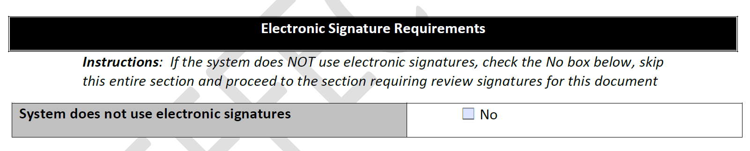
Electronic Signature Use
If system does not use electronic signatures, skip sections 13.0-21.0 and proceed to checklist review and approval, section 22.0

Slide 55
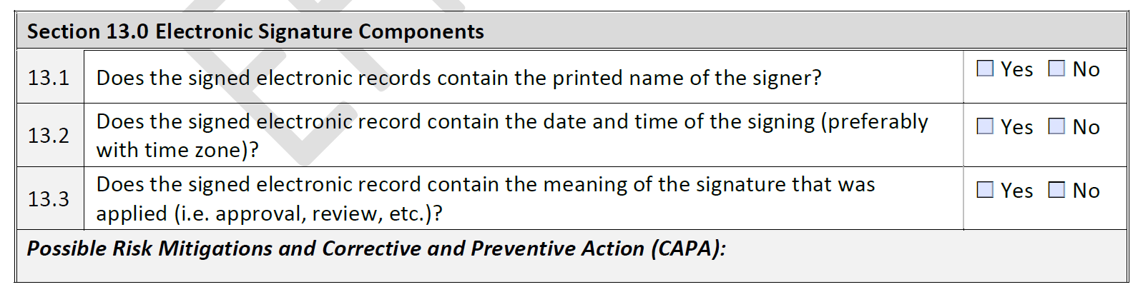
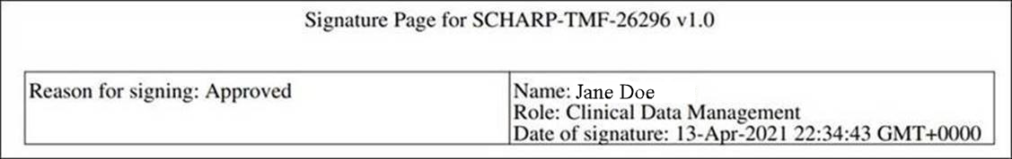
13.0: Electronic Signature Components
1
3
2

Slide 56
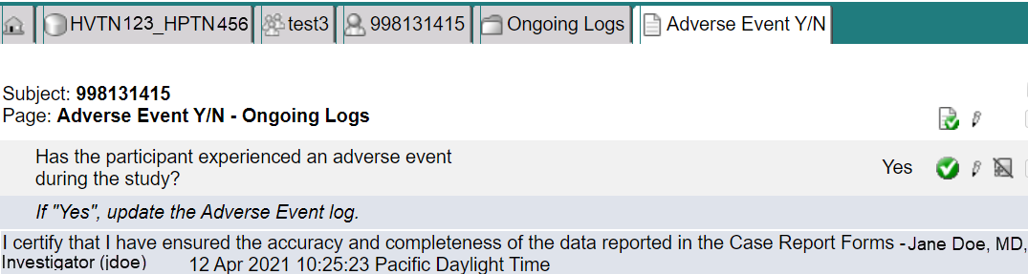
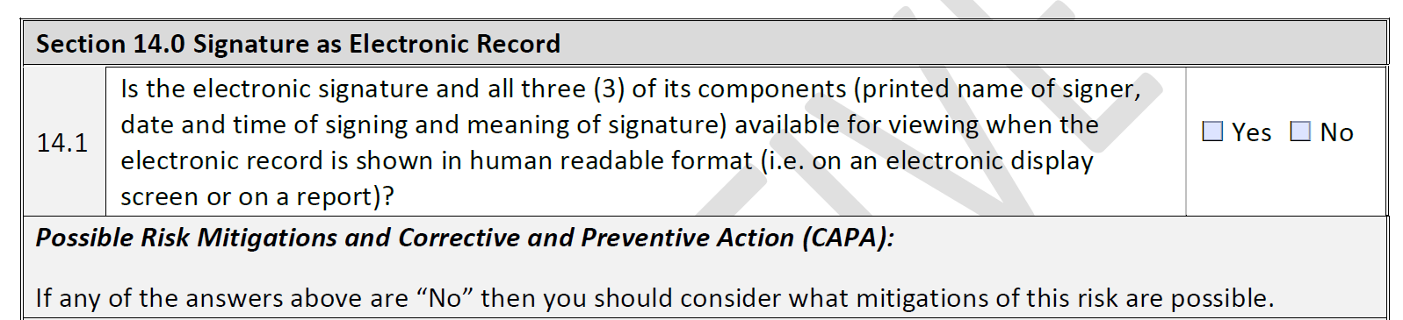
14.0: Signature as Electronic Record

Slide 57
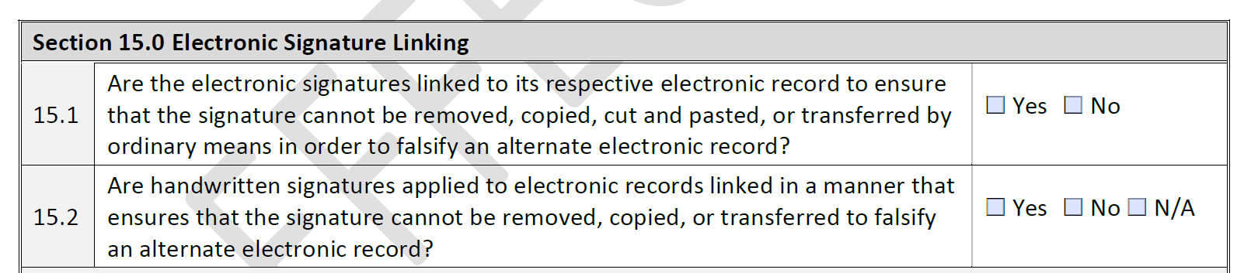
15.0: Electronic Signature Linking

Slide 58

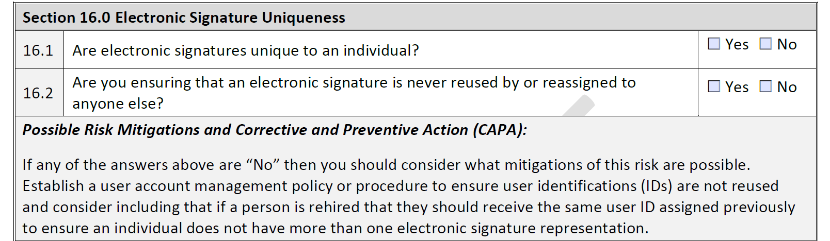
16.0: Electronic Signature Uniqueness

Slide 59
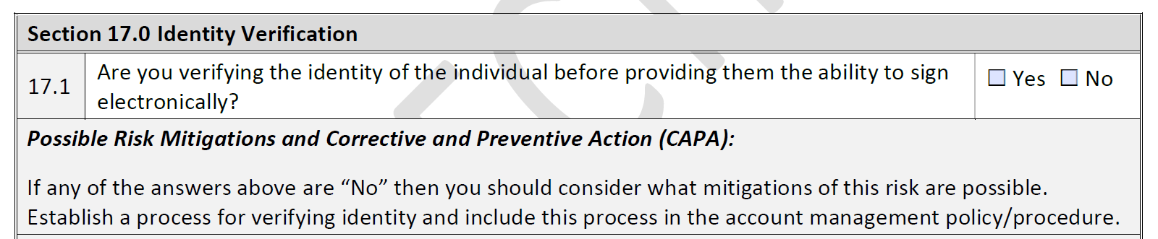

17.0: Identity Verification

Slide 60
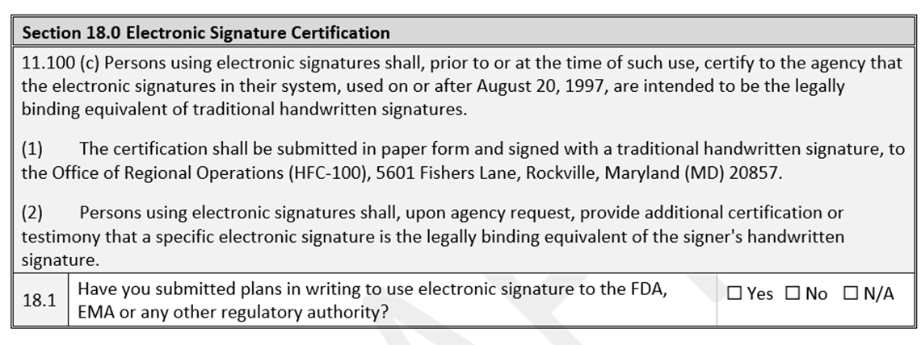
18.0: Electronic Signature Certification

Slide 61
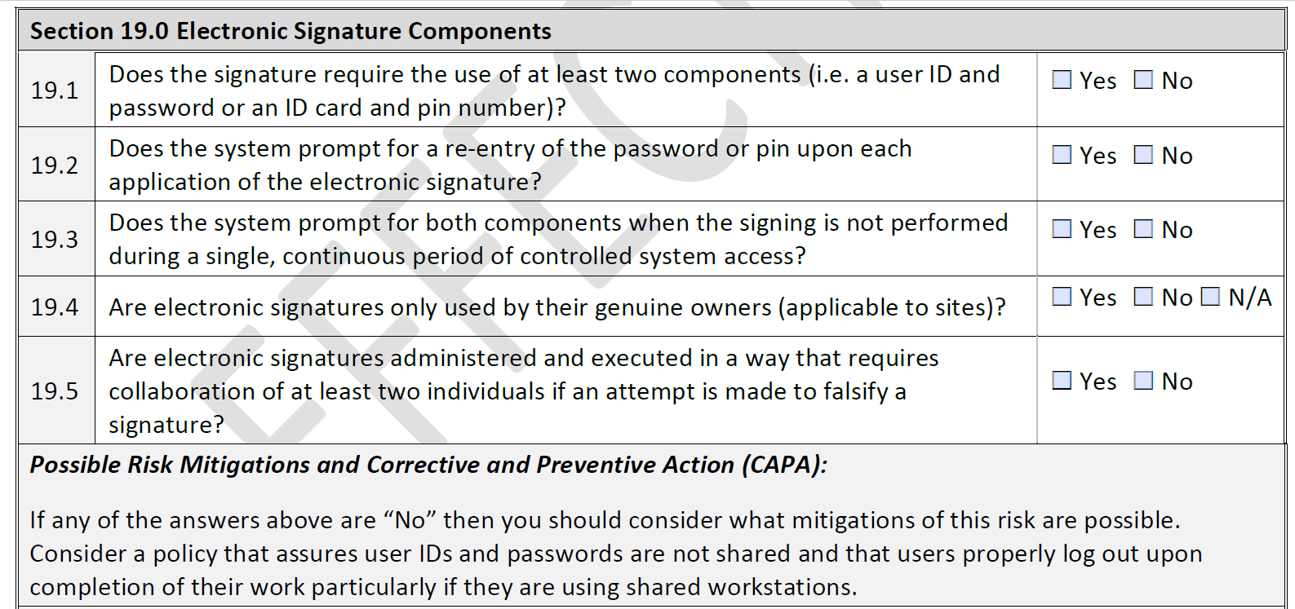
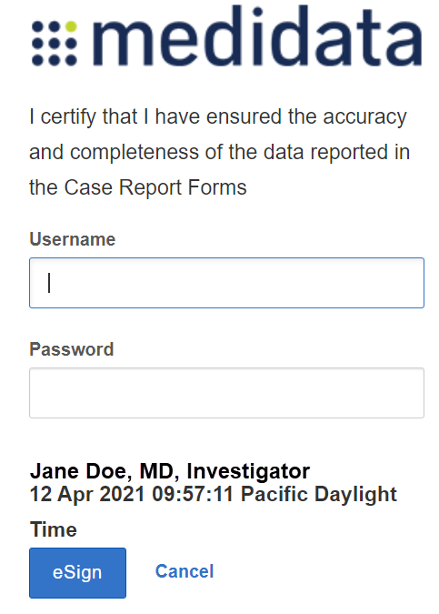
19.0: Electronic Signature Components

Slide 62
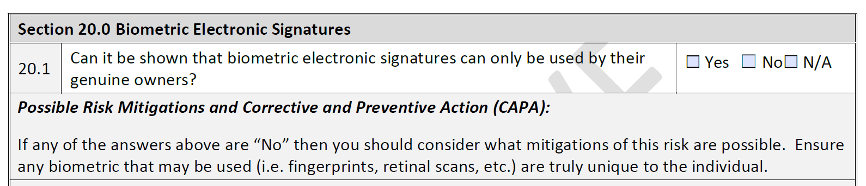



20.0: Biometric Electronic Signatures
What are examples biometric identifiers?

Slide 63




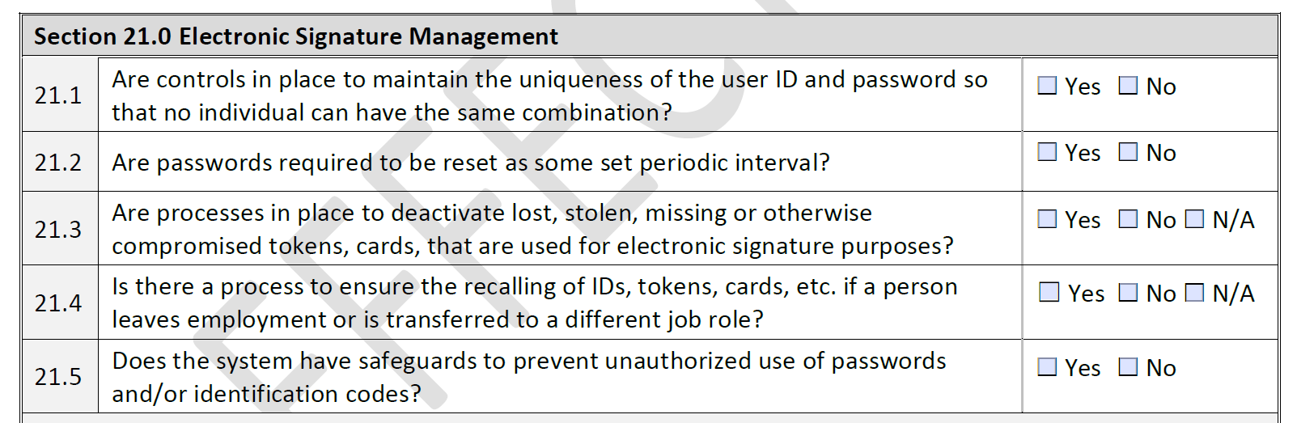
21.0: Electronic Signature Management
Unique ID and password
Password reset cadence
Procedures for lost, stolen or compromised ID tokens
Procedures for ID token retrieval
Safeguards for unauthorized use

Slide 64
Questions

Slide 65
Sections 22.0 and 23.0: daids eis evaluation checklist review and approval

Slide 66
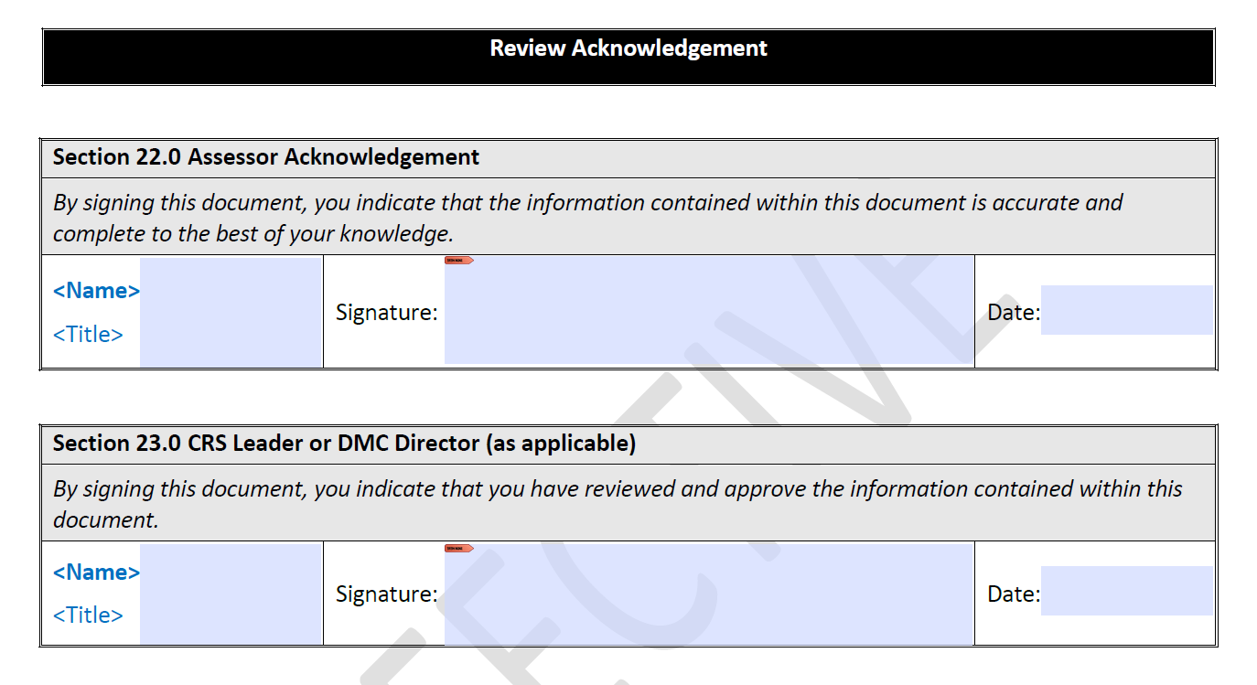
Checklist Review and Approval
Assessor attests accuracy and completeness of checklist
CRS authority provides final review and approval

Slide 67
Implementation instructions

Slide 68


Assessing Software
Does the electronic system collect data that will be submitted to any regulatory authority?
If yes, then checklist is required
Would the records, such as essential documents, be required to reconstruct the trial?
If yes, then checklist is required

Slide 69
Assessing Software: Exercise
A site is trying to decide which software needs a DAIDS EIS Evaluation Checklist. First, they identify all of the software they use.
  Payroll Wizard (payroll software)
  WriteIt (word processor)
  SmartCloud (cloud-based storage system for records)
  Medidata Rave (electronic data capture)
  FileMaster (electronic trial master file)

Slide 70
Assessing Software: Exercise
Does the electronic system collect data that will be submitted to any regulatory authority?
Would the records, such as essential documents, be required to reconstruct the trial?
Are the DMCs performing end user validation on our behalf?
  Payroll Wizard (payroll software)
    No; administrative software
  WriteIt (word processor)
    No; administrative software (does not actually “collect” data)
  SmartCloud (cloud-based storage system for records)
    Yes
  Medidata Rave (electronic data capture)
    No; DMC is validating on site’s behalf
  FileMaster (electronic trial master file)
    Yes

Slide 71


Checklist Updates
When must an updated checklist be resubmitted?
For any subsequent software release for the system

Slide 72




Checklist Resources
Presentation slides and recording
DAIDS website and FAQs
Checklist on DAIDS website
Other help

Slide 73
Questions

Slide 74
DAIDS
Electronic Information Systems (EIS) Policy Training
Closing
June 2021

Slide 75
EIS Policy Compliance
Timelines
Phased roll out of the policy
    Other collaborators: 01 December 2021
Timeline extended to allow for training prior to deadline.
What is EIS policy compliance
  Approved checklist = compliance

Slide 76
Acknowledgements
DAIDS EIS Policy working group
Data Management Centers
  for early input on the policy and
  for working with DAIDS on this training.
HANC for the coordination and support.
All the collaborators for meeting the regulatory requirements.

Slide 77
EIS Policy resources
Link to the EIS Policy: Electronic Information Systems (EIS) Policy
Implementation Memo: Electronic Information Systems Implementation Memo
Link to FAQ: Electronic Information System Policy FAQ
Submission of checklist: DAIDSCRSSEISChecklist.sm@ppdi.com
Queries: DAIDSCRSSEISChecklist.sm@ppdi.com
Regulation: 21 CRF Part 11

Slide 78
Questions?

Slide 79
Thank you!

