Slide 1



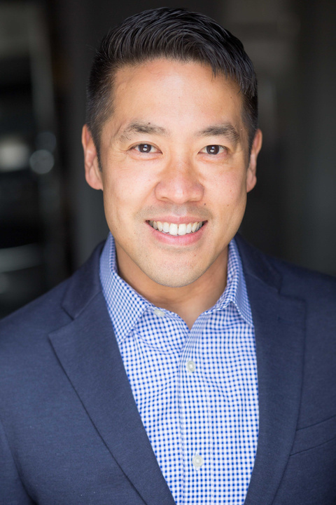
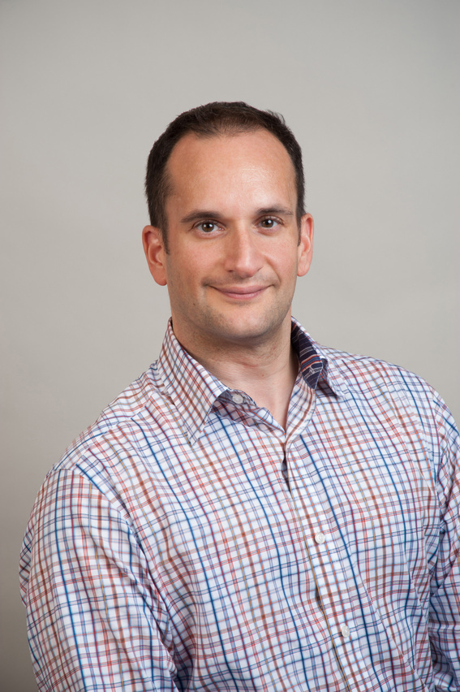




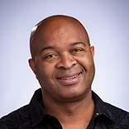

INCLUSIVE HIV PREVENTION & SEXUAL HEALTH: ADDRESSING THE NEEDS OF OLDER ADULTS IN CLINICAL TRIALS AND PRACTICE
DECEMBER 13, 2024
9:00-10:15AM PST/12-1:15PM EST
speakers
JEFFREY
KWONG
SCHOOL OF
NURSING, RUTGERS
RAPHY
LANDOVITZ
HPTN
UCLA CDU CFAR
TERRI L.
WILDER
SAGE
DAZON
DIXON
SISTERLOVE
moderator
sponsored by
RUSSELL
CAMPBEL
HANC
THIS WEBINAR IS HOSTED BY THEOFFICE OF HIV/AIDS NETWORK COORDINATION ON BEHALF OF THE DIVISION OF AIDS (DAIDS), OFFICE OF CLINICAL SITE OVERSIGHT (OCSO).

Slide 2
INCLUSIVE HIV PREVENTION & SEXUAL HEALTH:
ADDRESSING THE NEEDS OF OLDER ADULTS
IN CLINICAL TRIALS AND PRACTICE
speakers
moderator
JEFFREY
KWONG
SCHOOL OF
NURSING, RUTGERS
RUSSELL
CAMPBEL
HANC
RAPHY
LANDOVITZ
HPTN
UCLA CDU CFAR
TERRI L.
WILDER
SAGE
sponsored by
DAZON
DIXON
SISTERLOVE

Slide 3
Aging, HIV Prevention, Sexual Health
Jeffrey Kwong, DNP, MPH,AGPCNP-BC, FAANP, FAAN
Professor, Rutgers University – Newark, NJ
Nurse Practitioner, NYU Langone Medical Associates – New York, NY

Slide 4

In the U.S., the number of adults 65 yrs and older is projected to increase 47% by 2050
58 million in → 82 million
U.S. Census Bureau, 2023 National Population Projections Tables: Main Series.

Slide 5
Older Adults Are Vulnerable to HIV
Between 2013-2023, among adults 65 yrs +:
  Primary and secondary syphilis increased > 6x
  Gonorrhea increased ~4 x
  Chlamydia increased ~3x
More than 11% of respondents of the 2021 National Survey on Drug Use and Mental Health age 50 yrs + reported substance use including heroin, methamphetamine, cocaine
https://gis.cdc.gov/grasp/nchhstpatlas/main.html
https://www.samhsa.gov/data/sites/default/files/reports/rpt39441/NSDUHDetailedTabs2021/NSDUHDetailedTabs2021/NSDUHDetTabsSect5pe2021.htm

Slide 6

3 to 4 People Acquire HIV Every Hour in the US
In 2022, there were an estimated 31,800 new HIV cases
Estimated 1.2 million people living with HIV in the US

Slide 7
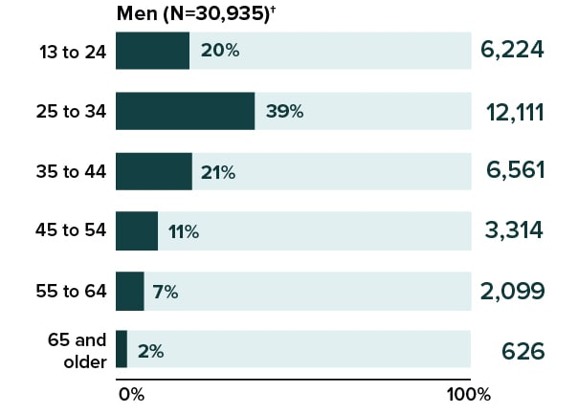
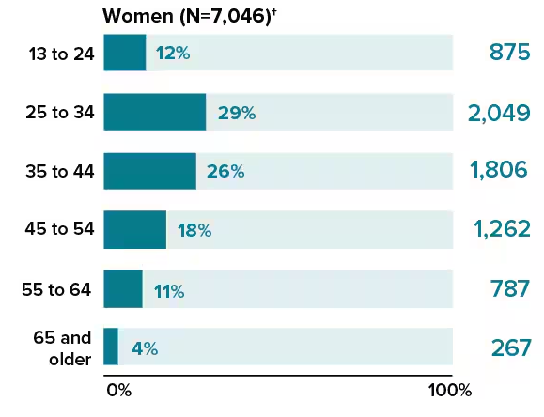
HIV Diagnosis (2022)
MEN
WOMEN
34.1% were Stage 3 @ time of diagnosis
9%
15%
CDC. Diagnoses of HIV infection in the United States and dependent areas, 2022. HIV Surveillance Report 2024; 29(1)

Slide 8
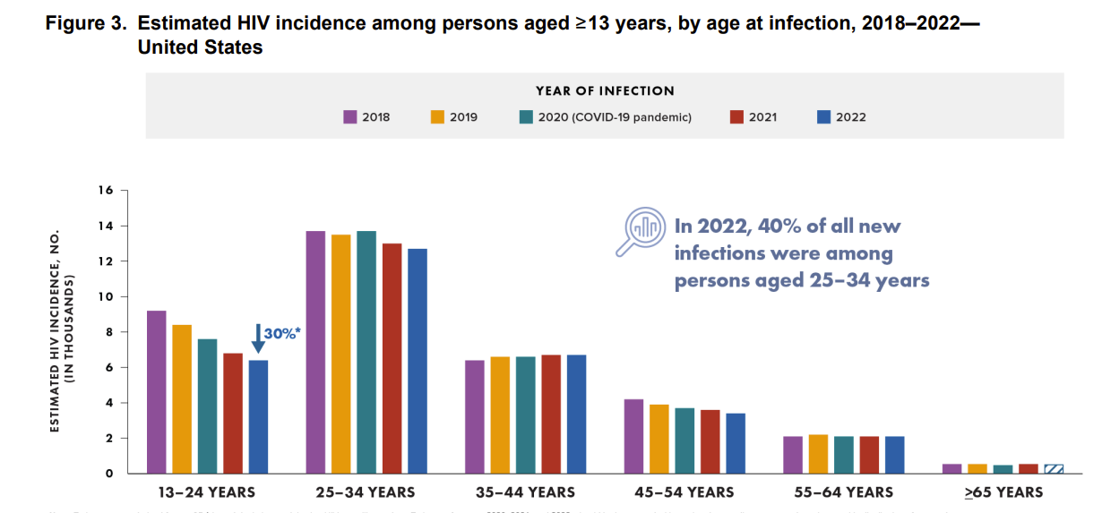
Centers for Disease Control and Prevention. Estimated HIV incidence and prevalence in the United States, 2018–2022. HIV Surveillance Supplemental Report 2024;29(No. 1). https://www.cdc.gov/ hiv-data/nhss/estimated-hiv-incidence-and-prevalence.html. Published May 2024. Accessed December 10, 2024

Slide 9
Barriers to HIV Prevention in Older Adults
Providers Do Not Talk About Sex
Stigma
Cost/
Insurance
Physical Challenges
Lack of Knowledge
Misconceptions about Risk
Notes:
TT

Slide 10
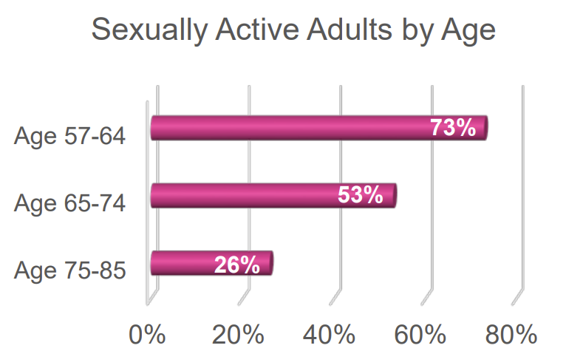
In a US study of people aged 75–85 yrs who were sexually active, 54% reported having sex 2-3 x/month and 23% reported having sex 1+ x/week
www.norc.org/Research/Projects/Pages/national-social-life-health-and-aging-project.aspx.
Lindau ST, et al. A study of sexuality and health among older adults in the United States. N Engl J Med. 2007;357(8):762-774. doi:10.1056/NEJMoa067423

Slide 11
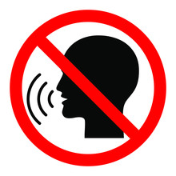
17% of older adults (65-80) talked about sex with a health care provider
However, 60% of older adults said they had to initiate the conversation
Image: creative commons
Agochukwu-Mmonu N, Malani PN, Wittmann D, et al. Interest in Sex and Conversations About Sexual Health with Health Care Providers Among Older U.S. Adults. Clin Gerontol. 2021;44(3):299-306. doi:10.1080/07317115.2021.1882637
ACTHIV 2023: A State-of-the-Science Conference for Frontline Health Professionals

Slide 12
CDC Recommendations For Routine Screening
Infection | Recommendation | Last Update
HIV | 13-64 yrs Vulnerability factors | 2006 **
Hepatitis B | Universal screening 18 yrs and older Vulnerability factors Anyone who asks for test | 2023
Hepatitis C | Universal screening ≥ 18 yrs Recognized Exposure Ongoing vulnerability Anyone who asks for test | 2020
www.cdc.gov

Slide 13
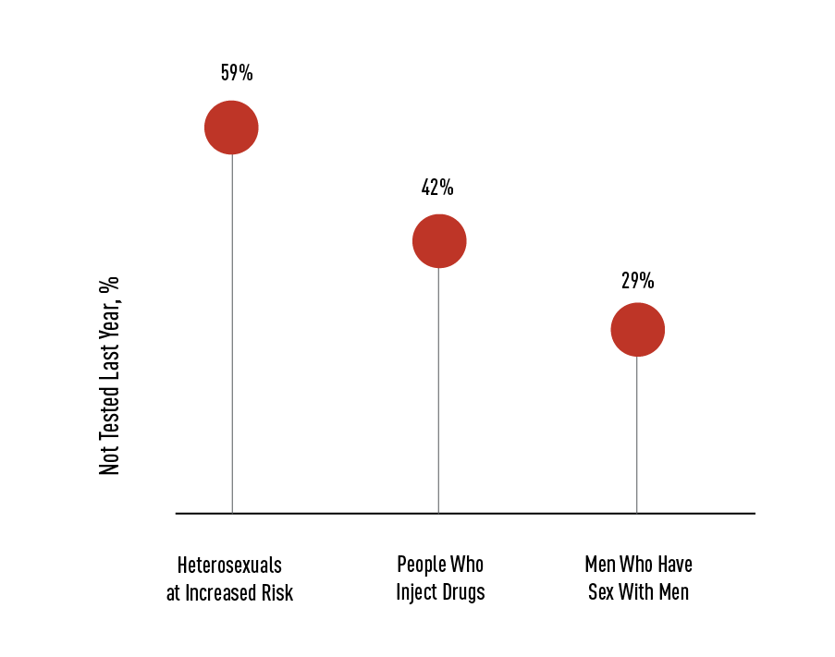


Missed Opportunities for HIV Testing
7 out of 10 people who were vulnerable to HIV who were not tested for HIV in the past year saw a primary care provider during that period
of the people who saw their primary care provider were not offered a test
75%
Notes:
Speaker’s Notes:
Many people at risk for HIV are not getting tested for HIV every year. That is, 29% of gay, bisexual, and other men who have sex with men; 42% of people who inject drugs; and 59% of heterosexual people are at risk because they had sex with someone at risk for or living with HIV.
Furthermore, 7 of 10 people at risk who were not tested for HIV in the past year saw a health care provider during that time, and >75% of them were not offered a test.
Health care providers can diagnose HIV sooner if they test more people and test people at risk more often.
Reference:
HIV Testing. CDC Vital Signs. Published December 2017. Accessed March 26, 2020. https://www.cdc.gov/vitalsigns/hiv-testing/index.html

Slide 14
More older adults are being prescribed PrEP in the U.S.
https://www.cdc.gov/hiv/library/reports/surveillance-data-tables/vol-4-no-3/index.html

Slide 15
Is there enough data?
Trial Name | Age Information
iPREX (TDF/FTC v Placebo) - MSM/TGW | 11%≥ 40 yrs old = TDF/FTC
iPreXOLE (TDF/FTC)- MSM/TGW | 17% ≥ 40 yrs old = TDF/FTC
DISCOVER(TAF/FTC vs TDF/FTC) - MSM/TGW | Max Age: TAF/FTC = 43 y TDF/FTC = 44 yrs
Partners PrEP (TDF vs TDF/FTC vs Placebo) - heterosexual men and women | 14% ≥ 45 yrs old = TDF/FTC 13% ≥ 45 yrs old = TDF
IPERGAY(TDF/FTC vs placebo) - MSM | 10% ≥ 50 yrs = TDF/FTC
HPTN 083 (CAB vs TDF/FTC) - MSM/TGW | > 60 yrs CAB (0.3.%) CAB /TDF/FTC (0.3%) 50-59 yrs CAB (2.6%) and TDF/FTC (2.2%)
HPTN 084 (CAB vs TDF/FTC) - cisgender women | upper age 45 yrs
Grant et al. (2014) Lancet Infect Dis.; Mayer et al (2020). Lancet; Landovitz et al. (2021) NEJM; Baeten et al. (2012) NEJM;Molina et al. (215), NEJM
Notes:
JK

Slide 16
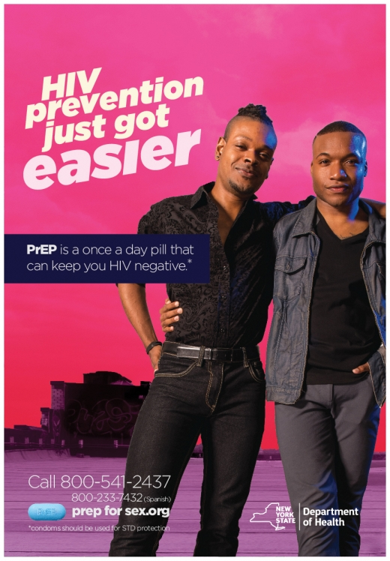




Is PrEP right for me?
Image sources: NYS Dept of Health, NYC Department of Health, Pan American Health Organization – all available in the public domain

Slide 17
Key Points
Healthcare teams caring for older adults must take into account physiologic, psychosocial, and cultural aspects of aging when providing care.
Normalizing conversations about sexual health and substance use should be a part of routine care for older adults.
HIV Treatment and Prevention Services are not bound by age.
Interventions, research efforts, and policies must be inclusive and take into consideration needs of older adults

Slide 18
Key Resources and References
Let’s Stop HIV Together
https://www.cdc.gov/stophivtogether/index.html
HIV Nexus
https://www.cdc.gov/hiv/clinicians/index.html
HealthinAging.org
https://www.healthinaging.org/a-z-topic/sexual-health
National Coalition for Sexual Health
https://nationalcoalitionforsexualhealth.org/
Substance Abuse and Mental Health Administration – Resources for Older Adults
https://www.samhsa.gov/resources-serving-older-adults

Slide 19
HPTN 083:
Lessons Learned for Older Adults
Raphael J. Landovitz, MD MSc
Professor of Medicine
Interim Chief, Division of Infectious Diseases
Director, UCLA Center for Clinical AIDS Research & Education
David Geffen School of Medicine at UCLA
Importance of HIV Prevention for Adults 50+ Webinar
13 December 2024

Slide 20
Disclosures
Raphael J. Landovitz reports consulting agreements and/or Scientific Advisory roles for Gilead Sciences, Merck Inc, RedQueen Therapeutics, and ViiV Healthcare (Financial Interest)

Slide 21
HPTN 083
Long-acting injectable cabotegravir for PrEP
Phase 3 study
Double-blind, safety and efficacy study for persons at high-risk for HIV infection in general good health
No IDU, HCV, HBV, seizure disorder, CVD, abnormal liver function
MSM/transgender women
Median age: 26 (22 – 32)
  123 (2.7%) participants were age 50+
Double-Blind, Placebo-Controlled
Step 1
(5 Weeks)
Step 2
(~3 years)
Step 3
(1 Year)
Oral
Cabotegravir
30 mg qd
Cabotegravir 600 mg
IM injection q8 weeks
Daily Oral
FTC/TDF
Daily Oral
FTC/TDF
Daily Oral
FTC/TDF
Daily Oral
FTC/TDF
Week 0 5 190 238
DSMB recommended early termination of blinded phase of both studies
Matching oral and IM placebos included in the oral and injection phase double-blind arms.
Conducted in US, Brazil, Peru, Argentina, South Africa, Vietnam, and Thailand.
Landovitz RJ, et al. N Engl J Med. 2021;385:595-608.

Slide 22
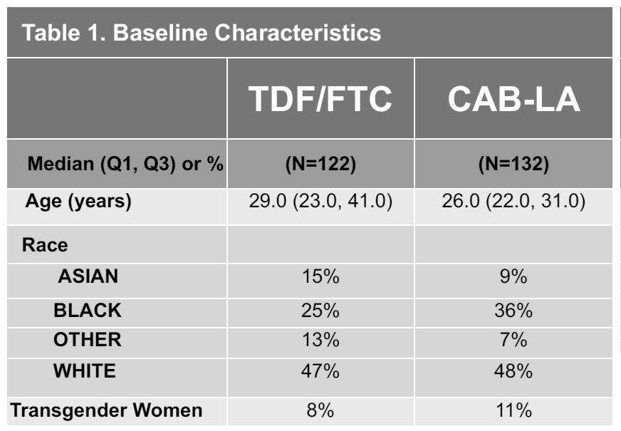
HPTN 083: Bone Mineral Density
CAB-LA versus TDF-FTC PrEP
BACKGROUND
HIV PrEP: Highly effective for HIV prevention
  TDF-FTC Oral PrEP: Effective but limited by adherence; may impact bone mineral density (BMD) with long-term use
  CAB-LA (HPTN 083): Found superior to TDF-FTC for HIV prevention, but relative bone safety remains unclear
METHODS
Bone Substudy: Conducted at 19 sites to assess BMD at lumbar spine, femoral neck, and total hip using DXA scans.
Analysis: Percentage BMD changes compared between arms; models adjusted for age and race differences.
8% of participants were 50 years or older
Brown T et al. CROI 2023. Poster #987.

Slide 23
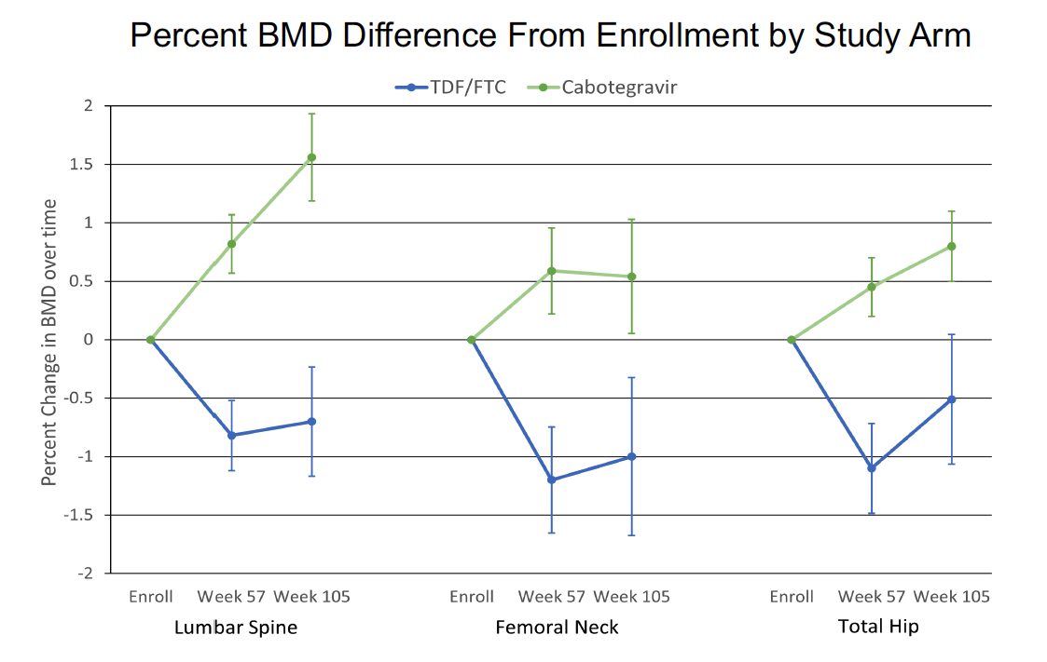
HPTN 083: Bone Mineral Density
CAB-LA versus TDF-FTC PrEP
BMD decreased in the TDF-FTC arm by 0.5-1.0%
BMD increased in CAB-LA arm 0.5-1.5%
Conclusions
Individuals at higher fracture risk (e.g., older age, lower BMD, osteoporosis) considering PrEP may opt for CAB-LA to support bone health.
Brown T et al. CROI 2023. Poster #987.

Slide 24
HPTN 083: Hypertension
CAB-LA versus TDF-FTC PrEP
BACKGROUND
Studies (e.g., 2SD, D2EFT, ADVANCE, NAMSAL) suggest INSTIs, particularly DTG, may increase hypertension (HTN) risk compared to NNRTIs, independent of weight/BMI changes; other trials (e.g., NEAT022, RESPOND) show no difference versus PIs.
HPTN 083 Post-hoc analysis compared HTN incidence rates between CAB and TDF-FTC arms
METHODS
HTN Definition: Two consecutive BP readings (SBP ≥140mmHg or DBP ≥90mmHg), new HTN diagnosis, or initiation of HTN medications.
Analysis: Cox regression for HTN risk (CAB vs. TDF-FTC), adjusting for demographics, weight changes, and anti-HTN medication use
Sensitivity Analyses: Censored at DSMB action and excluded participants on anti-HTN meds for other purposes
The mean age of the participants was 27 years, with 75% aged 45 years and older
Participants with pre-existing HTN were 8 years older on average than those without
20% with pre-existing HTN were over the age of 45 compared to 4% among those without pre-existing HTN
Landovitz et al. CROI 2024. Poster #0789

Slide 25
HPTN 083: Hypertension
CAB-LA versus TDF-FTC PrEP
Landovitz et al. CROI 2024. Poster #0789

Slide 26
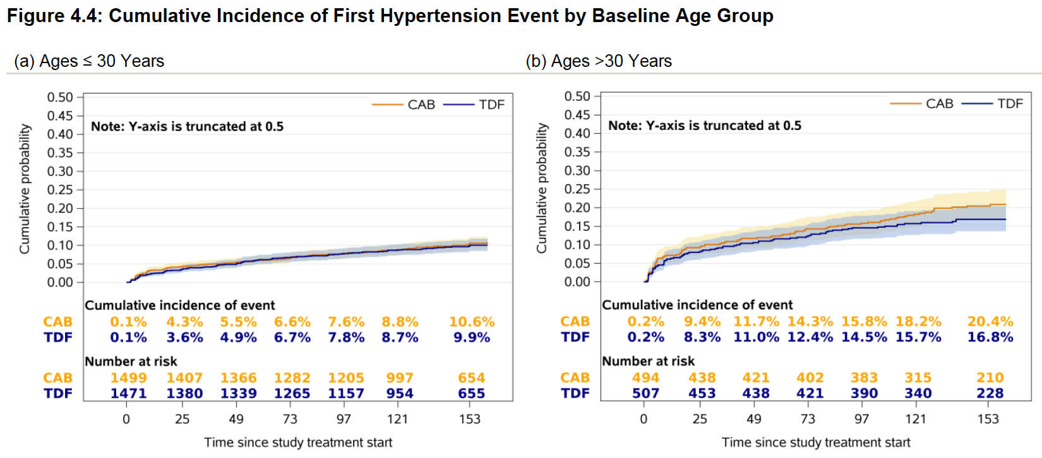
HPTN 083: Hypertension
CAB-LA versus TDF-FTC PrEP
Landovitz et al. CROI 2024. Poster #0789

Slide 27
HPTN 083: STIs and Efficacy
BACKGROUND
Bacterial STIs facilitate HIV transmission by lowering barriers to infection through mucosal inflammation and genital ulcers.
Evaluating the impact of STIs on PrEP efficacy is crucial.
Previous studies show STIs do not reduce protection provided by TDF/FTC.
CAB-LA has not been evaluated for similar effects.
Secondary analysis of HPTN 083 blinded period.
METHODS
STI Testing: Serologic tests for syphilis; NAAT for rectal/urethral gonorrhea and chlamydia every 6 months or with symptoms/exposures.
Incidence: Incident STI rates per 100 person-years calculated from enrollment to final STI test.
Analysis:
  Poisson regression assessed baseline factors associated with STI incidence.
  Cox proportional hazards modeling with STI status as a time-varying covariate
Brown T et al. CROI 2023. Poster #987.

Slide 28
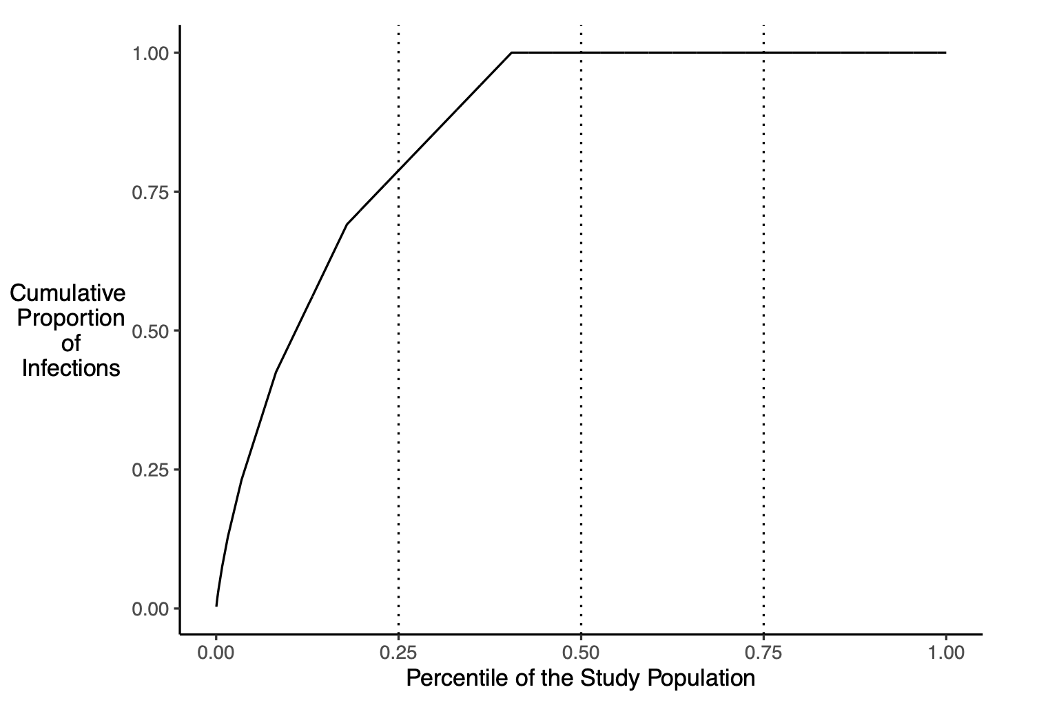
HPTN 083: STIs and Efficacy
Among 3859 participants, STIs were diagnosed in 1562 (40.5%), with multiple STIs reported for 691 (17.9%)
 | # Positive Tests | IR (per 100 PY)
Any STI | 2819 | 50.7
Syphilis | 923 | 16.7
Urogenital Gonorrhea | 134 | 2.4
Urogenital Chlamydia | 249 | 4.5
Rectal Gonorrhea | 600 | 11.0
Rectal Chlamydia | 913 | 16.7
1.00
79% of STI diagnoses
occurred in 25% of ppts
0.75
Cumulative Proportion of Infections
0.50
0. 25
0.00
0.00
0.25
0.50
0.75
1.00
Percentile of the Study Population
Clement ME et al. CROI 2024. Abstract #131
Clement ME et al. CID. 2024. ciae572.

Slide 29
HPTN 083: STIs and Efficacy
Univariate Model: Age was significantly associated with STI incidence at the alpha = 0.10 level. This indicates that, when analyzed individually, age had a notable relationship with STI outcomes.
Multivariable Model: Age remained statistically significant (p < 0.05) when analyzed alongside other factors like region, education level, marital status, and baseline STI status. This highlights its independent influence on STI incidence, even after accounting for these variables.
 | Univariate Model |  | Multivariate Model
 | IRR (95% Confidence Interval) | p-value | IRR (95% Confidence Interval) | p-value
Age
18-29 | Reference |  | Reference
30-39 | 0.76 (0.69, 0.83) | <0.001 | 0.77 (0.70, 0.85) | <0.001
40-49 | 0.69 (0.59, 0.80) | <0.001 | 0.73 (0.63, 0.86) | <0.001
50-59 | 0.58 (0.45, 0.75) | <0.001 | 0.68 (0.53, 0.89) | 0.004
60+ | 0.84 (0.43, 1.61) | 0.59 | 0.83 (0.43, 1.60) | 0.573
Clement ME et al. CROI 2024. Abstract #131
Clement ME et al. CID. 2024. ciae572.

Slide 30
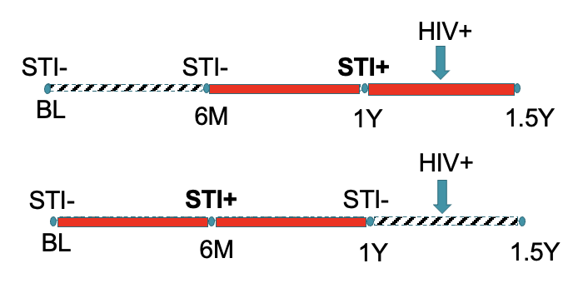
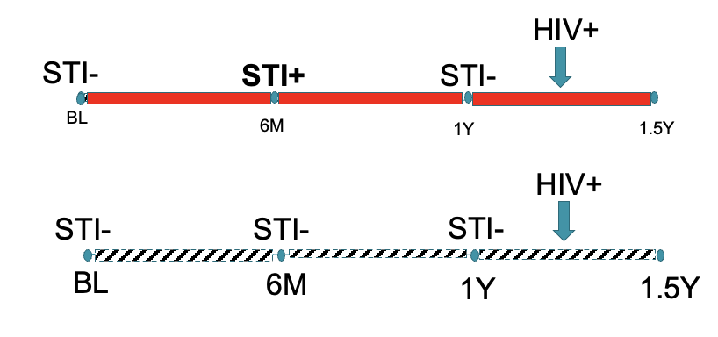
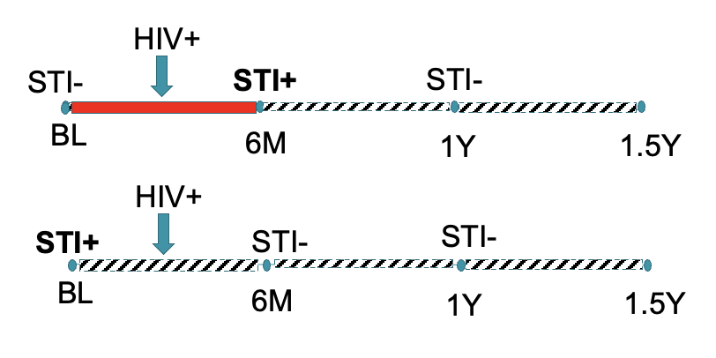
HPTN 083: STIs
HIV prevention efficacy is maintained
in the presence of Bacterial STIs
HIV Incidence and 95% Confidence Interval
Clement ME et al. CROI 2024. Abstract #131 | Clement ME et al. CID. 2024. ciae572.

Slide 31
HPTN 083: Performance characteristics of HIV RNA screening with CAB-LA PrEP
Study Design
Results
Population Characteristics
Landovitz. AIDS 2024. Abstr OAE0406LB.

Slide 32
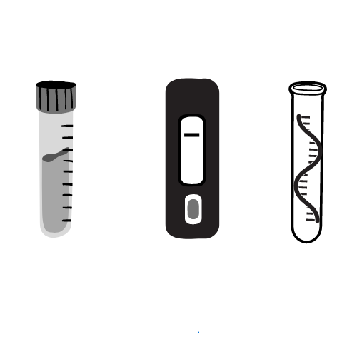
PPV of HIV Testing Algorithms with CAB-LA
HPTN 083
HPTN 084
TDF/FTC
CAB
TDF/FTC
CAB
91%
84%
86%
40%
Rapid test
95%
83%
100%
Insufficient
data
and
100%
100%
100%
100%
Ag/Ab test
or
80%
61%
62%
15%
86%
66%
70%
17%
RNA test
< 6 months
(on product)
N/A
9%
N/A
Data
forthcoming
> 6 months
(initiation)
N/A
60%
N/A
Data
forthcoming
Landovitz, CROI 2024, Abstract 128 | Voldal, IAS 2023, Abstract 5788

Slide 33
Thank you!
Questions? rlandovitz@mednet.ucla.edu

Slide 34

HIV Prevention Policy Update

Slide 35
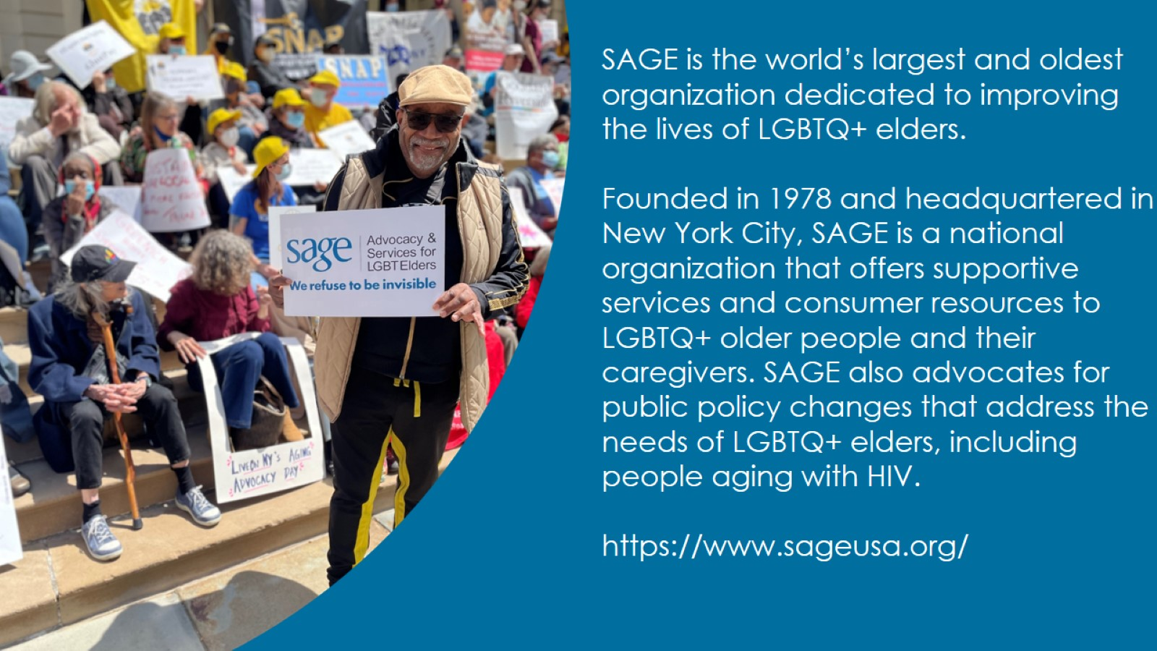

Slide 36

EXCITING POLICY News!

Slide 37

MEDICARE AND PREP

Slide 38
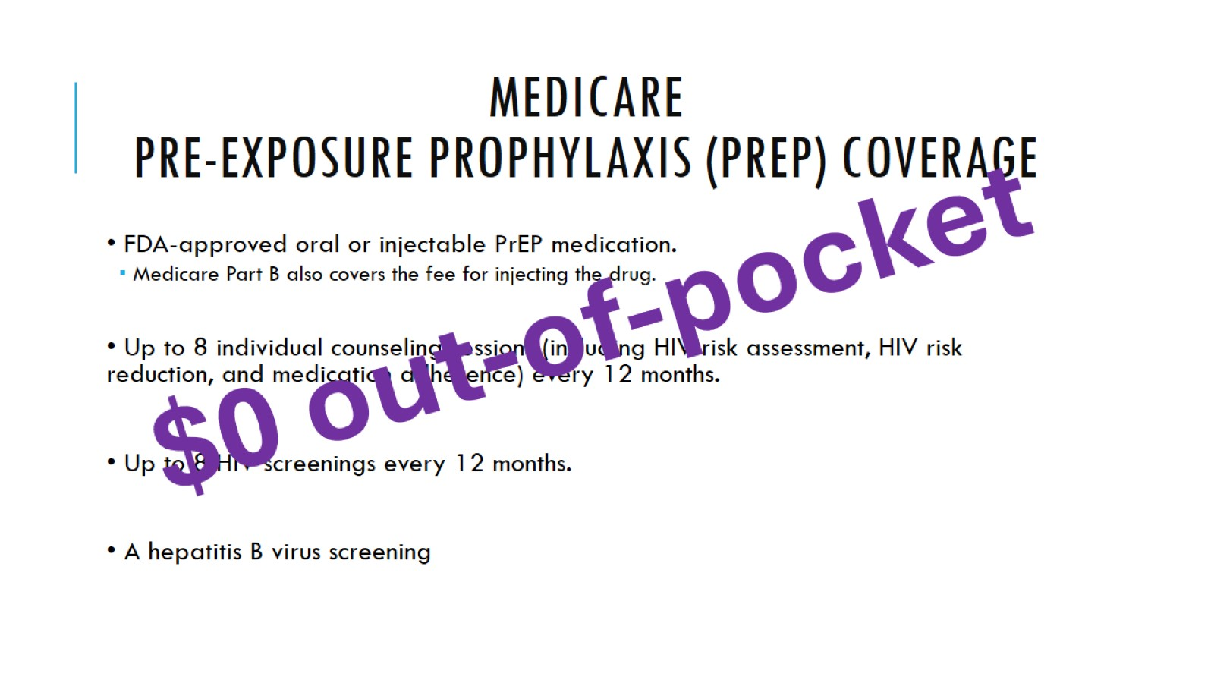
Medicare
Pre-exposure Prophylaxis (PrEP) Coverage

Slide 39
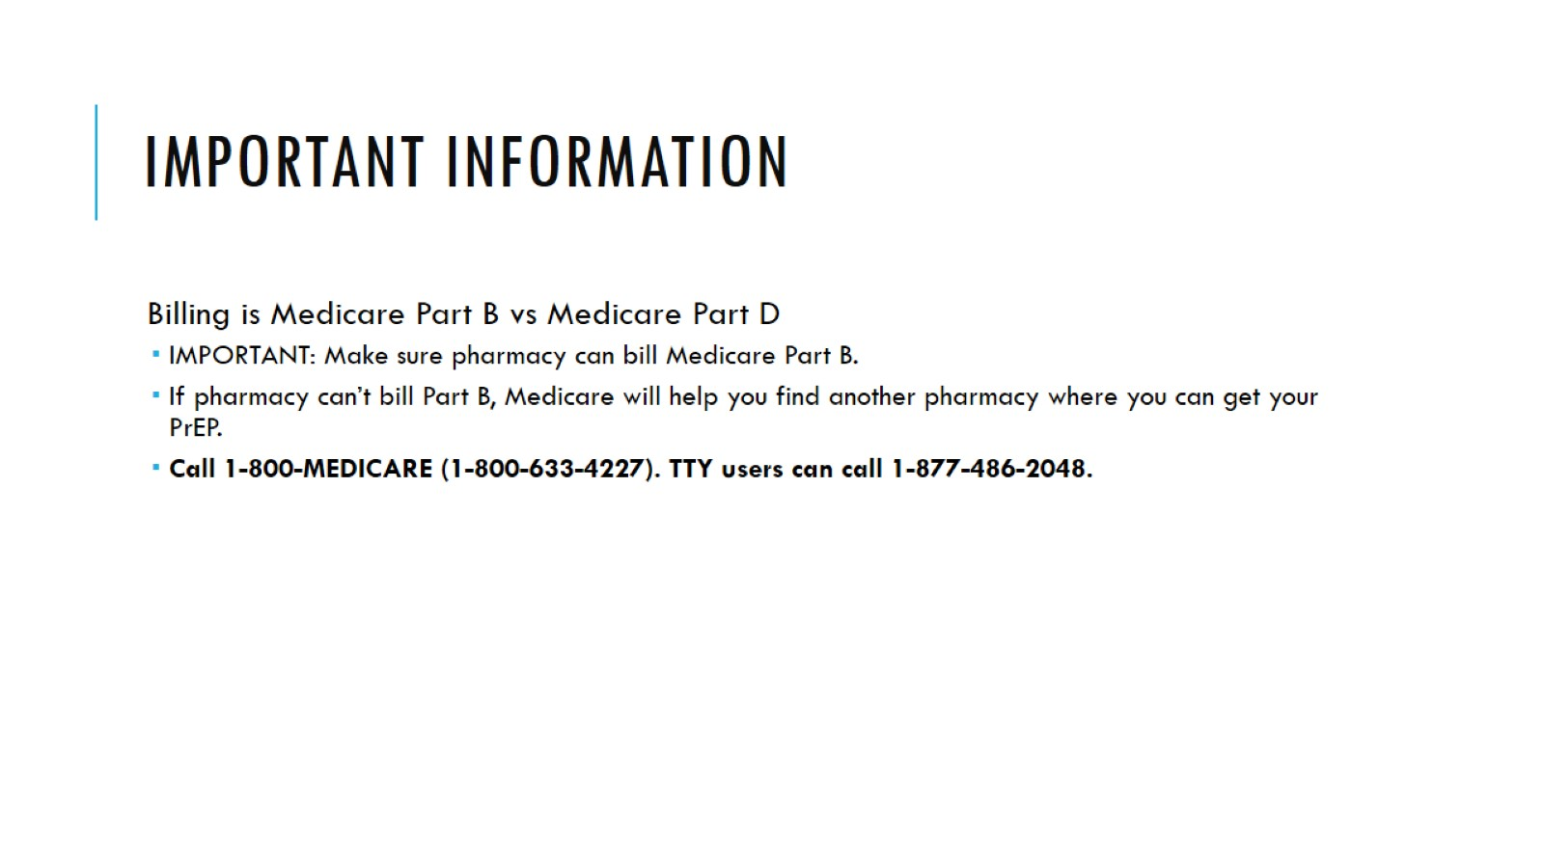
important information

Slide 40

CDC HIV Testing Guidelines

Slide 41
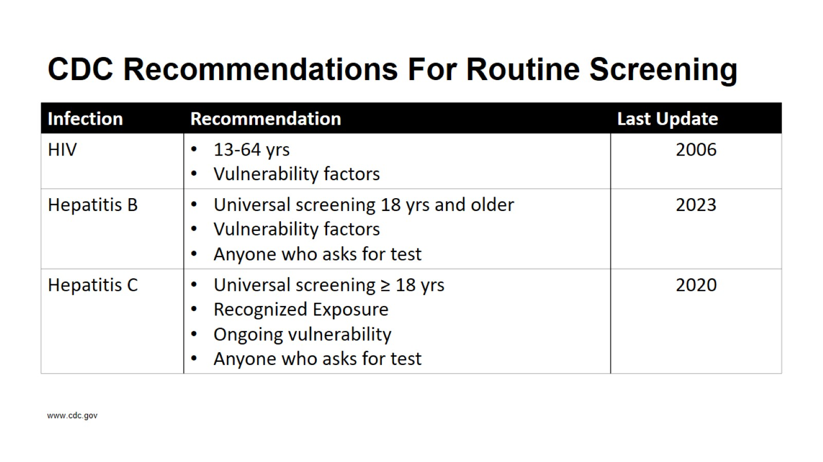
CDC Recommendations For Routine Screening

Slide 42
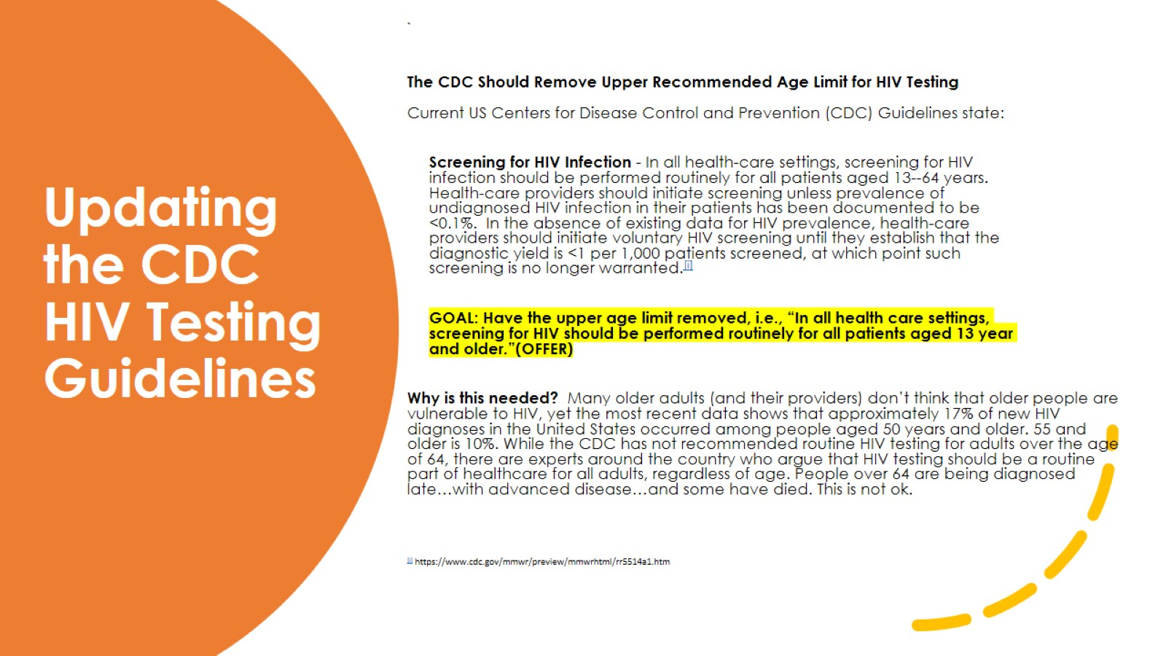
Updating the CDC HIV Testing Guidelines

Slide 43
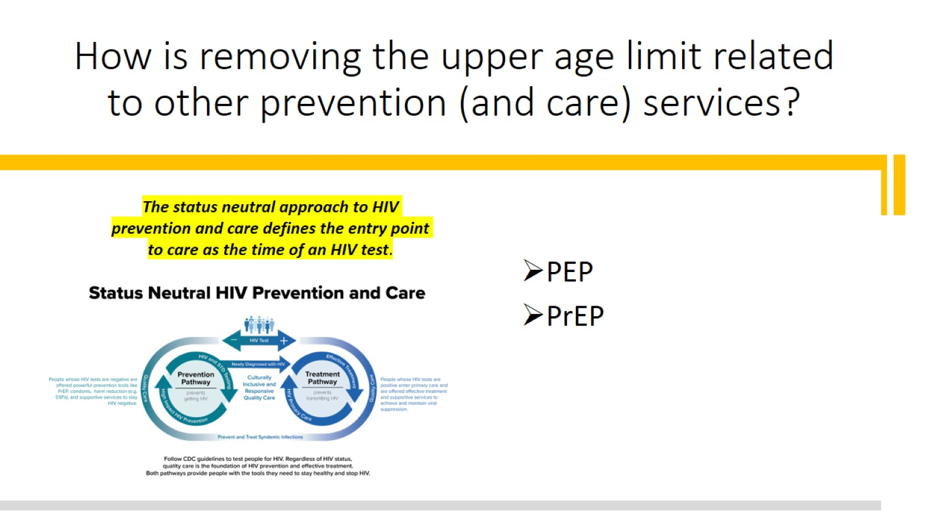
How is removing the upper age limit related to other prevention (and care) services?

Slide 44
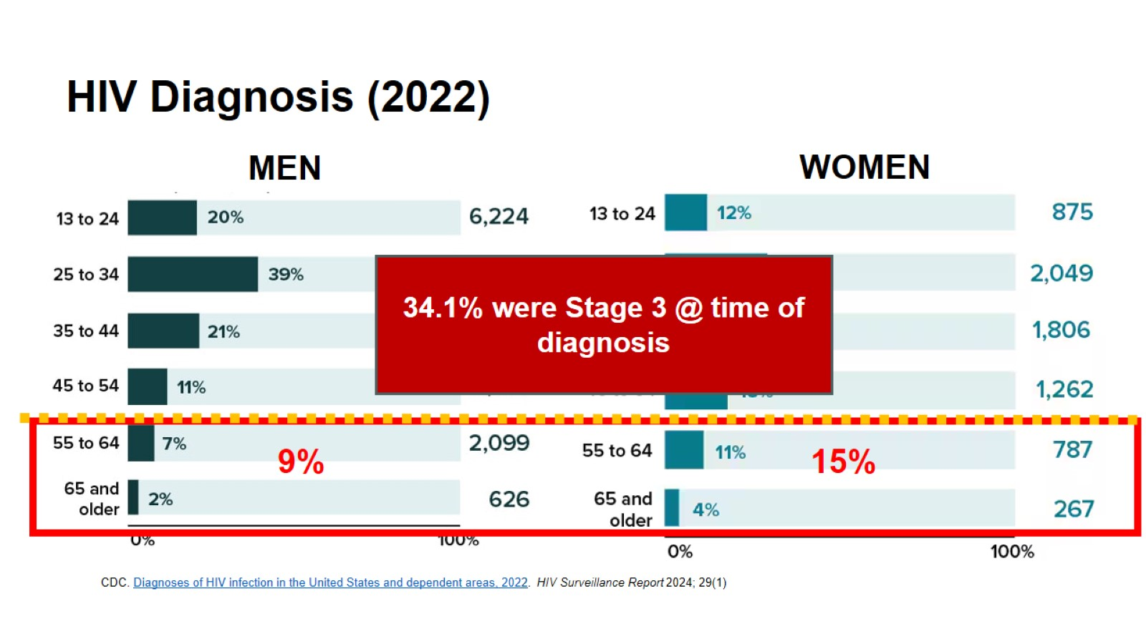
HIV Diagnosis (2022)

Slide 45
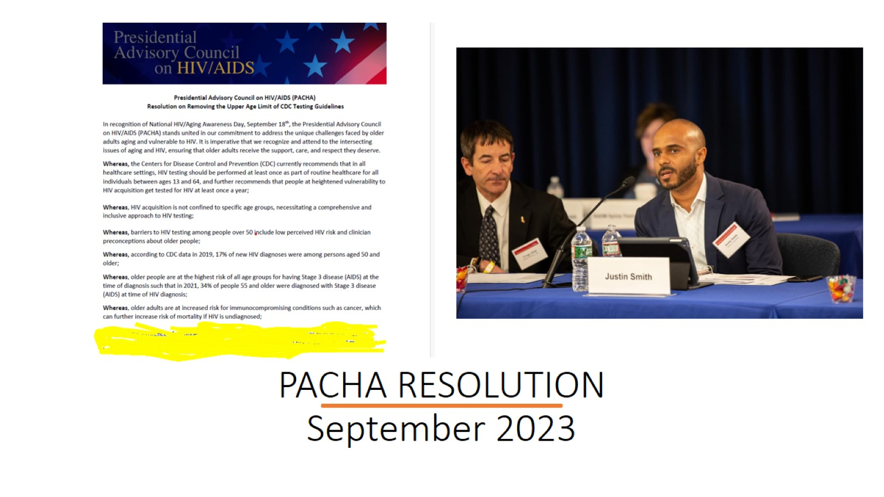
PACHA RESOLUTION
September 2023

Slide 46
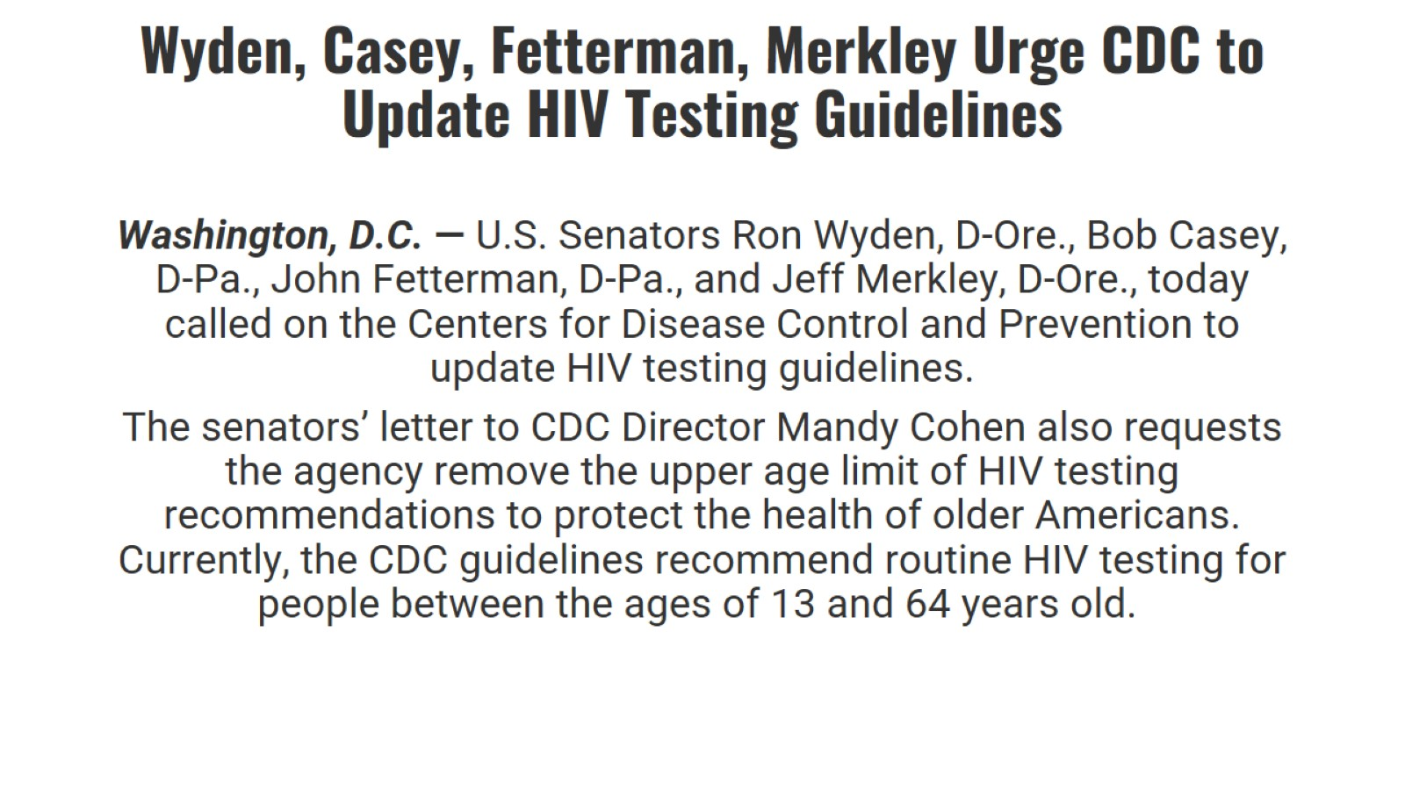
Wyden, Casey, Fetterman, Merkley Urge CDC to Update HIV Testing Guidelines

Slide 47
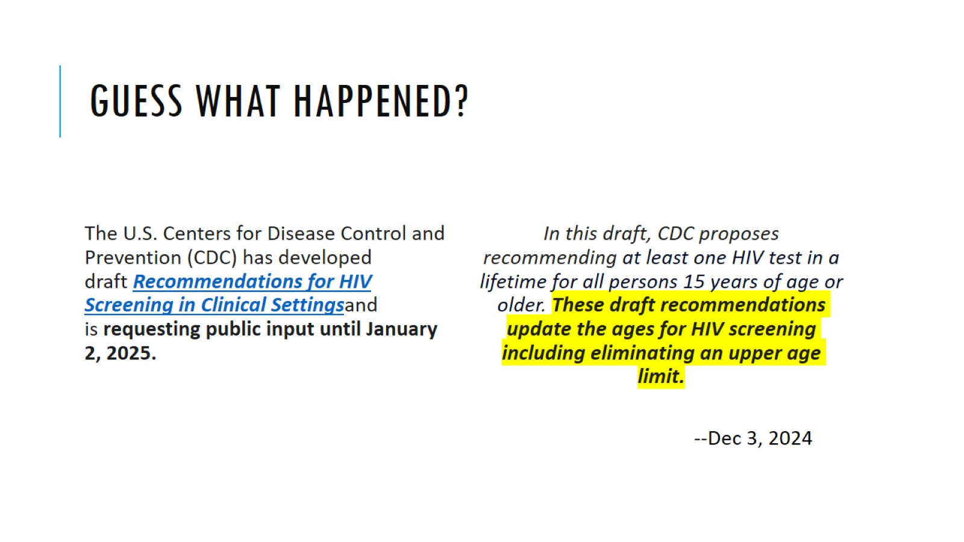
Guess what happened?

Slide 48

YES! YES! YES!

Slide 49
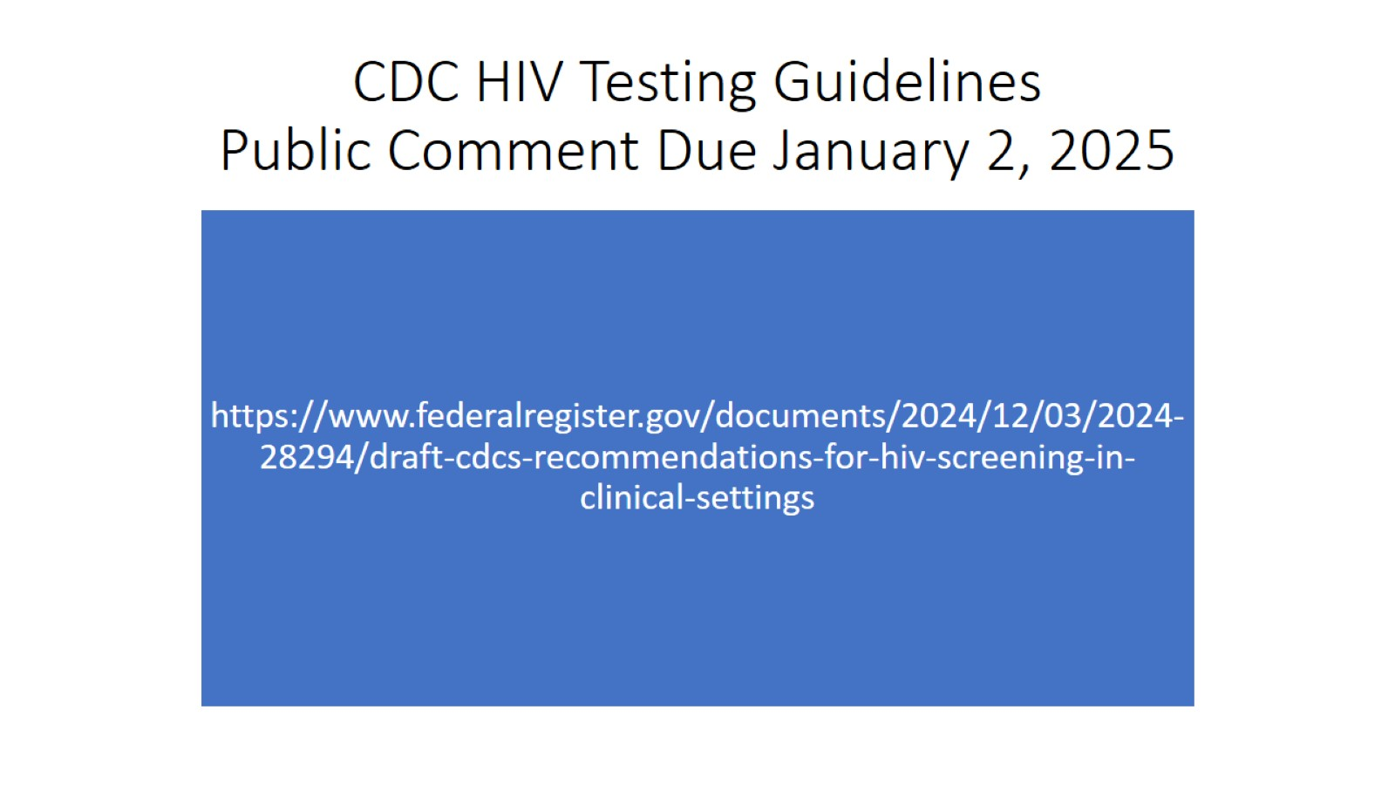
CDC HIV Testing Guidelines
Public Comment Due January 2, 2025

Slide 50
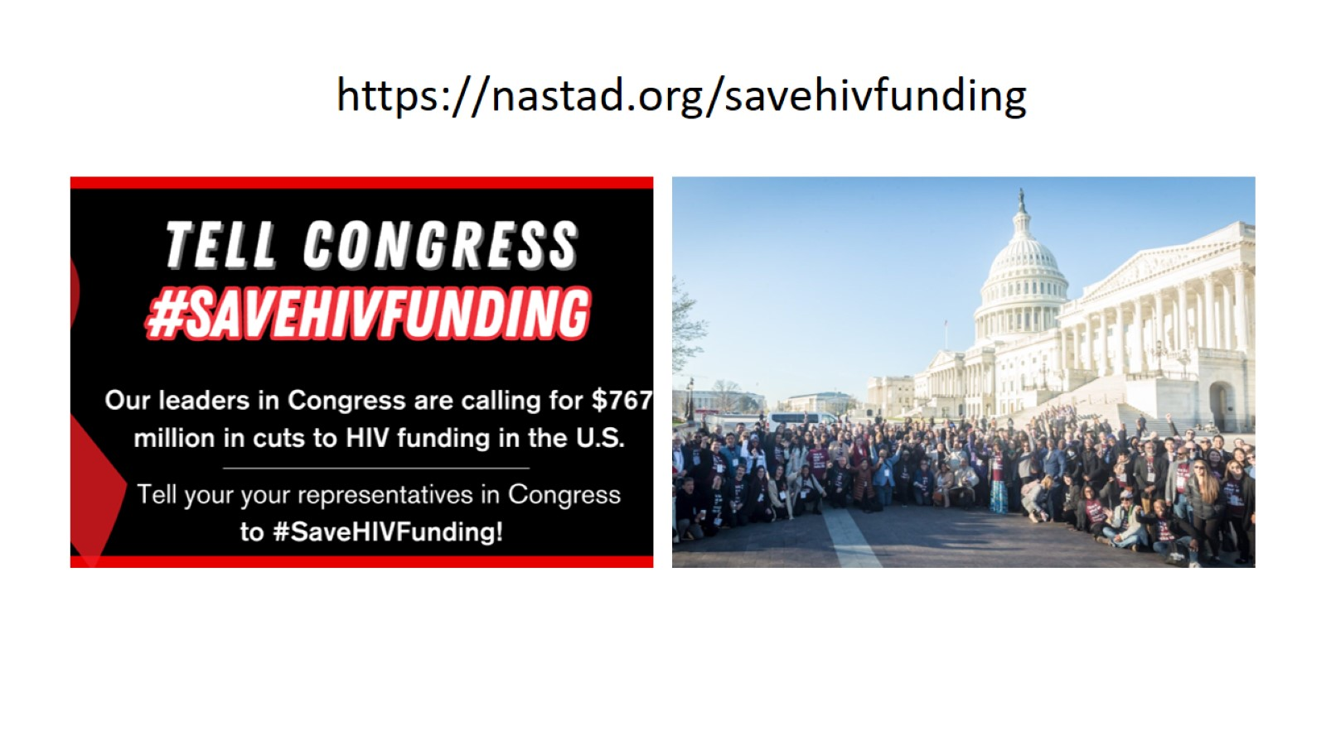

Slide 51
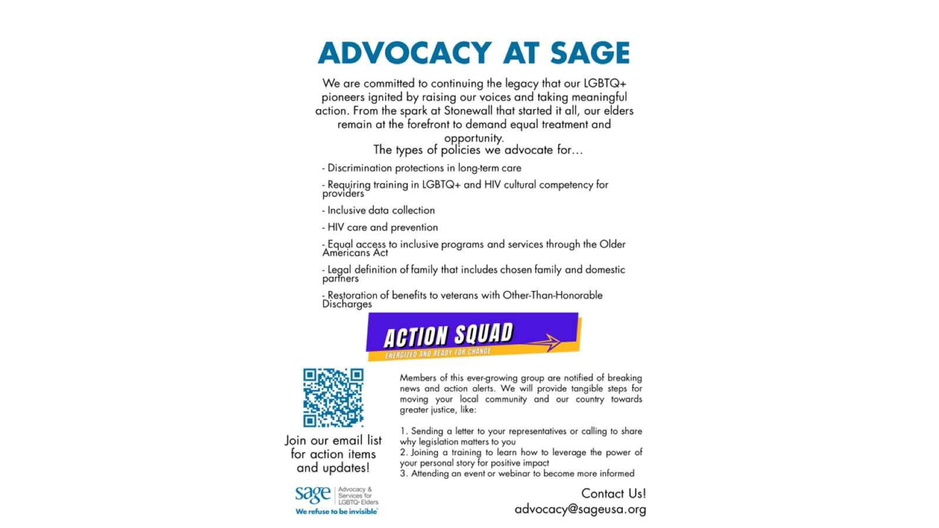

Slide 52

Thanks!

